Slide 3
REACH OUT AND READ WISCONSIN 2019 Annual Meeting
Wordless Books

Slide 4
Definitions
Book: long written or printed literary composition
Story: an account of incidents or events
Picture Book: book, typically for children, in which the illustrations are as important as – or more important than – the words in telling the story

Slide 5
Wordless and Near Wordless Books
Technicalities for the adult
Don’t forget! Children are ALWAYS focused on the art
Print awareness – not until age 3
Letter recognition – not until preschool
Reading – doesn’t start until kindergarten/1st grade

Slide 6
“Picture” in Picture Books = an Art Form
If you are NOT a visual thinker
Think critically about the art when you are purchasing books, it matters.
The picture book illustrations drive book sales
Most prestigious picture book award: Caldecott
Visual arts are a crucial component of our world

Slide 7
I must study politics and war, that my sons may study mathematics and philosophy…in order to give their children the right to study painting, poetry, music and architecture.
–John Q. Adams

Slide 8
Logic will take you from A to B.
Imagination will take you everywhere.
–Albert Einstein

Slide 9
Art in Picture Books: Visual Elements
Line – thick or thin
Shape - manipulated lines create shape

Slide 10
Art in Picture Books: Visual Elements
Color (or hue)
Analogous: red and orange
Complementary: red and green
Monochromatic: only one color used, dark to light
Neutrals: black, , grays, browns
white

Slide 11
Art in Picture Books: Visual Elements
Color (or hue)
Primary colors: red, yellow, blue
Secondary colors: orange, green, purple
Gradation: TRANSITION BACK
Value: relative lightness or darkness of a color
white

Slide 12
Art in Picture Books: Visual Elements
Texture
May be implied (e.g., Eric Carle books)
Touch and feel books
Perspective
Bird’s eye view vs. worm’s eye view

Slide 13
Art in Picture Books: Visual Elements
Composition: Arrangement of items on a page
Balance: objects arranged equally around surface
Symmetry: balance is achieved; two side are identical
Asymmetry: items arranged to give a visual imbalance
Contrast: thick/thin lines; jagged/rounded shape
Dominance: one item EMPHASIZED over another

Slide 14
Art in Picture Books: Media
Painting
Acrylic: creates opaque finish
Oil: rich, glossy finish, layering builds dimension
Watercolor: translucent quality
Gouache: watercolor with an opaque finish

Slide 15
Art in Picture Books: Media
Drawing
Pen-and-ink
Charcoal
Pencils (can be colored)
Pastels
Scratchboard: artwork is covered with black paint, then “scratched” to reveal colors below

Slide 16
Art in Picture Books: Media
Sculptural
Collage: Materials layered to create a 3D effect
Cut Paper: Cut papers layered to create a scene
Assemblage: Photographs of sculptural/3D designs

Slide 17
Art in Picture Books: Media
Printmaking
Woodcut: Pictures carved into wood, inked & printed
Linocut: Same process as woodcuts, uses linoleum
Etching: Designs are etched onto metal, extra step of acid immersion before laying ink and printing

Slide 18
Art in Picture Books: Media
Photography
Seen most often in non-fiction, nature books
Digital Art
Use of Photoshop to create art
Digital manipulation of a scanned painting or drawing to create added effects
Almost all picture book artwork goes through some sort of digital process before publication

Slide 19
Art in Picture Books: Style
Abstract: Emphasis is on color, shape, and form
Cartoon Art: Think of the Sunday newspaper
Expressionistic: Emphasis is on conveying emotion
Impressionistic: Captures a moment in time. Emphasis on how light (sunlight) changes how we view the world

Slide 20
Art in Picture Books: Style
Folk Art:
Great variety between cultures
Can emphasize colors and design: Rosemaling
Can create art out of everyday items
Weathervanes
Barn roof cupolas

Slide 21
Art in Picture Books: Style
Naive: Childlike; flat, two-dimensional quality
Realistic: Photo-realistic
Romantic: Lush detailing
Surreal
Has a dreamlike quality
Odd objects and characters portrayed
Tim Burton’s Nightmare Before Christmas
Salvador Dali

Slide 22
Wordless Books and the Story
Five elements to a story
Character
Main character
Narrator, not always same as main character
Other characters
Setting
Plot
Beginning, middle, end; PATTERNS

Slide 23
Wordless Books and the Story
Five elements to a story
Conflict
Stories have a conflict to resolve
Resolution
Should make sense
Cohesive with the rest of the story
Similar tone
Similar level of creativity
Are all necessary conflicts resolved?

Slide 24
Reach Out and Read and the Book
Books create opportunity for interactions
Books are the props
REMEMBER: The goal of ROR is to create conversational turns (in infants) and conversations (toddlers and older) that drive brain and language development

Slide 25
Reach Out and Read and the Book
NEVER FORGET
The books themselves matter
The more creative the artwork, the more opportunities for richer conversation

Slide 26
Benefits of Wordless Books
Parents
Levels the playing field for parents with literacy challenges
Plays to the strengths of parents who like to use sound effects, voices, acting, etc.
Rich artwork (story) provides opportunities for literacy-rich conversations

Slide 27
Benefits of Wordless Books
Parents
Gives parents more practice in asking questions and creating conversational moments
Who, what, where, why?
They can learn about the emotional life of their child
Has anything like that ever happened to you?

Slide 28
Benefits of Wordless Books
Children
Increases comprehension skills when answering:
Who, what, where, why?
Supports creative thinking
Provides opportunities to practice language, increases vocabulary

Slide 29
Benefits of Wordless Books
Children
Being listened to creates an incredibly powerful sense of validation
Builds a sense of self-worth and potency in the world
Older children (reading) –plays to strengths of visual thinkers
Helps keep the oral tradition alive
Blows the 144 character limits out of the water

Slide 30
Ripley Rocket and her dad (Travis) share:
MY FRIEND RABBIT

Slide 31
WHAT DID WE SEE?

Slide 32
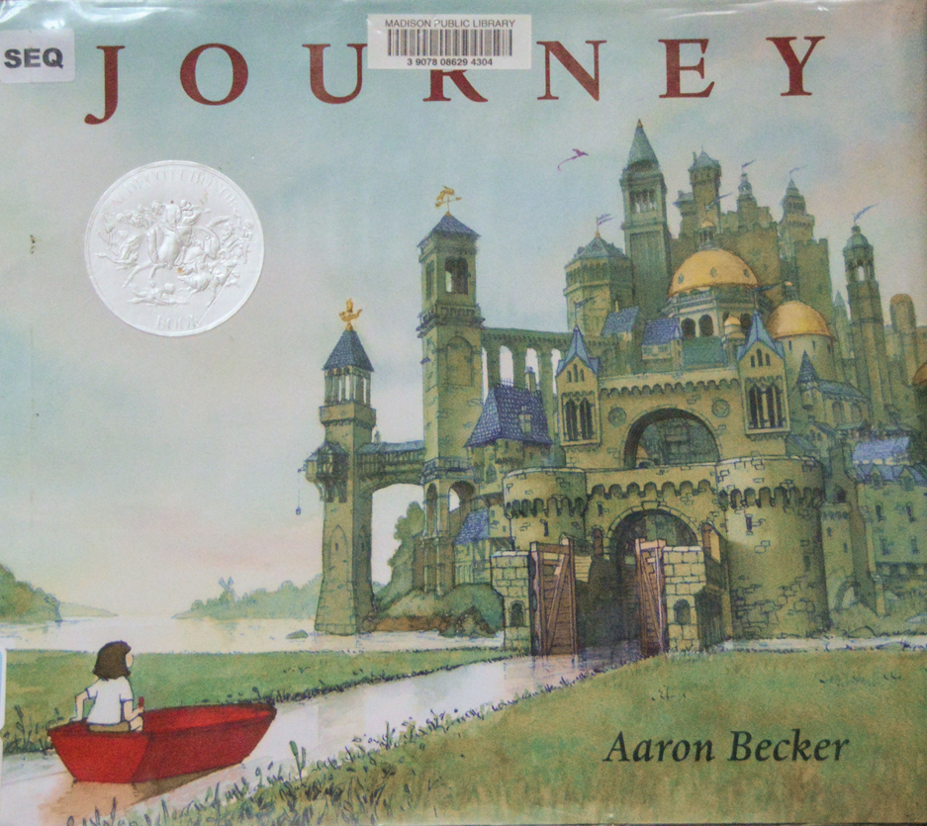

Slide 33
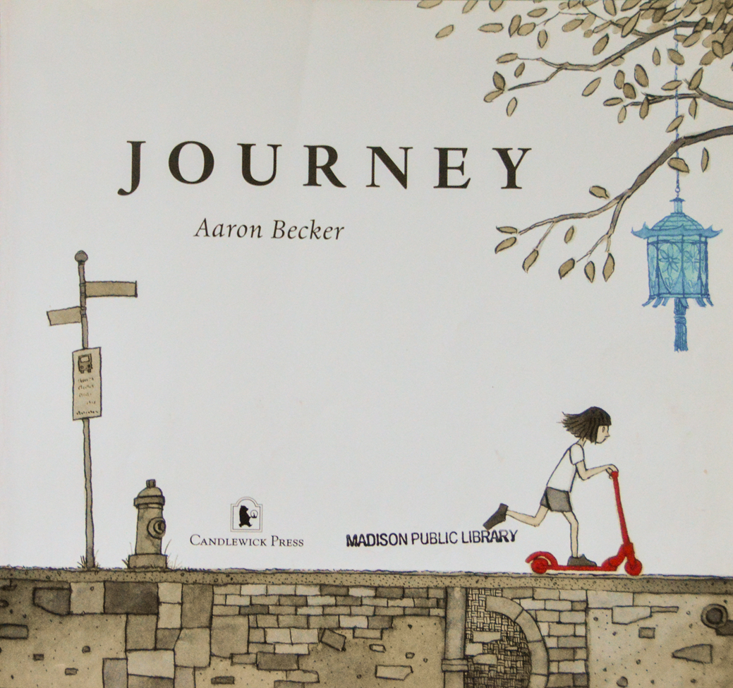

Slide 34
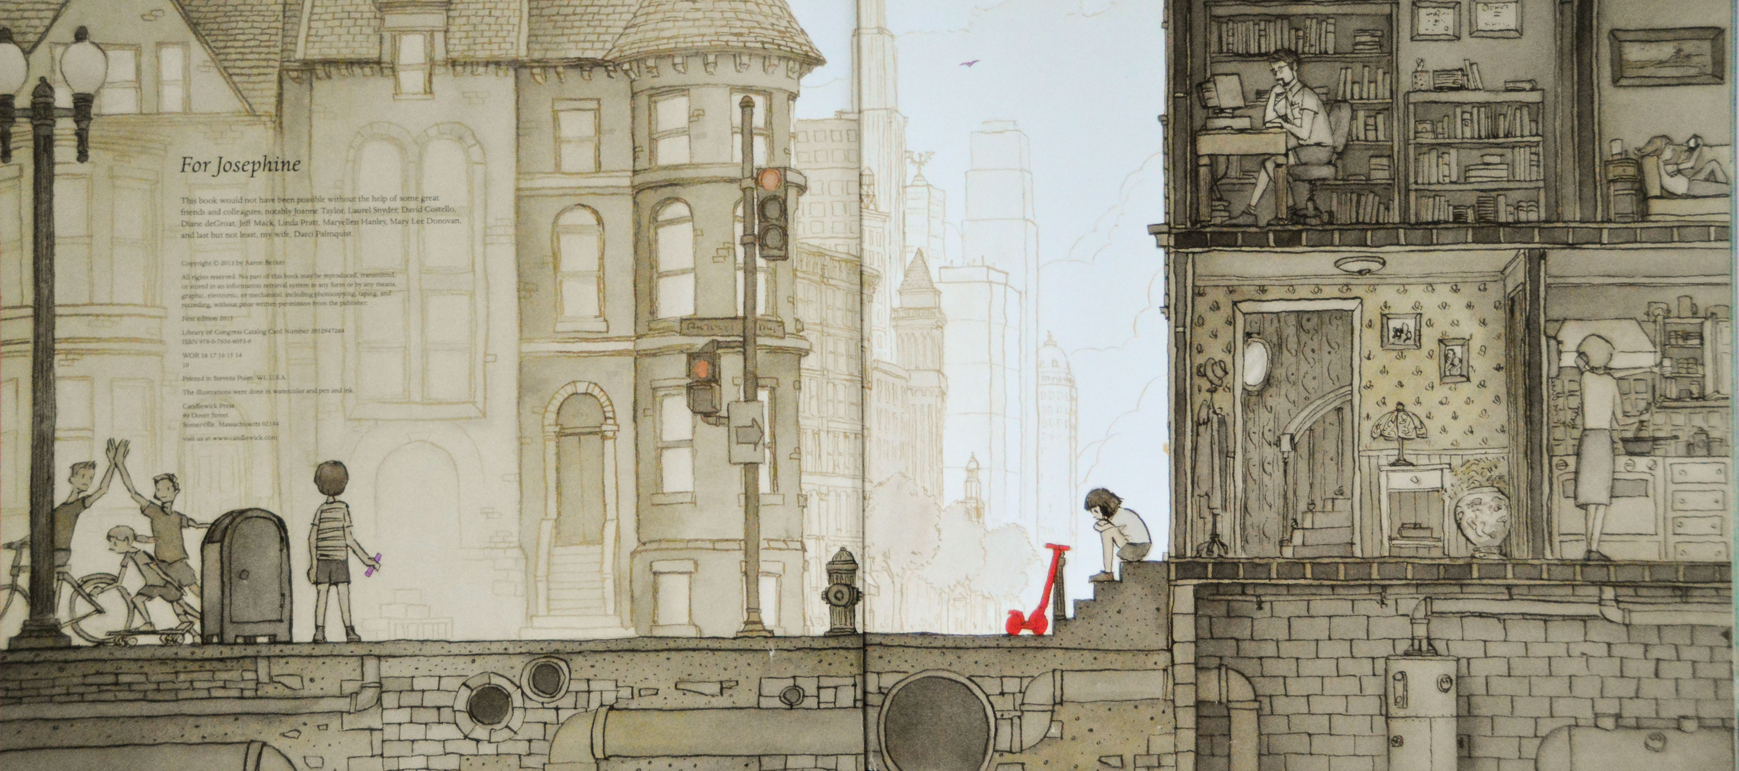

Slide 35
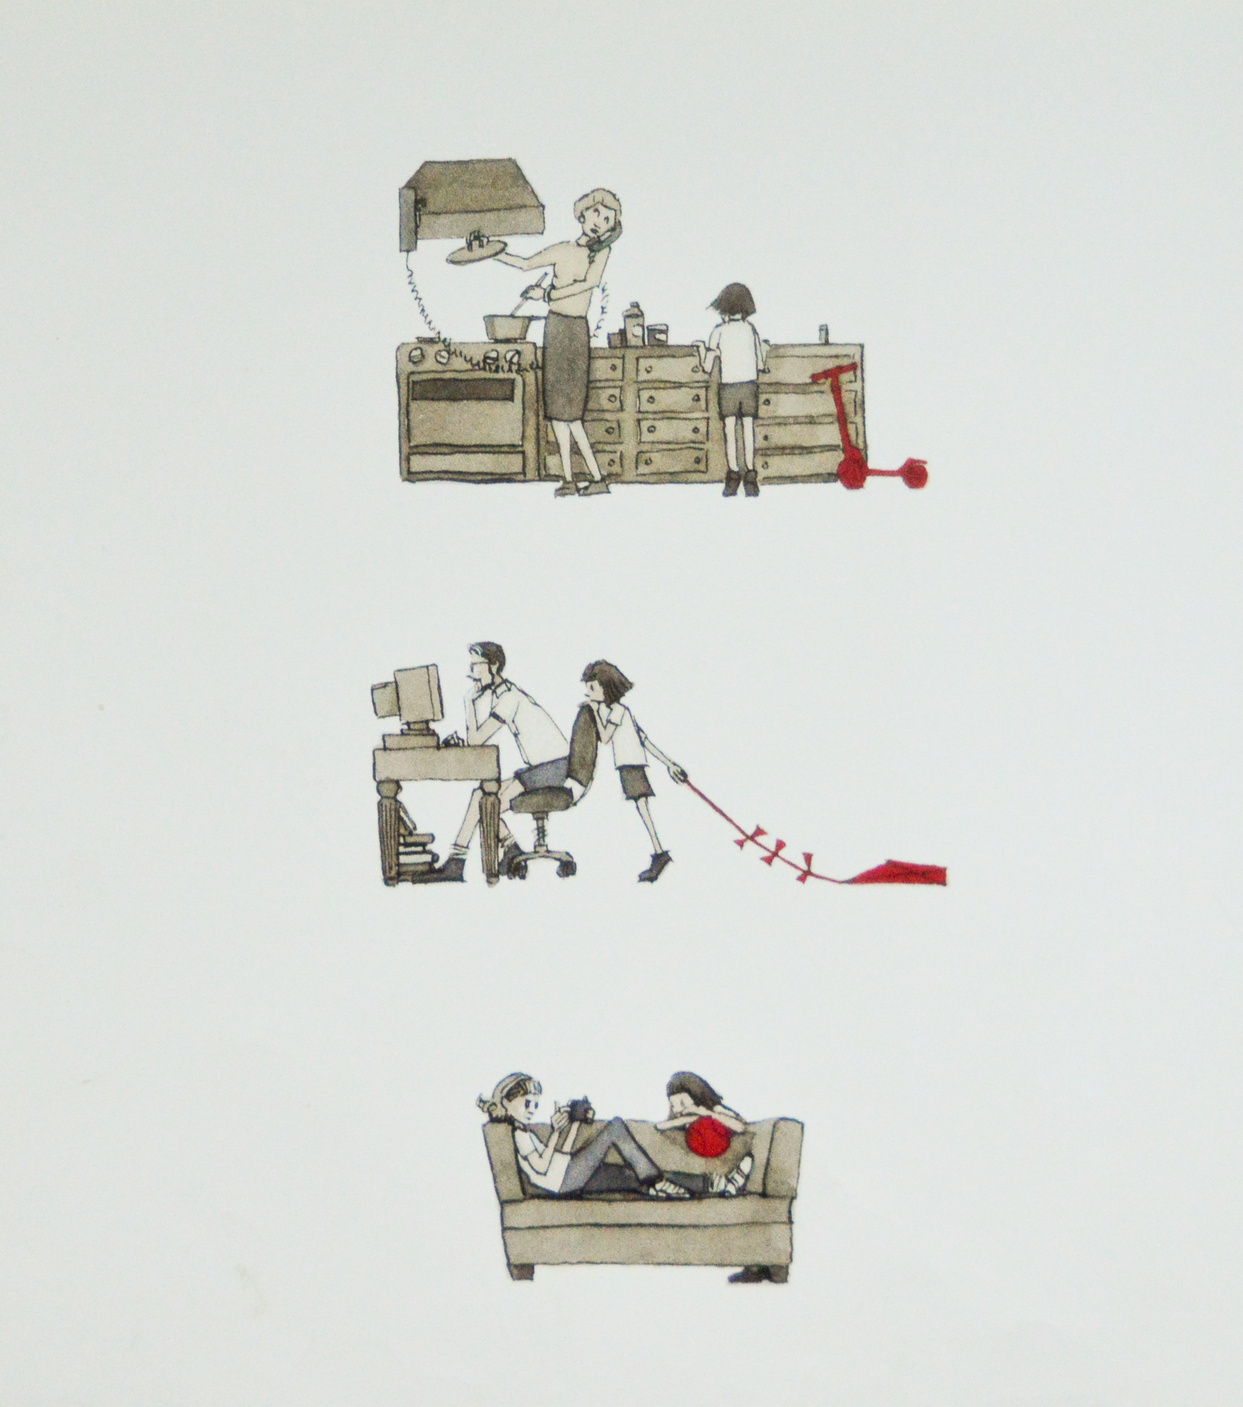

Slide 36
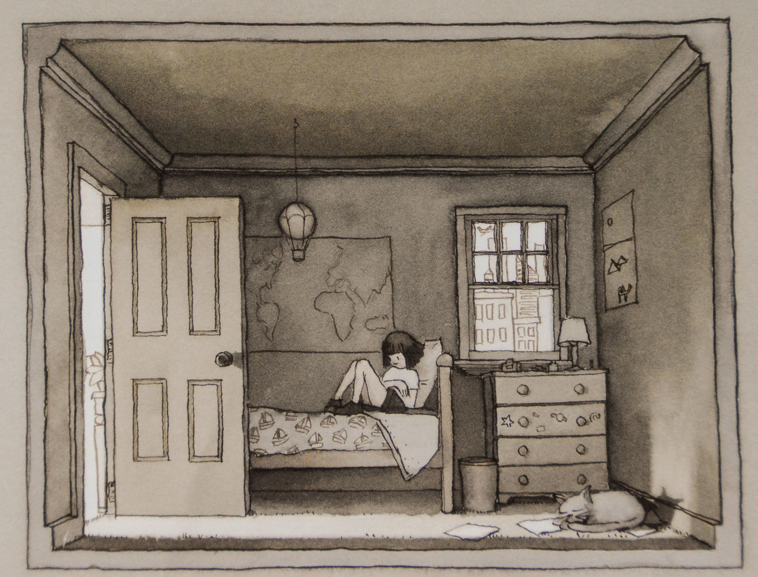

Slide 37
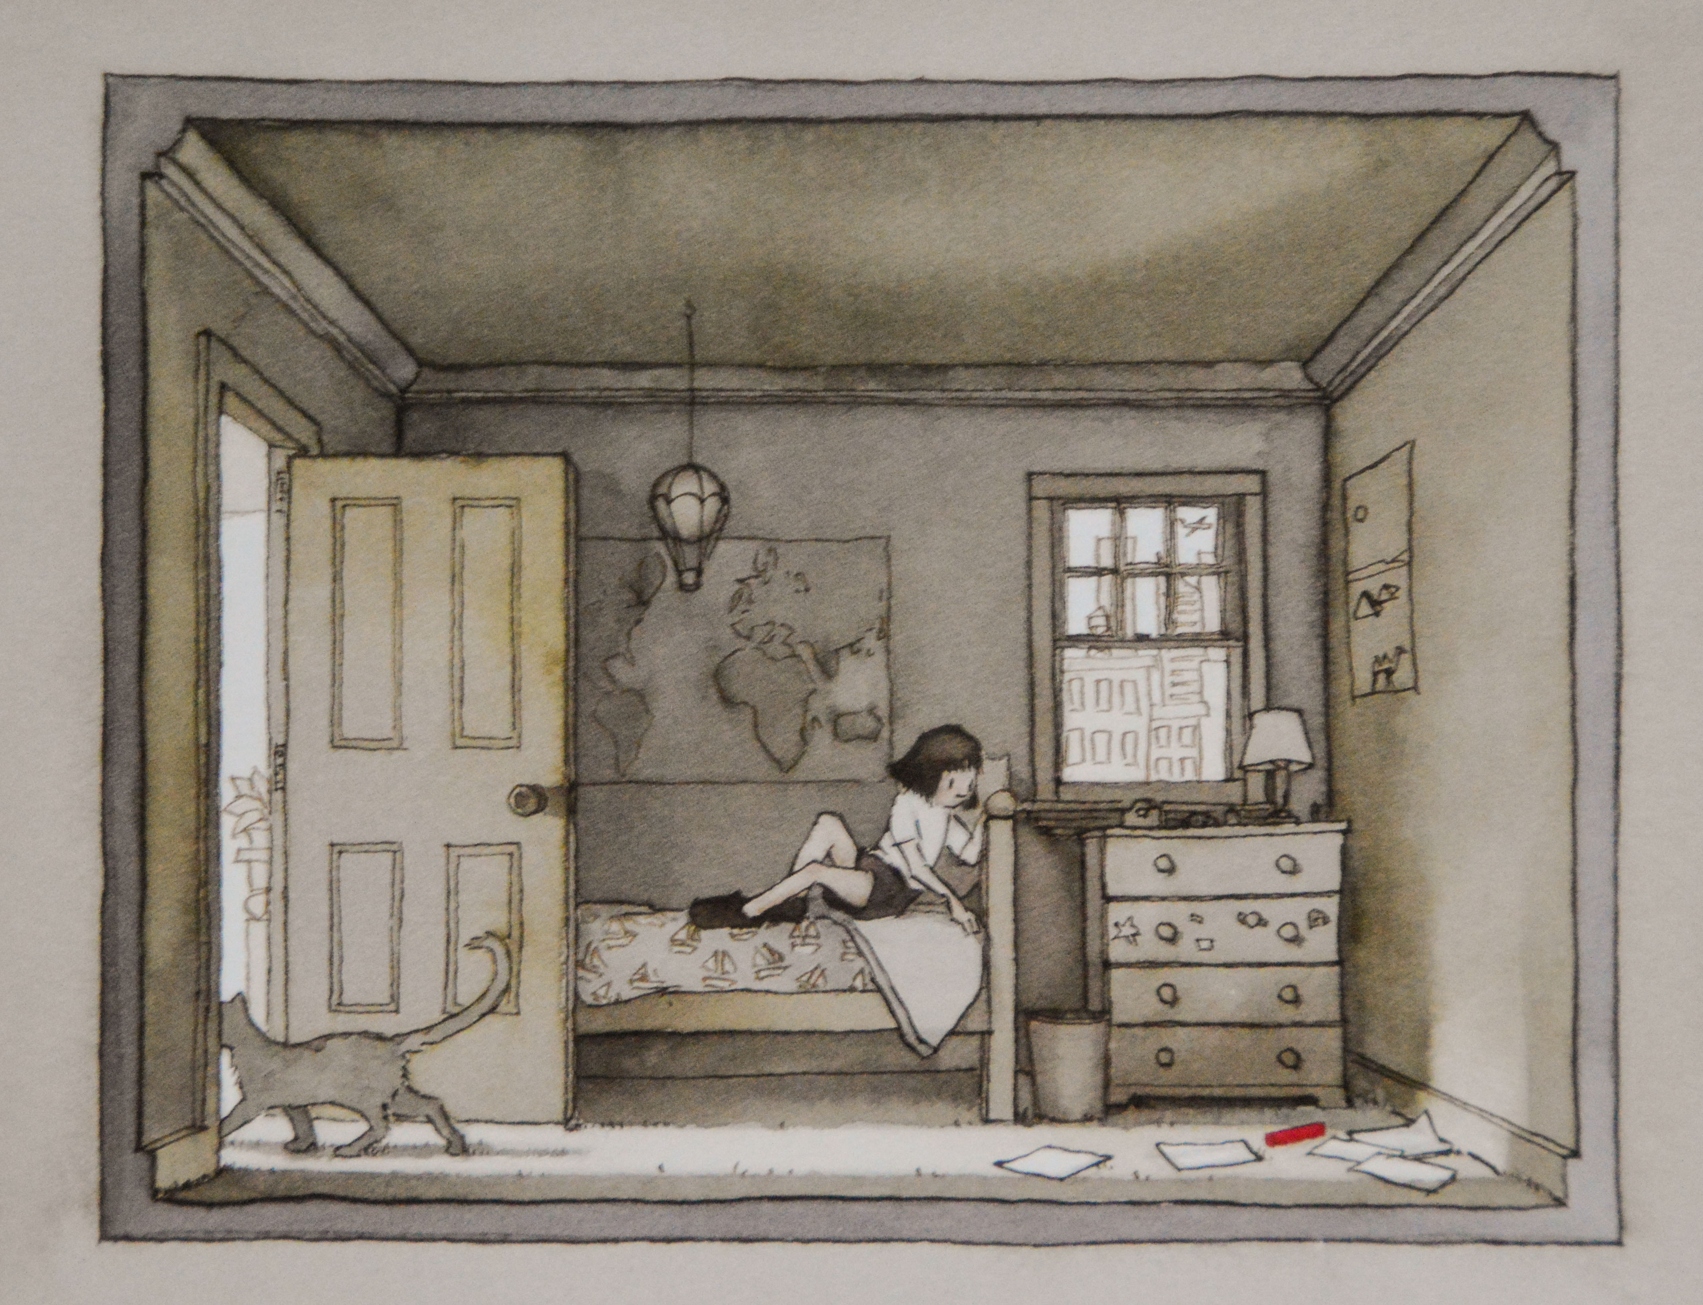

Slide 38
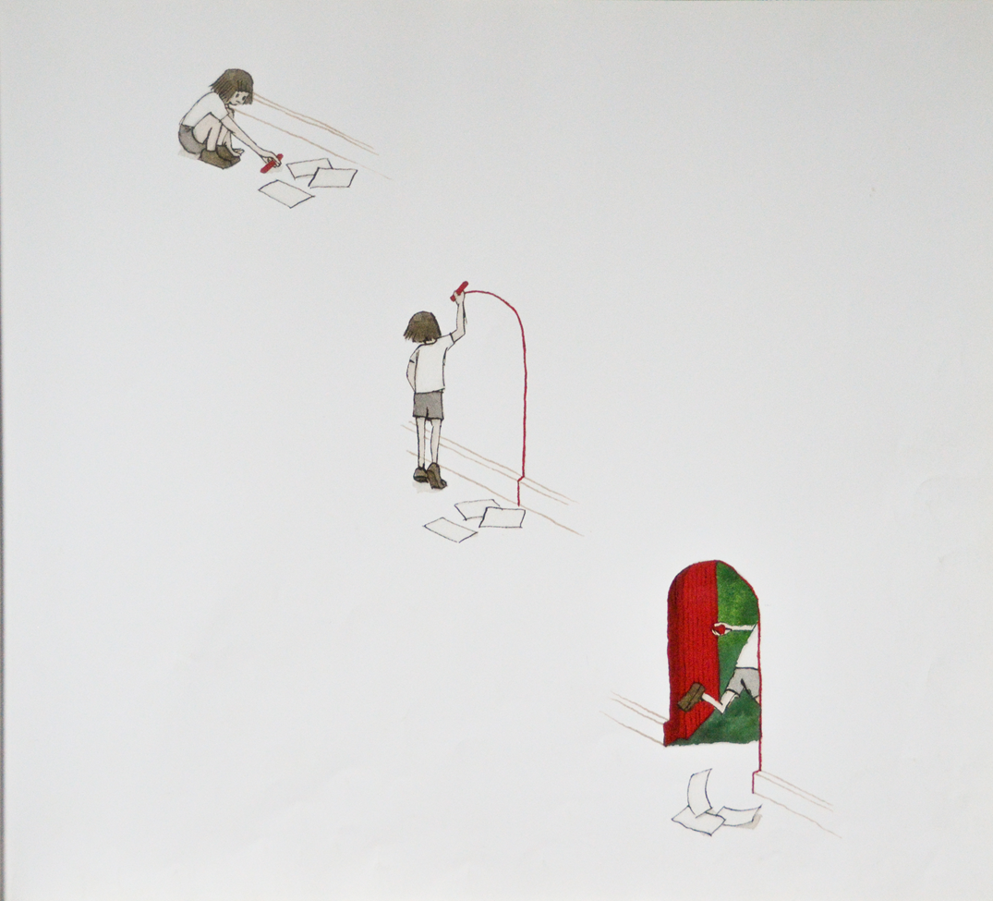

Slide 39
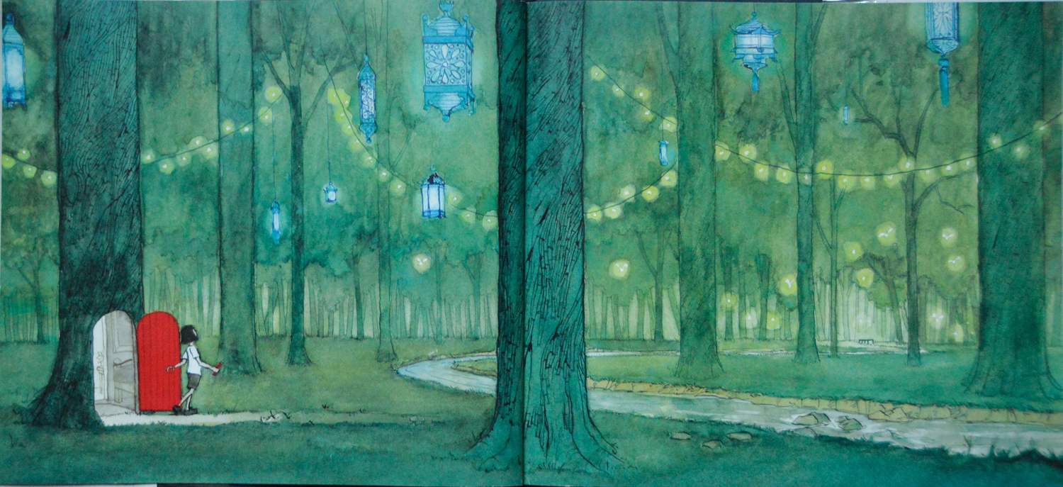

Slide 40
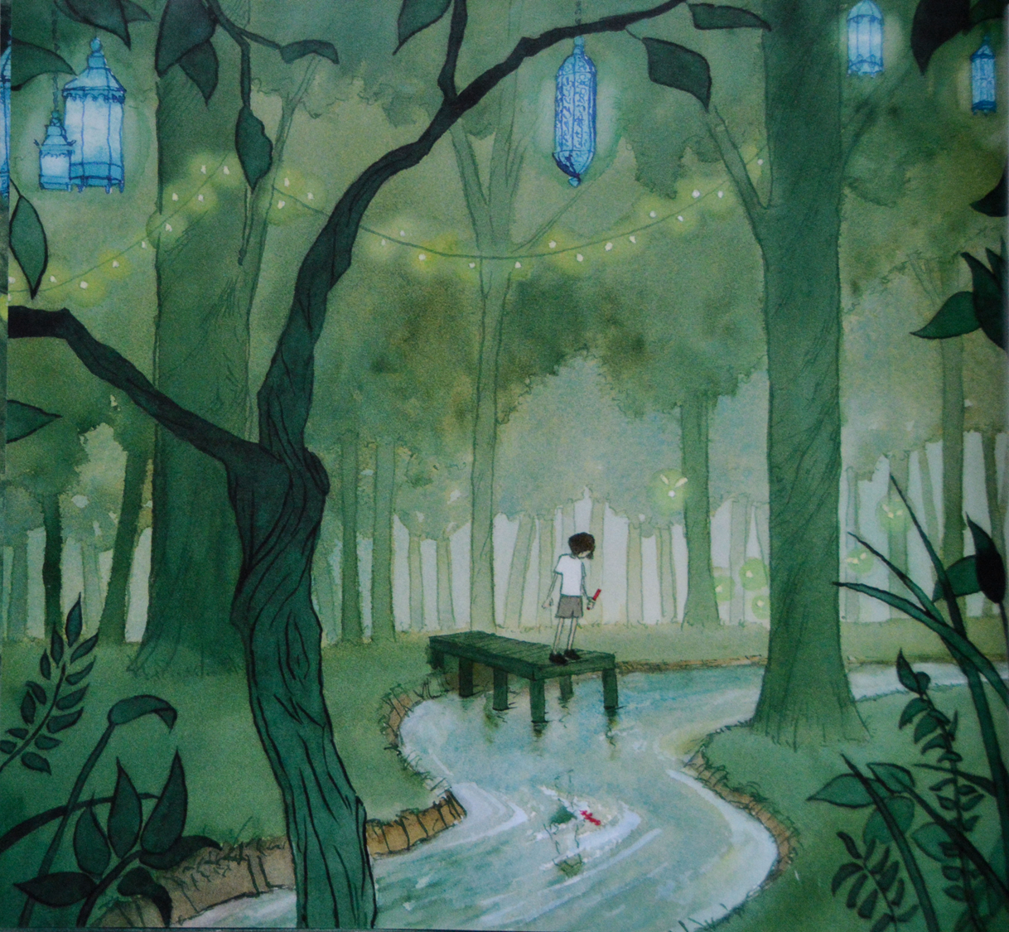

Slide 41
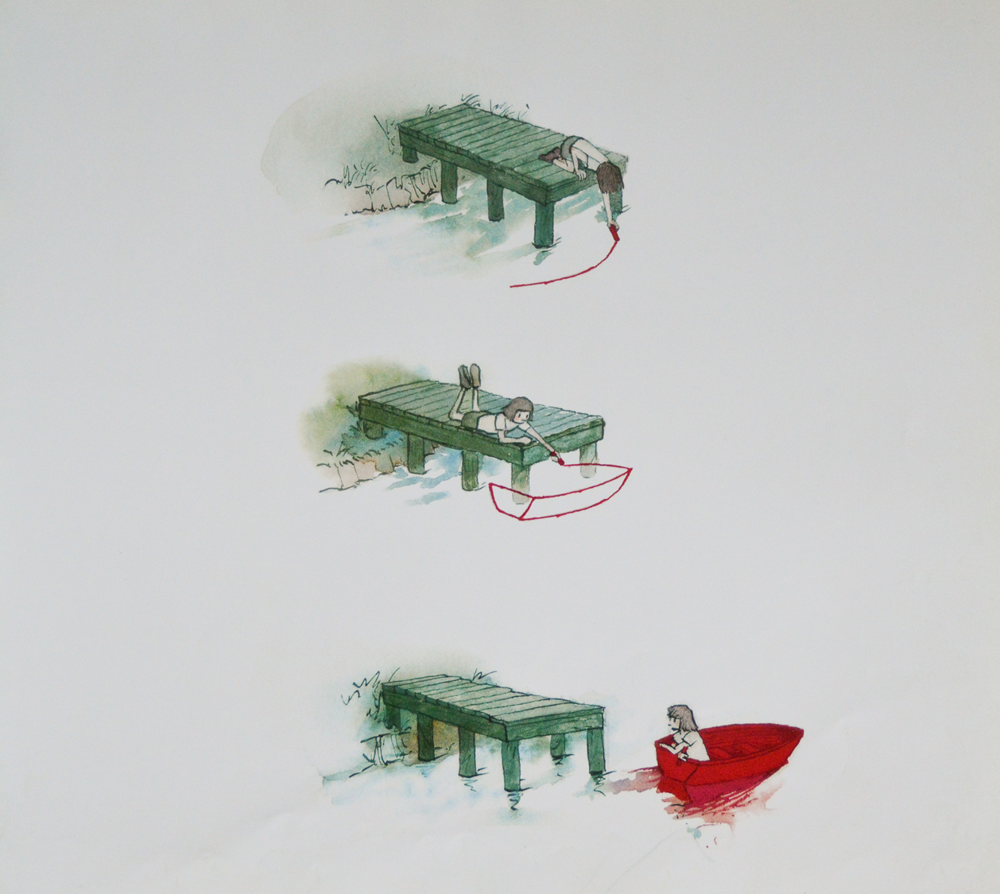

Slide 42
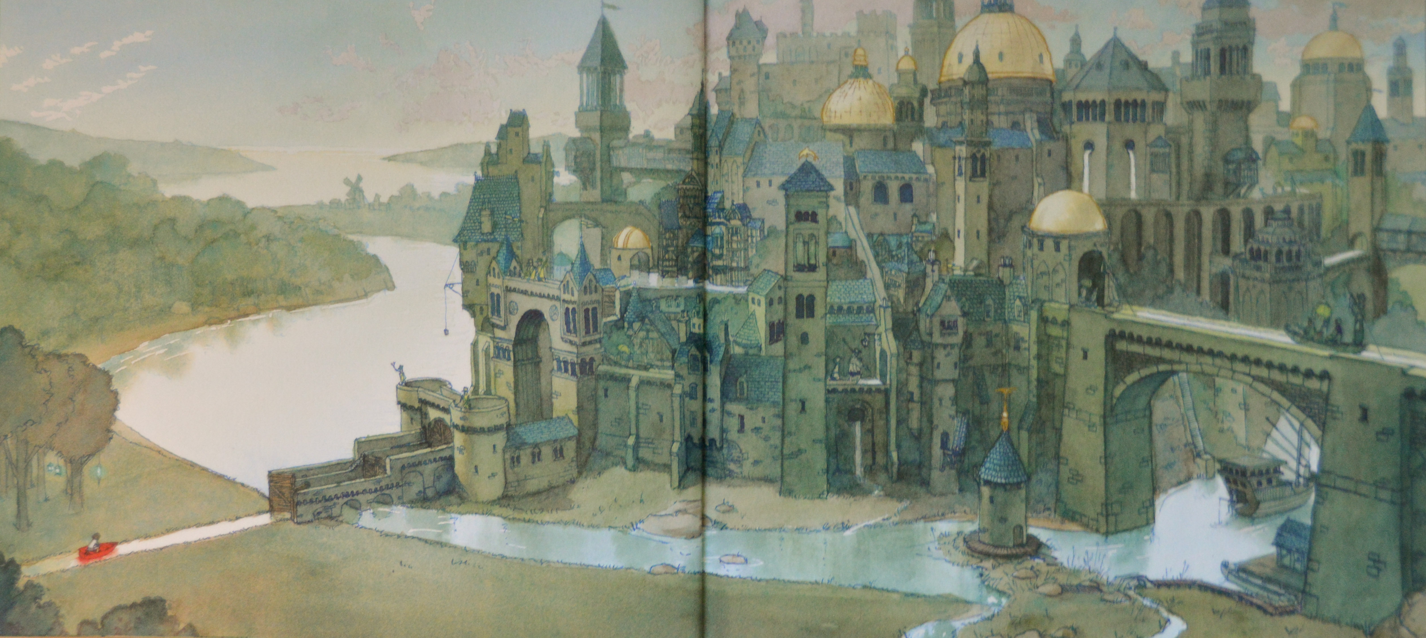

Slide 43
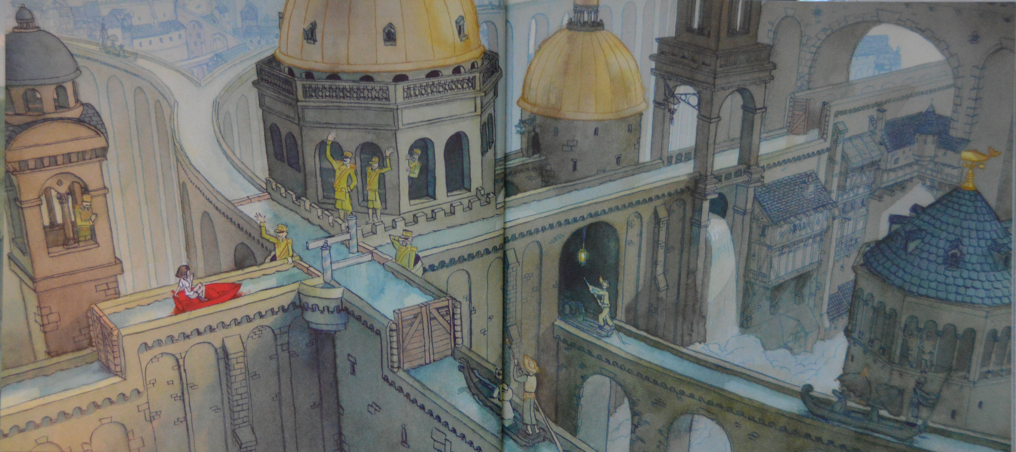

Slide 44
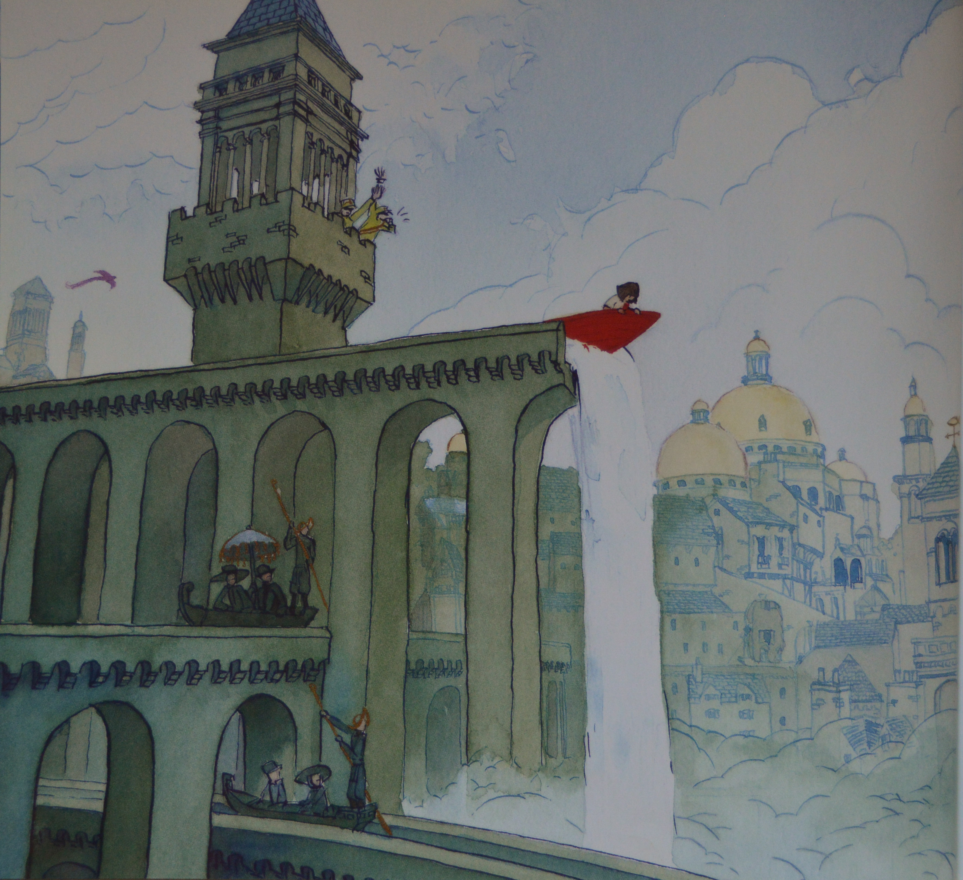

Slide 45
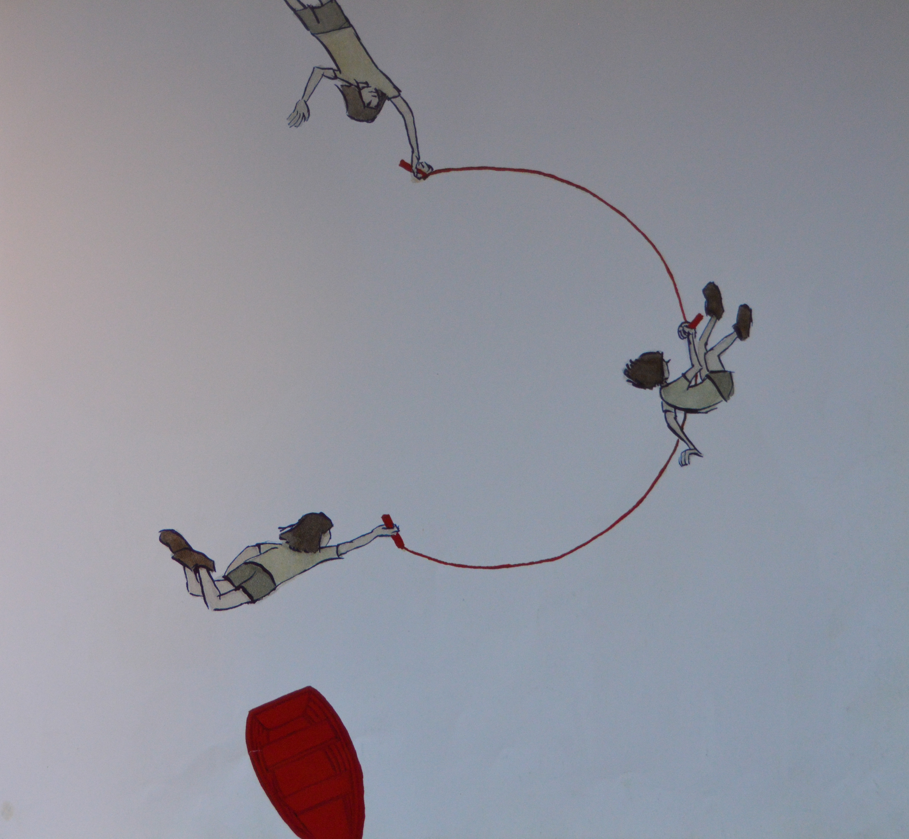

Slide 46
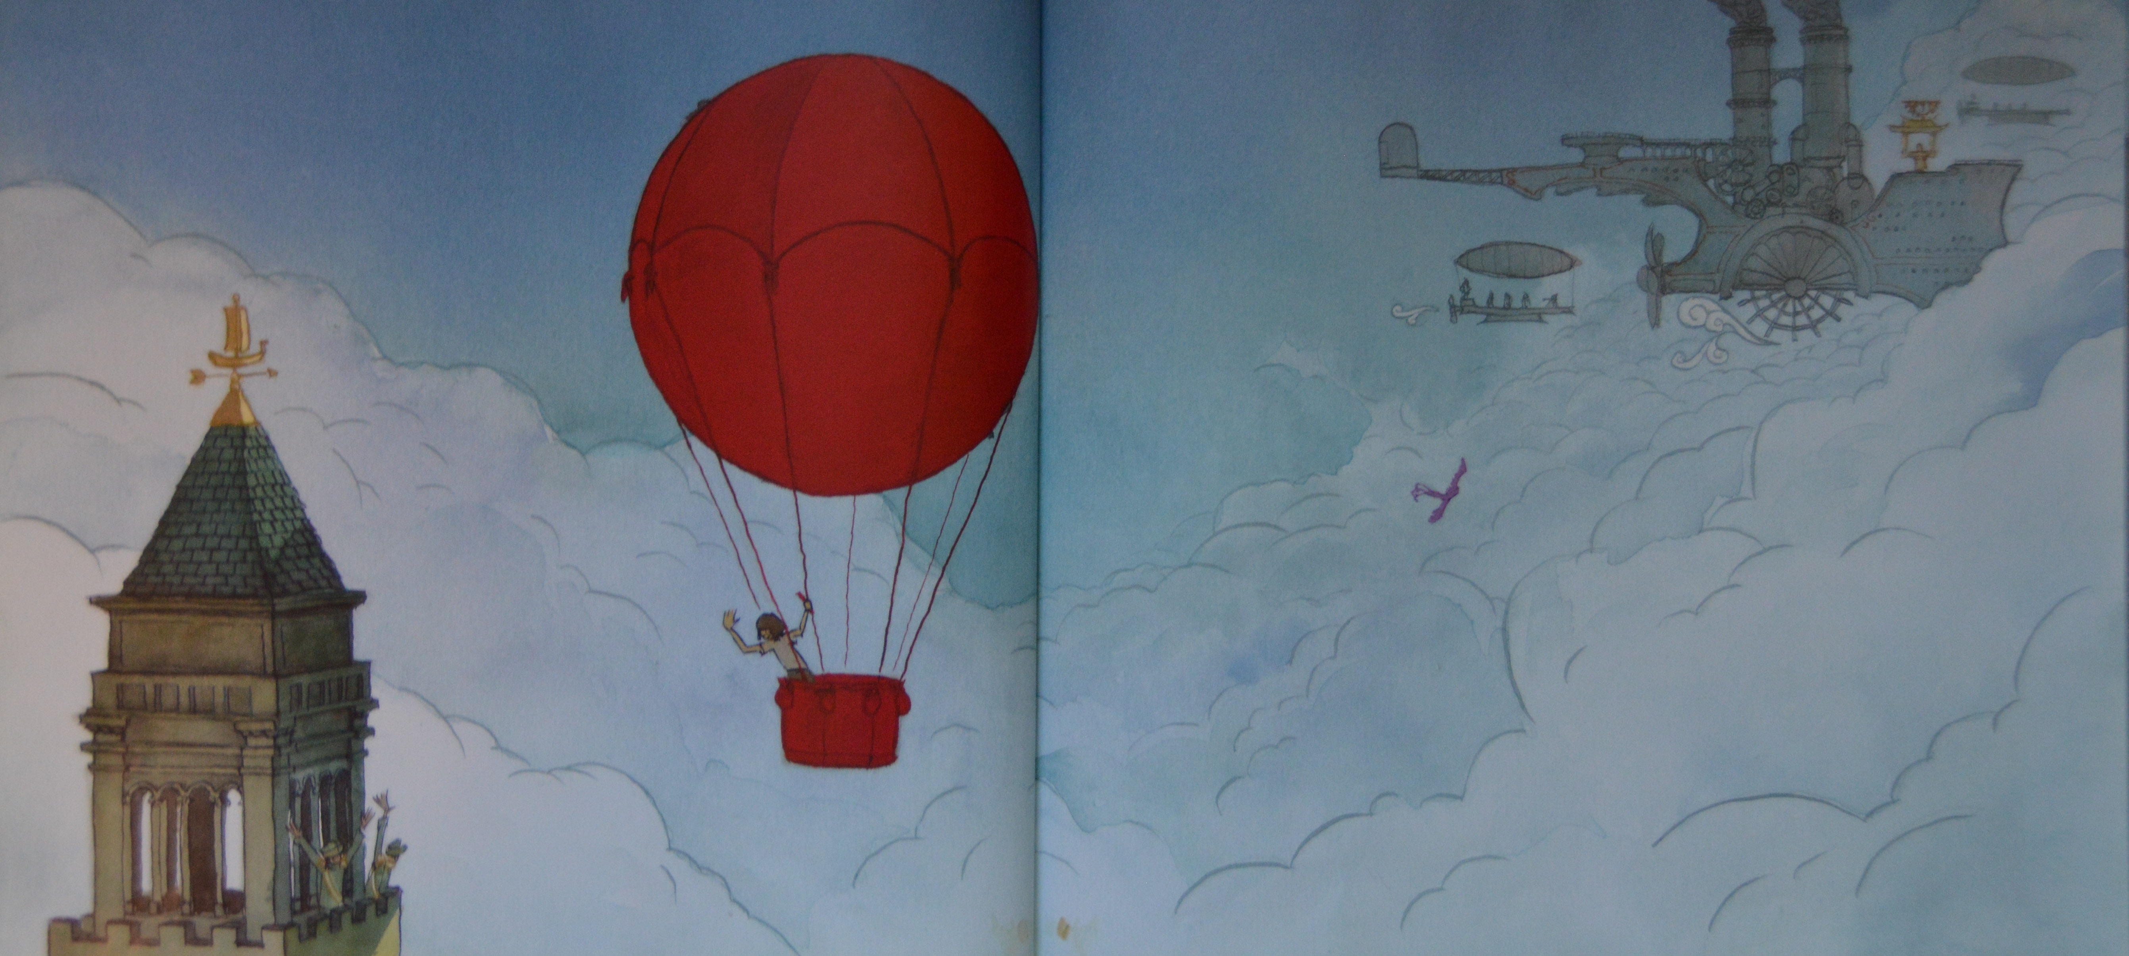

Slide 47
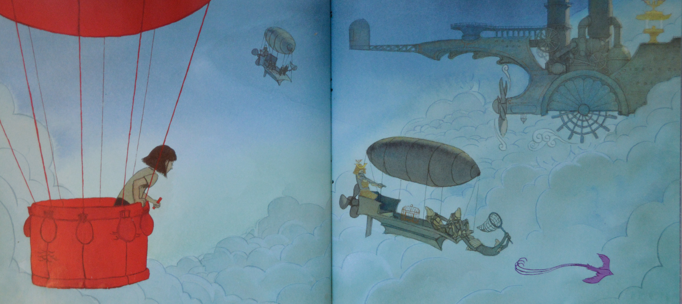

Slide 48
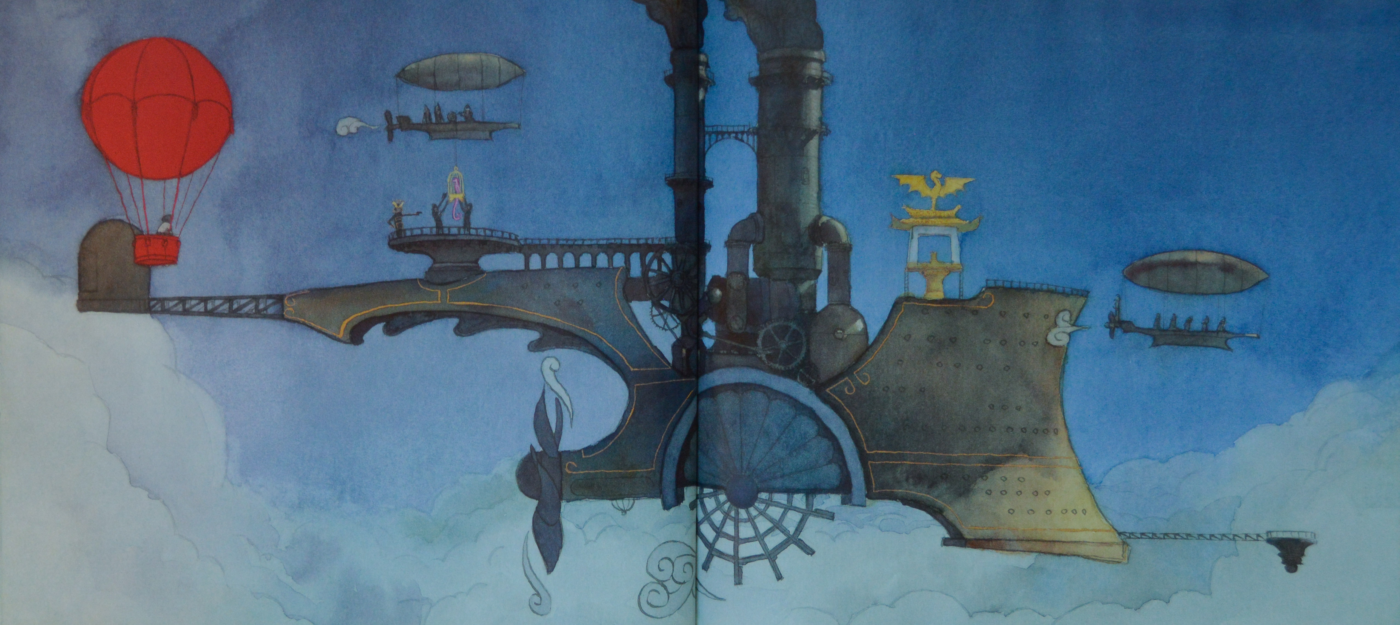

Slide 49
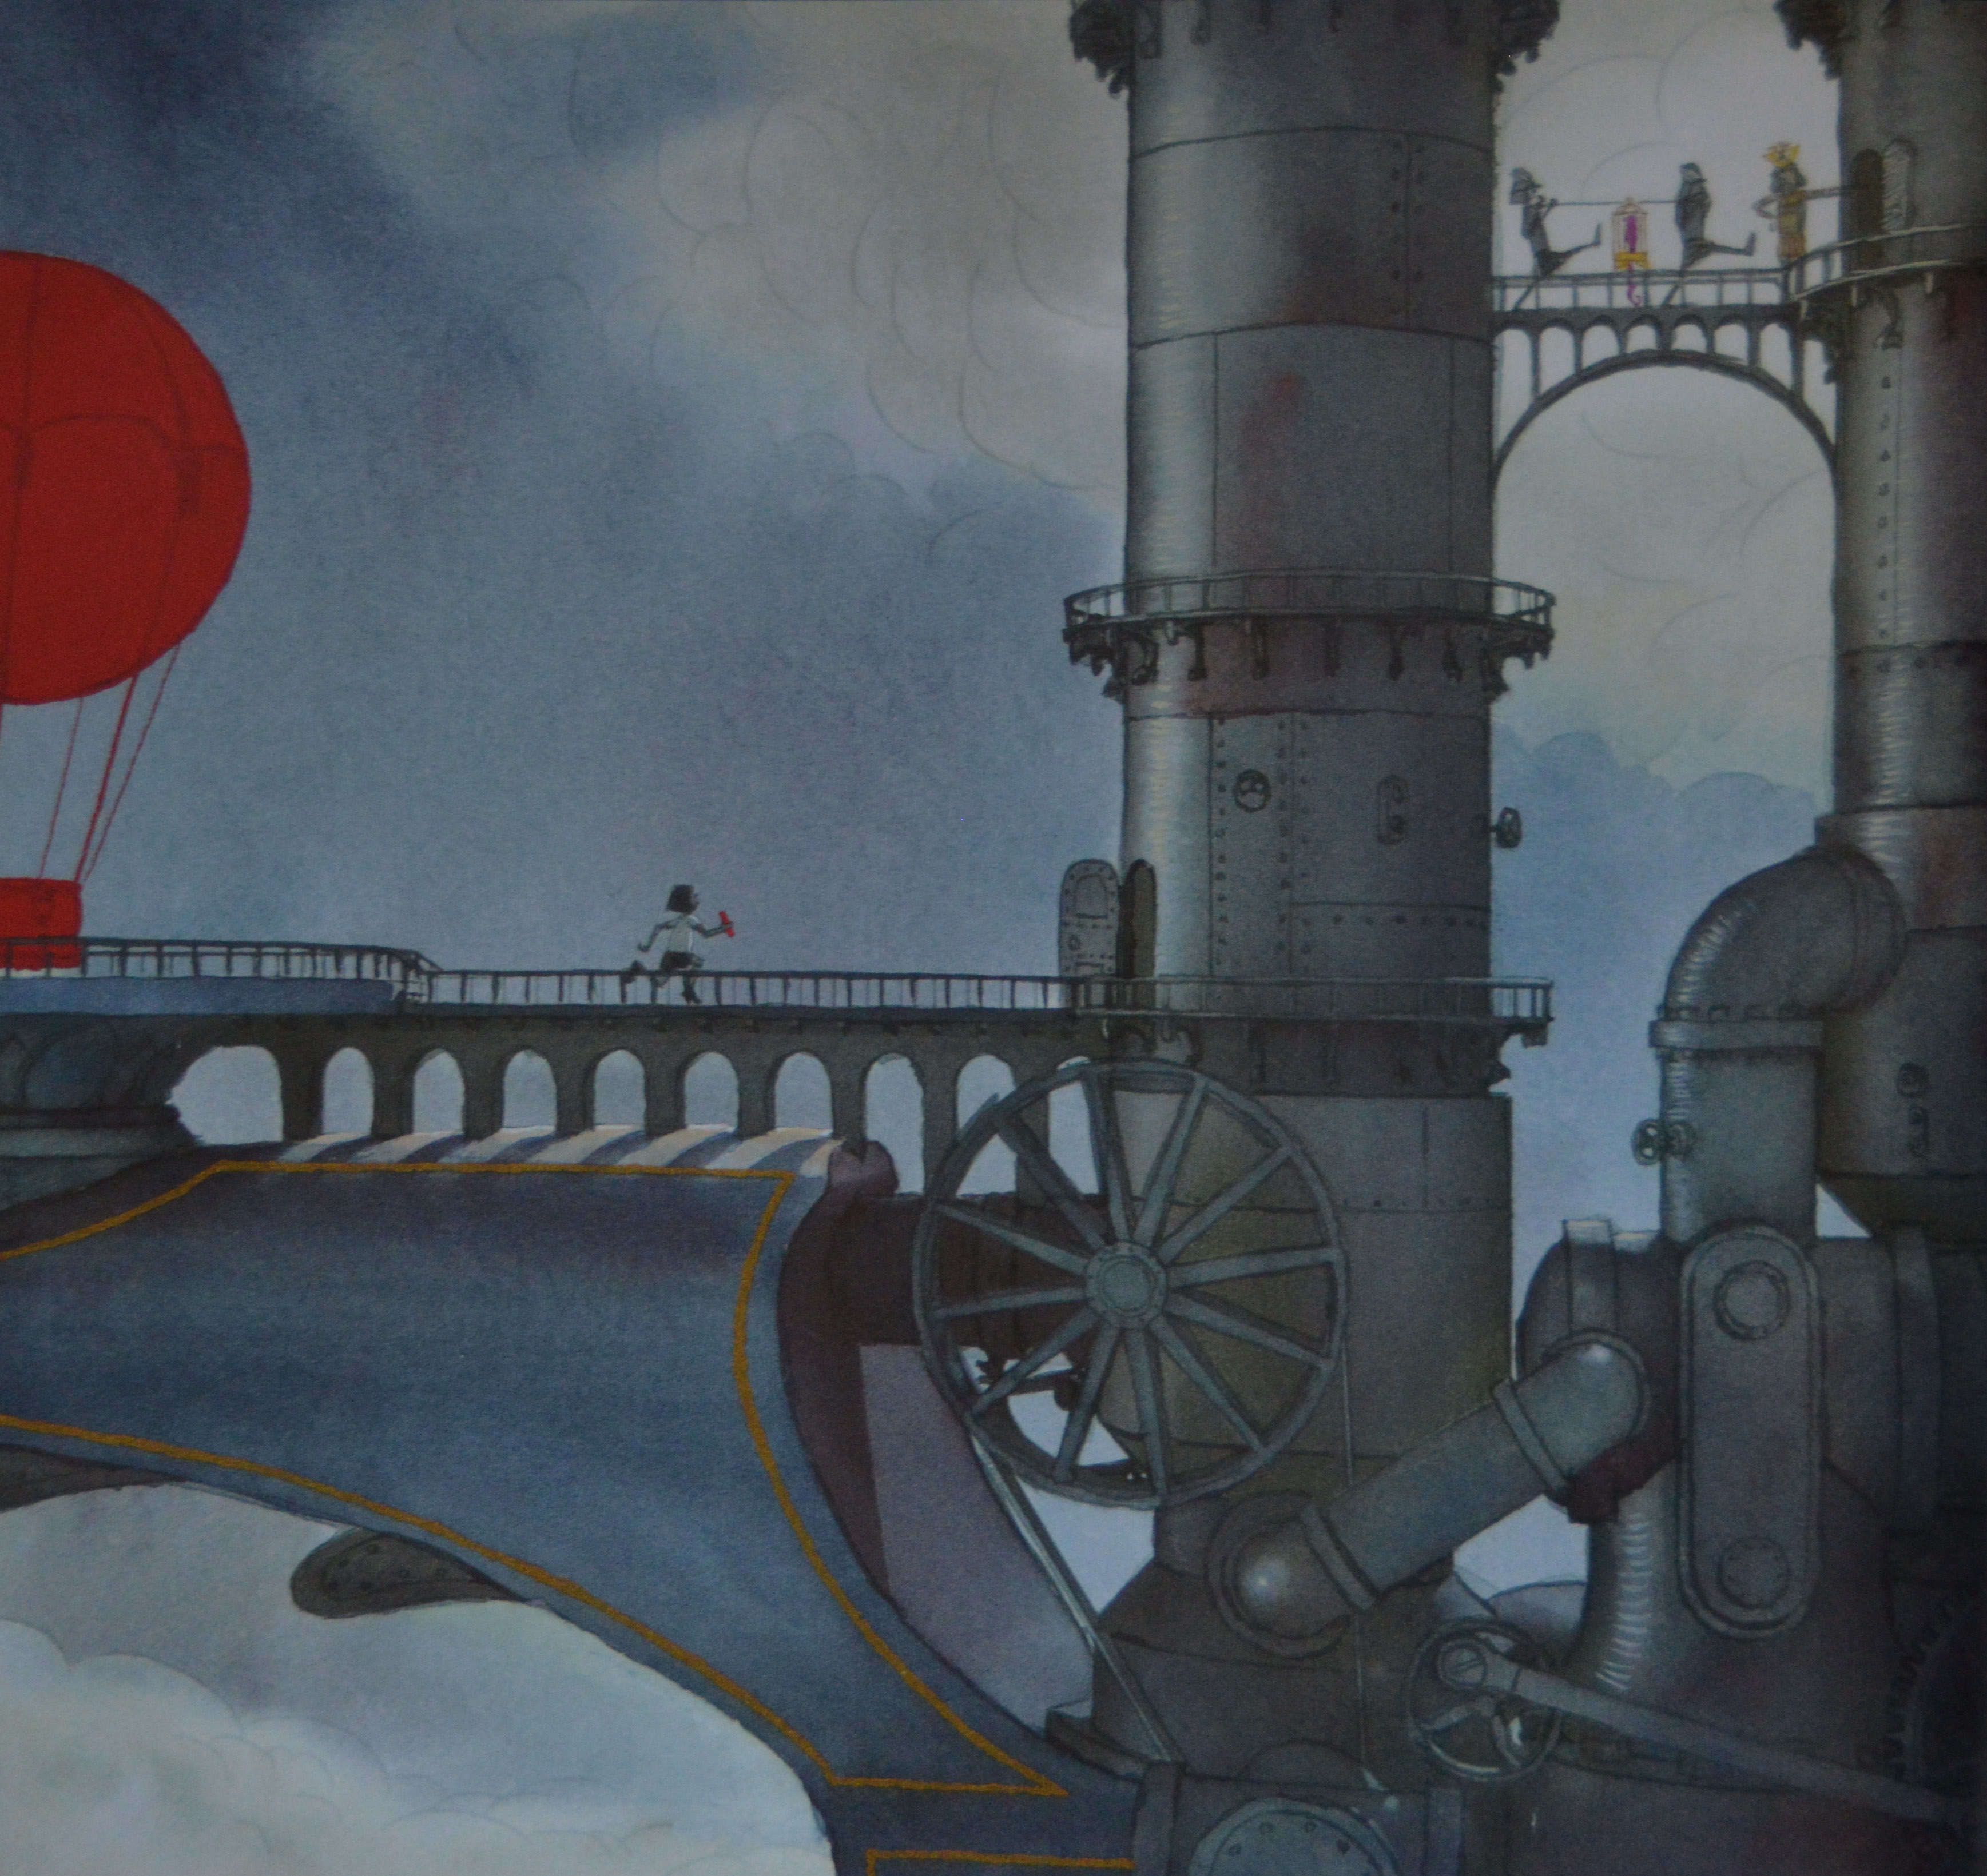

Slide 50
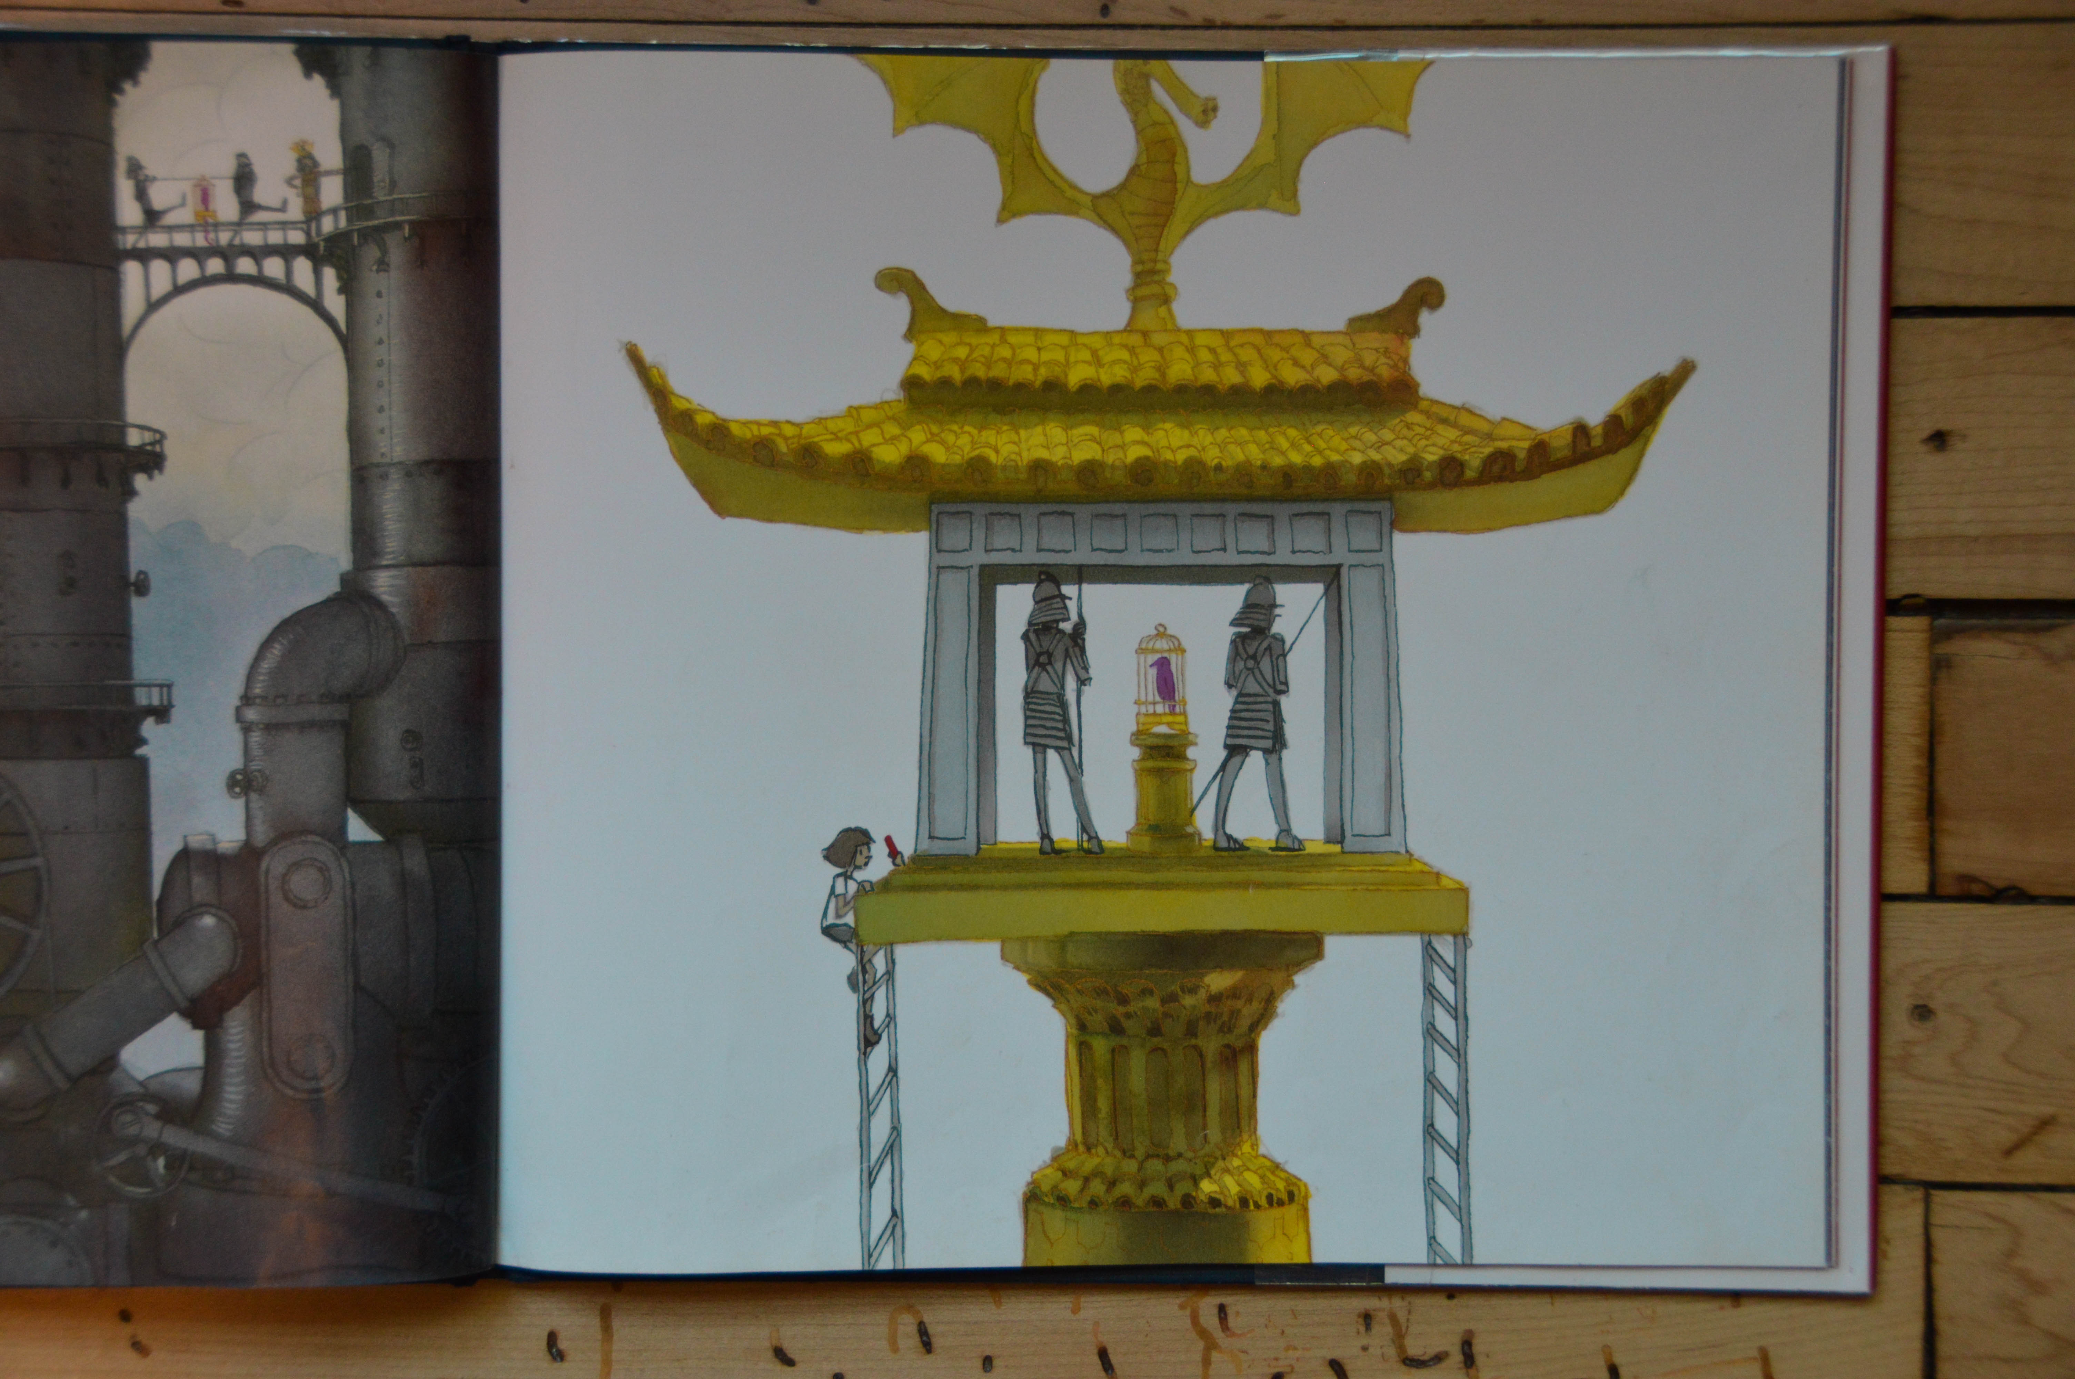

Slide 51
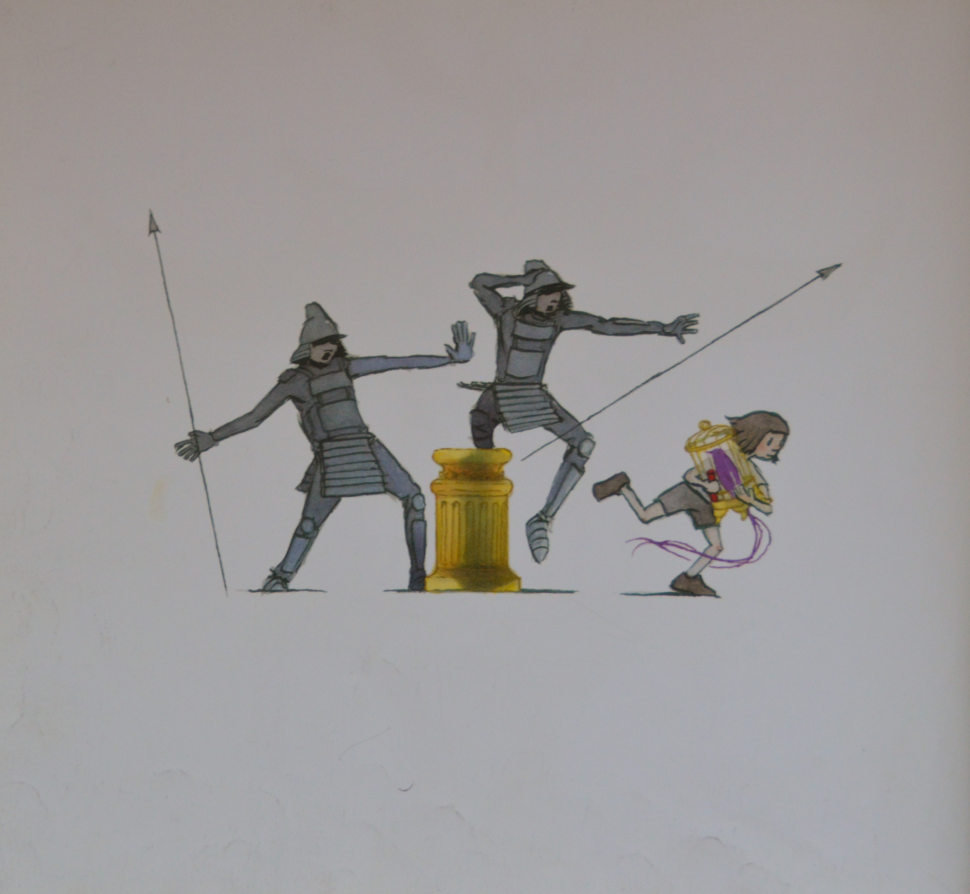

Slide 52
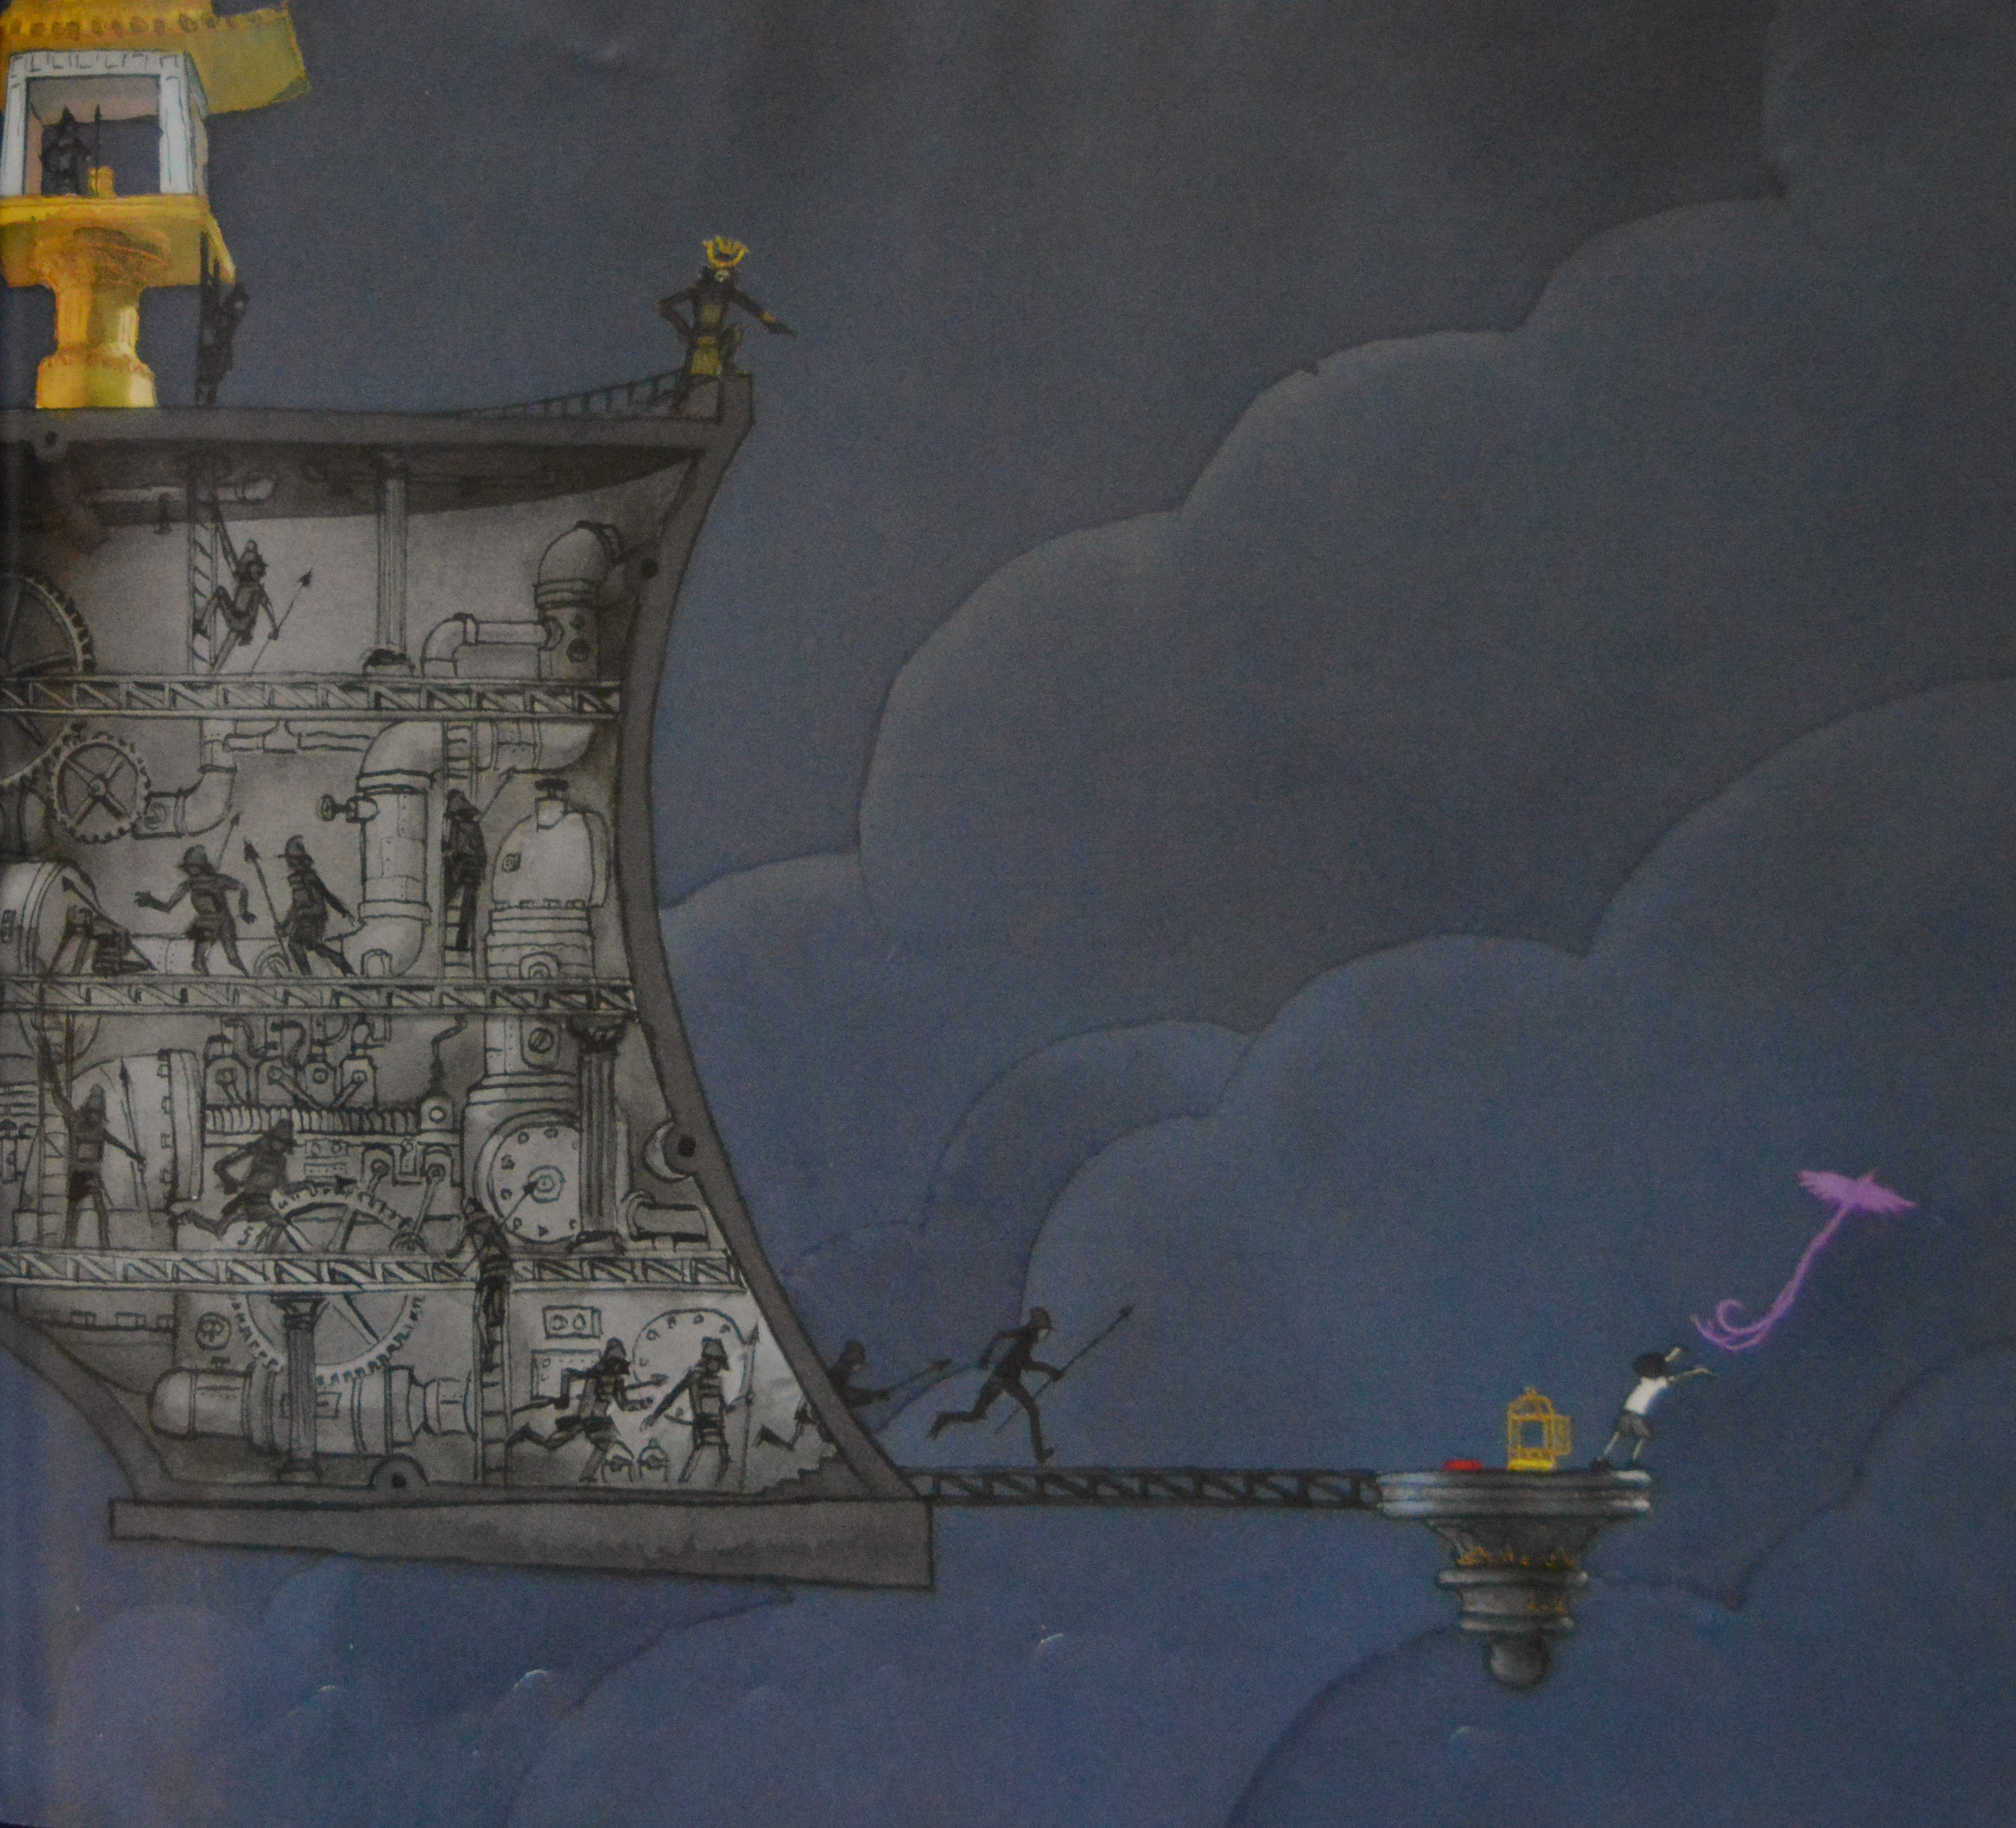

Slide 53
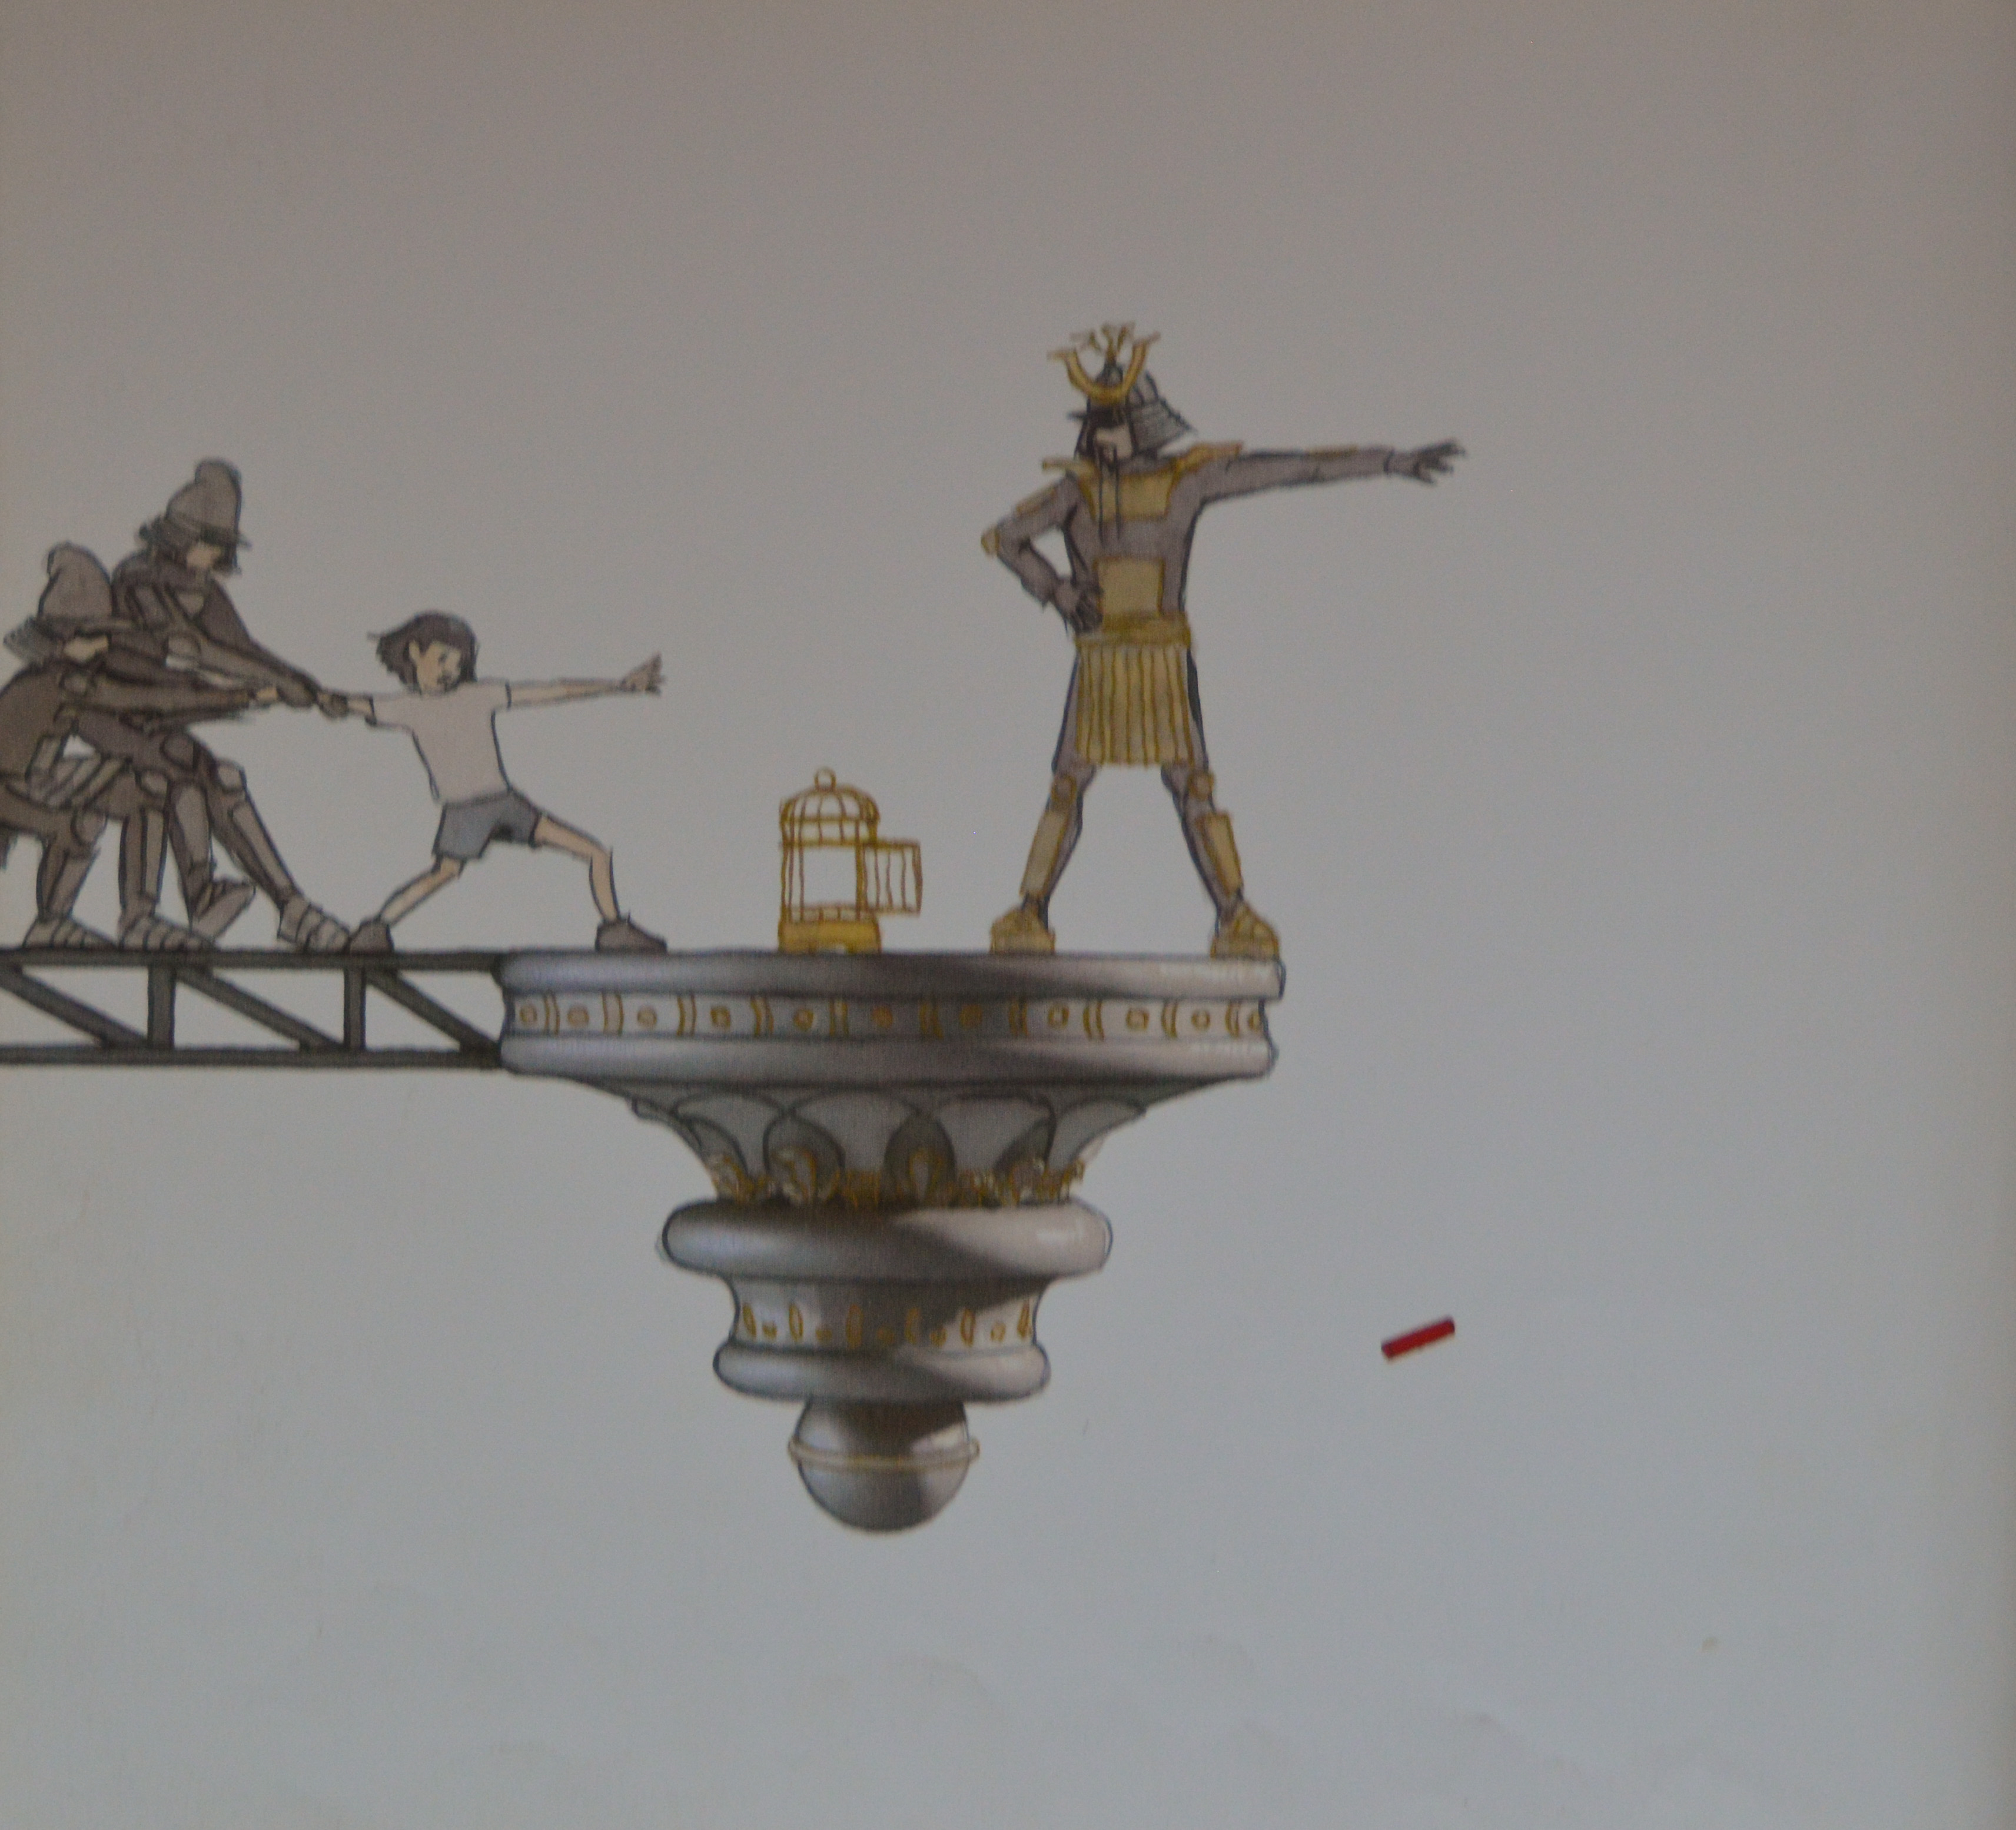

Slide 54
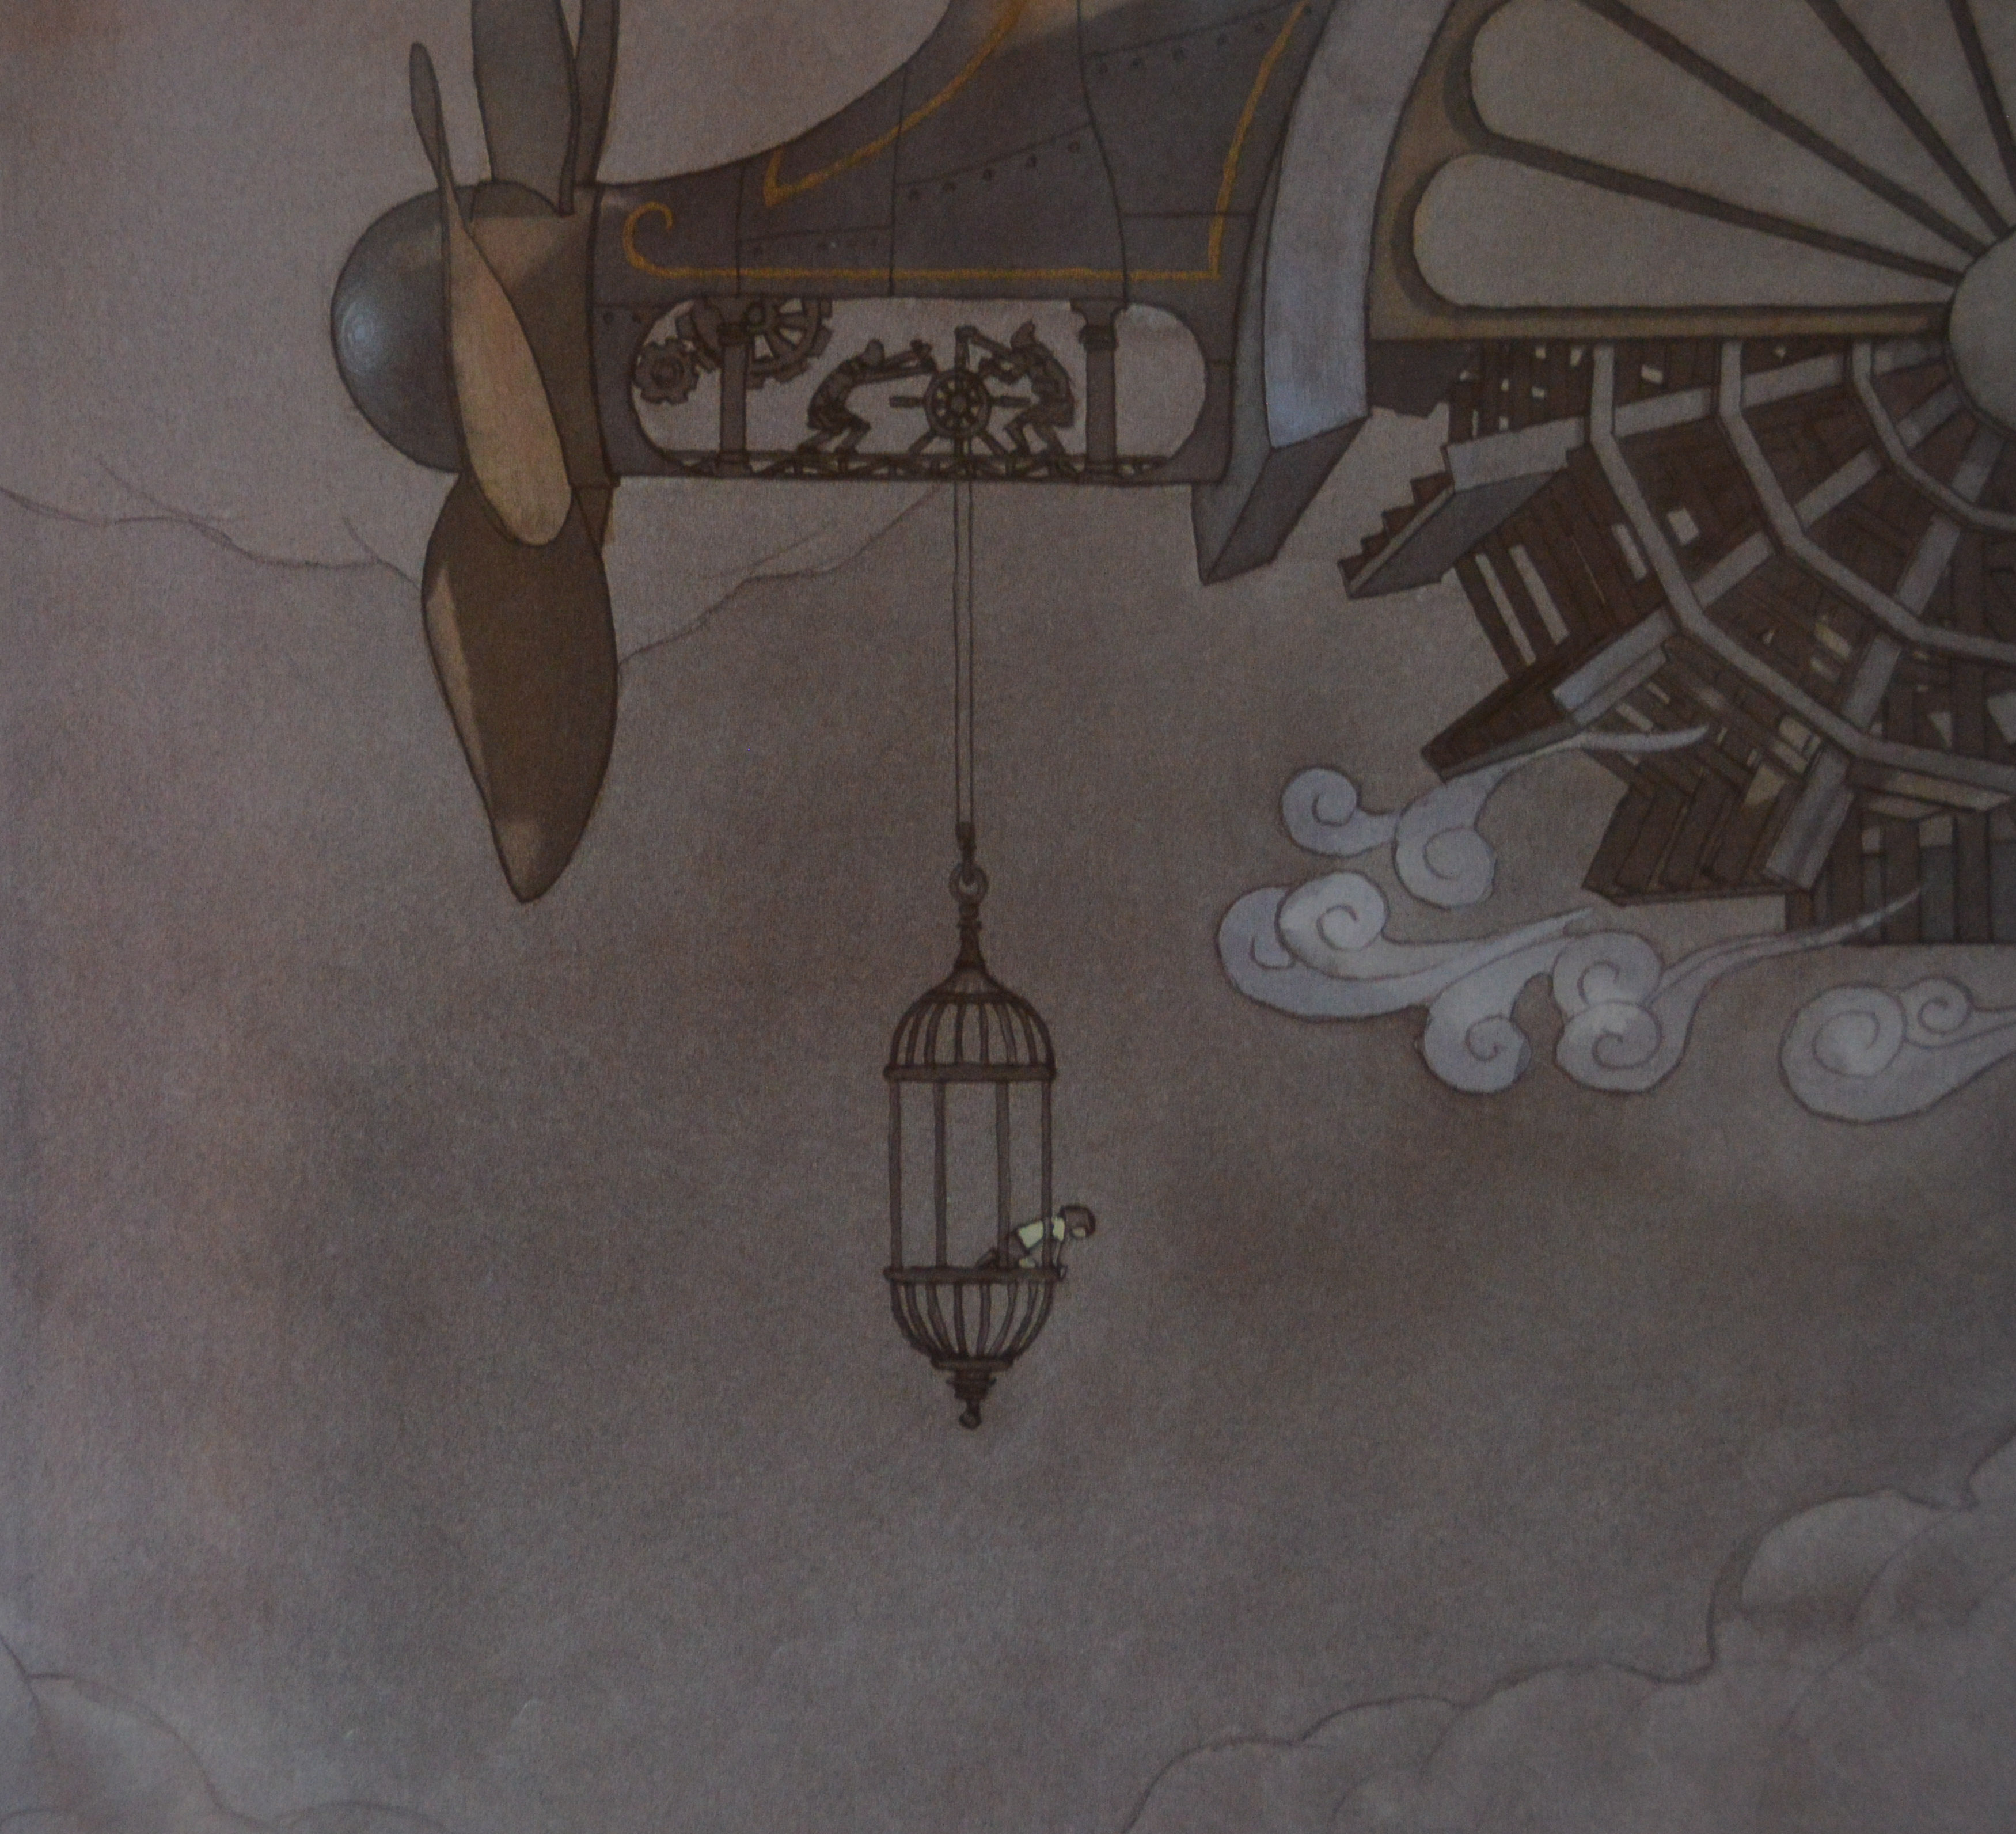

Slide 55
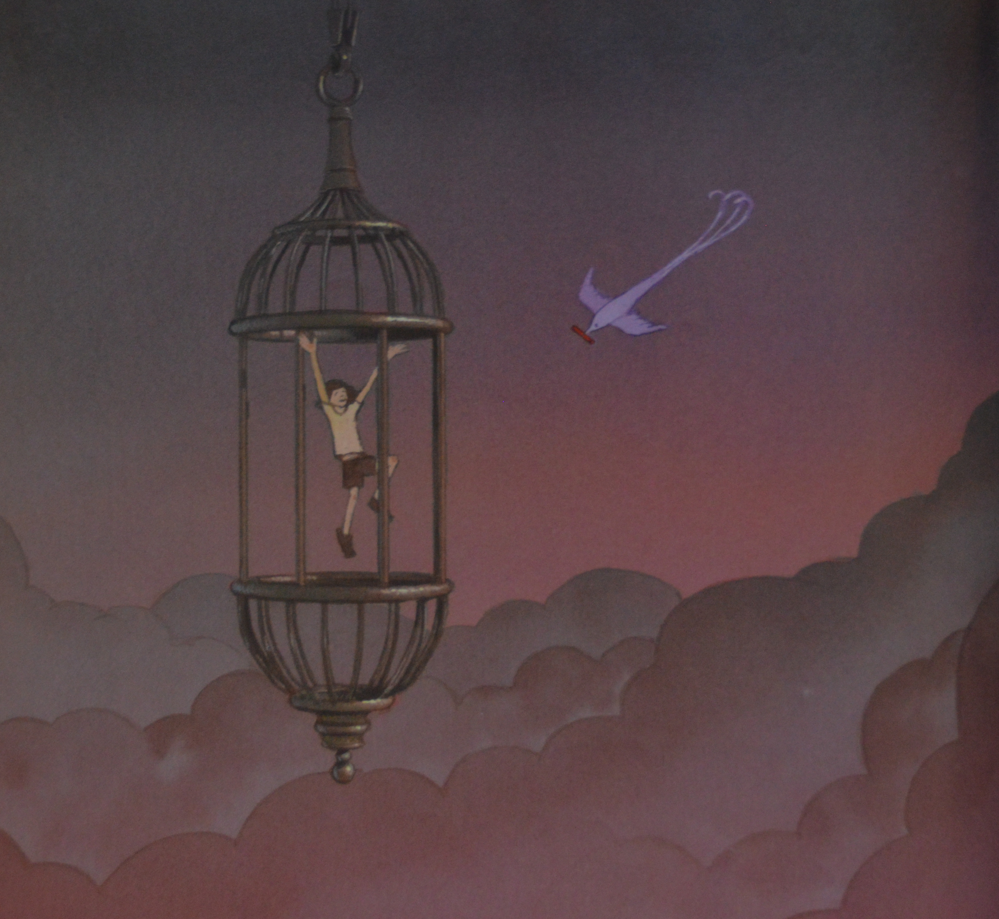

Slide 56
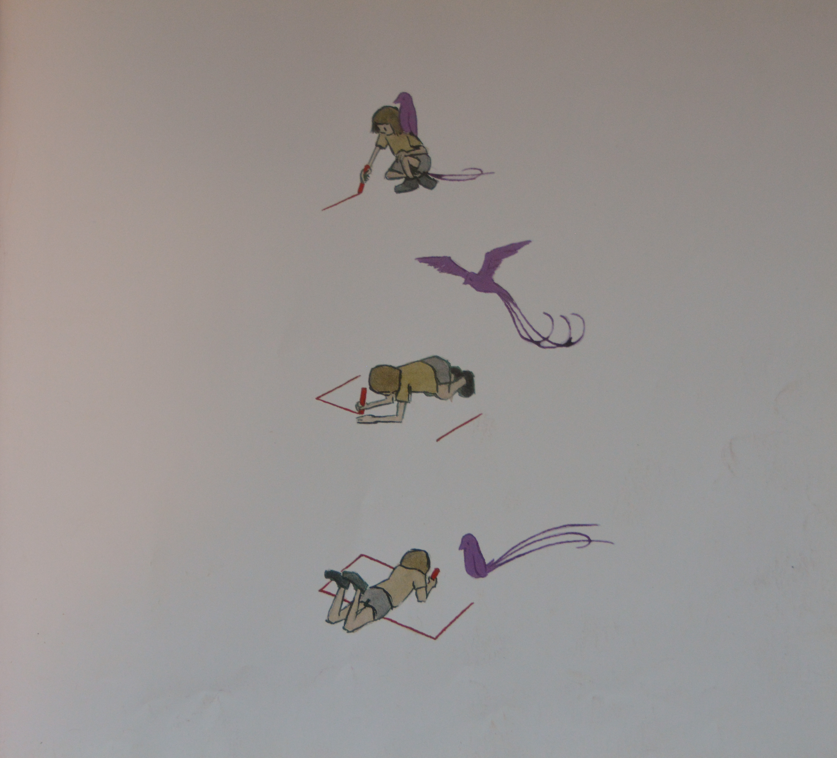

Slide 57
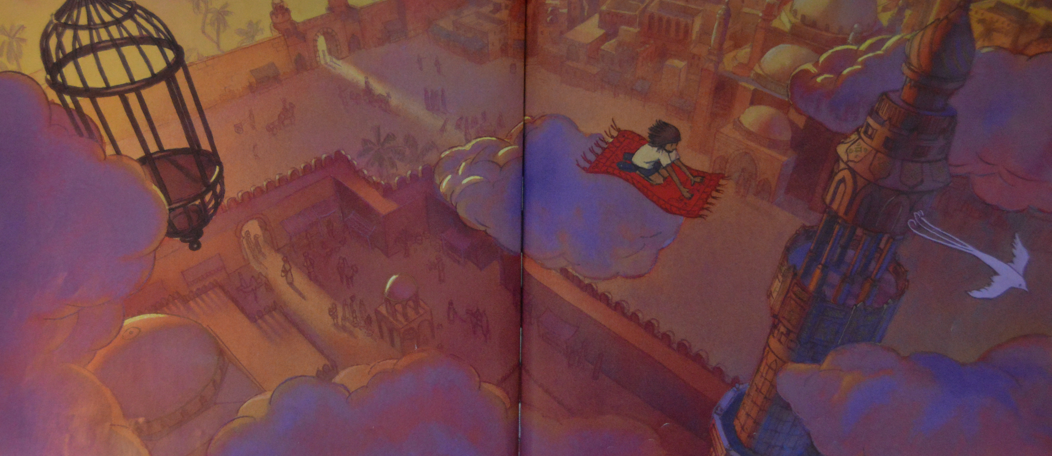

Slide 58
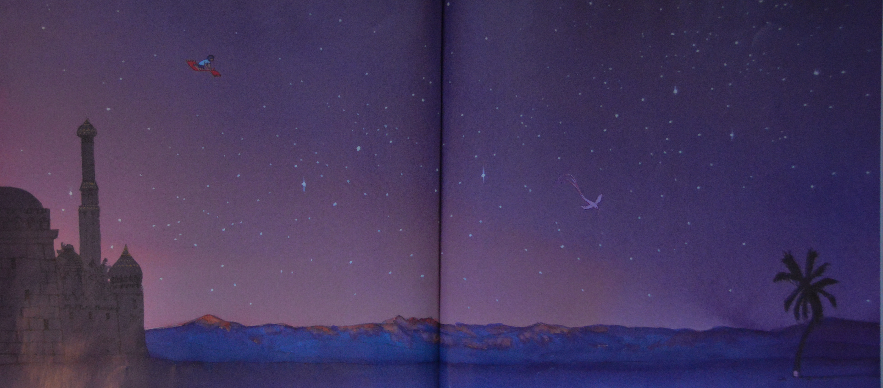

Slide 59
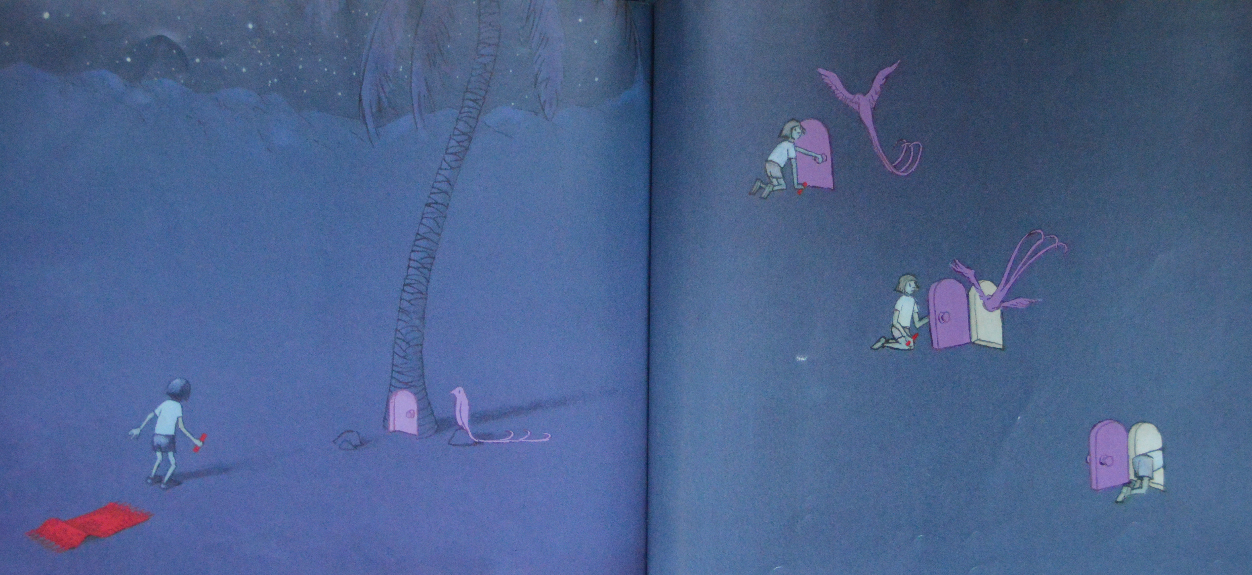

Slide 61
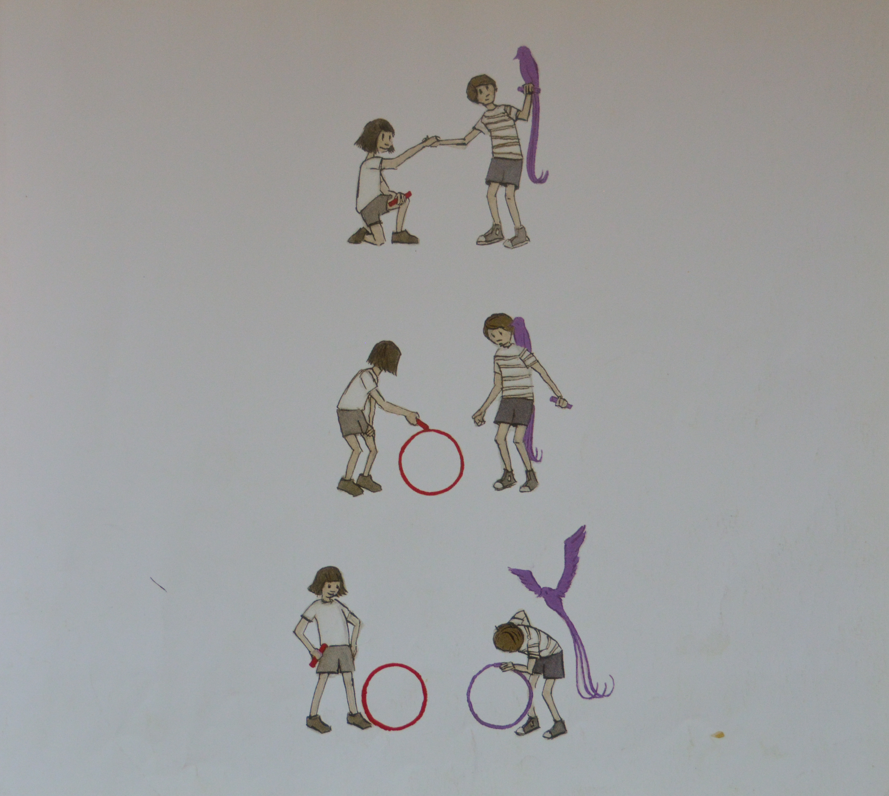

Slide 62
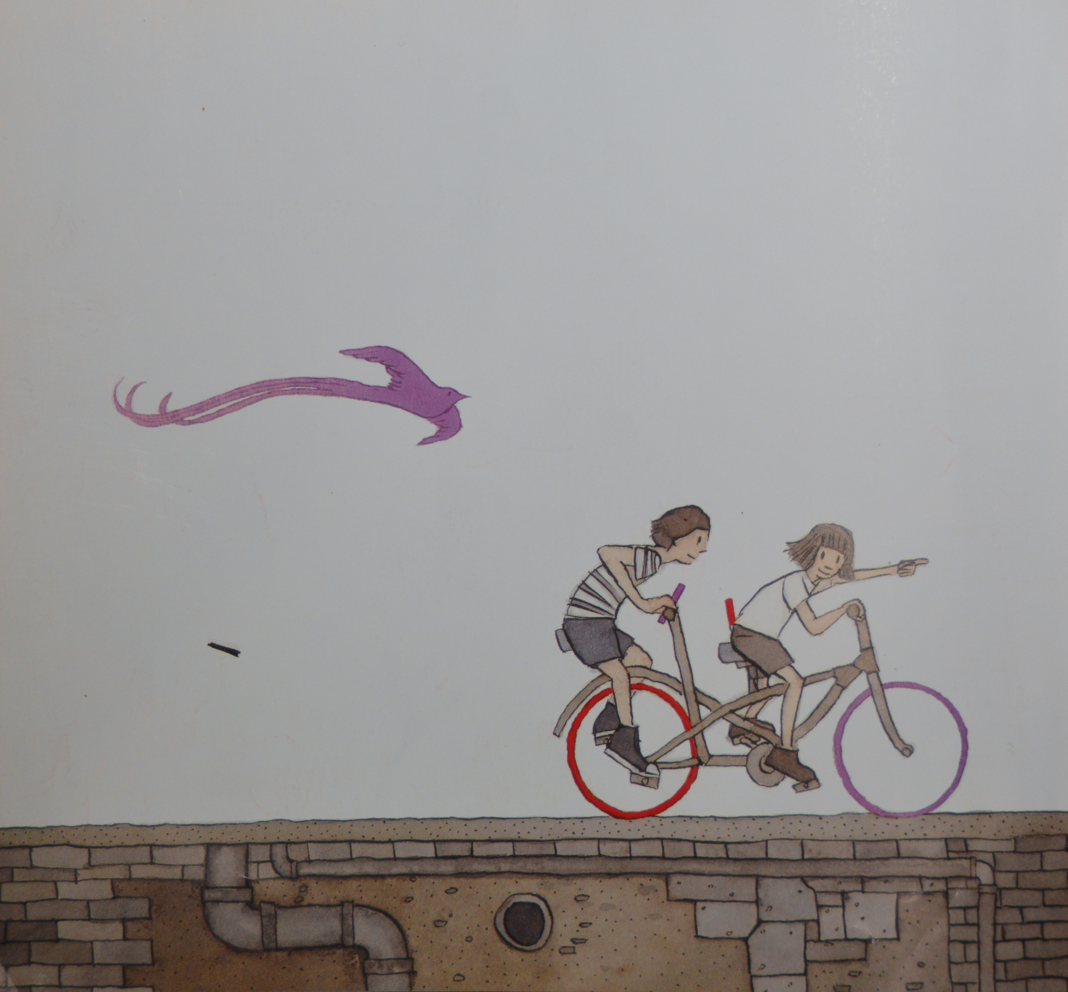

Slide 63
What Was the Experience Like For Us?

Slide 64
Questions and thank you
Karin Mahony, MEd, MSW kmahony@chw.org
Follow the Alliance on Facebook and Twitter @CHAWisconsin

