Slide 1
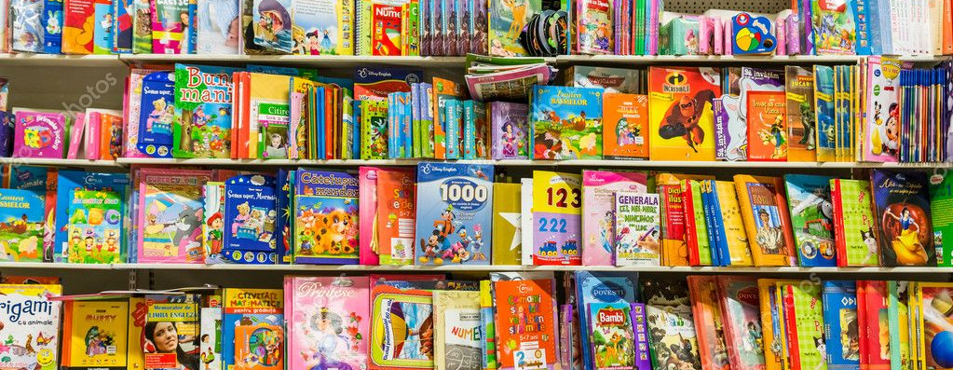
Book Funding for your Reach Out and Read program
By: Jamie L Donath, LPN

Slide 2
Book Funding Sources
z
Monetary donations
Fundraisers
Book donations

Slide 3
Monetary donations
z
Mail/email letters to local businesses
Call local community members
You won’t know the answer until you ask!

Slide 5
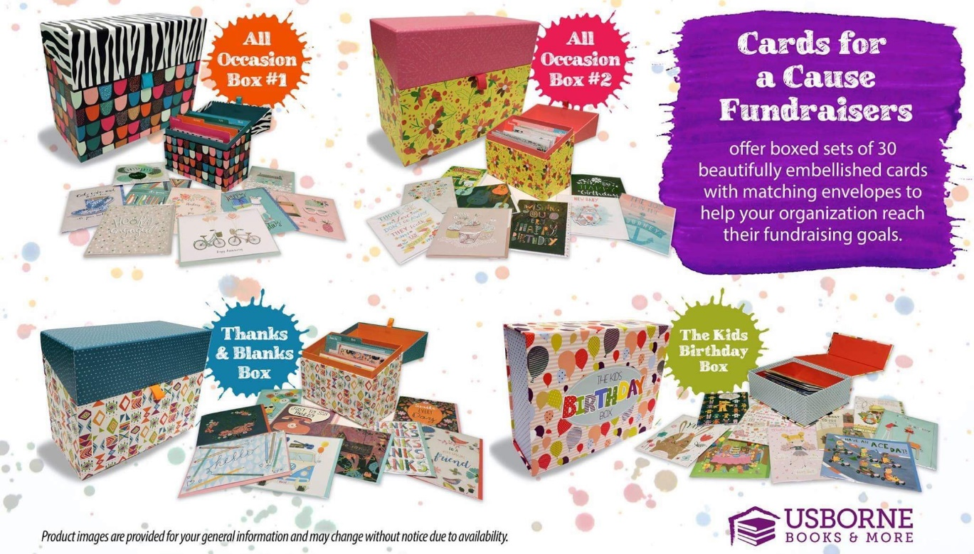
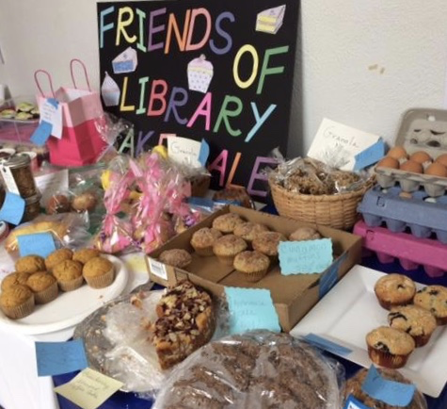
Fundraisers
z
Usborne books greeting cards fundraiser
20 boxes = $375 in Usborne books
Bake sale for community members

Slide 6
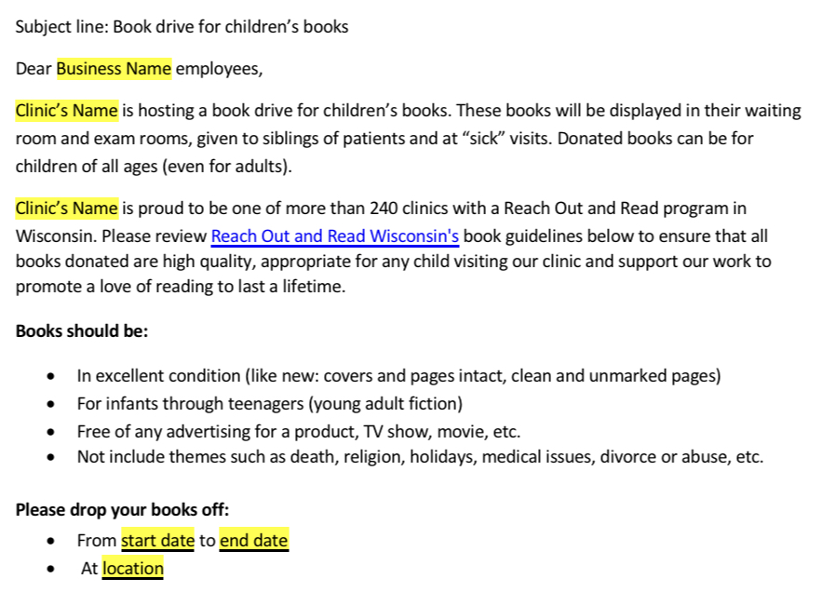
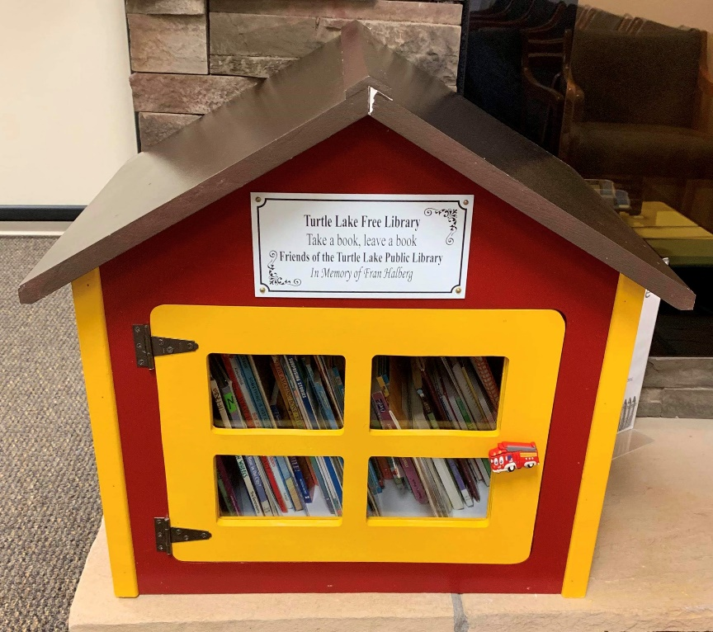
Book donations
z
Book drive within the community or local businesses
Vending machine coupon for every donated book
Book house for gently used books
Take a book, leave a book

Slide 8
Book ordering tips
Find sales
Bulk order
Usborne $2 books
Scholastic classroom account

Slide 9
Questions?
z

Slide 10
Thank you!
z

