Slide 1
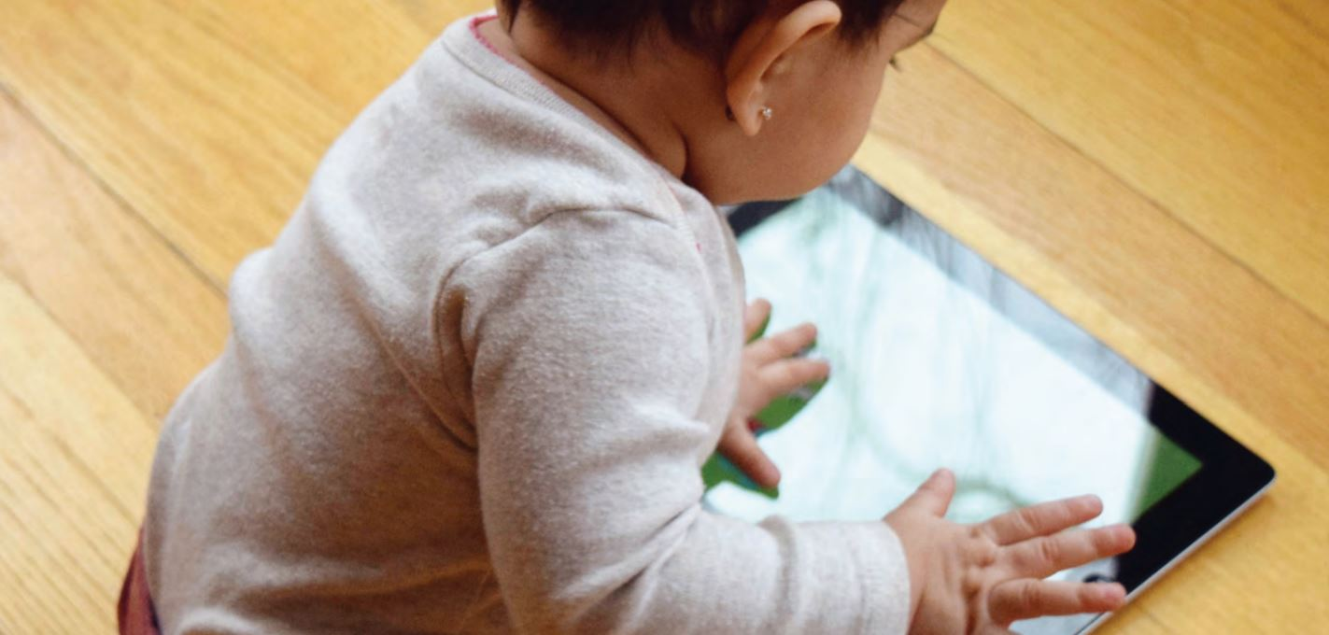
Reading in the digital age: Challenges, opportunities, practical tips
Commonsensemedia.org
October 11, 2019
Reach Out and Read Wisconsin
Tiffany Munzer; Alison Miller; Heidi Weeks; Niko Kaciroti; Jenny Radesky
Notes:
Thank you, I am just so thrilled and grateful for the chance to be here today and to share some of the projects I’ve been working on here with Dr. Radesky and the DBP team.

Slide 2
Disclosures
Academic Pediatric Association and Reach Out and Read
NICHD Grant # 5T32HD079350
No financial conflicts of interests to disclose
Dr. Radesky is paid to write for PBS Kids and is on the board of directors of Melissa and Doug
Notes:
These projects were generously supported by the APA, reach out and read, and a T32 training grant

Slide 3

“Parents are the best toys”
A newborn is legally blind, but can see 8 to 12 inches
  The distance of a human face
  Imitate the facial expressions of others as early as 42 minutes of age
Humans are primed for interaction with each other
Social interaction and parents nurture a child’s mind
Through this, development happens (attachment theory)
Parents are the best “toys”
GettyImages
Notes:
When I was a resident, Dr. Fealy, imparted a piece of wisdom that really stuck with me through training and inspired me to pursue developmental pediatrics. She taught me that “Parents are the best toys.” And for good reason! Parents are the most important and best teachers of children. So why is that?
The evidence shows that babies are biologically hard wired to love interacting with faces, and the first faces they see are their parents, who are socially contingent, responsive, and know their children’s needs and how to engage them more than anyone else. Parents build attachment and it is through this bond that much of the important learning about social-emotional skills, cognitive and language development happen.
To put it simply, parents do a lot! The more I interact with families and patients, and learn about child development, the more respect and deep admiration I have for the work they do.
So if “parents are the best toys,” then the corrallary to this statement is that children learn best from their parents. So if we want to support children as pediatricians, we have to support parents.

Slide 4

“Parents are the best toys”
What parents do really matters for children’s development!
Parents + books
The combination of parents and books can make a lot of magic happen
GettyImages
Notes:
When I was a resident, Dr. Fealy, imparted a piece of wisdom that really stuck with me through training and inspired me to pursue developmental pediatrics. She taught me that “Parents are the best toys.” And for good reason! Parents are the most important and best teachers of children. So why is that?
The evidence shows that babies are biologically hard wired to love interacting with faces, and the first faces they see are their parents, who are socially contingent, responsive, and know their children’s needs and how to engage them more than anyone else. Parents build attachment and it is through this bond that much of the important learning about social-emotional skills, cognitive and language development happen.
To put it simply, parents do a lot! The more I interact with families and patients, and learn about child development, the more respect and deep admiration I have for the work they do.
So if “parents are the best toys,” then the corrallary to this statement is that children learn best from their parents. So if we want to support children as pediatricians, we have to support parents.

Slide 5
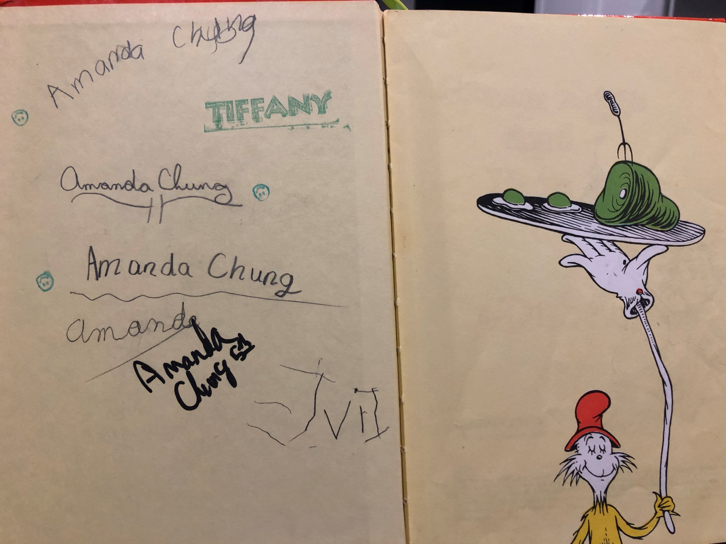
Read, talk, sing
Barnes and Noble, Pixabay
Notes:
And we’ve gone from green eggs and ham to screen apps and instagram

Slide 6
Read, talk, sing
Barnes and Noble, Pixabay
Notes:
And we’ve gone from green eggs and ham to screen apps and instagram

Slide 7
Read, talk, sing
Barnes and Noble, Pixabay
Notes:
And we’ve gone from green eggs and ham to screen apps and instagram

Slide 8
Read, talk, sing
Barnes and Noble, Pixabay
Notes:
And we’ve gone from green eggs and ham to screen apps and instagram

Slide 9
Read, talk, sing
When reading books, parents and children converse more and the words they use are more complex
But book reading has been on the decline recently
Barnes and Noble, Pixabay
Notes:
And we’ve gone from green eggs and ham to screen apps and instagram

Slide 10
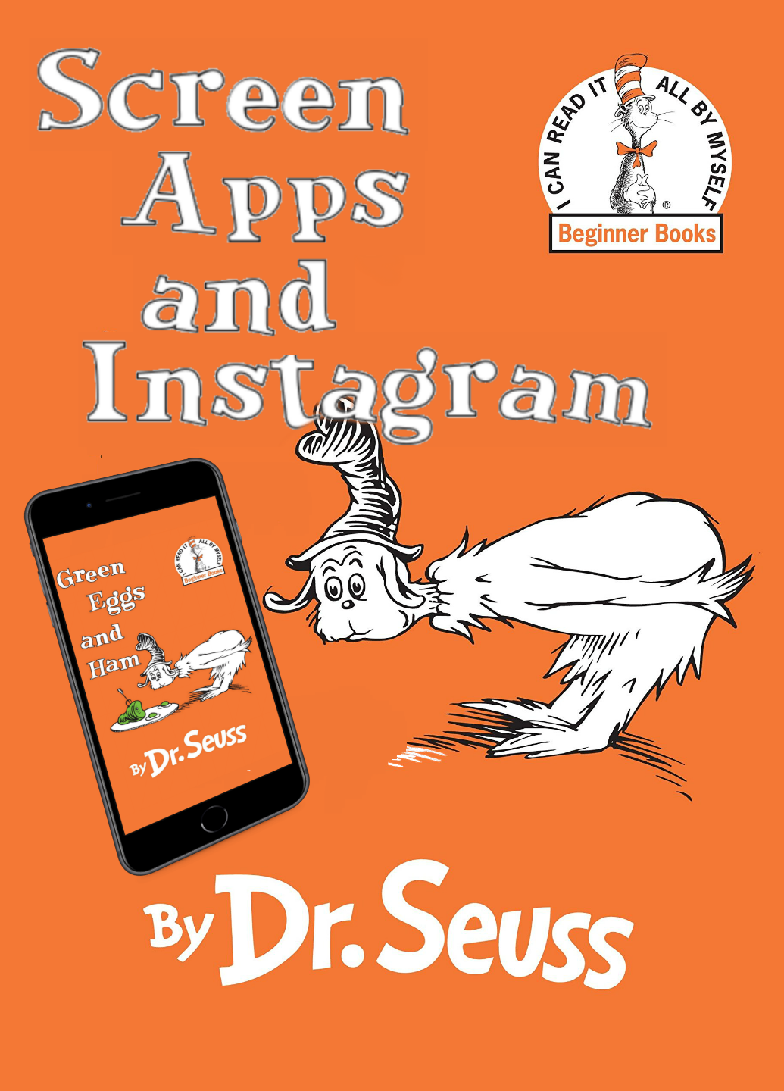
Screen apps and instagram
New screen “toys”
  Screens and apps are marketed as a way to improve children’s development
  Baby Einstein
  Digital preschools
How do these affect children’s development?
Barnes and Noble, Pixabay

Slide 11

Before/after
Screen
Apps
Instagram
Barnes and Noble, Pixabay

Slide 12

Digital Media
Digital “toys” with both benefits and drawbacks
  These benefits and drawbacks are attributable to the way these devices are used the biggest drawbacks is displacement of parenting interactions
  Tough to navigate this landscape (Radesky 2015)
  Families desire to give the best for their children (Radesky 2015)
    Baby Einstein
  No one right answer that works for everyone
Unicef
Notes:
And yet, in clinic and in observation of the world around us, we see digital media as being these ubiquitous, new toys with both benefits and drawbacks. The benefits and drawbacks really stem from the content that they are engaging with, and how they are using digital media as a tool.

Slide 13
Digital Media
Digital “toys” with both benefits and drawbacks
  These benefits and drawbacks are attributable to the way these devices are used
One of the biggest drawbacks is that it might interfere with parents and children interacting together
  Known in more traditional forms of digital media like TV
  Also mobile devices
  Parents feel distracted
  Highly persuasive technology designs
  Families desire to give the best for their children
Domoff 2017, Hiniker 2018, Radesky 2014 &2018, BJ Fogg, Radesky in revision, Radesky 2014
Notes:
However, there is a body of research noting that these digital forms of technology often decrease the quantity and the quality of parenting interactions, with background TV, and also in mobile devices. It’s hypothesized that this occurs because parents feel distracted, possibly due to how captivating and persuasive these technological designs are. Psychological principles of positive reinforcement and reward are used to engage people in their devices.
And, there is a fundamental desire for parents to give the best to their children, and they may look to technology, over their own skills, as a way to do that

Slide 14
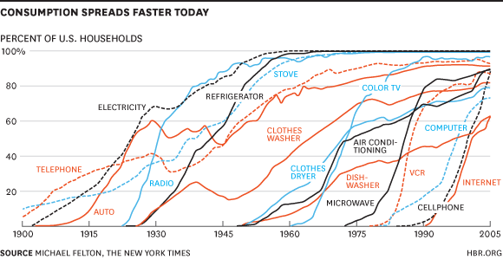
Exponential growth
Notes:
Every time a new technology is developed, it takes a long time to achieve a level of homeostasis
Adoption of the radio took 38 years to reach 50 million people, but adoption of the ipad took 88 days to reach 50 million people

Slide 15
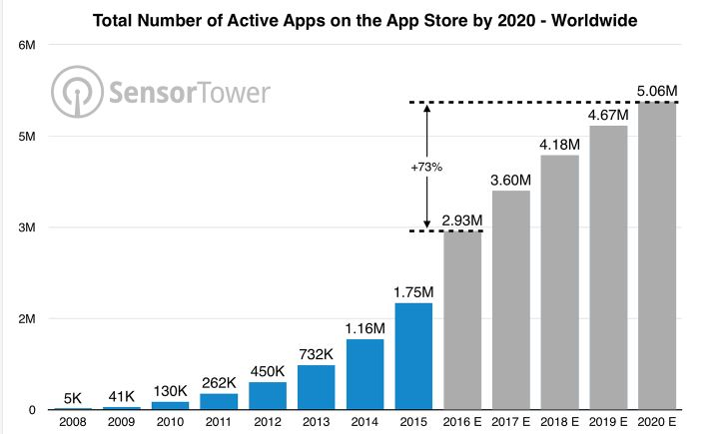
Exponential growth
Technology, apps, and content are all growing and evolving at an exponential pace
Hard to keep up with this growth
Technology is here to stay
SensoryTower

Slide 16
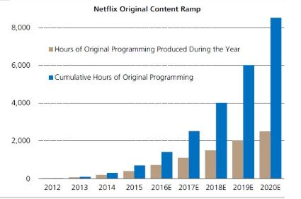
Exponential growth
Technology, apps, and content are all growing and evolving at an exponential pace
Hard to keep up with this growth
Technology is here to stay
SensoryTower, ValueWalk

Slide 17
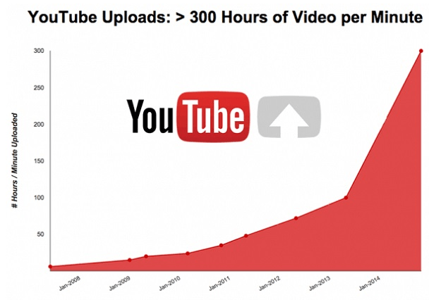
Exponential growth
Technology, apps, and content are all growing and evolving at an exponential pace
Hard to keep up with this growth
Technology is here to stay
SensoryTower, ValueWalk University of North Carolina

Slide 18
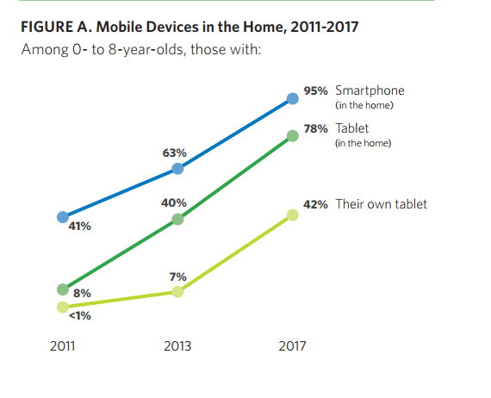
Mobile technology

Slide 19
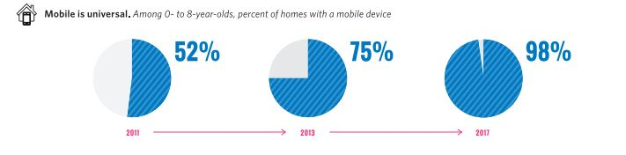
Concomitant increase in use by children
Commonsensemedia.org

Slide 20
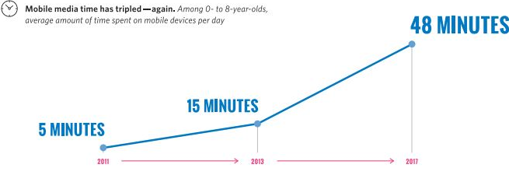
Concomitant increase in use by children
Commonsensemedia.org

Slide 21
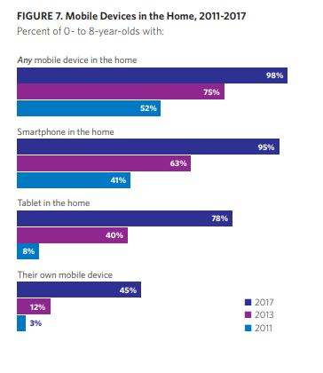
Children have their own devices
Commonsensemedia.org

Slide 22
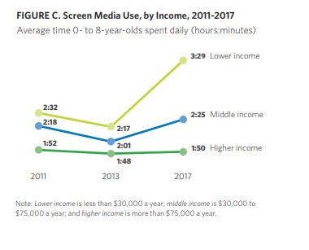
Differences in the way families using
Commonsensemedia.org

Slide 23
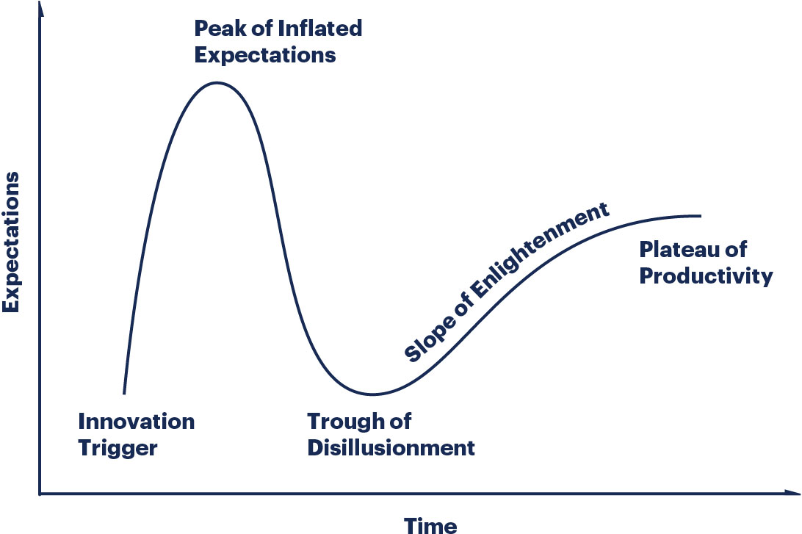
Hype cycle
Gartner.com

Slide 24
Hype cycle
Gartner.com

Slide 25
Health implications: trough of disillusionment
Starting at age 2 years, greater media exposure is associated with obesity
  Decreased satiety cues and capacity to regulate while eating in front of TV
  Exposure to more advertisements
Exposure to advertising of alcohol, sex, and smoking is associated with age of first use.
Poor sleep
  Arousing effects of digital content
Notes:
High levels of TV are associated with greater obesity and cardiovascular risk but these associations start at an early age

Slide 26
Hype cycle
Gartner.com

Slide 27
Hype cycle
Gartner.com

Slide 28
Why is this important?
Super hard for everyone to navigate this new content!
A lot of ways to use technology
  One approach that works for one child may not work for another
Families want more guidance
We are in the business of supporting parents and children
Pediatricians and science is still unsure how this affects child development

Slide 29
Why is this important?
Super hard for everyone to navigate this new content!
A lot of ways to use technology
  One approach that works for one child may not work for another
Families want more guidance
We are in the business of supporting parents and children
Science lags behind the technology

Slide 30
How can we help?
Understand the impact of digital media on parents and developing minds
Understand how different parents and children interact with digital media.
Understand how we can use digital media to work for families to foster child development in an evidence-based way.
Notes:
And so to that end, pediatricians can help ameliorate some of this uncertainty by learning and studying how digital media impacts parents and developing minds.
And when I think about what makes parents so uniquely suited to be the “best toys” for their children, it’s that they know their child the best and can tailor their approach to suit the needs of their children.
The individualized approach that parents have with their children is what I as a pediatrician strive for, to best support our families, so we need to understand how different parenting approaches or characteristics and different types of children or temperamental characteristics affect the way digital media are used.
And lastly, I think we need to learn about how technology can work for our families and not the other way around.

Slide 31
How can we help?
Understand the impact of digital media on parents and developing minds
Understand how different parents and children interact with digital media.
Understand how we can use digital media to work for families to foster child development in an evidence-based way.
Notes:
So going back to the concept of parents being the “best toys” for children, parents are so uniquely qualified to be the “best toys” for their children, because they know their child the best and can tailor their approach to suit the needs of their children.
The individualized approach that parents have with their children is also what pediatricians strive for. To best support our families, we need to understand how different parenting approaches and child characteristic interact with digital media.

Slide 32
How can we help?
Understand the impact of digital media on parents and developing minds
Understand how different parents and children interact with digital media.
Understand how we can use digital media to work for families to foster child development.
Notes:
And lastly, we need to learn about how technology can work for our families and not the other way around.

Slide 33

Our understanding so far
Inspired by Dr. Jenny Radesky
How does media affect parents and children?
CreativityPost.com
CreativityPost.com
Notes:
So with that being said, I’d like to introduce you to our conceptual model. Here is the parent-child dyad

Slide 34
Our understanding so far
Inspired by Dr. Jenny Radesky
How does media affect parents and children?
*
CreativityPost.com
CreativityPost.com
* Sameroff 1975, Bowlby 1951, Bates 1980
Notes:
This blue line represents their interactions

Slide 35

Our understanding so far
Inspired by Dr. Jenny Radesky
How does media affect parents and children?
CreativityPost.com
CreativityPost.com
Notes:
And here is an example of screen media

Slide 36
Our understanding so far
Inspired by Dr. Jenny Radesky
How does media affect parents and children?
CreativityPost.com
CreativityPost.com
*
* Radesky 2014, Kirkorian 2016, Schmidt 2008, Kabali 2015
Notes:
Children and media interact with each other in a way that is bidirectional.

Slide 37
Our understanding so far
Inspired by Dr. Jenny Radesky
How does media affect parents and children?
CreativityPost.com
CreativityPost.com
*
* Radesky 2014, Radesky 2018, Cheever 2014, Reid 2017
Notes:
Similarly, parents and media interact in a way that is bidirectional

Slide 38
Our understanding so far
Inspired by Dr. Jenny Radesky
How does media affect parents and children?
*
CreativityPost.com
CreativityPost.com
* Pempek 2014, Kirkorian 2009, Hiniker 2018, Radesky 2014

Slide 39
Our understanding so far
Inspired by Dr. Jenny Radesky
How does media affect parents and children?
CreativityPost.com
CreativityPost.com
Notes:
But for the scope of today’s talk, I’d like to stick to this simpler model, and talk about two different studies I worked on in fellowship to gain a better understanding of this conceptual model.

Slide 40
Our understanding so far
Inspired by Dr. Jenny Radesky
How does media affect parents and children?
CreativityPost.com
CreativityPost.com
Notes:
The second examined parent-child interactions and how screen media might affect this interaction.

Slide 41
How do we study this?
We have no idea what a “good” parent-child interaction over a mobile or tablet device looks like
Therefore, we chose shared book-reading as the gold standard
Used electronic books on tablet as our comparison or “intervention”

Slide 42

Introduction to ebooks
Joint book reading is important for cognitive and social-emotional development
  Vocabulary, phonemic awareness, and print concepts
  Builds attachment
  Executive functioning and attention
  School success
Rapid increase in mobile devices and ebooks
Parents verbally interact less reading on a device
Distracting enhancements interfere with comprehension
Zerotothree.org
Senechal et al 2002; Snow et al 1998; Storch et al 2001; Zuckerman et al 2009; Mendelsohn 2018
Notes:
So shifting gears a little bit, Shared book reading is one of the most important developmental activities parents and children can engage in. It builds vocabulary by exposing kids to sophisticated language, develops literacy skills such as phonemic awareness (translating letters into meaningful sounds and words), and creates knowledge of print concepts : starting a book from the beginning, turning left to right.
From a social-emotional standpoint, this shared time builds attachments with trusted caregivers and cultivates executive function skills and attentional control.
These concepts lay the ground work for academic success and positive effects of early life reading persist into school age and beyond.

Slide 43
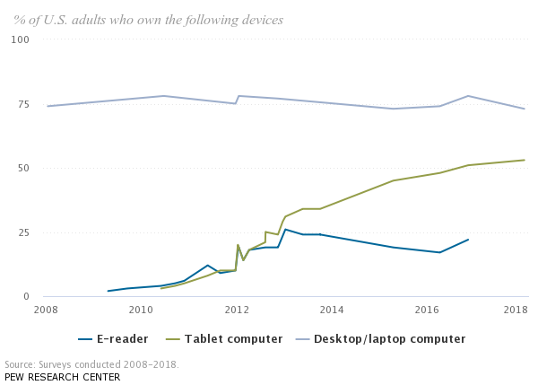
Introduction to ebooks
Joint book reading is important for cognitive and social-emotional development
  Vocabulary, phonemic awareness, and print concepts
  Builds attachment
  Executive functioning and attention
  School success
Rapid increase in mobile devices and ebooks
Parents verbally interact less reading on a device
Distracting enhancements interfere with comprehension
Percent of households owning devices
100
75
50
25
0
2008 2012 2014 2016 2018
Senechal et al 2002; Snow et al 1998; Storch et al 2001; Zuckerman et al 2009; Mendelsohn 2018 ; Pew research 2018
Notes:
However, in recent years, there has been a rapid increase in mobile device ownership by families with more families reading from a device. 75% of households own a tablet which is often used for reading and 25% of households own an e-reading device.

Slide 44
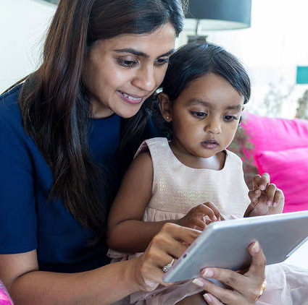
Introduction to ebooks
Joint book reading is important for cognitive and social-emotional development
  Vocabulary, phonemic awareness, and print concepts
  Builds attachment
  Executive functioning and attention
  School success
Rapid increase in mobile devices and ebooks
Parents verbally interact less reading on a device
Distracting enhancements interfere with comprehension
Senechal et al 2002; Snow et al 1998; Storch et al 2001; Zuckerman et al 2009; Pew research 2018; Chiong 2013; Luaricella et al 2014; Kremar 2014
Notes:
Prior research on shared book reading over a device has primarily been done in preschoolers and school-aged children, showing that parents verbally interact less while reading on a device. Additionally, there can be distracting enhancements (such as animation or sound effects) which actually interfere with comprehension.

Slide 45
Toddlers and ebooks
Studies in toddlers found:
  Parents prefer print books (better attention, enjoyment, social interactions)
  In one study testing a novel ebook compared with a print book:
    No differences in types of verbalizations
    More pointing with print
    Better memory of new word condition on ebook
Few studies examined parent-toddler verbal and nonverbal interactions, none used commercially-available books
Strouse et al 2017; Strouse et al 2017
Notes:
Toddlers are a group who have been understudied, but this is an important gap in the literature because toddlers have immature attentional capacity and are more susceptible to enhancements or distractions. They also need more support when reading from a device.
Previous studies in toddlers have found that parents prefer print over ebooks.

Slide 46
Toddlers and ebooks
Studies in toddlers found:
  Parents prefer print books (better attention, enjoyment, social interactions)
  In one study testing a novel ebook compared with a print book:
    No differences in types of verbalizations
    More pointing with print, but better memory of new word condition on ebook Few studies examined parent-toddler verbal and nonverbal interactions, none used commercially-available books
Strouse et al 2017; Strouse et al 2017
Notes:
However, in one study testing a novel ebook compared with a print book, there were no differences in types of verbalizations, more pointing with print, and toddlers had better memory of a new, invented word when they read it on an ebook.

Slide 47
Toddlers and ebooks
Studies in toddlers found:
  Parents prefer print books (better attention, enjoyment, social interactions)
  In one study testing a novel ebook compared with a print book:
    No differences in types of verbalizations
    More pointing with print, but better memory of new word condition on ebook
No studies examined parent-toddler nonverbal interactions, or commercially-available books
Strouse et al 2017; Strouse et al 2017
Notes:
No studies have examined parent-toddler NONVERBAL interactions, meaning their body language, joint attention, parental responsivity, and no studies have utilized commercially-available electronic books.

Slide 48
Aims
In parents and toddlers, want to see if:
  There is less conversation (and lower quality conversation) when reading ebooks versus print
  Quality of nonverbal (social-emotional) interactions lower when reading ebooks versus print
Notes:
Therefore our aims are, in parent-toddler dyads to test the hypotheses that:
Dialogic verbalizations (or rich language used by parents to scaffold their children and facilitate child expressive communication) is lower when reading ebooks

Slide 49
Aims
In parents and toddlers, want to see if:
  There is less conversation (and lower quality conversation) when reading ebooks versus print
  Body language is better (more snuggling, less conflict) when reading ebooks versus print
Notes:
And that the quality of nonverbal or social-emotional interactions are lower when reading ebooks

Slide 50
What we did
37 parents and toddlers (children 24-36 months of age)
Came to lab:
  Free play for 5 mintues
  Reading 15 minutes (enhanced ebook, basic ebook, and print)
  Surveys (Demographics, technology use, BITSEA (toddler behavior), CDI (expressive language)
Notes:
To test these aims, we recruited 37 otherwise healthy, English-speaking participants through an online research portal and community fliers
Within-subjects, counter-balanced, cross-over study design, which essentially means that we randomized families such that an equal number of participants received ebooks first and an equal number received print first.

Slide 51
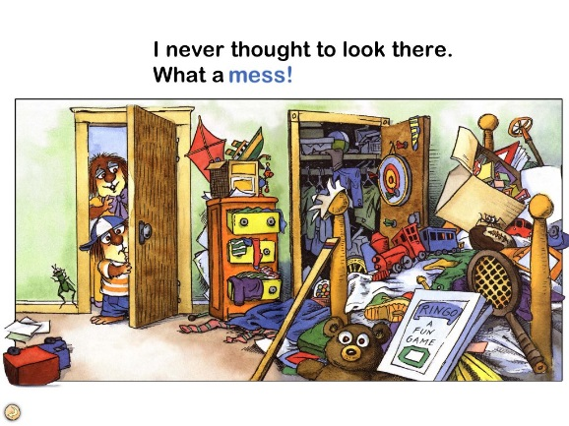

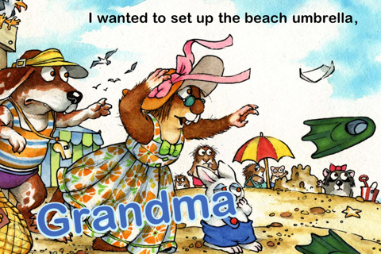
What we did
Print book
Basic ebook
Enhanced ebook
Within-subjects, counter-balanced, cross-over study design
Reading Protocol: 3 books for 5 minutes each
  Books were contained in three open boxes labelled 1-3 on a counter
    Boxes in view of child to observe behavior dysregulation when returning book
  Parents instructed to retrieve books sequentially and to “look at the book” for 5 minutes.
Notes:
The reading protocol included one print, basic ebook, meaning an electronic book with page-turning capabilities, and an enhanced ebook, meaning an electronic book with gamified or interactive features such as sound effects (pushing pictures would produce the name of the picture and an associated animation). We asked parents to select the “read it myself” button for all ebook conditions (such that the machine was not reading the book).
The order of book condition was randomized such that an equal number of participants received a print book first, basic ebook first, and enhanced ebook first.
Parents looked at all three books for five minutes each, for a total of 15 minutes of book reading, which felt just right for most families.

Slide 52
What we watched for
Verbal: During the reading activity, coded presence of parent and child verbalizations in 10-second intervals to reliability (Kappa > 0.70)
  PARENT:
  Dialogic (“What’s happening here?”)
  Nondialogic (“Point to the spider.”)
  Read (Verbatim book text)
  Format (“Turn the page.” “Swipe here.”)
  Negative directive book format (“Don’t touch that button.”)
  Off-task (“Do you need to use the bathroom?”)
  Total: Sum of all of the above
  CHILD:
  Book-related (“Look, a spider.”)
  Negative (“No, I do it.”)
  Other {“Can I have water?”)
Coding schemes adopted from: Whitehurst 1985; Chiong 2013
Notes:
After families completed the protocol, we developed coding schemes adopted from previous studies and categorized parent and child verbalizations in 10-second intervals to reliability.
For parents, we coded for
Dialogic verbalizations, which includes rich language parents use to scaffold their children, such as open-ended questions or relating the book back to a child’s experience
Nondialogic verbalizations, which are related to the book, but more simple prompts or comments than dialogic verbalizations
Parent reading the text verbatim
Format verbalizations, which are related to aspects of using the book like turn the page or tap that picture
Negative directives about the book format like don’t touch that button or don’t turn up the volume
And off-task and total verbalizations

Slide 53
What we watched for
Verbal: During the reading activity, coded presence of parent and child verbalizations in 10-second intervals to reliability (Kappa > 0.70)
  PARENT:
  Dialogic (“What’s happening here?”)
  Nondialogic (“Point to the spider.”)
  Read (Verbatim book text)
  Format (“Turn the page.” “Swipe here.”)
  Negative directive book format (“Don’t touch that button.”)
  Off-task (“Do you need to use the bathroom?”)
  Total: Sum of all of the above
  CHILD:
  Book-related (“Look, a spider.”)
  Negative (“No, I do it.”)
  Off-task (“Can I have water?”)
Coding schemes adopted from: Whitehurst 1985; Chiong 2013
Notes:
Similarly, child utterances were coded into book-related, negative, and off-task verbalizations

Slide 54
What we watched for
Frequency of pushing escape button (or closing book), child tablet grabbing, parent/child pushing hand away during book reading (interception), and moving the book away from the other (pivot).
Solitary space: Child creates a space that prevents parents from easily viewing the book.
Currently coding:
  Mind-mindedness
Coding schemes adopted from: Hiniker et al 2018; Sonnenchien et al. 2002;

Slide 55
What we watched for
Nonverbal Global Codes (scale of 1-5, 5 is best outcome):
  Shared positive affect: Smiling, laughing together, enjoyment of the activity (ICC = 0.84).
  Collaborative book reading: parent-child proximity, shared possession of the book, parental responsiveness (ICC = 0.75).
  Currently coding:
    Solitary space
    Frequency of pushing home screen, tablet grabbing, parent/child pushing hand away during book reading
    Parent engagement
    Mind-mindedness
Coding schemes adopted from: Hiniker et al 2018; Sonnenchien et al. 2002;
Notes:
To quantify the quality of reading experience, we also coded for nonverbal global codes on a scale of one through five with five being the best possible outcome. We quantified shared positive affect (smiling, laughing together), and collaborative book reading experience (which included elements of dyad proximity, shared possession of the book, mutual synchrony, and parental responsiveness)

Slide 56
Methods– analysis plan
Conducted a 3-way repeated measures ANOVA for each parent and child interaction outcome
  Enhanced vs print
  Enhanced vs basic
  Basic vs print
Adjusted for covariates with p <.05 to improve model fit
Notes:
A 3-way anova was used to analyze each parent and child outcome by book format, meaning we compared dyads to themselves since they each read enhanced, basic, and print books.
We adjusted for covariates with p<.05

Slide 57
Results– Participant characteristics
Study sample | n =37, n (%)
Child age (months) | 29.2 (SD = 4.2)
Parent age (years) | 33.5 (SD = 4.0)
Parent relationship to child Mother Father | 30 (81.1%) 7 (18.9%)
Child sex Male Female | 20 (54%) 17 (46%)
Child race/ethnicity White, non-Hispanic Black, non-Hispanic Hispanic or other | 21 (56.8%) 6 (16.2%) 10 (27.0%)
Parent education Some college courses 2-year college degree 4-year college degree More than 4-year college degree | 4 (10.8%) 5 (13.5%) 14 (37.8%) 14 (37.8%)
Parent marital status Single Married | 4 (10.8%) 33 (89.2%)
Notes:
So delving into our results, our sample was primarily mothers, with an even split of boys and girls, with diverse ethnic and educational backgrounds

Slide 58
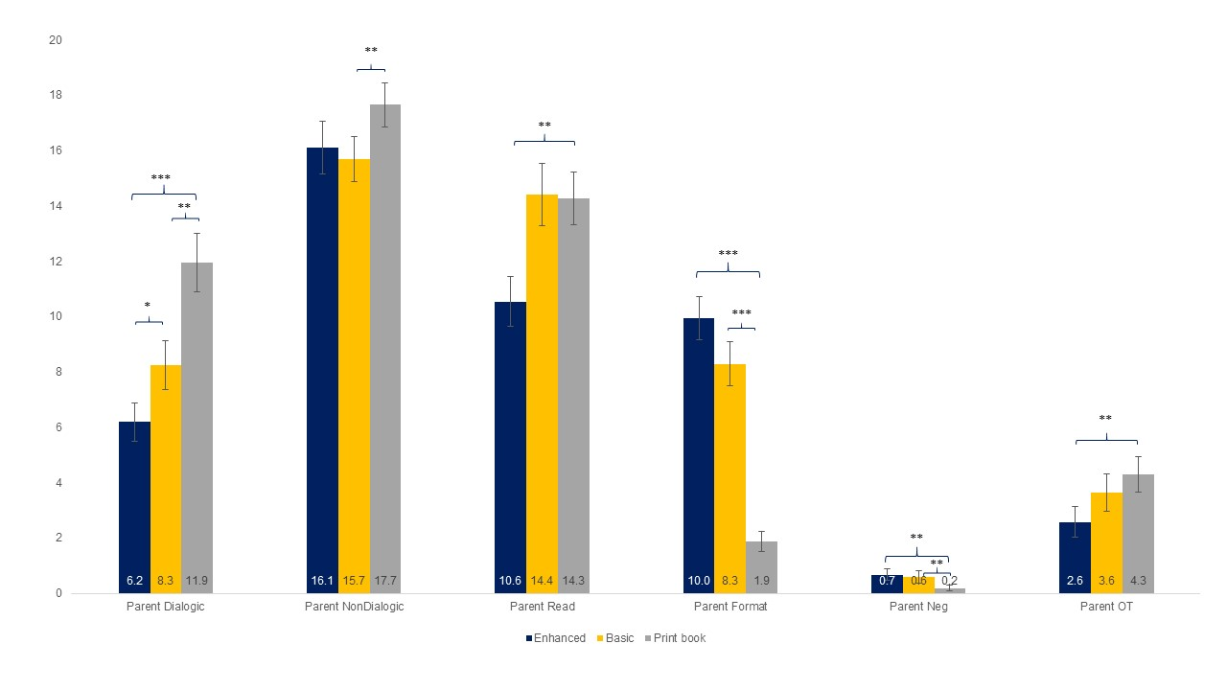
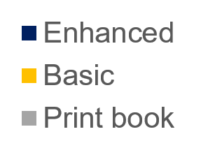
Results- parent verbalizations
20
18
16
14
12
10
8
6
4
2
0
Dialogic
Nondialogic
Read
Format
Negative
Off-task
Munzer et al 2018, under revision
Notes:
Alright, now to get to our results. to orient you to these slides, the x-axis has parent verbal categories. The y-axis has number of intervals containing verbalizations in each category. The dark blue is the enhanced ebook, yellow is basic, and grey is print.

Slide 59
More dialogic verbalizations in print
20
18
16
14
12
10
8
6
4
2
0
Dialogic
Munzer et al 2018, under revision
Notes:
Let’s go through each category one by one. There were more dialogic verbalizations in print versus ALL types of ebooks

Slide 60
More non-dialogic verbalizations in print
20
18
16
14
12
10
8
6
4
2
0
Nondialogic
Munzer et al 2018, under revision
Notes:
More parent nondialogic verbalizations in print books versus basic ebooks

Slide 61
More reading in basic and print
20
18
16
14
12
10
8
6
4
2
0
Read
Munzer et al 2018, under revision
Notes:
Parents read the text more in print and basic ebooks compared with enhanced ebooks

Slide 62
More format verbalizations in ebook
20
18
16
14
12
10
8
6
4
2
0
Format
Munzer et al 2018, under revision
Notes:
Parents made more format verbalizatiosn in all types of ebooks compared with print

Slide 63
More negative verbalizations in ebooks
20
18
16
14
12
10
8
6
4
2
0
Negative
Munzer et al 2018, under revision
Notes:
Similarly, parents also had more negative verbalizations related to format in both ebook conditions compared with print

Slide 64
More off-task verbalizations in print
20
18
16
14
12
10
8
6
4
2
0
Off-task
Munzer et al 2018, under revision
Notes:
And more off-task verbalizations in print versus enhanced ebooks

Slide 65
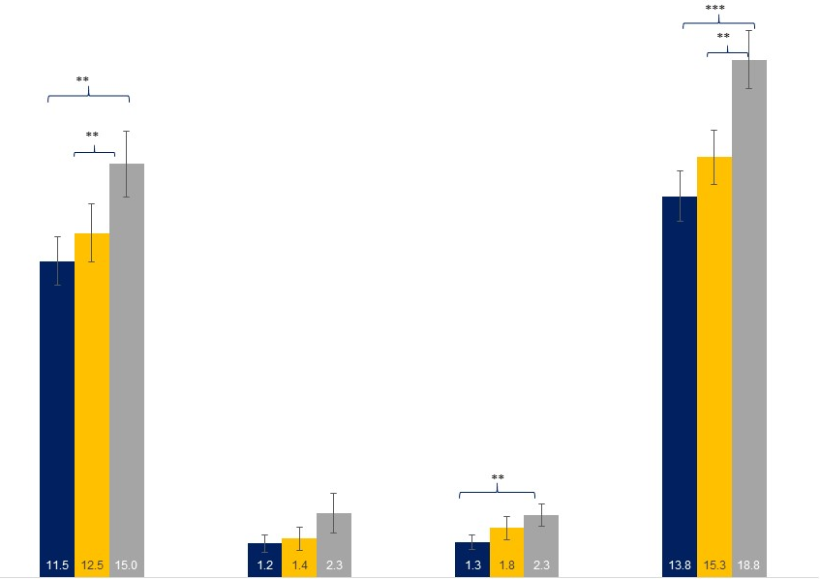
Results- child verbalizations
20
18
16
14
12
10
8
6
4
2
0
*
Book-related
Negative
Off-task
Total
Munzer et al 2018, under revision
Notes:
We had similar results for child verbalizations

Slide 66
More book verbalizations in print
20
18
16
14
12
10
8
6
4
2
0
*
Book-related
Munzer et al 2018, under revision
Notes:
There were more book-related verbalizations in print versus any type of ebook

Slide 67
No difference in negative verbalizations
20
18
16
14
12
10
8
6
4
2
0
*
Negative
Munzer et al 2018, under revision
Notes:
No differences in negative verbalizations

Slide 68
More off-task in print
20
18
16
14
12
10
8
6
4
2
0
*
Off-task
Munzer et al 2018, under revision
Notes:
More off-task in print versus enhanced ebook

Slide 69
More total verbalizations in print
20
18
16
14
12
10
8
6
4
2
0
*
Total
Munzer et al 2018, under revision
Notes:
And lastly, more total verbalizations in print versus any type of ebook

Slide 70
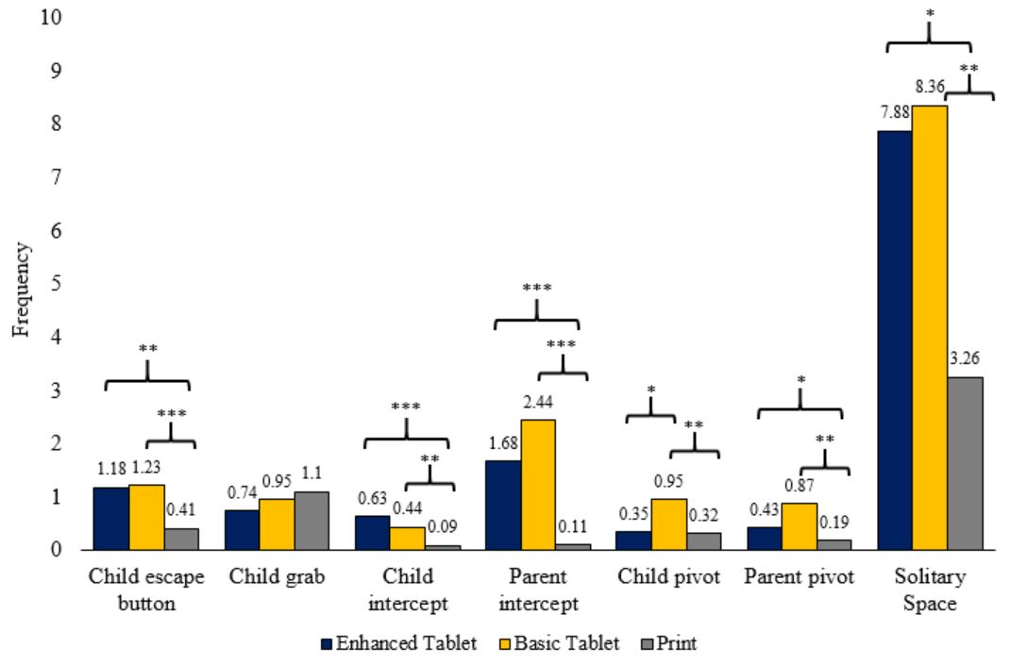
Discrete nonverbal behaviors
10
9
8
7
6
5
4
3
2
1
0
Child escape
Child grab
Child intercept
Parent intercept
Child pivot
Parent pivot
Solitary space
Munzer et al 2018, in preparation

Slide 71
Child escaping book more in ebooks
10
9
8
7
6
5
4
3
2
1
0
Child escape
Munzer et al 2018, in preparation

Slide 72
No differences in child grabbing book
10
9
8
7
6
5
4
3
2
1
0
Child grab
Munzer et al 2018, in preparation

Slide 73
More child interceptions in ebooks
10
9
8
7
6
5
4
3
2
1
0
Child intercept
Munzer et al 2018, in preparation

Slide 74
More parent interceptions in ebooks
10
9
8
7
6
5
4
3
2
1
0
Parent intercept
Munzer et al 2018, in preparation

Slide 75
More child pivots in basic ebook
10
9
8
7
6
5
4
3
2
1
0
Child pivot
Munzer et al 2018, in preparation

Slide 76
More parent pivots in basic ebook
10
9
8
7
6
5
4
3
2
1
0
Parent pivot
Munzer et al 2018, in preparation

Slide 77
More solitary space in ebooks
10
9
8
7
6
5
4
3
2
1
0
Solitary space
Munzer et al 2018, in preparation

Slide 78
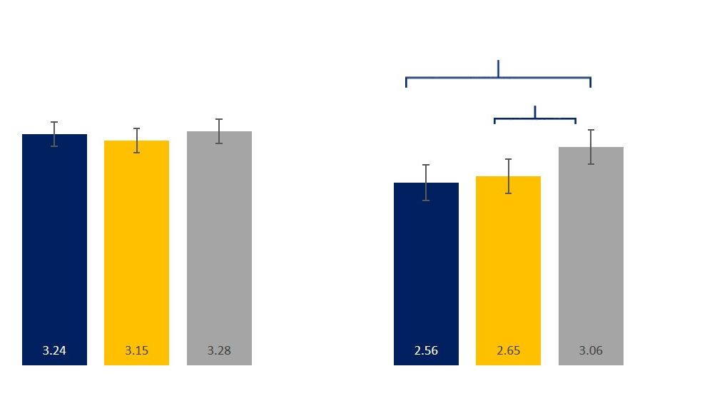
Social-emotional results
**
4
3
2
1
0
*
Shared positive affect
Collaborative book reading
Munzer et al 2018, under revision
Notes:
Here are our social-emotional results

Slide 79
No differences in shared positive affect
**
4
3
2
1
0
*
Shared positive affect
Collaborative book reading
Munzer et al 2018, under revision
Notes:
There was no difference in shared positive affect

Slide 80
More collaborative reading in print
**
4
3
2
1
0
*
Shared positive affect
Collaborative book reading
Munzer et al 2018, under revision
Notes:
Print books produced more collaborative book reading than any type of ebook.

Slide 81
Implications
With tablets, parents and children had less conversation, the quality was lower, and they read less compared with print books
Parents focused more on the technology itself
Notes:
Similarly, when reading ebooks, children make fewer book-related and total verbalizations compared with print books, which is likely a result of children attending to or being distracted by the enhancements.
Conclusions: Concept that the affordances of the objects design makes it easier vs harder to verbally and nonverbally interact and the importance of this for transferring knowledge from tablets/media or for learning words/literacy.
- Tablets are highly engaging, but the quality of engagement around reading is different.

Slide 82
Implications
Parents and children also struggled to control the book with tablets
Children’s body language was often turned away from their parents.
This may be affecting the quality of the reading experience AND the conversation
Quality of the experience was higher when reading print books.

Slide 83
Implications
It was not just the tablet enhancements that were interfering with quality of reading, but also the tablet itself Parents and children may have preconceived notions of how to interact with a tablet
  Designed to be a personal device, so may not facilitate shared reading between two individuals
  Children may have learned that the tablet is really just for “play”
  But, this is important because prior research has shown that just “tapping” or “swiping” is not enough to learn from

Slide 84
Implications
It was not just the tablet enhancements that were interfering with quality of reading, but also the tablet itself
Parents and children interacted less together on tablet ebooks
  But, this is important because prior research has shown that just “tapping” or “swiping” is not enough to learn from, and toddlers still need a lot of parent help to learn from screens
Parents and children may have preconceived notions of how to interact with a tablet
  Designed to be a personal device, so may not facilitate shared reading between two individuals
  Children may have learned that the tablet is really just for “play”

Slide 85
Implications
It was not just the tablet enhancements that were interfering with quality of reading, but also the tablet itself
Parents and children interacted less together on tablet ebooks
  But, this is important because prior research has shown that just “tapping” or “swiping” is not enough to learn from, and toddlers still need a lot of parent help to learn from screens
Parents and children may have ideas of how to use a tablet (or may not know how)
  Designed to be a personal device, so may not facilitate shared reading between two individuals
  Children may have learned that the tablet is really just for “play”

Slide 86
Implications
Limitations: Few participants, ebooks are new to this group
We still want to recommend print books over electronic books, especially in this age group
Though experts recommend co-viewing media together, it may be harder to do on tablets
This study taught me a lot about specific ways that tablet play may interfere with parents and children’s relationships
Notes:
Finally, given the decreased quantity of parent-child verbalizations and quality of interactions occurring over ebooks versus print, pediatricians may wish to consider recommending print books over ebooks for toddlers and their parents.

Slide 87
“Parents are still the best toys”
Despite the rise in new digital toys, parents are still the best toys!
These were only two studies, and many more questions to answer
Notes:
So all of this information is to just echo what Dr. Fealy taught me five years ago, that Parents really are the best toys, even with all the rising availability of digital toys. As a pediatrician, I’d like to learn more about the ways that media function to support or hinder how parents interact with children and look forward to a lifetime of getting to support families.
Thank you!

Slide 88

Where do we go from here?
If tablets shouldn’t babysit our toddlers, who will!?
Digital technologies very much a part of daily life
We need to learn how to make these technologies work for families
Changes from the top down– and not just at the individual level (it’s not you, it’s them!)
Notes:
So all of this information is to just echo what Dr. Fealy taught me five years ago, that Parents really are the best toys, even with all the rising availability of digital toys. As a pediatrician, I’d like to learn more about the ways that media function to support or hinder how parents interact with children and look forward to a lifetime of getting to support families.
Thank you!

Slide 89
Where do we go from here?
If tablets shouldn’t babysit our toddlers, who will!?
Digital technologies very much a part of daily life
We need to learn how to make these technologies work for families
Changes from the top down– and not just at the individual level (it’s not you, it’s them!)
Notes:
So all of this information is to just echo what Dr. Fealy taught me five years ago, that Parents really are the best toys, even with all the rising availability of digital toys. As a pediatrician, I’d like to learn more about the ways that media function to support or hinder how parents interact with children and look forward to a lifetime of getting to support families.
Thank you!

Slide 90
Where do we go from here?
If tablets shouldn’t babysit our toddlers, who will!?
Digital technologies very much a part of daily life
We need to learn how to make these technologies work for families
Changes from the top down– and not just at the individual level (it’s not you, it’s them!)
Notes:
So all of this information is to just echo what Dr. Fealy taught me five years ago, that Parents really are the best toys, even with all the rising availability of digital toys. As a pediatrician, I’d like to learn more about the ways that media function to support or hinder how parents interact with children and look forward to a lifetime of getting to support families.
Thank you!

Slide 91
Where do we go from here?
If tablets shouldn’t babysit our toddlers, who will!?
Digital technologies very much a part of daily life
We need to learn how to make these technologies work for families
Changes from the top down– and not just at the individual level (it’s not you, it’s them!)
Notes:
So all of this information is to just echo what Dr. Fealy taught me five years ago, that Parents really are the best toys, even with all the rising availability of digital toys. As a pediatrician, I’d like to learn more about the ways that media function to support or hinder how parents interact with children and look forward to a lifetime of getting to support families.
Thank you!

Slide 92
Changes to technology/policy
Parents do a ton already!
Technology design changes:
  Privacy protections have not kept pace in the digital environment
  Industry and policy makers need to understand children’s limits
  Decrease tracking on devices and selling data to third parties
  Create more appropriate content
  Limit ads for children
Notes:
High levels of TV are associated with greater obesity and cardiovascular risk but these associations start at an early age

Slide 93
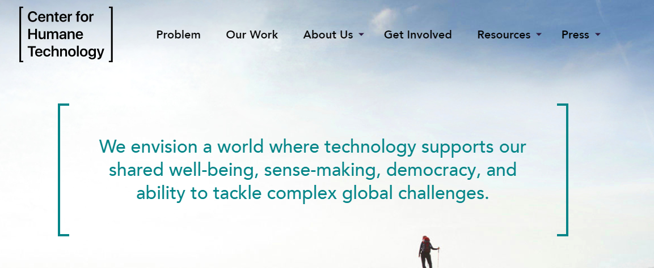
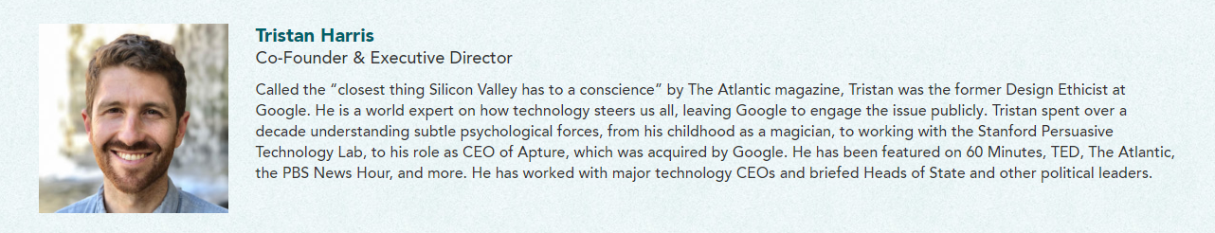
Changes to technology/policy
Notes:
High levels of TV are associated with greater obesity and cardiovascular risk but these associations start at an early age

Slide 94
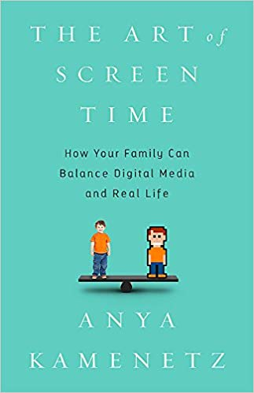
General rules
From Anya Kamenetz’s book, The Art of Screen Time:
  Enjoy screen media
  And with others
  Not too much
  And safely/respectfully

Slide 95
General rules
From Anya Kamenetz’s book, The Art of Screen Time:
  Enjoy screen media
  And with others
  Not too much
  And safely/respectfully

Slide 96
General rules
From Anya Kamenetz’s book, The Art of Screen Time:
  Enjoy screen media
  And with others
  Not too much
  And safely/respectfully

Slide 97
General rules
From Anya Kamenetz’s book, The Art of Screen Time:
  Enjoy screen media
  And with others
  Not too much
  And safely/respectfully

Slide 98
Practical tips: Enjoy together
Use media in social/creative ways, not to displace sleep, exercise, and in-person social opportunities
  Video chat, which brings people together
  Age-appropriate shows and games
  Play video games together, which helps teach sportsmanship
RESOURCES: Commonsensemedia.org
Youtube Kids
AAP Media and Young Minds Radesky et al. 2016

Slide 99
Practical tips: Enjoy together
Use media in social/creative ways, not to displace sleep, exercise, and in-person social opportunities
  Video chat, which brings people together
  Age-appropriate shows and games
  Play video games together, which helps teach sportsmanship
RESOURCES: Commonsensemedia.org
Youtube Kids
AAP Media and Young Minds Radesky et al. 2016

Slide 100
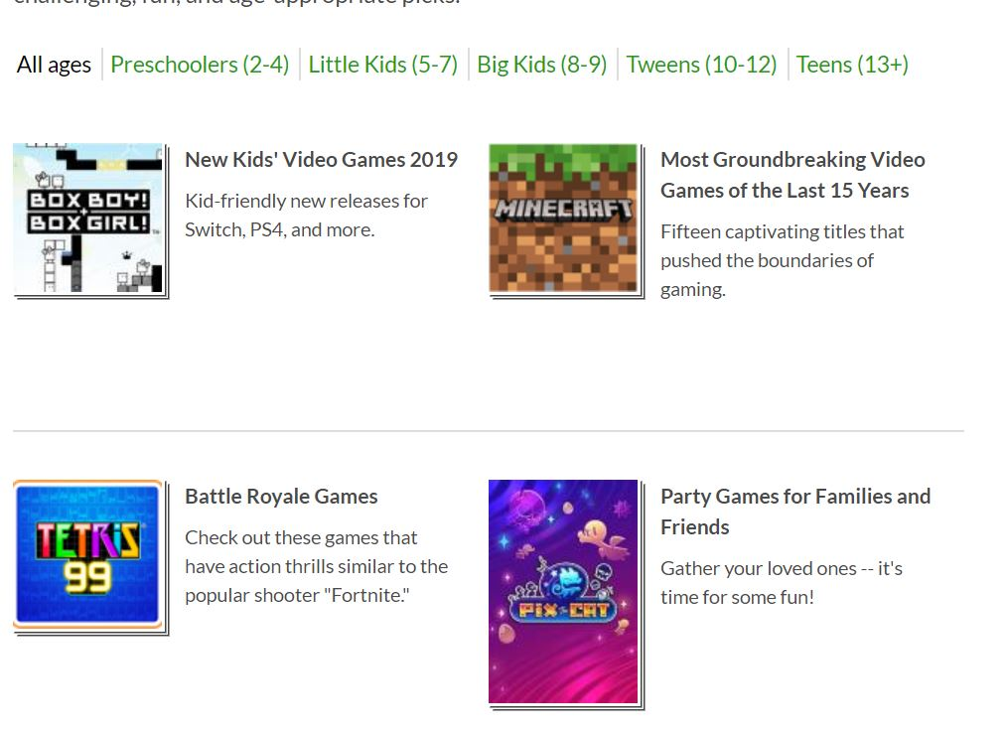
Practical tips: Enjoy together
Commonsensemedia.org

Slide 101
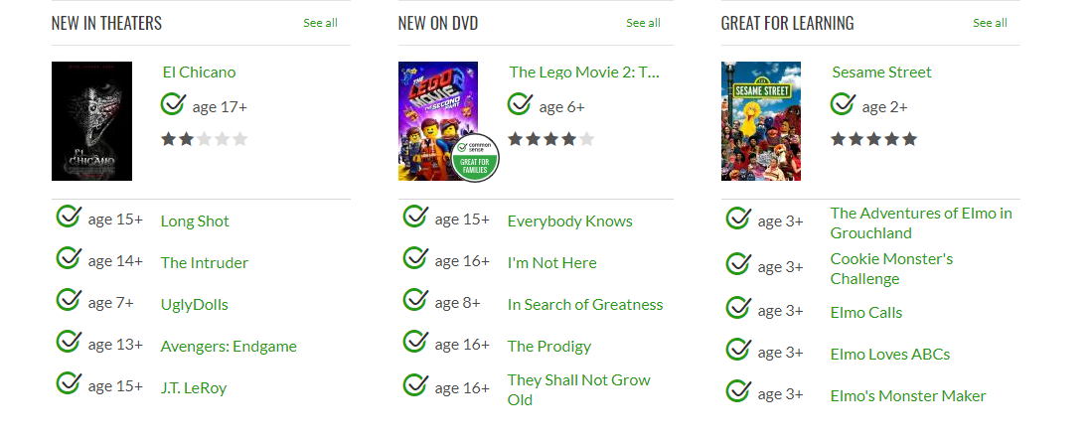
Practical tips: Enjoy together
Commonsensemedia.org

Slide 102
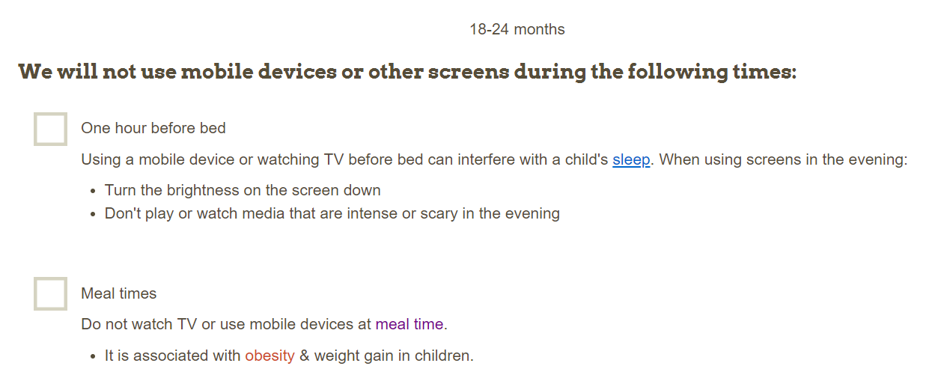
Practical tips: Not too much
Children younger than 18 months, discourage use of screen media other than video-chatting
Create unplugged spaces/times
  Dinner time
  Bedrooms
RESOURCE: Family Media Plan from healthychildren.org American Academy of Pediatrics
Notes:
These times are important opportunities to catch up with family members and share about the day.
Because screens emit blue light at night which stimulates production of melatonin, if possible to avoid screens an hour before bedtime (and fill this time with shared reading and getting ready for bed to wind down)

Slide 103
Practical tips: Not too much (apps)
Very few of the commercially available apps found in the educational section of app stores are actually educational!
Recent reviews of hundreds of toddler/preschooler apps labeled as educational demonstrated that most apps show low educational potential:
  target only rote academic skills (eg, ABCs, colors)
  not based on established curricula
  include almost no input from developmental specialists or educator
Meyer + Radesky 2018; Hirsch-Pasek 2016

Slide 104
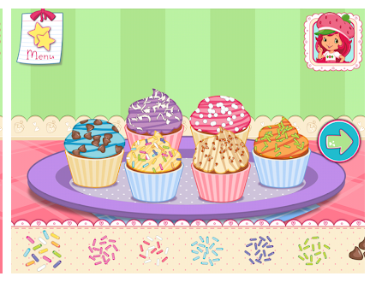
Practical tips: Not too much (apps)
Sesame Workshop has a team of psychologists without advertisements and they silence the device trackers
Marisa Meyer and Jenny Radesky played 135 apps for kids age 5 and less
  Found lots of inappropriate ads and content for kids (e.g.: mental health resources, etc.)
  Coercive strategies asking for in-app purchases (strawberry shortcake)
Meyer + Radesky 2018; Hirsch-Pasek 2016

Slide 105
Practical tips: Safety and respect
Teach your child how to be a digital citizen
  Rules for how to use technology respectfully
    Respecting privacy, not being rude online, and telling a parent or trusted adult if being bullied or disrespectful online
  Rules for digital safety
    Avoid giving out personal information, sharing private photos, text and drive/cross street
    Do not befriend or chat with someone without parent’s permission
    Also teaching about advertisements
      Children are at particular risk of not understanding what might be an advertisement versus not

Slide 106
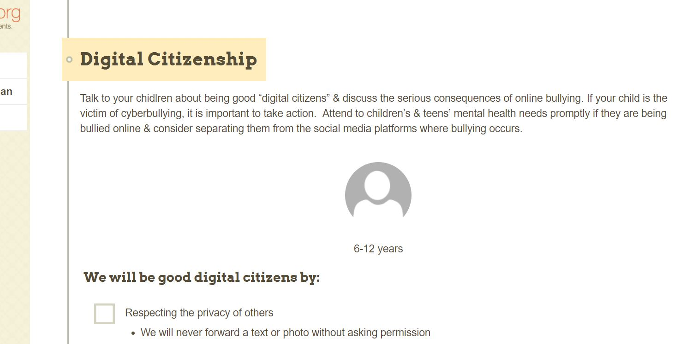
Practical tips: Safety and respect

Slide 107
Practical tips: Summary
Encourage parents to choose educational and prosocial content
  May need to preview apps beforehand
Create unplugged spaces
Use media in social/creative ways, not to displace sleep, exercise, and play
  Hands-on, unstructured, and social play important
AAP Media and Young Minds Radesky et al. 2016

Slide 108
Practical tips: Summary
Younger children don’t have the ability to learn yet from digital media ( babies and toddlers)
  Children younger than 18 months, discourage use of screen media other than video-chatting
  Children 18-24 months, choose high-quality programming and view together
For school age children, watch and play together– encourages interactions, bonding, sportsmanship
  If you can’t watch with them read a summary about the show/activity and ask your children later
Avoid the use of technology reactively to calm children down
AAP Media and Young Minds Radesky et al. 2016
Notes:
Children need to be able to identify and handl strong emotions– tech as a go-to strategy for calming emotions may not be practical or effective!

Slide 109
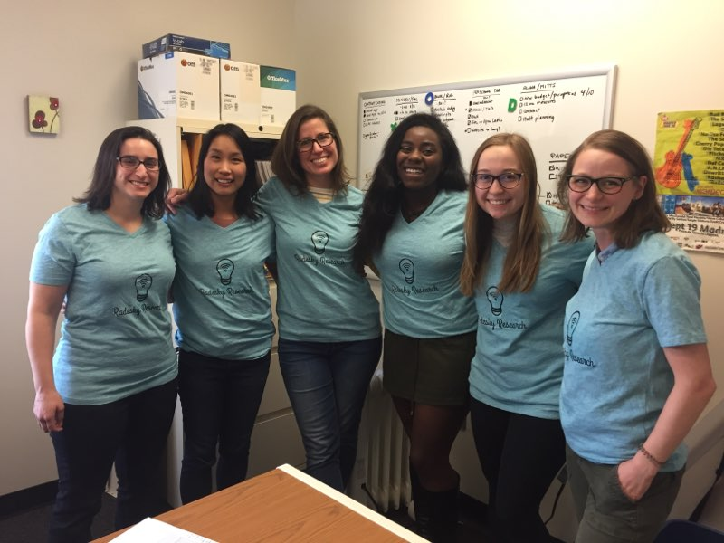
Special thanks to:
Jenny Radesky
Rosa Ball
Heidi Weeks
Alison Miller
Julie Lumeng
Joy Boakye
Anastasia Pacifico
Ranya Alkayhat
Barbara Felt
Prachi Shah
Megan Pesch
My amazing co-fellows, Chioma, Megan, Kim, and Jackie
Participants and families
Reach Out and Read, Academic Pediatric Association
Family and friends
Notes:
Thank you so much to you for your attention and a special thank you to my truly incredible mentor, Jenny Radesky, diligent research team, participants/families, and Reach out and Read/APA for this

Slide 110
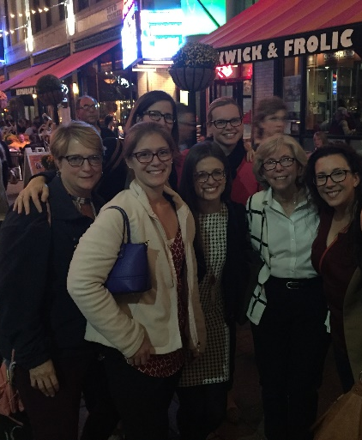
Special thanks to:
Jenny Radesky
Rosa Ball
Heidi Weeks
Alison Miller
Julie Lumeng
Joy Boakye
Anastasia Pacifico
Ranya Alkayhat
Barbara Felt
Prachi Shah
Megan Pesch
My amazing co-fellows, Chioma, Megan, Kim, and Jackie
Participants and families
Reach Out and Read, Academic Pediatric Association
Family and friends
Notes:
Thank you so much to you for your attention and a special thank you to my truly incredible mentor, Jenny Radesky, diligent research team, participants/families, and Reach out and Read/APA for this

Slide 111
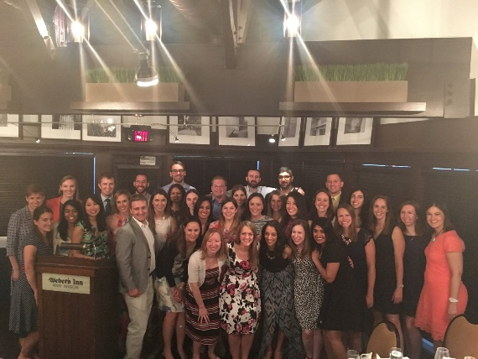
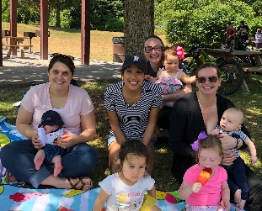
Special thanks to:
Jenny Radesky
Rosa Ball
Heidi Weeks
Alison Miller
Julie Lumeng
Joy Boakye
Anastasia Pacifico
Ranya Alkayhat
Barbara Felt
Prachi Shah
Megan Pesch
My amazing co-fellows and co-residentsKim, and Jackie
Participants and families
Reach Out and Read, Academic Pediatric Association
Family and friends
Notes:
Thank you so much to you for your attention and a special thank you to my truly incredible mentor, Jenny Radesky, diligent research team, participants/families, and Reach out and Read/APA for this

Slide 112

Special thanks to:
Jenny Radesky
Rosa Ball
Heidi Weeks
Alison Miller
Julie Lumeng
Joy Boakye
Anastasia Pacifico
Ranya Alkayhat
Barbara Felt
Prachi Shah
Megan Pesch
My amazing co-fellows and co-residents
Participants and families
Reach Out and Read, Academic Pediatric Association
Family and friends
Notes:
Thank you so much to you for your attention and a special thank you to my truly incredible mentor, Jenny Radesky, diligent research team, participants/families, and Reach out and Read/APA for this

Slide 113

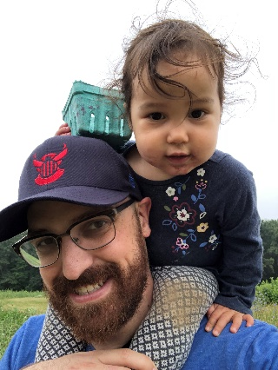
Special thanks to:
Jenny Radesky
Rosa Ball
Heidi Weeks
Alison Miller
Julie Lumeng
Joy Boakye
Anastasia Pacifico
Ranya Alkayhat
Barbara Felt
Prachi Shah
Megan Pesch
My amazing co-fellows and co-residents
Participants and families
Reach Out and Read, Academic Pediatric Association
Family and friends
Notes:
Thank you so much to you for your attention and a special thank you to my truly incredible mentor, Jenny Radesky, diligent research team, participants/families, and Reach out and Read/APA for this

Slide 114
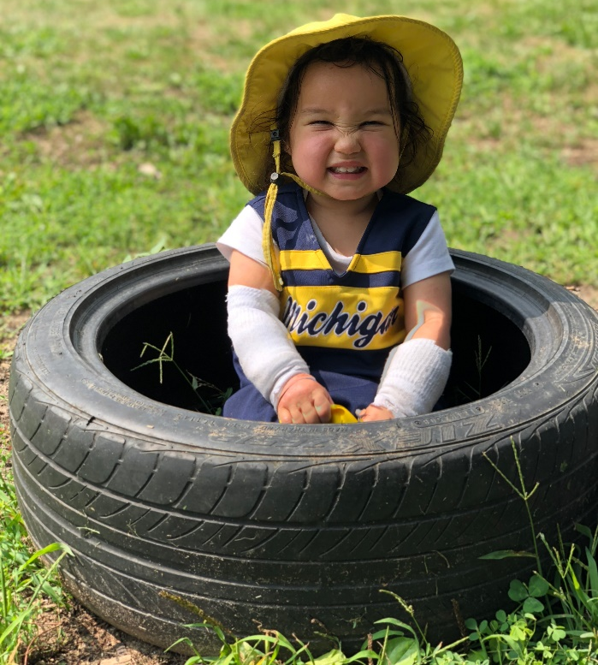
Feedback, questions? Thank you!

Slide 115
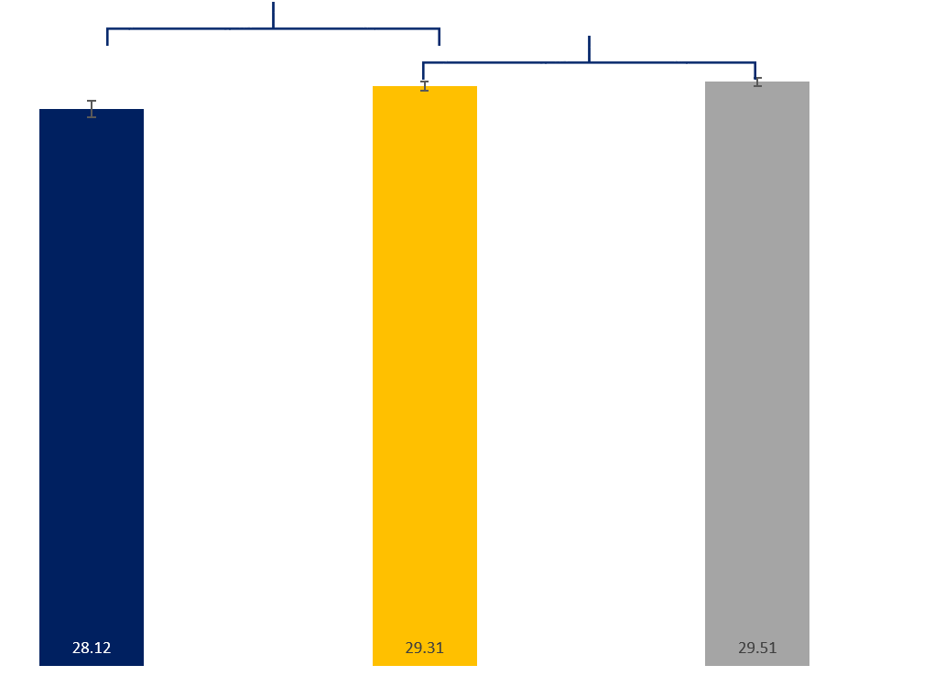
Differences in total parent verbalizations
**
**
30
25
20
15
10
5
0
Enhanced
Basic
Print
Total parent verbalizations by book format

Slide 116
Results– Participant characteristics
Study sample | n = 37, n (%)
Child has used tablet to read a book Almost never Rarely Occasionally Often Most of the time | 23 (62.2%) 2 (5.4%) 4 (10.8%) 6 (16.2%) 2 (5.4%)
Daily time spent reading books together Not used <30 minutes 30 minutes-1 hour 1-2 hours 3-4 hours | 8 (21.6%) 16 (43.2%) 9 (24.3%) 3 (8.1%) 1 (2.7%)
BITSEA problem score Possible problem: Yes Possible problem: No | 2 (5.4%) 35 (94.6%)
CDI, mean percentile score (SD) | 52.9 (SD=33.4)

