Slide 1

Stock asthma medication in
Wisconsin schools:
Implementing 2023 Wisconsin Act 195

Slide 2
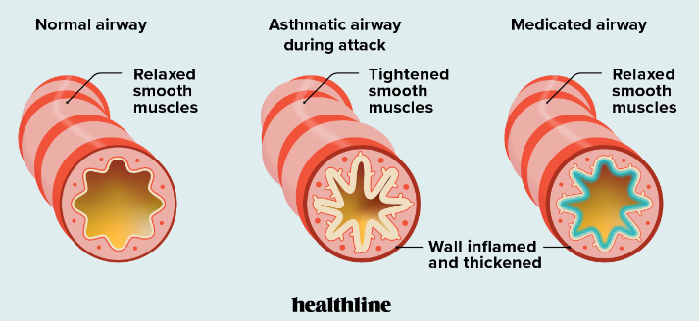
Asthma:
Asthma is a chronic lung disease that cannot be cured, but can be controlled
Common asthma symptoms: wheezing, chest tightness, shortness of breath, coughing
An asthma attack is when someone experiences a sudden worsening of symptoms
During an asthma attack, 3 things happen in the airways: they become inflamed and swollen, the muscles around the airway tighten and they fill with mucus
An asthma attack can feel like trying to breathe through a narrow straw or like an elephant is sitting on your chest
Bronchodilators quickly make breathing
easier by relaxing the muscles in the lungs
and widening the airways within minutes

Slide 3
Importance of stock asthma medication:
The problem:
  Asthma is very common and can be a deadly disease
  Asthma attacks can worsen quickly and must be treated immediately
  Asthma is a top cause of school absenteeism
Benefits:
  Medication is easy to administer, inexpensive and very safe
  Calls to Emergency Medical Services (i.e., 911 calls) can be prevented if asthma is treated in school and the symptoms are relieved
  Students can remain in school; parents can remain at work (eliminating the costs of hospital trips, missed school/work days)
  Saves lives and money
WI asthma data: https://www.dhs.wisconsin.gov/publications/p02412-20.pdf

Slide 4
SUMMARY: 2023 WISCONSIN ACT 195
Types of schools | Public, private or tribal
Type of medication | Bronchodilator, such as albuterol, used for the quick relief of asthma symptoms; includes an orally inhaled medication that contains a premeasured single dose of albuterol or albuterol sulfate delivered by a nebulizer or by a pressurized metered-dose inhaler
School plan | Specified by governing body of a school; must be approved by a physician, an advanced practice nurse prescriber, or a physician assistant; should be consistent with state school medication statute Wis. Stat. § 118.29
Training requirements | Specified by governing body of a school in school plan; should be consistent with training requirements listed in statute Wis. Stat. § 118.29(6)
Who can administer meds | School nurse or delegated school personnel
Where/when meds can be administered | On school premises or at a school-sponsored activity
Who can receive meds | A pupil or other person who the school nurse or delegated school personnel believes in good faith is experiencing respiratory distress, regardless of whether the pupil or other person has a prescription for a short-acting bronchodilator
Is there immunity from civil liability? | Yes
Summary (see table next slide)

Slide 5
Implementation steps:
Create a school asthma plan and obtain approval
Obtain a standing medical order and a prescription
Obtain a supply of bronchodilators and spacers
Delegated school staff must complete required training
Visit https://www.chawisconsin.org/initiatives/environmental-health/stock-asthma-medications/ for resources to help with each of these steps. See next 3 slides for examples.

Slide 6
Sample policies provided on webpage:
Sample District Policy
  Neola, an organization that many Wisconsin school districts use to create their policies, will also incorporate policy guidance about stock albuterol in their update for the 2024-25 school year
Sample Policy Communication to Parents
Sample Protocol for Administration
  May be edited while working with district legal counsel
Sample Reporting Form
Sample Follow-up Communication to Parents/Primary Care Provider After Administration of Stock Medication
  Asthma policy should include that a phone call is made and/or an email sent to the student’s parents/guardian/Primary Care Provider after administration
Sources: AAAAI’s SAMPRO Stock Inhaler Toolkit – August 2023 and American Lung Association’s Stock Asthma Medication Toolkit

Slide 7
Getting medication and supplies:
Standing Medical Order and Prescription templates
Letter to Pharmacy regarding new legislation
  Letter can be paired with the provided PDF of the legislation
  Can also be paired with Pharmacy Society of Wisconsin’s Back To School guide explaining new legislation

Slide 8
Staff Training:
Required training for staff administering medications:
Wisconsin Department of Public Instruction
  https://dpi.wi.gov/sspw/pupil-services/school-nurse/training/medication
Supplemental staff training specific to asthma:
American Lung Association
  https://lung.training/courses/stock-asthma-medication.html
  https://lung.training/courses/asthma_basics.html

Slide 9
Contact Information:
  Questions, comments and requests for additional information may be directed to:
  Carissa Hoium, MPH
  Environmental Health Program Leader/Wisconsin Asthma Coalition Coordinator
  Children’s Health Alliance of Wisconsin
  choium@childrenswi.org
  414-337-4569
Thank you!

