Slide 1
Sleep Baby Safe
A training for professionals working with families
(guiding conversations with families to ensure their babies thrive)
Notes:
“We recognize “safe sleep and co-sleeping” has received significant attention, as the nightly news continues to cover local tragedies where an infant has died in a sleep environment. Families report they continuously receive mixed messages about how to sleep their baby – from medical professionals, family members and friends. As a professional, we know you want to share a common and consistent message about safe sleep with the families you work with. While there are public campaigns to spread the safe sleep message, we also recognize public campaigns only reach so far, and families have very “real” circumstances that often dictate where and how their baby sleeps. We value the strong and trusting relationships you have with families and the position you may be in to have a “conversation” rather than promoting a campaign.
Wisconsin has joined other states around the country to develop tools and trainings specifically for people who are most likely to talk with parents. In fact, there are 36 states working on safe sleep as part of the national HRSA Collaborative Improvement and Innovation Network (CoIIN) initiative. The Wisconsin Department of Health Services (DHS) has identified Safe Sleep as one of its key MCH priorities. In partnership with DHS, Children’s Health Alliance of Wisconsin leads a safe sleep learning community of local health departments and other partners throughout Wisconsin working on safe sleep. The goal of these collaborative groups and resources is to ensure conversations are taking place with every family, and every caregiver, with accurate and consistent information about safe sleep so families can make a decision that is best for them.

Slide 2
Objectives
Why it matters: Understand research and “why” behind safe sleep recommendations
Play it safe: Know and share safe sleep recommendations from American Academy of Pediatrics (AAP)
Let’s talk: Engage in conversations with caregivers about baby’s sleep environment
Notes:
There are 3 parts to this training:
First, we will discuss infant mortality data and “why” behind safe sleep recommendations
Secondly, we will share the updated safe sleep recommendations from the American Academy of Pediatrics (AAP)
Lastly, we will discuss tips to best engage in conversations with caregivers about baby’s sleep environment
Our overall goal for this training is to prepare you to guide families on using safe sleep practices.
Pass around sign-in sheet and encourage participants to include their email addresses.
Conduct pre-survey at this time.
Stress that it’s ok if they do not know some of the answers, participant’s personal information is not included on the survey and their answers are only for us to measure training outcomes.

Slide 3
Your knowledge & confidence
What do you know about infant mortality?
How familiar are you with AAP guidelines?
Are you confident in your conversations with families about the sleep environment?
What are your personal feelings about how and where an infant should sleep?
Notes:
These questions should be used to engage the group and get a feel for where they are at. After open brief discussion, add following comment:
“Some of us probably put our babies on their tummies to sleep, decorated the crib with cute bumper pads ,matching quilts and stuffed animals, and even shared a bed. Everyone wants to protect a new baby and we used to think this is the way you did it. Now we know “soft” is not always protective. Over time, we have learned the best and safest way to sleep a baby.
Also can use example of our use of seat belts today vs. many years ago or ability to smoke just about anywhere years ago but not any longer.
There are many terminologies used interchangeably by parents and professionals. In this training, we will discuss co-bedding and co-sleeping, which are referencing an adult sharing a sleep surface with a baby. One of the recommendations is to share a room, which is not to be confused with co-sleeping.

Slide 4
Why it Matters
The Facts
Notes:
During the first part of our training, we will discuss infant mortality data and the “why” behind the safe sleep guidelines.

Slide 5
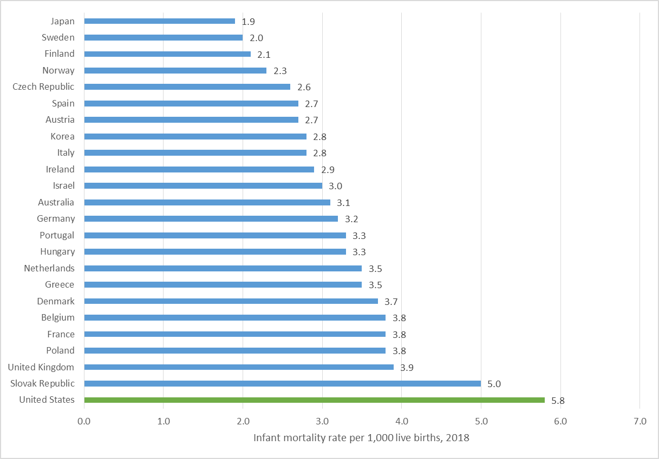
Infant mortality by country, 2018
Source: (OECD, 2020).
Notes:
“Before we talk about how to have conversations about safe sleep, we would like to provide a brief overview of infant mortality, or death, and why having campaigns and conversations matter.
A rate is the number of people experiencing some event, such as a sleep-related death, divided by the number of people at risk for the event, for a specific period of time. Rates are expressed in terms of a unit of population. Infant mortality rates are usually expressed per 1,000 live births. Rates allow us to make comparisons without worrying about the effects of population size.
As you can see from this chart, the United States ranks high in infant mortality among other developed countries. You will notice that Finland has one of the lowest infant mortality rate among these countries. We will talk more about Finland later in this training.”
Reference
Organization for Economic Cooperation and Development [OECD]. (2020). Infant mortality rates (indicator). http://doi.org/10.1787/83dea506-en (Accessed on 5 November 2020)

Slide 6
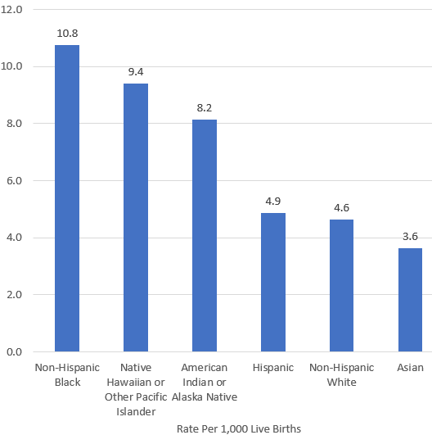
U.S. infant mortality by race and ethnicity, 2018
Source: (CDC, 2020).
Notes:
“As identified in this figure from the Centers for Disease Control and Prevention (CDC), U.S. infant mortality rates are higher among Non-Hispanic Black infants babies and American Indian/Alaska Native infants compared to all babies. Although the rate of infant death has declined over time for all races, the racial disparities in infant mortality rates that we see here have persisted over time despite these declines. For this reason, it is important to look at infant mortality through a health equity lens.
In 2018, infant mortality rates by race and ethnicity were as follows:
Non-Hispanic black: 10.8
American Indian/Alaska Native: 9.4
Native Hawaiian or other Pacific Islander: 8.2
Hispanic: 4.9
Non-Hispanic white: 4.6
Asian: 3.6
Reference
CDC. (2020). Infant mortality. Retrieved from https://www.cdc.gov/reproductivehealth/maternalinfanthealth/infantmortality.htm

Slide 7
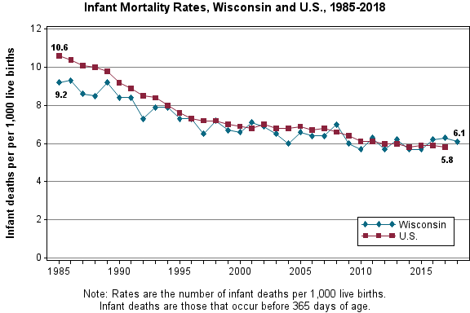
Infant mortality in Wisconsin
Source: (Wisconsin Department of Health Services, 2020).
Notes:
“Nationally the rate of infant death has steadily declined consistent with the promotion of babies sleeping on their backs in the early 90s. Wisconsin mirrors the national pattern, however has experienced inconsistencies. As noted on the previous slide; the rate for African American babies dying in Wisconsin is higher than all babies.”
Note: If anyone asks about why Wisconsin’s line goes up and down, please respond with the following: Because number of deaths in individual states can be small compared to a national view, you will naturally see more variance in the graphing. It is important to always look at the trend over time.
Reference
Wisconsin Department of Health Services, Division of Public Health, Office of Health Informatics. (2020). WISH infant mortality module. Retrieved from https://www.dhs.wisconsin.gov/wish/infant-mortality/index.htm

Slide 8
Infant mortality at the local level
[County name]
Notes:
Local data can be obtained with help from Children’s Health Alliance of Wisconsin for your county if a local source is not available. Please contact Alliance staff for assistance or delete this slide from presentation.

Slide 9
Leading causes of infant death
Preterm birth (born early and often too small)
Serious birth defects
Maternal complications of pregnancy
Sudden Infant Death Syndrome (SIDS)
Injury (including suffocation)
Notes:
“While we are primarily talking about the sleep environment in this training, it is important to understand other key causes of infant death. Prematurity - babies born too early and often too small, is the number one reason for infant death. Babies born less than five and half pounds are at a higher risk of infant death. Birth defects and complications of mom’s pregnancy are other causes. These deaths often occur in the first month of life. Once an infant reaches one month of age, the most common causes of death are related to Sudden Infant Death Syndrome (SIDS) and the sleep environment. Sleep related deaths are often categorized as suffocation. In 2013, sleep related was the cause in 13% of all infant deaths in Wisconsin.”
“If the number one reason for deaths is prematurity, why focus on safe sleep? Much work remains as we work to reduce prematurity before baby is born, but once baby is born, prevention is a priority to make sure all babies reach their first birthday and beyond. Sleeping baby safely, breast feeding and not smoking are the top prevention actions we can take.”

Slide 10
Sudden Unexpected Infant Deaths
SUID
SIDS
ASSB
Unknown
Infection
Metabolic disorders
Cardiac disorders
Poisoning
Notes:
“Sometimes the titles used around infant death can be confusing. We are hoping the next few diagrams help clarify. SUID deaths are “sudden, unexpected infant deaths that occur in infants less than one year of age, and whose cause of death is not immediately obvious prior to an investigation. Sudden Infant Death Syndrome (SIDS) deaths are a sub category of a SUID. A death is only supposed to be categorized as SIDS if a cause of death cannot be explained after a complete thorough investigation of the death scene, complete autopsy is performed, and a review occurs of the clinical history of the infant and parents. There continues to be inconsistency in how our medical examiners and coroners use the SIDS classification. Sleep related deaths are not necessarily SIDS. Infant deaths in a sleep environment are often “suffocation” and fall under Accidental Suffocation & Strangulation in Bed (ASSB). These deaths are preventable in most cases. When a death is considered “unknown,” the medical examiner or coroner does not have all the information needed to determine the official cause of death. Part of educating families is to help them view sleep related deaths as preventable and not a mysterious phenomenon outside their control.”

Slide 11
SIDS risk: triple risk model
Notes:
“Because unsafe sleep practices can be a risk factor for SIDS, let’s talk a bit more about what puts an infant at risk for SIDS and what is shown to help in preventing it. There is not one definitive cause of SIDS. It is believed there are several factors called the triple risk model. Vulnerable means there is an underlying defect or brain abnormality that makes the baby vulnerable. Certain factors such as defects in the brain that control respiration or heart rate, or genetic mutations (birth defect like Down Syndrome) increase vulnerability. Critical development period refers to the infant’s first 6 months of life when rapid growth occurs and changes in homeostatic controls occur. (breathing, sleeping, heart rate, blood pressure etc.) Outside stressors are things in the baby’s environment such as second hand smoke, overheating, sleep position or surface, or an upper respiratory condition. Although these stressors are not believed to single-handedly cause the infant death, they may tip the balance against the vulnerable infant’s chances for survival. This model above helps us understand a babies vulnerabilities. Some medical examiners and coroners are no longer categorizing deaths as SIDS but instead as unknown, particularly when in a sleep environment. Because we know so much more today, it is very rare that there is not a factor that could have possibly impacted the death. SIDS deaths are very rare.”
You may want to site Dr. Corden’s example that babies are born a dandelion (strong and thrive in any environment) or an orchid - delicate and fragile – susceptible to any change etc.)

Slide 12
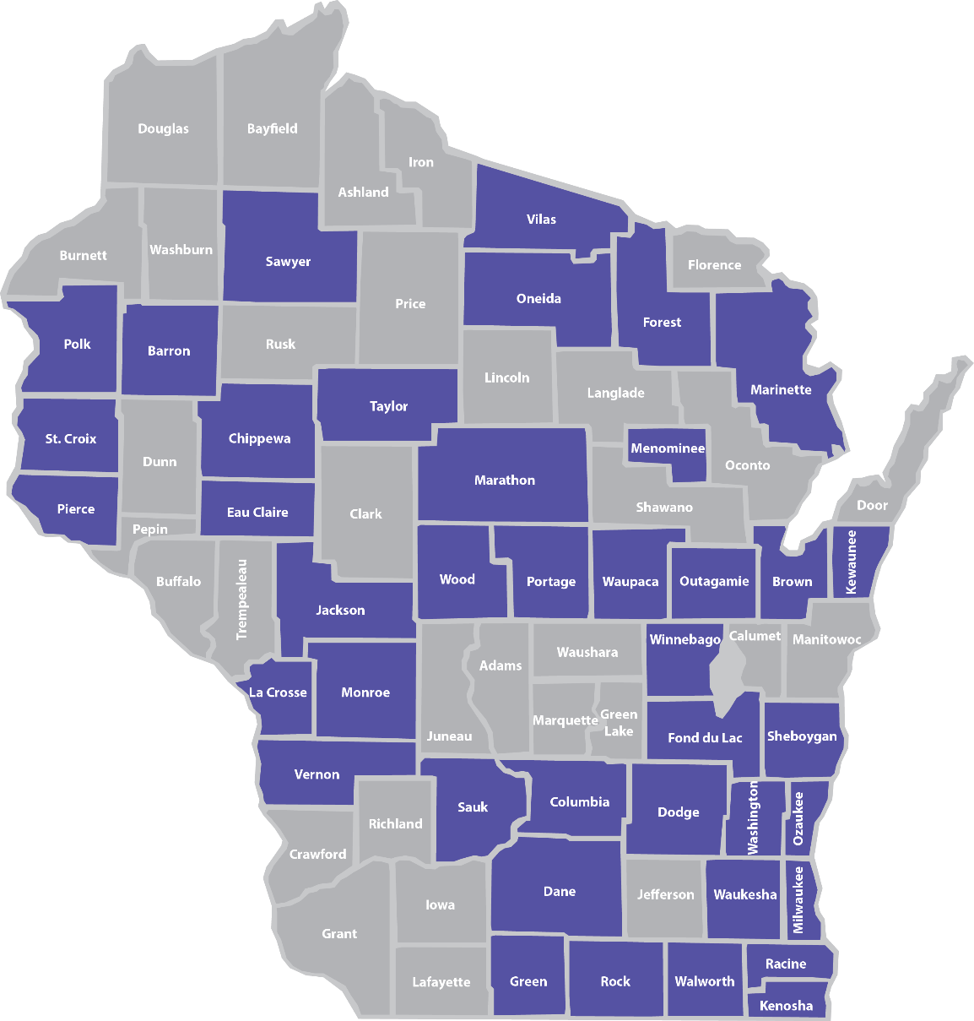
Wisconsin SUIDs by county
Notes:
“Now that you know more about SUID and SIDS, let’s talk about the numbers in Wisconsin. Between 2015-2017, 182 Wisconsin infants died in unsafe sleep environments in 40 different counties.
Each of these deaths occurred while the infant was sleeping or was in the sleep environment. These deaths fall into two categories:
Undetermined (77 percent): This includes deaths certified as SUID, Sudden Infant Death Syndrome (SIDS) and Undetermined.
2. Asphyxia (23 percent): This includes asphyxia due to the infant’s position, other objects in the sleep environment or overlay by another individual.
On average, more than one infant per week dies in an unsafe sleep environment in Wisconsin. This map shows that SUIDs can happen in all corners of our state, in both urban or rural areas.
Additional data from the 2017 SUIDs in Wisconsin:
Among 2017 SUIDs, 25% of infants were placed on their stomachs. An additional 14% were placed on their sides.
In regards to surface, 54% of infants were placed on an adult bed and 9% of infants were on a couch.
The majority (80%) of the incidents leading to a SUID occurred at the infant’s home. Among these cases, 87% of infants had a safe sleep surface available.
The majority (77%) of SUID sleep environments contained soft bedding. The most common bedding items were blankets (49%), pillows (46%) and comforters (42%).
Among 2017 SUIDs, 63% of infants were sharing a surface with one or more adults or children.
Caregiver substance use while sharing a sleep surface with the infant was confirmed in 18% of cases.
More details on the SUID data in Wisconsin is available in the full SUID Report on the Children’s Health Alliance of Wisconsin website: www.chawisconsin.org/sbs.”

Slide 13
Play it Safe
AAP Recommendations
Notes:
During the next part of our training, we will discuss the American Academy of Pediatrics (AAP) recommendations for safe sleep.

Slide 14
AAP safe sleep guidelines
Notes:
"The AAP policy statement on safe sleep was revised in 2016. These are evidence-based recommendations based on research from experts in the field of child safety and safe sleep. These gold standard recommendations have been adapted not only by primary care pediatricians but family physicians, neonatologists, and child care professionals who provide care for infants. (Reference the Academy’s parent portal, www.HealthyChildren.org) These guidelines were never intended to spark debate or controversy. They were meant to better inform families of how they could reduce risk of something very bad happening to their baby, and to establish universal messaging and common language around sleeping babies safely. They are meant to help give every baby the best chance to reach their 1st birthday safely and healthy.”

Slide 15
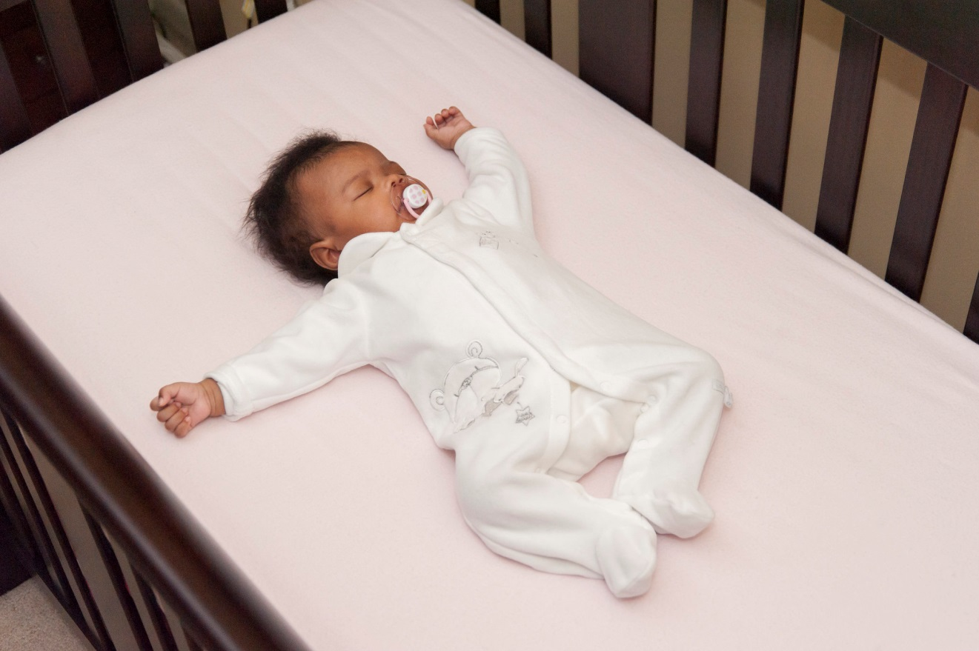
Alone, on Back, in Crib and in Smoke-free air
Notes:
“Babies are not born with habits. How they sleep is a learned behavior. They will learn to be comfortable however they are placed right from the start. In addition to the recommendation encouraging sharing a room, it is highly recommended to follow the ABCs. Alone, on the back and in a crib or Pack N’ Play, and free from any smoke in the air. Babies need to sleep on their back for every sleep time. (Nap, night time, day care, visit to someone’s home etc.) Babies love consistency. If they start out sleeping on their backs, they learn to sleep this way. Habits are hard to break so it is easier for both parents and their baby to sleep safely starting with the very first sleep.“
“As you can see, this baby is using a pacifier. Some research has shown use of a pacifier is a preventive measure. However, if mom is breast feeding, pacifiers should only be used after breast feeding has been established. Generally after one month.”
Let’s talk a moment about the effects of secondhand smoke. Infants who are exposed to secondhand smoke after birth also are at greater risk for SIDS. Chemicals in secondhand smoke appear to affect the brain in ways that interfere with its regulation of infants' breathing. Infants who die from SIDS have higher concentrations of nicotine in their lungs and higher levels of cotinine (a biological marker for secondhand smoke exposure that stays in the baby’s system longer) than infants who die from other causes.”

Slide 16
Back-to-sleep
Babies are less likely to choke
on their backs
Image courtesy of the Safe to Sleep® campaign, for educational purposes only; Eunice Kennedy Shriver National Institute of Child Health and Human Development, http://safetosleep.nichd.nih.gov; Safe to Sleep® is a registered trademark of the U.S. Department of Health and Human Services.
Notes:
“Yes it is true that long ago we put babies on their tummies because we thought it would keep them from choking on their spit-up. But we found out babies were at higher risk for suffocation. Then we put them on their side, but found babies didn’t stay on their side and rolled one way or the other. After research and studies, we found that babies sleeping on their backs is the safest – as you can see the trachea (airway) actually lies on top of the esophagus (tube that goes into the stomach). When a baby spits up, gravity will keep the spit-up in the esophagus, and it will either come out of the baby’s mouth or he will swallow it. Either way his trachea is protected when the baby is on his back. Also, placing the baby on his tummy doesn’t allow him to breathe in fresh air. Since the back to sleep campaign started in 1992, we’ve seen a 50 % reduction in infant deaths. New parents often hear from grandparents and others that their babies slept on their tummy. This is part of the conversation you will have about how over time, we learn new information. Seat belts are a good example to use. While many of us survived never wearing a seat belt, we wear them now, and we would agree if we were in a car crash, our chances of surviving are much greater if we are wearing a seat belt.”
Demonstrate the trachea on top of the esophagus using two fingers. Finger on top is the trachea – baby can breathe.

Slide 17
Share a room…not a bed
Promotes breastfeeding easily
Promotes bonding safely
Avoids risks of bed sharing
Room sharing is now recommended up to age 1year
Notes:
“The AAP guidelines are built around the promotion of breast feeding, bonding and safety. Keeping baby close to mom allows for each of these to occur. Breast fed babies are at a reduced risk for a sudden and unexpected infant death. However, we must recognize not all babies are or can be breast fed and this does not diminish the importance of bonding and safety.”
“Adult beds have lots of risk factors in them. There are a variety of soft, pillow-top mattresses, which do not support infants necks. A baby on a soft surface is at an increased risk of cutting off their airway if their heads roll forward or sideways or are hyperextended. Most adult beds also have pillows and blankets, which could easily suffocate an infant. Babies are not coordinated enough to move a blanket or pillow off of their face.”

Slide 18
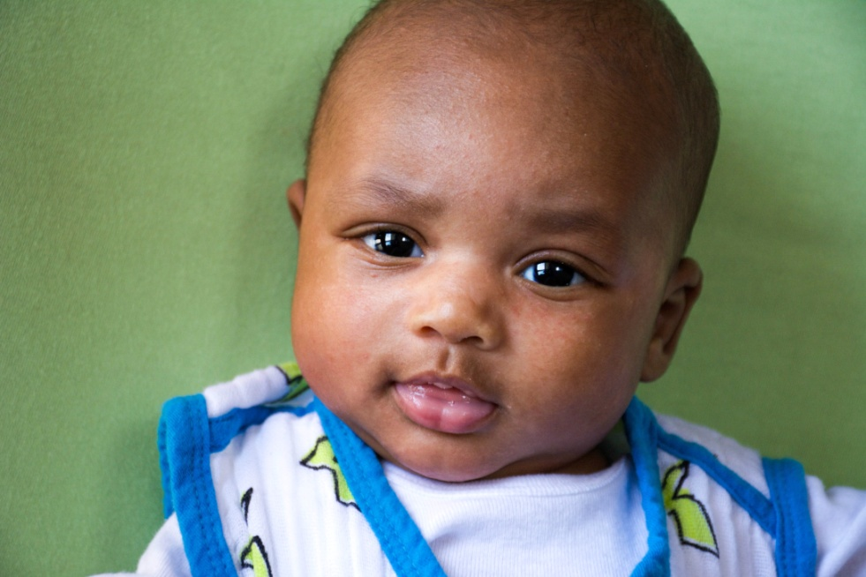
Breastfeeding is recommended
Associated with a reduced risk of SIDS
Breastfeeding has been shown to be more protective against SIDS than not breastfeeding
Notes:
“Breast fed babies are at a reduced risk for a sudden and unexpected infant death. However, we must recognize not all babies are or can be breast fed and this does not diminish the importance of bonding and safety. Breast feeding is a protective factor. The protective effect of breastfeeding increases with exclusivity, but any breastfeeding is still protective. A study from 2009 by Vennemann, et al. suggests breastfeeding reduces the risk of SIDS by ~50% throughout all ages of infancy (Vennemann, et al., 2009). In 2015 the World Health Organization released a recommendation infants are breastfed exclusively through the first 6 months of life while other nutritious complementary food should be given after 6 months through two years of life or there after (World Health Organization, 2015).”
71. Ip S, Chung M, Raman G, Trikalinos TA, Lau J. A summary of the Agency for Healthcare Research and Quality’s evidence report on breastfeeding in developed countries. Breastfeed Med. 2009;4(suppl 1):S17–S30
72. Vennemann MM, Bajanowski T, Brinkmann B, et al; GeSID Study Group. Does breastfeeding reduce the risk of sudden infant death syndrome? Pediatrics. 2009;123. Available at: www.pediatrics.org/cgi/content/full/ 123/3/e406
73. Hauck FR, Thompson J, Tanabe KO, Moon RY, Vennemann M. Breastfeeding and reduced risk of sudden infant death syndrome: a meta-analysis. Pediatrics. 2011;128(1): 103–110

Slide 19
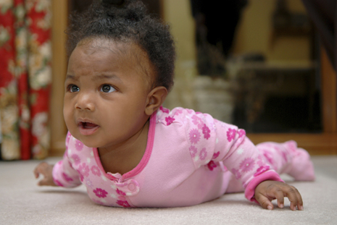
Back-to-sleep…tummy to play
Awake, tummy time allows baby to develop different muscles
Tummy time helps avoid “flat head”
Always supervise tummy time
Notes:
“Babies need tummy time to develop different muscles in their growing bodies; but it should only be when they are awake and supervised. Tummy time also helps prevent a baby from getting a flat head. It allows baby to experience their surroundings from a different vantage point! Encouraging families to incorporate tummy time with their infants should be a priority.”

Slide 20
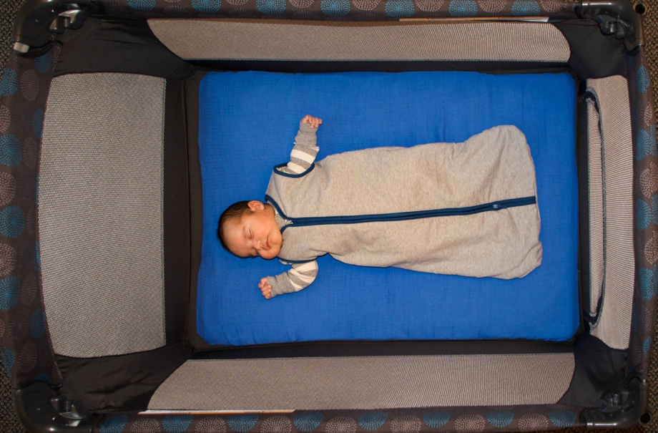
Avoid overheating
Set room temperature to what is comfortable for adults
Dress baby to be comfortable
Use a sleep sack
Notes:
“Parents often think babies need to be kept warmer than themselves. Again, based on the triple risk model, this could be an environmental stressor that increases the risk of an unexplained infant death. We have learned that babies can become overheated and as a result are at risk for death. Sleep sacks are great because the baby is adequately covered and avoids the risk of a blanket. Healthy babies do a good job regulating their own body temperature.”
“Although the research is new, using a fan in the room is considered a protective factor for an unexplained death. This is thought to be due to air circulation and reducing the amount of CO around the baby. However the fan should never blow directly on the infant.”
Many people have questions about the safety of swaddling. The AAP says that swaddling is a good technique for calming baby and promoting sleep if done correctly. Phase out swaddling by age 2 months or before baby can roll. “
Be conscious when putting a blanket over the car seat. Many parents do this to keep baby safe from cold temperatures, but should limit how long the blanket is covering the baby. Use a breathable material to avoid overheating and lack of fresh air.

Slide 21
Use a safe crib or Pack ‘n Play
Notes:
“Let’s talk about safe surfaces to sleep a baby. Sleep surfaces can vary depending on cultural tradition, space and mobility. What is most important is NOT to sleep a baby on a soft surface such as a couch, bean bag chair etc. The most common surfaces are a crib or Pack ‘n Play. Cribs today should contain a firm mattress, only 6 centimeters of space between rails on the crib (a soda can should not fit through the rails), no drop sides on the crib, strong hardware and tough testing, no bumper pads or stuffed animals, blankets, pillows, loose baby items etc. Pack ‘n Plays also should have a tight fitting sheet free from items mentioned.”
Google consumer product safety commission for more information and for a list of recalls on baby products.

Slide 22
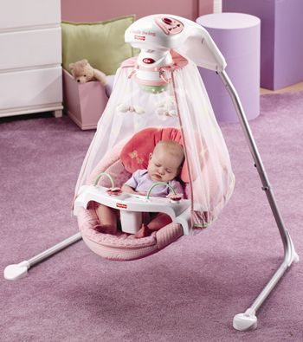
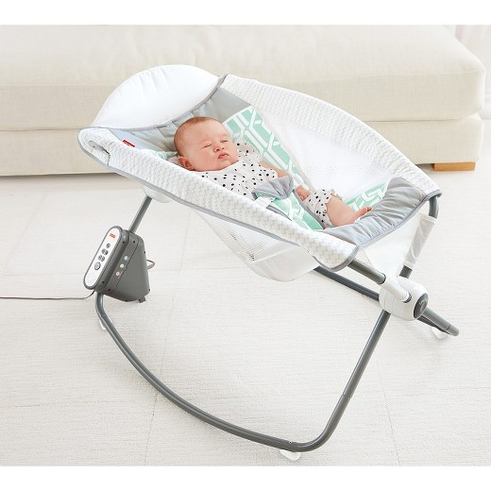
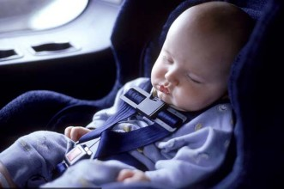
Always sleep on a firm, flat surface
NOT in a swing, car seat, or inclined product
Notes:
“Babies should not be left to sleep in a car seat, baby swing or in other semi-reclined surfaces such as a Rock n’ Play™.
A common reason for using the semi-reclined position of the Rock 'n Play™ and other products is for management of reflux, but research has shown that this position does not actually decrease reflux. The American Academy of Pediatrics' reflux management guidelines for physicians states that, “semisupine positioning, particularly in an infant carrier or car seat, may exacerbate gastroesophageal reflux and should be avoided when possible, especially after feeding" (semisupine means reclined). Additionally, semi-reclined sleep positions can compromise baby's airway and restrict breathing. Many of these infant products also include fluffy pillows and headrests, which increases the risk of SIDS.
A car seat is meant to protect an infant while traveling in a car. When the car seat comes out of the base, it changes the angle of the seat and can compromise baby’s neck position and airway. We know that we cannot keep baby awake all the time and dosing off will happen while traveling, but it is important to avoid baby going into a deep sleep in the car seat– that is when it becomes unsafe. When traveling long distances, encourage families to take frequent breaks and check on baby often if he/she is sleeping.”
References
American Academy of Pediatrics reflux management guidelines for physicians: http://pediatrics.aappublications.org/content/early/2013/04/24/peds.2013-0421
Pediatric Gastroesophageal Reflux Clinical Practice Guidelines: http://www.naspghan.org/files/documents/pdfs/position-papers/FINAL%20-%20JPGN%20GERD%20guideline.pdf

Slide 23
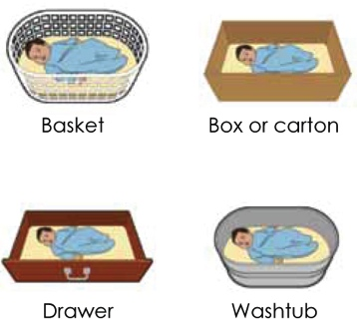
Alternative sleep surfaces
Image courtesy of the Safe to Sleep® campaign, for educational purposes only; Eunice Kennedy Shriver National Institute of Child Health and Human Development, http://safetosleep.nichd.nih.gov; Safe to Sleep® is a registered trademark of the U.S. Department of Health and Human Services.
Notes:
“Alternatives to the traditional crib have been around for a very long time and were introduced to address concerns and desires expressed by families including how they can sleep near their baby but keep them safe. In 1937 Finland had an extremely high infant mortality rate of 65 deaths for every 1,000 births. The government passed the Maternity Grants Act to help decrease the high rate. Originally for families in poverty, the grant provided every newborn infant with the basics so that he or she would have the same start and chance at life as other infants in higher economic classes. The program now gives every baby a box, no matter what economic class. The kit includes a box for the baby to sleep in along with other necessities such as clothes, diapers, etc. Once Finland’s babies started sleeping in boxes, their infant mortality rates dropped to 3.38 deaths for every 1,000 births.” (Moheny, 2013)
“No matter what container is used, the surface must be flat and firm. A changing pad for example can be used in the bottom of a container as long as it is not fluffy, is tucked into the mattress and is secure. Often times this alternative can be used for families that are visiting, transient families, or just wanting baby in another room near you.”
Refer families to a local source for a crib or Pack ‘n Play. Make information available to training attendees
Note: There are several organizations now offering baby boxes to families in Wisconsin. Learn more: www.chawisconsin.org/sbs.

Slide 24
Share the message
Share where and how baby sleeps with baby sitters and other family members
Notes:
“It is important that parents share this information with other family members and caregivers. Encourage parents to share table talk sheet with others. Ask mom what would be helpful to her in communicating the messages.”
“Babies learn to sleep a certain way. If a baby is used to sleeping on their back and then is slept on their tummy, they are 4 times at risk for something happening. Babies love consistency.”

Slide 25
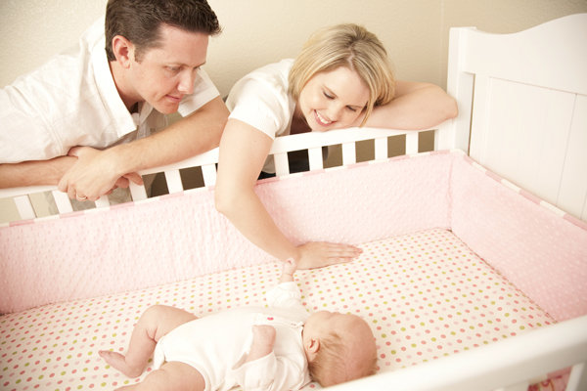
Is this baby safe?
Notes:
“Here is a sleep environment. What do you believe poses a risk to this baby?
Answer: Bumper pads

Slide 26
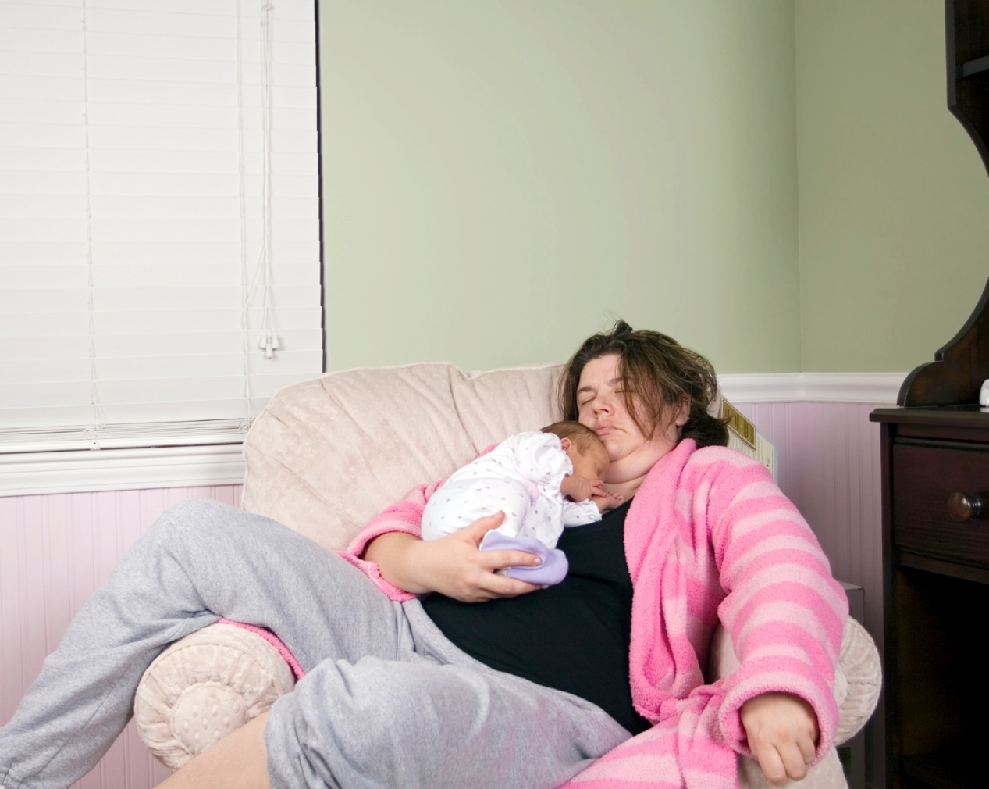
Is this baby safe?
Notes:
“It is important that babies always sleep in a crib or Pack N’ Play every time they are asleep. Couches, chairs – especially bean bag chairs – are dangerous.”
Answer: Chair is unsafe

Slide 27
Is this baby safe?
Notes:
“Here is another sleep environment for a baby. What do you think?”
Answer: In bed with adult
On tummy
Sleeping on soft bedding and near big pillow

Slide 28
Let’s Talk
Having the Conversation
Notes:
During the last part of our training, we will discuss and practice how to have effective conversations with families about safe sleep.

Slide 29
Conversation goals
Help parent feel safe in sharing his/her thoughts and feelings
Avoid making parent feel interrogated or guilty
Build trust and openness
Notes:
Safe sleep can be a difficult topic to discuss with families. Keep these goals in mind when having a conversation with a parent about their infant’s sleep.

Slide 30
Why families might not embrace the AAP guidelines
Comfort of baby or adult
Convenience
Safety of home and neighborhood
Prior experience with other children or own childhood
Advice from family members or friends
Lack of space for a crib
Lack of a crib (money or access)
Differing information or knowledge
Mixed messages from health care providers
Information is not culturally competent
Notes:
“It is important to listen and understand why families may not adhere to the AAP recommendations. We must approach the conversation with questions and reaffirm we are hearing and understanding the family’s circumstances. As we continue our discussion today we will address how you can help meet the families’ needs. For example, a parent may think if they are sleeping with their baby, they can be there if something happens – not realizing they may be increasing the chance of something happening.”

Slide 31
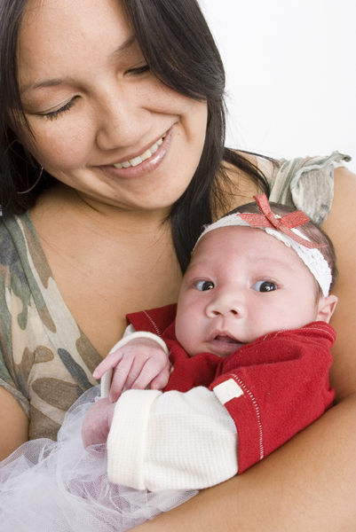
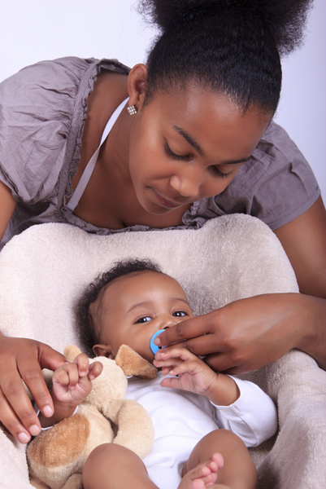
Cultural and family traditions
Notes:
“All moms and families want their baby to be safe and grow up to lead a healthy life. It is important to approach a family in this light and not make them feel guilty if they are doing something different than the recommended AAP guidelines. We should share we have learned a lot from our history and ancestors. While traditions and cultures are valued, we cannot ignore what we have learned and information that will help babies thrive. You want to share all that you know and what we have learned over time so they as a family can make decisions based on factual information. But in the end families make the choice. Risk factors in a sleep environment affect all cultures and all socioeconomic classes of people, rich and poor. It is important to share the same information with all families.”
“How do you reconcile your own traditions or experience with sleeping your baby? Let’s talk about this.”
“Let’s explore our own experiences so we can better understand where our feelings originated.”

Slide 32
O.A.R.S.
Open-ended questions
Affirmations
Reflective listening
Summarizing
Notes:
“Many of you may have been trained in motivational interviewing. This is an opportunity to apply those techniques.
O.A.R.S. is a skills-based model of interactive techniques adapted from a client-centered approach, using motivational interviewing principles. Both verbal and non-verbal techniques need to be adapted to be culturally sensitive and appropriate.
“Let’s simplify this by focusing on these simple steps. This approach is one you may already be using as you work with families on other topics. Key thoughts to remember are:
You and the parent should be guiding each other’s conversations
You need to follow with what the parent says
Information needs to be given in a constructive way to the parent.”
Here are examples of open-ended questions:
What has your mom or other family members told you about sleeping your baby?
How do you feel about where your baby should sleep?
How is your sleep arrangement working for you?
Tell me about a typical day at your house.
Tell me why it is difficult for you to get baby to sleep.”
Ask permission to educate:
“Is it ok if I tell you about a few things regarding safe sleep?”
Source: https://public.health.oregon.gov/HealthyPeopleFamilies/ReproductiveSexualHealth/Documents/edmat/OARSEssentialCommunicationTechniques.pdf

Slide 33
Explore more
Extend
“What else have you heard about safe sleep? How do you feel about it?”
Clarify
“Do you think baby will not sleep as well on his back?”
Reflect
“I hear you are saying you feel you won’t bond with baby if you aren’t sleeping with him, is that correct?”
Redirect
“I can see you’re worried about baby’s safety. May I connect you with a Pack ‘n Play that will fit next to your bed so baby can sleep close to you?”
Notes:
“The more you hear and understand, the better you can address a parent’s needs. Here are some examples of follow up questions in each of the categories:
EXTEND - “What else have you heard about safe sleep? How do you feel about that? Tell me more about how things are working for you.”
CLARIFY – “Do you think baby will not sleep as well on his back? What do you think is most difficult about sleeping baby in his crib? When you say baby is safe where he sleeps do you mean he is …..? Are you concerned your baby will not be safe if sleeping apart from you?”
REFLECT – “So you’re saying you feel where your baby sleeps is safe. You think your mom won’t support you sleeping your baby differently than she slept you. You feel you won’t bond with your baby if you’re not sleeping with him.”
REDIRECT – “I can see you’re worried about your baby’s safety. I’m going to connect you with someone who can get you a Pack N’ Play that will fit right next to your bed so baby can be near you. I can see you’re worried about food for your other children. I am going to give you a name of someone who can help you. Do you have other concerns about sleeping your baby safe?”
Please note these are examples of different questions and not meant to all be used

Slide 34
When to say what
Prenatal visits
“Where will baby sleep at night when you bring him/her home?”
Postpartum visits
“How is it working out where your baby is sleeping for naptimes and at night?”
Notes:
Prenatal visits
“Can we talk about where baby will sleep when you bring him/her home? I know you want to do everything you can to make sure your baby is healthy and safe. Tell me about what you are thinking about where your baby will sleep.”
Postpartum visit
Ask the mother/caregiver, “How is it working out where your baby is sleeping for naptimes and at night?”
Responses in either situation
“I want to share what we know is the very best way for your baby to sleep safely. We know so much more now than we did when we were born.”
Reference AAP recommendations for night time and nap time. Stress babies are most vulnerable to SIDS during the 0-4 month period. Feel free to share the data: In 2015, 47 babies died in 22 different Wisconsin counties due to an unsafe sleep environment.”
“Our home visiting program strongly supports the AAP recommendations and is working hard to make sure all our families receive this important information.”
If mom does not want to engage in conversation or is committed to a specific sleep environment, ask if it would be okay if you touch base on the subject again at a future visit. Reassure her you only want to support her desire to see her baby grow up healthy.

Slide 35
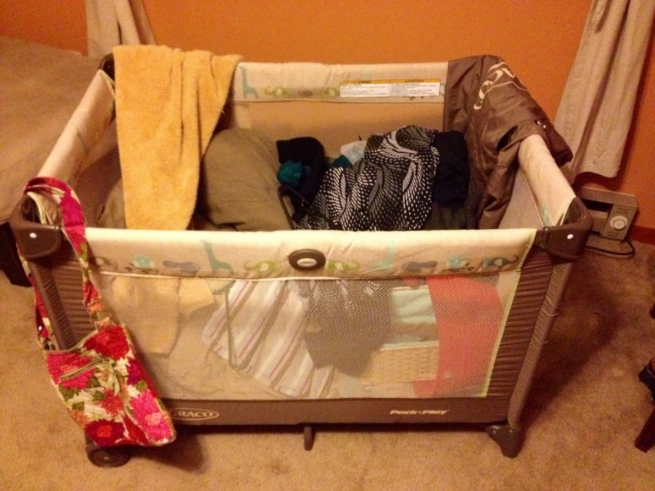
What if parent says…
“My baby sleeps in a Pack ‘n Play.” (It’s evident that it is used as a storage bin).
“I know they say to not sleep with your baby, but I really want to because he just sleeps better with me.”
“I don’t want my baby sleeping alone in a bed that has nothing in it.”
Notes:
“We cannot predict when or if a baby will die in an unsafe sleep environment. We only can control how we place our baby to sleep, for every sleep. The statistics show us that at least 4 babies will die each month in an unsafe sleep environment in the State of Wisconsin. We now know the risk factors associated with those deaths. Here are some suggested responses.”
Response to first bullet: “When does your baby sleep in the Pack N’ Play? Using it for temporary storage is contaminating the area with germs. It’s important to keep the Pack N’ Play clean and empty so baby can use it at anytime.
Response to second/third bullet: “I know you want to do everything you can to protect your baby and I just want to help you the very best I can. My responsibility as your ______ is to provide you with the most up-to-date information available. It is your decision as a parent as to where your baby sleeps. I am here to help you problem solve. Tell me why you feel so strongly about having your baby sleep in your bed. (Discuss the parent’s feelings and weave in a suggestion base on parent response.)

Slide 36
What if parent says…
“We don’t have room for another bed in our bedroom/sleeping area.”
“I am careful and don’t move around when I sleep.”
“Nothing happened to me as a baby, so why would something happen to my baby.”
“It doesn’t matter what you say, I am going to sleep with my baby.”
Notes:
“If they are concerned about space in their bedroom, suggest moving a dresser out of the room so the crib will fit next to the parents bed. Or suggest a Pack N’ Play which may fit better”
“Moms who have experienced their baby's death have said that they "didn't think it would happen to them. They too thought they did not move around. Sleep studies have shown that parents move more often than they realize.“
“Nothing happened to many babies just like many of us survived not wearing a seat belt growing up. But based on what happened to others not so lucky and what we have learned over time, we all wear seat belts and we have found safer ways for babies to sleep.”

Slide 37
Helpful response
“As your [home visitor] I cannot tell you how to sleep with your baby safely because there truly is no safe way. But let’s talk about how you can reduce the risk of anything happening. Remember what we talked about…”
Notes:
You may have a family tell you that they hear what you’re saying, but plan to sleep with their baby or use blankets regardless. This is a difficult position to be in, but this response can be helpful. Remember, this decision is ultimately the family’s choice, and our role as professionals is to provide the family with all the tools, resources and education necessary before deciding how their baby will sleep. Remind the family that you will likely bring the topic up again the next time you meet, and reiterate the importance of following the safe sleep guidelines you have shared.
“I hear what you are saying, and you have the right to choose where and how your baby sleeps. I care about you and your baby, and just want to make sure you have all the information we have so your baby has the best chance to reach his first birthday. I am not able to tell you how to sleep with your baby safely because there just isn’t a safe way. But please think about all we have talked about and reduce the risks to your baby as much as possible.”
“It is my job to give you information to help you make the best possible choices for you and your family. I know it is hard to change routines. I know you want what is best for your baby so I am here to help you.”
As role playing occurs, have training attendees practice this phase or a similar phrase in their own words. Stress that home visitors or others should NOT ever say how to sleep safely. Rather reference reducing risk.

Slide 38
Role playing
Groups of 3
Roles:
Professional (i.e. home visitor)
Parent or caregiver
Observer
Notes:
“Let’s role play situations you have encountered and discuss what your response might be given the information learned in this training.”
Some suggestions:
Divide into groups of three and choose roles (Parent, professional, observer).
Provide each group with situations on index cards (use examples from “What if parent says…” slides).
Have groups role play situation. Ask observer to provide feedback to two others in group.
Bring entire group back together to share success, their comfort in having the conversation, challenges etc.

Slide 39
Helpful tools for you
Personal notebook (spiral bound refresher for reference)
“Table talk” handout
Know your community resources
Notes:
The refresher notebook is for your personal use to review prior to a home visit. This will help guide you in your conversations and provides suggested language for you to use.
The “table talk” sheets can serve as a tool to keep the conversation focused and provide mom with visual graphics to emphasize key points. They have been prepared to serve five different populations, American Indian/Alaska Native, African American, White, Hispanic and Asian. You can leave the sheet in the home.
Know your community resources well so that you can help connect families to what they need.
Visit the Children’s Health Alliance of Wisconsin website for more tools, resources and handouts: www.chawisconsin.org/sbs.

Slide 40
You will make a difference
Relationship
Trust
Educated choice
Babies sleeping safely
Notes:
“As a professional, you will develop trusting relationships with families. It is ultimately a family’s decision to sleep their baby any way they choose; however, your role is to provide families with all of the information available so they can make informed choices. Use your knowledge and resources to support your families and encourage them to make healthy decisions.”

Slide 41
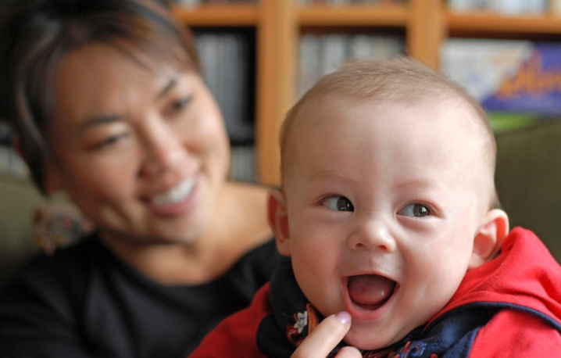
Thank you for all you do!
Notes:
Conclusion: “We would appreciate and value your feedback so we can improve the training for future groups and enhance the materials. We have a post survey for you today, and you will also receive an email survey in the next 6-8 weeks to capture your experience in having safe sleep conversations with families. Please be honest and direct with your feedback so we can create what is best for you and our families. Thank you!”
Conduct post survey
Remind attendees to look for a survey link from Children’s Health Alliance of Wisconsin within the next 6-8 weeks, asking about how your conversations are going and how families are responding.
Collect all pre and post surveys and the sign in sheet. Email or mail these to Children’s Health Alliance of Wisconsin as soon as possible.

Slide 42
Updated: January 2019

