Slide 1
Sleep Baby Safe
A training for medical providers
(guiding conversations with families to ensure babies thrive)
Notes:
“We recognize “safe sleep and co-sleeping” has received significant attention. The nightly news continues to cover local tragedies where an infant has died in a sleep environment. Families report they continuously receive mixed messages about how to sleep their baby – from medical professionals, family members and friends.
We recognize the need for a public campaign to spread a consistent message. But we also recognize a public campaign only reaches so far, and families have very “real” circumstances that often dictate where and how their baby sleeps. We value the strong and trusting relationships physicians establish with families as their medical home and the position you are in to have a “conversation.
That is why Wisconsin is joining other states around the country to develop tools and trainings, specifically for those on the front lines with families – home visitors, child care providers and you. In fact there are 36 states working on safe sleep as part of the national HRSA Collaborative Improvement and Innovation Network (CoIIN) initiative . Wisconsin has a safe sleep team comprised of local public health leaders, community organizations and hospitals working together on this topic. Our goal is to ensure conversations are taking place with every family, and every caregiver, with accurate and consistent information about safe sleep so families can make a decision that is in their baby’s best interest. Our priority is to make sure families have factual information and are aware of what we have learned over the past 20 years. It is important to respect the family’s choice and not judge the family for the decision they ultimately make. This training is based on, and consistent with the AAP guidelines and was influenced by the results of focus groups that were held throughout Wisconsin in late 2014 and piloted in 2015.
And finally, we recognize your time with a mom is limited, and your focus is primarily on the clinical health of mom – not necessarily care giving factors. Our goal is for you to become a champion of making sure that someone has a conversation with mom about safe sleep and ensure it takes place by someone on your team. If it is not you, who could it be?”

Slide 2
Objectives
Provide update on infant mortality
Refresh knowledge of American Academy of Pediatrics (AAP) safe sleep recommendations
Promote engaging families in conversations about baby’s sleep environment
Guide families on using safe sleep practices
Notes:
“We are hopeful and confident you will achieve these objectives (Read them) through this training and the materials and tools you will be provided with to use with families. “
“We would like to gauge your utilization of the AAP recommendations by answering a few short questions.”
Pass out survey.

Slide 3
Personal beliefs
What are your personal feelings about how and where an infant should sleep?
Do your personal experiences impact your clinical practice?
Notes:
“We recognize as professional clinicians you adhere to evidence-based recommendations with your patients, but we can’t ignore personal experience. Some of us probably put our babies on their tummies to sleep, decorated the crib with cute bumper pads, matching quilts and stuffed animals, and even shared a bed. Everyone wants to protect a new baby and we used to think this is the way you did it. Today, of course, research has shown that “soft” is not always protective. We’ve learned over time, the best way to offer protection of a baby. We do, however, want you to recognize your own personal feelings about how and where an infant should sleep, and whether or not your personal experience impacts your clinical practice. Your own personal feelings can help you relate to families and understand why some may not adhere to the AAP guidelines. It gives us an opportunity to meet families where they are and to help them understand the reasons why we recommend these safe sleep guidelines.”

Slide 4
Leading causes of infant death
Preterm birth
Congenital anomalies
Maternal complications
Sudden Infant Death Syndrome (SIDS)
Unintentional and intentional injury (including suffocation)
Notes:
“As we all know these are the leading cause of infant mortality in the United states and in Wisconsin. Each year, more than 350 Wisconsin infant die before their first birthday. Of that, approximately, 65 percent are due to complications of prematurity, 20 percent to congenital anomalies, 15 percent to “SIDS” and the remainder to unintentional and intentional injury. This information comes from Wisconsin vital statistics, specifically death certificates.”

Slide 5
Sudden Unexpected Infant Deaths
SUID
SIDS
ASSB
Unknown
Infection
Metabolic disorders
Cardiac disorders
Poisoning
Notes:
“There is still confusion around what SIDS is and is not. According to the scientific research, including the Journal of Pediatrics, SIDS is a diagnosis of exclusion and cannot be explained. A true SIDS death occurs when the infant is in a safe-sleep environment. However, we know that common language and how death certificates are signed are not always consistent with this definition of SIDS. A death is only supposed to be categorized as SIDS if a cause of death cannot be explained after a complete thorough investigation of the death scene, complete autopsy is performed, and a review occurs of the clinical history of the infant and parents. There continues to be inconsistency in how our medical examiners and coroners use the SIDS classification. Sleep related deaths are not necessarily SIDS.
There are two types of sudden unexpected or unexplained infant deaths (SUID). The first is explained, which includes things like poisoning, accidental strangulation and suffocation in bed (ASSB) or metabolic disorders. They are sudden, initially unexplained and very unexpected. However, after autopsy and investigation, we know what happened. The second type of SUID is unexplained, which includes SIDS and unknown. Part of our goal in Sleep Baby Safe is to educate families to help them understand that sleep-related deaths are preventable and not a mysterious phenomenon.”

Slide 6
SIDS risk: triple risk model
Notes:
Note: Provide copies at the training and reference in folder received.
“The triple risk model is helpful in understanding the complicated nature of SUID. This model highlights the convergence of three events that may take place when an infant dies from SUID. Because unsafe sleep practices can be a risk factor for SIDS, we are promoting that families and professionals like home visitors receive education on the triple risk model. We have found that it is helpful in understanding how the convergence of different factors can impact their infant. In fact, we have found that the following example is really helpful for families to hear that babies are born a dandelion (strong and thrive in any environment) or an orchid - delicate and fragile – susceptible to any change etc.)”

Slide 7
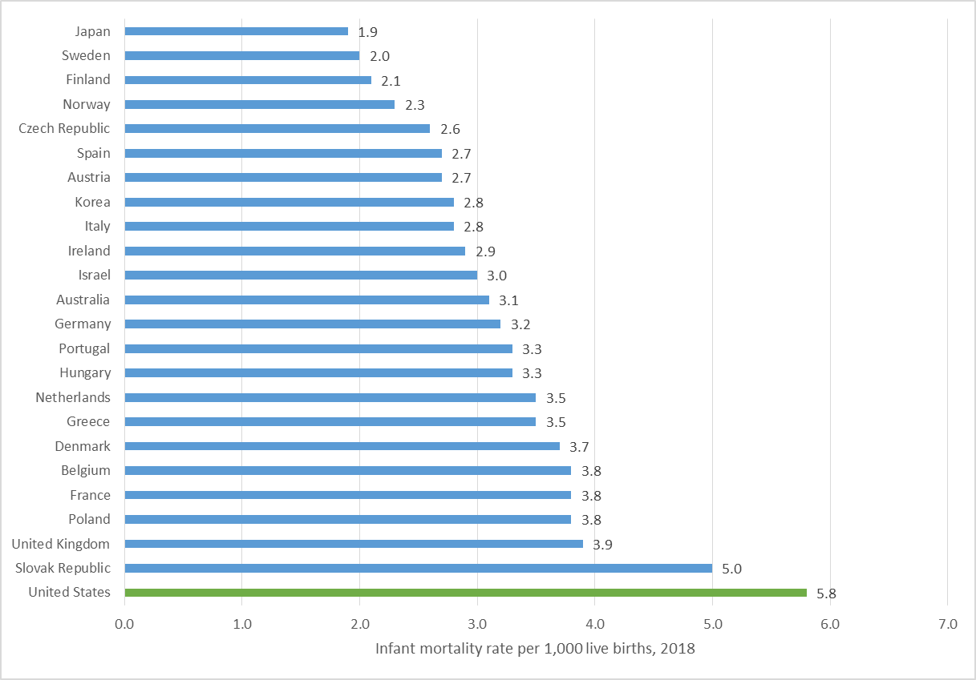
Infant mortality by country, 2018
Source: (OECD, 2020).
Notes:
“Before we talk about how to have conversations about safe sleep, we would like to provide a brief overview of infant mortality, or death, and why having campaigns and conversations matter.
A rate is the number of people experiencing some event, such as a sleep-related death, divided by the number of people at risk for the event, for a specific period of time. Rates are expressed in terms of a unit of population. Infant mortality rates are usually expressed per 1,000 live births. Rates allow us to make comparisons without worrying about the effects of population size.
As you can see from this chart, the United States ranks high in infant mortality among other developed countries. You will notice that Finland has one of the lowest infant mortality rate among these countries. We will talk more about Finland later in this training.”
Reference
Organization for Economic Cooperation and Development [OECD]. (2020). Infant mortality rates (indicator). http://doi.org/10.1787/83dea506-en (Accessed on 5 November 2020)

Slide 8
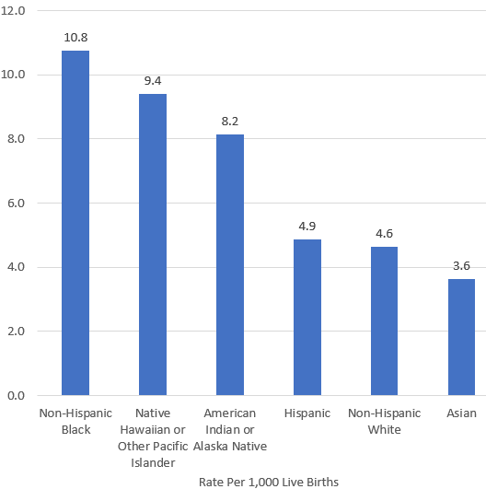
U.S. infant mortality by race and ethnicity, 2018
Source: (CDC, 2020).
Notes:
“As identified in this figure from the Centers for Disease Control and Prevention (CDC), U.S. infant mortality rates are higher among Non-Hispanic Black infants babies and American Indian/Alaska Native infants compared to all babies. Although the rate of infant death has declined over time for all races, the racial disparities in infant mortality rates that we see here have persisted over time despite these declines. For this reason, it is important to look at infant mortality through a health equity lens.
In 2018, infant mortality rates by race and ethnicity were as follows:
Non-Hispanic black: 10.8
American Indian/Alaska Native: 9.4
Native Hawaiian or other Pacific Islander: 8.2
Hispanic: 4.9
Non-Hispanic white: 4.6
Asian: 3.6
Reference
CDC. (2020). Infant mortality. Retrieved from https://www.cdc.gov/reproductivehealth/maternalinfanthealth/infantmortality.htm

Slide 9
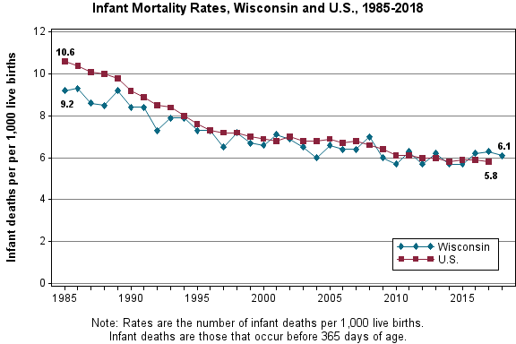
Infant mortality in Wisconsin
Source: (Wisconsin Department of Health Services, 2020).
Notes:
“Nationally the rate of infant death has steadily declined consistent with the promotion of babies sleeping on their backs in the early 90s. Wisconsin mirrors the national pattern, however has experienced inconsistencies. As noted on the previous slide; the rate for African American babies dying in Wisconsin is higher than all babies.”
Note: If anyone asks about why Wisconsin’s line goes up and down, please respond with the following: Because number of deaths in individual states can be small compared to a national view, you will naturally see more variance in the graphing. It is important to always look at the trend over time.
Reference
Wisconsin Department of Health Services, Division of Public Health, Office of Health Informatics. (2020). WISH infant mortality module. Retrieved from https://www.dhs.wisconsin.gov/wish/infant-mortality/index.htm

Slide 10
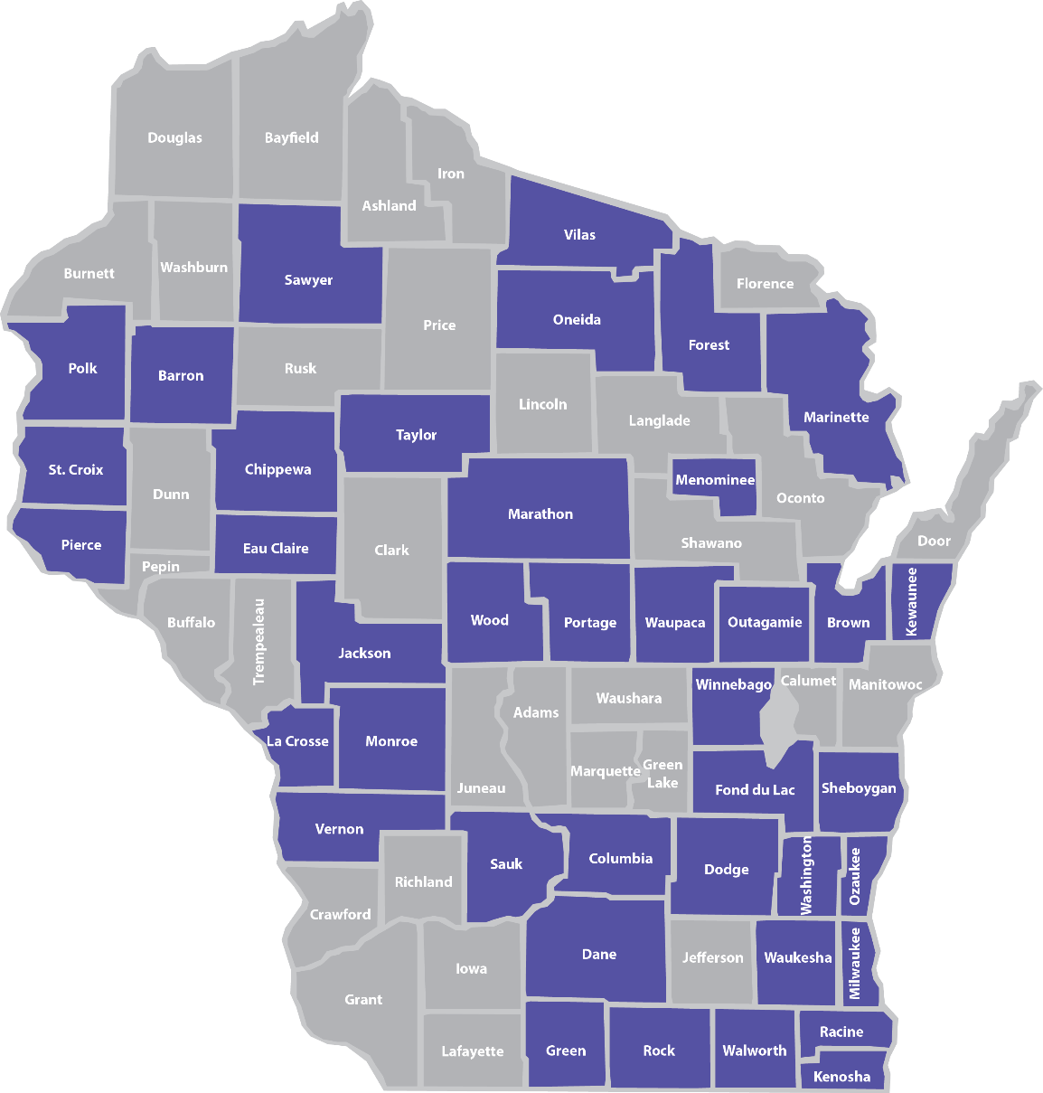
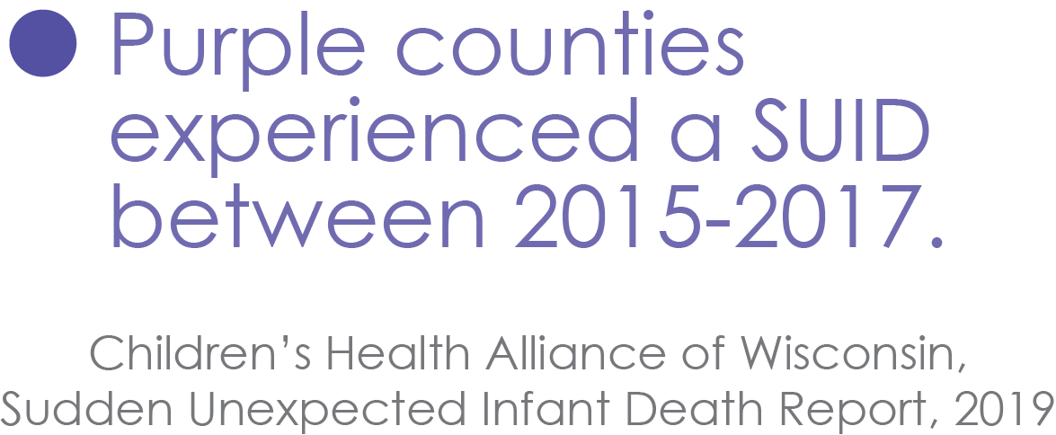
Wisconsin SUIDs by county
Notes:
“Now that you know more about SUID and SIDS, let’s talk about the numbers in Wisconsin. Between 2015-2017, 182 Wisconsin infants died in unsafe sleep environments in 40 different counties.
Each of these deaths occurred while the infant was sleeping or was in the sleep environment. These deaths fall into two categories:
Undetermined (77 percent): This includes deaths certified as SUID, Sudden Infant Death Syndrome (SIDS) and Undetermined.
2. Asphyxia (23 percent): This includes asphyxia due to the infant’s position, other objects in the sleep environment or overlay by another individual.
On average, more than one infant per week dies in an unsafe sleep environment in Wisconsin. This map shows that SUIDs can happen in all corners of our state, in both urban or rural areas.
Additional data from the 2017 SUIDs in Wisconsin:
Among 2017 SUIDs, 25% of infants were placed on their stomachs. An additional 14% were placed on their sides.
In regards to surface, 54% of infants were placed on an adult bed and 9% of infants were on a couch.
The majority (80%) of the incidents leading to a SUID occurred at the infant’s home. Among these cases, 87% of infants had a safe sleep surface available.
The majority (77%) of SUID sleep environments contained soft bedding. The most common bedding items were blankets (49%), pillows (46%) and comforters (42%).
Among 2017 SUIDs, 63% of infants were sharing a surface with one or more adults or children.
Caregiver substance use while sharing a sleep surface with the infant was confirmed in 18% of cases.
More details on the SUID data in Wisconsin is available in the full SUID Report on the Children’s Health Alliance of Wisconsin website: www.chawisconsin.org/sbs.”

Slide 11
Infant mortality at the local level
Notes:
Local data can be obtained from Children’s Health Alliance of Wisconsin for your county if a local source is not available. Please reach out to your contact at the Alliance for assistance if needed.
This is very important to share with the physicians so be sure to include your specific county data if possible.

Slide 12
AAP safe sleep guidelines
Notes:
Note: Provide a hard copy of the AAP guidelines in packet
“The AAP policy statement on safe sleep was revised in October 2016 and remains the standard used when discussing infant safe sleep. The AAP recommendations have been adopted by a variety of medical professionals including OBGYN’s, family practice physicians and others. Additionally, it has been adopted by a variety of community-based organizations, such as home visitors, child care centers, etc. The AAP’s parent portal (www.healthychildren.org) has a variety of resources that are widely used.
These guidelines were never intended to spark debate or controversy. They were meant to better inform families of how they could reduce risk of SUID and to establish universal messaging and common language around sleeping babies safely.
We will address some of the top recommendations today and reference the studies that led to the AAP’s recommendations. The citations are included in the actual guidelines if you would like more in-depth information on the research.

Slide 13
Top 10 recommendations
Back to sleep for every sleep, even naps
Use a firm sleep surface
Room-sharing without bed-sharing up to age 1
Keep soft objects and loose bedding out of the crib
Pregnant women should receive prenatal care
Notes:
“Looking at the AAP guidelines and the 2013/14 SUID data, these are the top 10 evidence-based recommendations we will discuss today as promoted in the Journal of Pediatrics. These are risk factors that can be changed to help prevent SUID in Wisconsin.”
Read through each recommendation.

Slide 14
Top 10 recommendations
6. Avoid smoke exposure during pregnancy and after birth
7. Avoid alcohol and illicit drug use during pregnancy and after birth
8. Breastfeeding is recommended
9. Consider offering a pacifier at nap and bedtimes
10. Avoid overheating
Notes:
Read through each recommendation.

Slide 15
Back to sleep for every sleep
Notes:
“Babies are not born with habits. How they sleep is a learned behavior. They will learn to be comfortable however they are placed right from the start. In addition to the recommendation encouraging sharing a room, it is highly recommended to follow the ABCs. Alone, on the back and in a crib or Pack N’ Play, and free from any smoke in the air. Babies need to sleep on their back for every sleep time. (Nap, night time, day care, visit to someone’s home etc.) Babies love consistency. If they start out sleeping on their backs, they learn to sleep this way. Habits are hard to break so it is easier for both parents and their baby to sleep safely starting with the very first sleep.“
Li DK, Petitti DB, WillingerM, et al. Infant sleeping position and the risk of sudden infant death syndrome in California, 1997–2000. Am J Epidemiol. 2003;157(5):446–455
Fleming PJ, Blair PS, Bacon C, et al. Environment of infants during sleep and risk of the sudden infant death syndrome: results of 1993–5 case-control study for confidential inquiry into stillbirths and deaths in infancy. Confidential Enquiry Into Stillbirths and Deaths Regional Coordinators and Researchers. BMJ. 1996; 313(7051):191–195

Slide 16
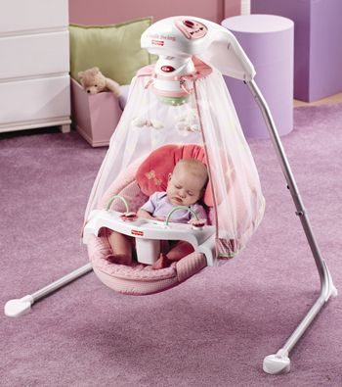
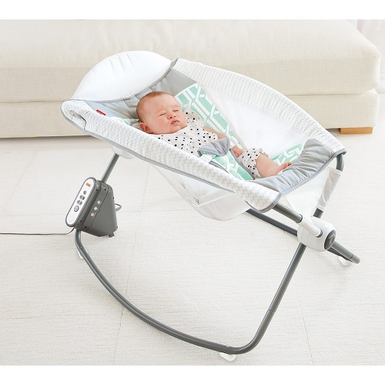
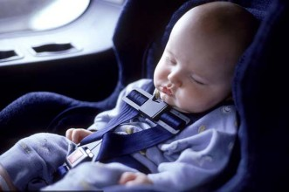
Use a firm, flat surface
NOT a swing, car seat, or inclined product
Notes:
“The supine sleep position, as you may know, does not increase the risk of choking and aspiration in infants, even those with gastro-esophageal reflux. Elevating the head of the crib is not effective and is not recommended. There will always be exceptions to this which would often be driven by a specialist.
Babies should not be left to sleep in a car seat or baby swing, or boppy pillow. A baby’s airway can become occluded (blocked) in these positions and can cut off their ability to breathe because their neck is not strong enough.
We cannot keep baby awake all the time and dosing off might happen, but it is important to not let them go into a deep sleep in the car seat or the swing – that is when it becomes unsafe. Caution families to be conscious of putting a blanket over the car seat and limit how long the blanket is covering the baby. Use a breathable material to avoid overheating and lack of fresh air.
We’ve heard from some parents that some physicians might guide a family to let their infant sleep in a swing or car seat. However please note, SUID deaths in Wisconsin have occurred in these environments in 2013-2014.”
8. Malloy MH. Trends in post-neonatal aspiration deaths and reclassification of sudden infant death syndrome: impact of the “Back to Sleep” program. Pediatrics. 2002;109(4): 661– 665 1036
9. Tablizo MA, Jacinto P, Parsley D, Chen ML, Ramanathan R, Keens TG. Supine sleeping position does not cause clinical aspiration in neonates in hospital newborn nurseries. Arch Pediatr Adolesc Med. 2007;161(5): 507–510
10. Vandenplas Y, Rudolph CD, Di Lorenzo C, et al. Pediatric gastroesophageal reflux clinical practice guidelines: joint recommendations of the North American Society for Pediatric Gastroenterology, Hepatology, and Nutrition (NASPG
11. Tobin JM, McCloud P, Cameron DJ. Posture and gastro-oesophageal reflux: a case for left lateral positioning. Arch Dis Child. 1997; 76(3):254 –258HAN) and the European Society for Pediatric Gastroenterology, Hepatology, and Nutrition (ESPGHAN). J Pediatr Gastroenterol Nutr. 2009;49(4):498 –547
American Academy of Pediatrics reflux management guidelines for physicians: http://pediatrics.aappublications.org/content/early/2013/04/24/peds.2013-0421
Pediatric Gastroesophageal Reflux Clinical Practice Guidelines: http://www.naspghan.org/files/documents/pdfs/position-papers/FINAL%20-%20JPGN%20GERD%20guideline.pdf

Slide 17
Share a room…not a bed
Promotes breastfeeding easily
Promotes bonding safely
Avoids risks of bed sharing
Room sharing is now recommended up to age 1
Image courtesy of the Safe to Sleep® campaign, for educational purposes only; Eunice Kennedy Shriver National Institute of Child Health and Human Development, http://safetosleep.nichd.nih.gov; Safe to Sleep® is a registered trademark of the U.S. Department of Health and Human Services.
Notes:
“The AAP guidelines are built around the promotion of breast feeding, bonding and safety. Keeping baby close to mom allows for each of these to occur.
Adult beds have lots of risk factors in them. There are a variety of soft, pillow-top mattresses, which do not support infants necks. A baby on a soft surface is at an increased risk of cutting off their airway if their heads roll forward or sideways or are hyperextended. Most adult beds also have pillows and blankets, which could easily suffocate an infant. Babies are not coordinated enough to move a blanket or pillow off of their face.”
5. Blair PS, Fleming PJ, Smith IJ, et al. Babies sleeping with parents: case-control study of factors influencing the risk of the sudden infant death syndrome. CESDI SUDI Research Group. BMJ. 1999;319(7223):1457–1462
7. Carpenter RG, Irgens LM, Blair PS, et al. Sudden unexplained infant death in 20 regions in Europe: case control study. Lancet. 2004; 363(9404):185–191
30. Mitchell EA, Thompson JMD. Co-sleeping increases the risk of SIDS, but sleeping in the parents’ bedroom lowers it. In: Rognum TO, ed. Sudden Infant Death Syndrome: New Trends in the Nineties. Oslo, Norway: Scandinavian University Press; 1995:266 –269
31. Tappin D, Ecob R, Brooke H. Bedsharing, roomsharing, and sudden infant death syndrome in Scotland: a case control study. J Pediatr. 2005;147(1):32–37

Slide 18
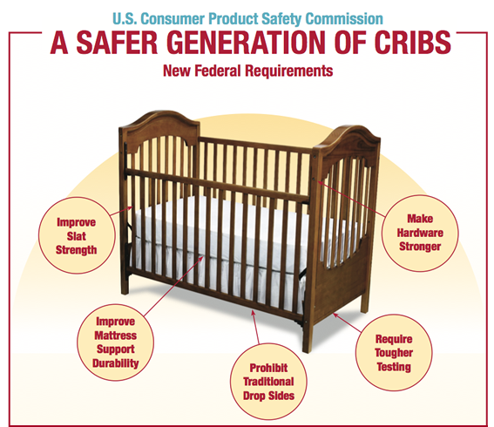
Keep soft objects out of crib
No blankets
No comforters
No pillows
No bumper pads
Notes:
“Let’s talk about safe surfaces to sleep a baby. Sleep surfaces can vary depending on cultural tradition, space and mobility. What is most important is NOT to sleep a baby on a soft surface such as a couch, bean bag chair etc. The most common surfaces are a crib or Pack N’ Play. Cribs today should contain a firm mattress, only 6 centimeters of space between rails on the crib (a soda can should not fit through the rails), no drop sides on the crib, strong hardware and tough testing, no bumper pads or stuffed animals, blankets, pillows, loose baby items etc. Pack N’ Plays also should have a tight fitting sheet free from items mentioned.”

Slide 19
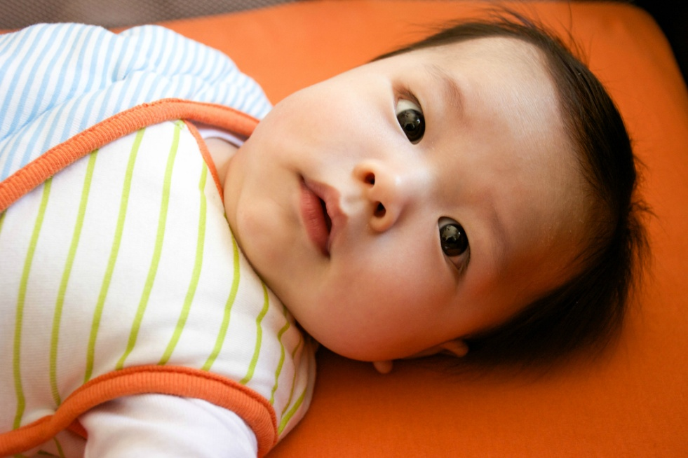
Regular prenatal care
There is epidemiologic evidence linking a lower risk of SIDS for infants whose mothers obtain regular prenatal care
Notes:
“The CDC defines “regular” prenatal care as at least 6 visits. 63% of those mothers who experienced a SUID received regular prenatal care.
There have been several studies looking at these risk factors, and mothers of cases studied were more likely to be younger, less educated and nonwhite, and more of them smoked during pregnancy and did not attend prenatal care. Placental issues were also a risk.”
Refer to SUID report.
54. Getahun D, Amre D, Rhoads GG, Demissie K. Maternal and obstetric risk factors for sudden infant death syndrome in the United States. Obstet Gynecol. 2004;103(4): 646 – 652
55. Kraus JF, Greenland S, Bulterys M. Risk factors for sudden infant death syndrome in the US Collaborative Perinatal Project. Int J Epidemiol. 1989;18(1):113–120
56. Paris C, Remler R, Daling JR. Risk factors for sudden infant death syndrome: changes associated with sleep position recommendations. J Pediatr. 2001;139(6):771–777
57. Stewart A, Williams S, Mitchell E, Taylor BJ, Ford R, Allen EM. Antenatal and intrapartum factors associated with sudden infant death syndrome in the New Zealand Cot Death study. J Paediatr Child Health. 1995; 31(5):473– 478

Slide 20
Avoid smoke exposure
Both maternal smoking and smoke in the
infant environment after birth are major risk
factors for SIDS
Notes:
“Studies show that prenatal exposure to cigarette smoke may result in increased risk of SIDS. Smoking prior to the birth causes low birth weight and preterm birth which both cause an increased risk of SIDS (Best, 2009). The same study suggests that second hand smoke exposure causes decreased lung function in infants and children as well as impaired arousal patterns of infants (American Academy of Pediatrics, 2011).
Chemicals in secondhand smoke appear to affect the brain in ways that interfere with its regulation of infants' breathing. Infants who die from SIDS have higher concentrations of nicotine in their lungs and higher levels of cotinine (a biological marker for secondhand smoke exposure that stays in the baby’s system longer) than infants who die from other causes.
53% of infants who died in a sleep environment were exposed to secondhand smoke after birth.”
1. Willinger M, James LS, Catz C. Defining the sudden infant death syndrome (SIDS): deliberations of an expert panel convened by the National Institute of Child Health and Human Develop
58. MacDorman MF, Cnattingius S, Hoffman HJ, Kramer MS, Haglund B. Sudden infant death syndrome and smoking in the United States and Sweden. Am J Epidemiol. 1997;146(3): 249 –257
59. Schoendorf KC, Kiely JL. Relationship of sudden infant death syndrome to maternal smoking during and after pregnancy. Pediatrics. 1992;90(6):905–908
60. Malloy MH, Kleinman JC, Land GH, Schramm WF. The association of maternal smoking with age and cause of infant death. Am J Epidemiol. 1988;128(1):46 –55
61. Haglund B, Cnattingius S. Cigarette smoking as a risk factor for sudden infant death syndrome: a population-based study. Am J Public Health. 1990;80(1):29 –32
63. Best D; American Academy of Pediatrics, Committee on Environmental Health; Committee on Native American Child Health; Committee on Adolescence. Technical report—secondhand and prenatal tobacco smoke exposure. Pediatrics. 2009;124(5). Available at: www.pediatrics.org/cgi/ content/full/124/5/e1017

Slide 21
Avoid alcohol and illicit drugs
There is an increased risk of SIDS with
prenatal and postnatal exposure to alcohol
or illicit drug use
Notes:
“This is a common sense statement made to parents. Much of the reason has to do with breastfeeding and how infants could potentially become exposed.
We consider the impairment of the parent and how more deeply one sleeps after consuming alcohol or taking certain drugs. It is often unknown whether the alcohol or drug use was a causal or contributing factor in the death (2013/14 SUID report).”
7. Carpenter RG, Irgens LM, Blair PS, et al. Sudden unexplained infant death in 20 regions in Europe: case control study. Lancet. 2004; 363(9404):185–191
37. Blair PS, Sidebotham P, Evason-Coombe C, Edmonds M, Heckstall-Smith EM, Fleming P. Hazardous co-sleeping environments and risk factors amenable to change: case control study of SIDS in south west England. BMJ. 2009;339:b3666
64. Rajegowda BK, Kandall SR, Falciglia H. Sudden unexpected death in infants of narcotic dependent mothers. Early Hum Dev. 1978; 2(3):219 –225
65. Chavez CJ, Ostrea EM Jr, Stryker JC, Smialek Z. Sudden infant death syndrome among infants of drug-dependent mothers. J Pediatr. 1979;95(3):407– 409
66. Durand DJ, Espinoza AM, Nickerson BG. Association between prenatal cocaine exposure and sudden infant death syndrome. J Pediatr. 1990;117(6):909 –911
67. Ward SL, Bautista D, Chan L, et al. Sudden infant death syndrome in infants of substance-abusing mothers. J Pediatr. 1990;117(6):876 – 881
68. Rosen TS, Johnson HL. Drug-addicted mothers, their infants, and SIDS. Ann N Y Acad Sci. 1988;533:89 –95
69. Kandall SR, Gaines J, Habel L, Davidson G, Jessop D. Relationship of maternal substance abuse to subsequent sudden infant death syndrome in offspring. J Pediatr. 1993;123(1):120 –126
70. Fares I, McCulloch KM, Raju TN. Intrauterine cocaine exposure and the risk for sudden infant death syndrome: a meta-analysis. J Perinatol. 1997;17(3):179 –182

Slide 22
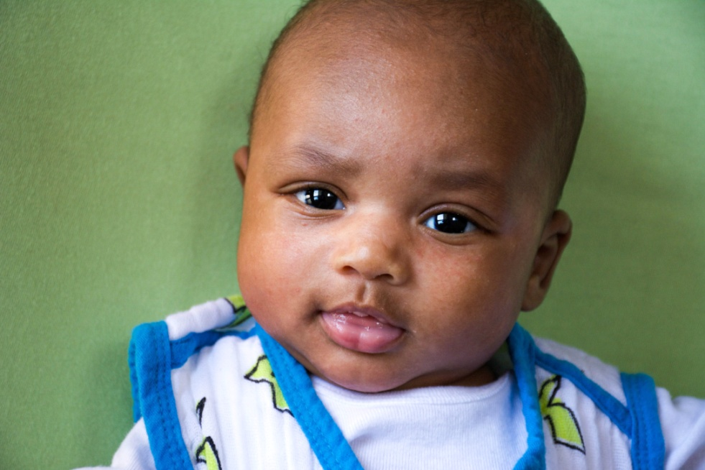
Breastfeeding is recommended
Breastfeeding is associated with a reduced risk of SIDS
Breastfeeding has been shown to be more protective against SIDS than not breastfeeding
Notes:
“Breast fed babies are at a reduced risk for a sudden and unexpected infant death. However, we must recognize not all babies are or can be breast fed and this does not diminish the importance of bonding and safety. Breast feeding is a protective factor. The protective effect of breastfeeding increases with exclusivity, but any breastfeeding is still protective. A study from 2009 by Vennemann, et al. suggests breastfeeding reduces the risk of SIDS by ~50% throughout all ages of infancy (Vennemann, et al., 2009). In 2015 the World Health Organization released a recommendation infants are breastfed exclusively through the first 6 months of life while other nutritious complementary food should be given after 6 months through two years of life or there after (World Health Organization, 2015).”
71. Ip S, Chung M, Raman G, Trikalinos TA, Lau J. A summary of the Agency for Healthcare Research and Quality’s evidence report on breastfeeding in developed countries. Breastfeed Med. 2009;4(suppl 1):S17–S30
72. Vennemann MM, Bajanowski T, Brinkmann B, et al; GeSID Study Group. Does breastfeeding reduce the risk of sudden infant death syndrome? Pediatrics. 2009;123. Available at: www.pediatrics.org/cgi/content/full/ 123/3/e406
73. Hauck FR, Thompson J, Tanabe KO, Moon RY, Vennemann M. Breastfeeding and reduced risk of sudden infant death syndrome: a meta-analysis. Pediatrics. 2011;128(1): 103–110

Slide 23
Consider offering a pacifier
Offer at nap time and bed time
Studies have reported a protective effect of pacifiers on the incident of SIDS
The protective effect persists through the sleep period even if it falls out of the baby's mouth
Notes:
“Although the reason for use of a pacifier as a protective factor is still unclear, the protective effect continues through each sleep opportunity. And this is true even if the pacifier falls out during sleep.
A 2003 study conducted by Hauk, Herman and Donovan shows decreased risk of SIDS if a pacifier was used during infant sleep (Hauck et al., 2003). If the infant is resistant to taking the pacifier it does not need to be given as well as reinserted once the infant falls asleep. If the mother is breastfeeding, delayed pacifier use is recommended until breastfeeding as been strictly established, usually 3-4 weeks of age (American Academy of Pediatrics, 2005).”
It is important for the mom to establish breastfeeding before introducing the pacifier.
3. Hauck FR, Herman SM, Donovan M, et al. Sleep environment and the risk of sudden infant death syndrome in an urban population: the Chicago Infant Mortality Study. Pediatrics. 2003;111(5 pt 2): 1207–1214
7. Carpenter RG, Irgens LM, Blair PS, et al. Sudden unexplained infant death in 20 regions in Europe: case control study. Lancet. 2004; 363(9404):185–191
32. McGarvey C, McDonnell M, Chong A, O’Regan M, Matthews T. Factors relating to the infant’s last sleep environment in sudden infant death syndrome in the Republic of Ireland. Arch Dis Child. 2003;88(12):1058 –1064
74. American Academy of Pediatrics, Section on Breastfeeding. Breastfeeding and the use of human milk. Pediatrics. 2005;115(2): 496 –506

Slide 24
Avoid overheating
Set room temperature to what is comfortable for adults
Dress baby to be comfortable
Use a sleep sack
Use of a fan in the room has been considered a protective factor
Notes:
“Parents often think babies need to be kept warmer than themselves. Again, based on the triple risk model, this could be an environmental stressor that increases the risk of an unexplained infant death. We have learned that babies can become overheated and as a result are at risk for death. Healthy babies do a good job regulating their own body temperature. A study conducted by Fleming et al. in 1990 showed that overheating an infant comes with a higher risk of SIDS (Fleming et al., 1990). Generally, infants should be dressed appropriately for the weather with no more than one extra layer in which an adult would wear. Sleep sacks are great because the baby is adequately covered and avoids the risk of a blanket.
A study completed by Blair, et al. in 2008 suggests that over bundling and covering of the face should be avoided as well (Blair et al., 2008). Again, caution families to be conscious of putting a blanket over the car seat and limit how long the blanket is covering the baby. Using a breathable material to avoid overheating and lack of fresh air is important to share.
Although the research is new, a study completed by Coleman-Phlox et al. in 2008 found that using a fan in the room is considered a protective factor for an unexplained death. This is thought to be due to air circulation and reducing the amount of CO around the baby. However, the fan should never blow directly on the infant.”
37. Blair PS, Sidebotham P, Evason-Coombe C, Edmonds M, Heckstall-Smith EM, Fleming P. Hazardous co-sleeping environments and risk factors amenable to change: case control study of SIDS in south west England. BMJ. 2009;339:b3666
75. Fleming P, Gilbert R, Azaz Y, et al. Interaction between bedding and sleeping position in the sudden infant death syndrome: a population based case-control study. BMJ. 1990; 301(6743):85– 89
Coleman-Phlox et al.
76. Ponsonby AL, Dwyer T, Gibbons LE, Cochrane JA, Jones ME, McCall MJ. Thermal environment and sudden infant death syndrome: case-control study. BMJ. 1992;304(6822): 277–282
77. Ponsonby AL, Dwyer T, Gibbons LE, Cochrane JA, Wang YG. Factors potentiating the risk of sudden infant death syndrome associated with the prone position. N Engl J Med. 1993; 329(6):377–382
78. Iyasu S, Randall LL, Welty TK, et al. Risk factors for sudden infant death syndrome among northern plains Indians. JAMA. 2002; 288(21):2717–2723

Slide 25
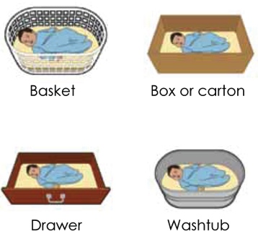
Alternative safe sleep surfaces
Image courtesy of the Safe to Sleep® campaign, for educational purposes only; Eunice Kennedy Shriver National Institute of Child Health and Human Development, http://safetosleep.nichd.nih.gov; Safe to Sleep® is a registered trademark of the U.S. Department of Health and Human Services.
Notes:
“Alternatives to the traditional crib have been around for a very long time and were introduced to address concerns and desires expressed by families. Such as, how they can sleep near their baby but keep them safe. In 1937 Finland had an extremely high infant mortality rate of 65 deaths for every 1,000 births. The government passed the Maternity Grants Act to help decrease the high rate. Originally for families in poverty, the grant provided every newborn infant with the basics so that he or she would have the same start and chance at life as other infants in higher economic classes. The program now gives every baby a box, no matter what economic class. The kit includes a box for the baby to sleep in along with other necessities such as clothes, diapers, etc. Once Finland’s babies started sleeping in boxes, their infant mortality rates dropped to 3.38 deaths for every 1,000 births (Moheny, 2013).
No matter what container is used, the surface must be flat and firm. A changing pad for example can be used in the bottom of a container as long as it is not fluffy, is tucked into the mattress and is secure. Often times this alternative can be used for families that are visiting, transient families, or just wanting baby in another room near you.”
Note: Refer families to a local source for a crib or Pack N Play. Make information about local resources available to training attendees so they know where to send families.

Slide 26
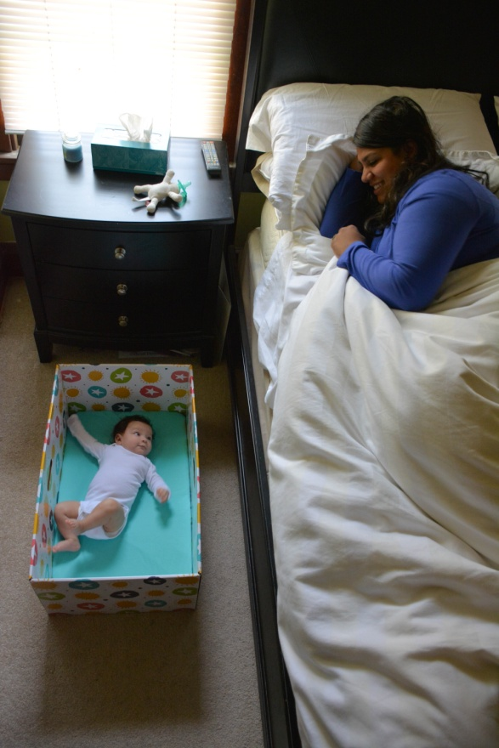
Alternative safe sleep surfaces
Notes:
“Some families use a Baby Box or Newborn Nest as a way to keep their babies safe as an alternative sleep option. Newborn Nests are a rather new infant product, and there is currently no evidence from the US demonstrating that Newborn Nests are effective in reducing infant mortality rates. However, there is promising evidence from other countries. Based on this, there was a desire from statewide partners to pilot Newborn Nests.
In response to the infant mortality crisis Wisconsin and the nation is facing, Children’s Hospital of Wisconsin has decided to pilot Newborn Nests in a few of their programs across the state. From the data collected on sleep-related infant deaths, we know that many of the families served in Children’s Hospital of Wisconsin programs are at an increased risk for a sudden-unexpected infant death. Children’s Hospital of Wisconsin Foundation has funds set aside for SIDS research, which is supporting this work. Throughout 2016, this pilot program has been developed and implemented, and data is being collected in an effort to quantify the findings and share the results.
It is important to note that the Newborn Nests are NOT intended to replace cribs or Pack n’ Plays, and are presented to families as an additional tool for providing their infant with a safe sleep environment for every sleep time. The Newborn Nests that have been distributed so far in Wisconsin have been especially useful for families who are transient, living in small spaces or are following specific cultural traditions.”
Note:
Children’s Health Alliance is working closely with Children’s Hospital on this pilot program and can provide additional information if there is interest from training participants on learning more about the Newborn Nest.

Slide 27
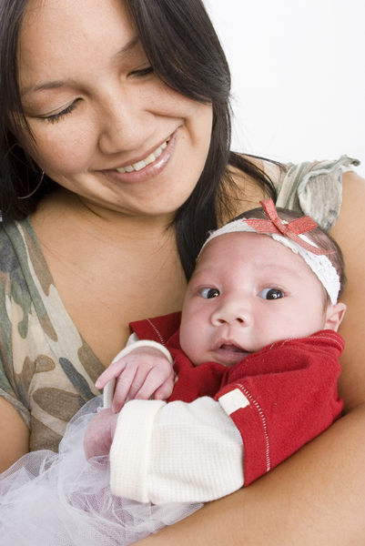
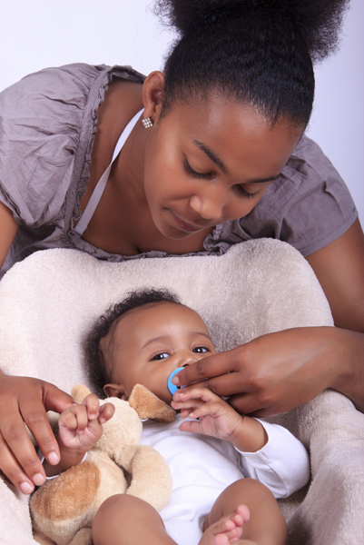
Cultural tradition
Notes:
“As you know, it is important to learn and acknowledge a family's culture, religion and traditions. Our goal is to respect and value the beliefs of each family while assisting them in thinking about a new way of maintaining culture and tradition while ensuring their baby is safe. Engaging in a meaningful dialogue with families can help ensure that an infant is sleeping safely while things like culture, religion and family tradition are honored.
All moms and families want their baby to be safe and grow up to lead a healthy life. It is important to approach a family in this light and not make them feel guilty if they are doing something different than the recommended AAP guidelines. We should share we have learned a lot from our history and ancestors. While traditions and cultures are valued, we cannot ignore what we have learned and information that will help babies thrive. You want to share all that you know and what we have learned over time so they as a family can make decisions based on factual information. But in the end families make the choice. Risk factors in a sleep environment affect all cultures and all socioeconomic classes of people, rich and poor. It is important to share the same information with all families.”

Slide 28
Why families might not embrace the AAP guidelines
Comfort of baby or themselves
Convenience
Safety
Prior experience with other children or own childhood
Advice from family members or friends
Lack space for a crib
Lack of a crib (money or access)
Differing information or knowledge
Mixed messages from health care providers
Information is not culturally appropriate
Notes:
“Here are some of the reasons families might not embrace the AAP guidelines. Many of you may have heard some or all of these at some point in your practice. Does anyone have any thoughts or stories of conversations with families that were similar to these? How do you typically respond to a family that shares these concerns or situations with you?
It is important to listen and understand why families may not utilize the AAP recommendations. We must approach the conversation with questions and reaffirm you are hearing and understanding the family’s circumstances.”

Slide 29
Conversations with families
Prenatal
Where will baby to sleep when you bring him home?
Will you travel overnight with baby?
Where will baby stay while you are working?
Postpartum
Where did baby sleep last night?
Do you know where baby sleeps at daycare?
“I really support these guidelines as your [pediatrician].”
Notes:
“Asking the family questions about their plans for where baby will sleep will help the parents think about, if they haven’t already, their plans for baby’s sleep environment. This can help spark your conversation with a family about all the places that their baby may need to sleep, including day care, on the weekends, etc.
It’s important to create a trusting relationship where the family leads the conversation. You can learn a lot by asking open ending questions through some basic motivational interviewing.
Talking about AAP guidelines may be overwhelming to a family, but they will trust your opinion. Be sure to let them know through your conversation that these are the guidelines that you support and that it will help keep their baby safe.
Again, we recognize you may not be able to have the conversation – but how can you ensure this information is being shared with the family by you or other staff?”

Slide 30
No safe way to share a bed
“As your physician I cannot tell you how to sleep with your baby safely because there truly is no safe way. But let’s talk about how you can reduce the risk of anything happening. Remember what we talked about…”
Notes:
Let the training participants know they will determine their own way to deliver the following message:
“You have the right to choose where and how your baby sleeps. I care about you and your baby, and just want to make sure you have all the information we have so your baby has the best chance to reach his/her first birthday. I am not able to tell you how to sleep with your baby safely because there just isn’t a safe way. But please think about all we have talked about and reduce the risks to your baby as much as possible.”
OR
“It is my responsibility to give you information to help you make the best possible choices for you and your family. I know you want what is best for your baby so I am here to help you.”

Slide 31
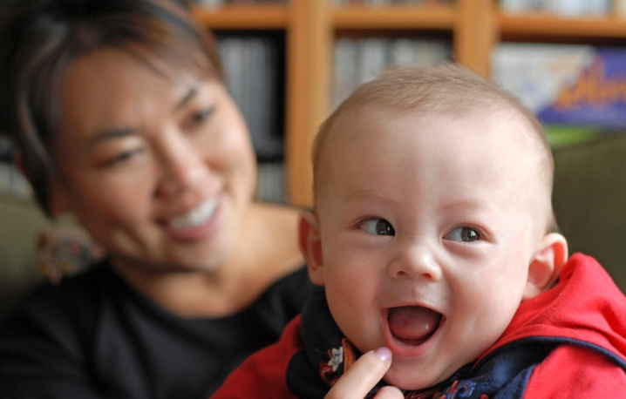
Thank you for all you do!
Notes:
Conduct post survey of training session

Slide 32
Updated: January 2018

