Slide 1
Sleep Baby Safe
Ensuring your baby thrives
Notes:
Trainer/educator needs to introduce yourself and organization then:
Reference that the WI Dept Heath Services made safe sleep a priority and your relationship to DHS or Children’s Health Alliance of Wisconsin
Include that this is a National effort to improve the sleep environment for babies
You want the audience to know who “we” is and why this “we” is talking to them
“We recognize “safe sleep and co-sleeping” has received significant attention and we know that families are continuously receiving mixed messages about how to sleep their baby – from medical professionals, family members and friends. We want to make sure every family knows what we have learned and has the most accurate and consistent information in hopes that all babies are sleeping safe.”
Ask the parents: What messages have you received about infants sleeping? What do you know about safe sleep?
Possibly add (depending on responses): Some of us probably put our babies on their tummies to sleep, decorated the crib with cute bumper pads ,matching quilts and stuffed animals, and even shared a bed. Everyone wants to protect a new baby and we used to think this is the way you did it.

Slide 2
Goals
Understand the “why” behind the safe sleep recommendations
Be able to name the ABCs of safe sleep
Set a goal for your baby’s safest sleep
Notes:
We want to help you understand what has been learned over the past 20 plus years, and WHY your baby should sleep alone, on their back in an uncluttered crib. And by the end you can consider what you want for your baby and set a goal for how your baby will safely sleep.

Slide 3
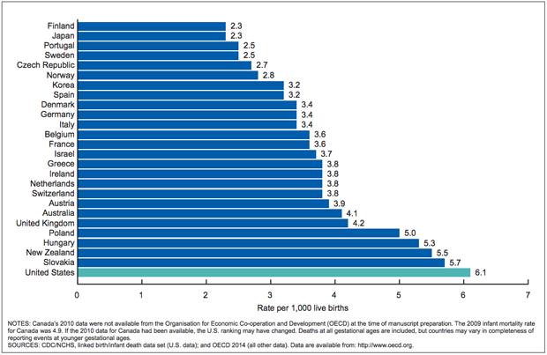
Infant mortality in the U.S., 2010
Notes:
“Before we talk about how to provide your baby a safe sleep environment, we would like to talk about the problem. As you can see the US has the highest infant mortality compared to many other developed countries – infant mortality is the death of an infant in the first 12 months and this is all infant deaths not just sleep-related ones. But, once an infant reaches one month of age, a common cause of death is related to SIDS and the sleep environment. Sleep related deaths are often categorized as suffocation. This has become an important issue to the U.S. as there are now 36 states that have committed to improving safe sleep and spreading the word.”

Slide 4
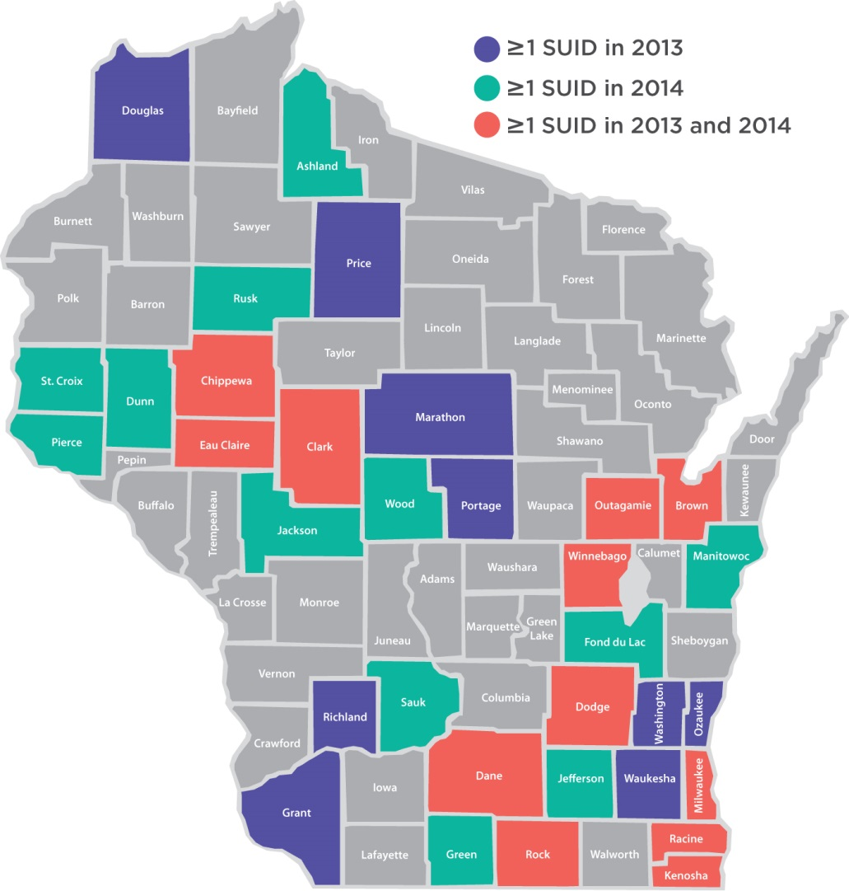
Infant sleep-related deaths
56 Sudden Unexpected Infant Deaths:
59% were male
89% were older than 28 days
20% were born with a low birth weight
9% involved a caregiver under the influence
76 % were not sleeping on a firm surface
58% were sleeping in an adult bed
62% were sharing sleep space with adult
87% had soft objects or loose bedding in the sleep environment
Notes:
“Now let’s take a closer look at Wisconsin. During 2013 -14, 118 infants died in unsafe sleep environments in 33 different counties. In 2013 there were 55 unexpected infant deaths in 20 different WI counties. Several key points of the SUID report released by Children’s Health Alliance include:
List percentages that involve the sleep environment
Note that the lowest percentage involves a caregiver being under the influence. Often times people think this is the most common reason behind an unexpected death, but this goes to show that there are many other risks happening.
It is important you know that this isn't to scare you, but to make you aware of the risks that come with an unsafe sleep environment. We have to remember there are thousands of babies and parents out there sleeping safely as we speak, and yes accidents happen and you fall asleep next to them, but we want you to view sleep related deaths as preventable and not a mysterious phenomenon outside our control. Once a baby is born, prevention is a priority. Sleeping baby safe, breastfeeding, and not smoking are the top prevention actions we can take.”

Slide 5
Know your ABCs
Notes:
The American Academy of Pediatrics is a national organization of pediatricians devoted to taking care of your babies and children. Based on what they have learned through many years of experience and research, they revised the guidelines for safe sleep in 2011.
The new guidelines are now the gold standard and widely accepted and used by primary care pediatricians, family physicians, neonatal care, and child care professionals. Since having babies sleep their backs infant deaths have been steadily decreasing and even further supporting the use of the ABC’s. These are meant to help give every baby the best chance to reach their 1st birthday safely and healthy.”

Slide 6
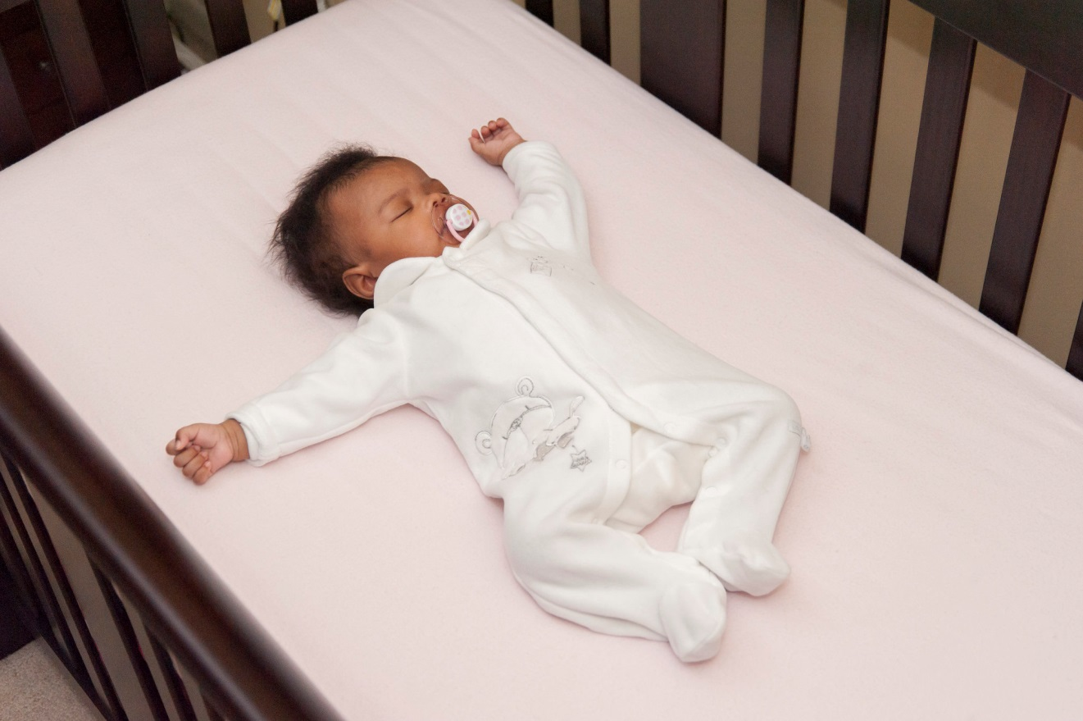
Alone, on Back, in Crib and in Smoke-free air
Notes:
“ It is highly recommended to follow the ABCs. Alone, on the back and in a crib or Pack N’ Play, and free from any smoke in the air. Babies need to sleep on their back for every sleep time. (Nap, night time, day care, visit to someone’s home etc.) Babies love consistency. If they start out sleeping on their backs, they learn to sleep this way because sleeping is a learned behavior (like talking).”
“Infants who are exposed to secondhand smoke after birth also are at greater risk for SIDS. Chemicals in secondhand smoke appear to affect the brain in ways that interfere with its regulation of infants' breathing. More specifically, Infants who die from SIDS have higher concentrations of nicotine in their lungs and higher levels of cotinine (a biological marker for secondhand smoke exposure that stays in the baby’s system longer) than infants who die from other causes.”

Slide 7
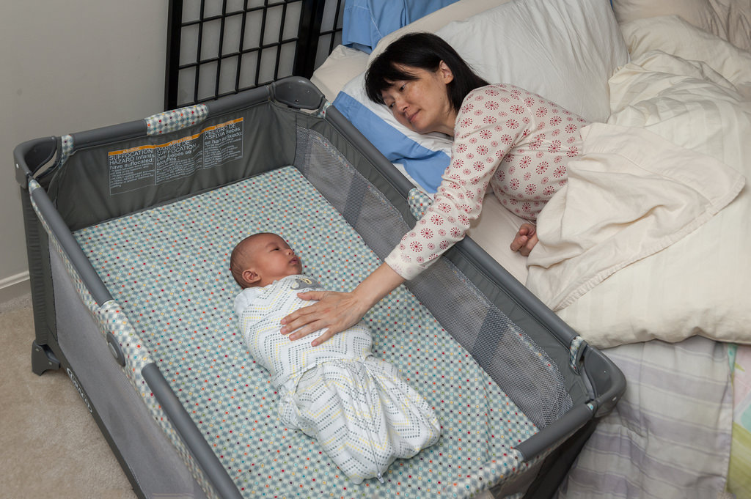
ALONE Share a room…not a bed
Promotes breastfeeding easily
Promotes bonding safely
Avoids risks of bed sharing
Image courtesy of the Safe to Sleep® campaign, for educational purposes only; Eunice Kennedy Shriver National Institute of Child Health and Human Development, http://safetosleep.nichd.nih.gov; Safe to Sleep® is a registered trademark of the U.S. Department of Health and Human Services.
Notes:
“Share a room instead of a bed because adult beds have lots of risk factors in them. There are a variety of soft, pillow-top mattresses, which do not support infants necks, this increases their risk of cutting off their airway if their heads roll forward or sideways or are hyper extended. There are also pillows and blankets which could easily suffocate an infant. Babies are not coordinated enough to move a blanket or pillow off of their face. Keeping baby close to you promotes breast feeding, bonding and safety. Breast fed babies are at a reduced risk for an unexpected infant death.”

Slide 8
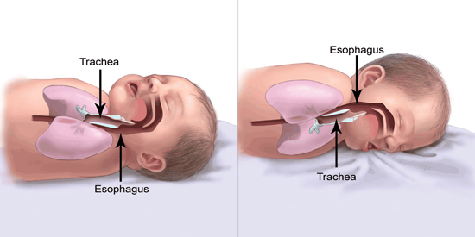
BACK-to-sleep
Babies are less likely to choke
on their backs
Image courtesy of the Safe to Sleep® campaign, for educational purposes only; Eunice Kennedy Shriver National Institute of Child Health and Human Development, http://safetosleep.nichd.nih.gov; Safe to Sleep® is a registered trademark of the U.S. Department of Health and Human Services.
Notes:
After research and studies, we found that babies sleeping on their backs is the safest – as you can see the trachea (airway) actually lies on top of the esophagus (tube that goes into the stomach). When a baby spits up, gravity will keep the spit-up in the esophagus, and it will either come out of the baby’s mouth or he will swallow it. Either way his trachea is protected when the baby is on his back. Also, placing the baby on his tummy doesn’t allow him to breathe in fresh air. Since the back to sleep campaign started in 1992, we’ve seen a 50 % reduction in infant deaths.”
Demonstrate using two fingers. Finger on top is the trachea – baby can breathe.

Slide 9
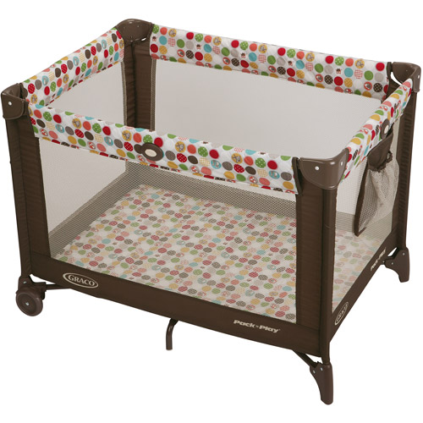
CRIB or Pack N’ Play Uncluttered safe
Notes:
“What is most important is to sleep a baby in a cribs that has a firm mattress, only 6 centimeters of space between rails on the crib (a soda can should not fit through the rails), no drop sides on the crib, strong hardware and tough testing, no bumper pads or stuffed animals, blankets, pillows, loose baby items etc. (nothing means nothing!) Pack N’ Plays also should have a tight fitting sheet free from items mentioned. Using a Pack N’ Play for temporary storage is contaminating the area with germs. It’s important to keep it clean and empty so baby can use it at anytime.”
(Google consumer product safety commission for more information)

Slide 10
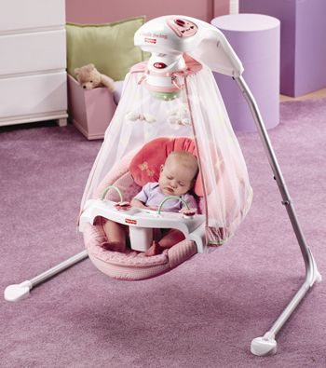
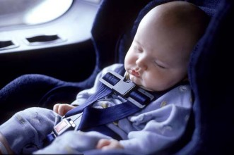
Always sleep on a firm surface
NOT the swing NOT the car seat
Notes:
“Babies should not be left to sleep in a car seat or baby swing. A baby’s airway can become blocked when their neck is bent and cuts off their ability to breath because their neck is not strong enough. Be conscious of putting a blanket over the car seat, you want to limit how long the blanket is covering the baby and you want to use a breathable material to avoid overheating and lack of fresh air. We cannot keep baby awake all the time and dosing off might happen, but it is important to not let them go into a deep sleep in the car seat or the swing – that is when it becomes unsafe.”

Slide 11
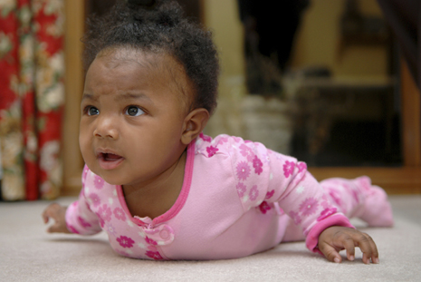
Back-to-sleep…tummy to play
Babies will learn to be comfortable if they start out on their backs and stay on their backs
On their backs at every sleep time – naps and nighttime
Notes:
“Babies are not born with habits. Habits are hard to break so it is easier for both parents and their baby to sleep safely if parents always, consistently place baby to sleep alone, on their backs, in a crib, in a smoke-free home, starting at birth, and during every sleep time. Babies do need tummy time to develop different muscles, but it should only be when they are awake and supervised. Tummy time is important to help avoid your baby getting a flat head.

Slide 12
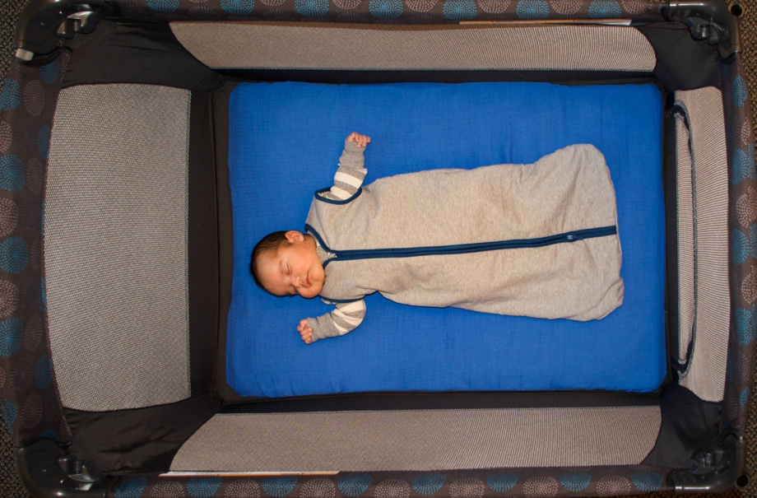
Avoid overheating
Set room temperature to what is comfortable for adults
Dress baby to be comfortable
Use a sleep sack
Notes:
“Parents often think babies need to be kept warmer than themselves. We have learned that babies can become overheated and as a result are at risk for death. Sleep sacks are great because the baby is adequately covered and avoids the risk of a blanket. Healthy babies do a good job regulating their own body temperature.”

Slide 13
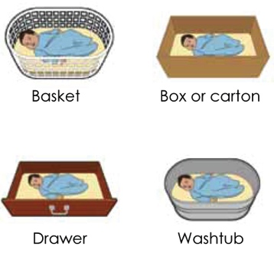
Alternative sleep surfaces
Image courtesy of the Safe to Sleep® campaign, for educational purposes only; Eunice Kennedy Shriver National Institute of Child Health and Human Development, http://safetosleep.nichd.nih.gov; Safe to Sleep® is a registered trademark of the U.S. Department of Health and Human Services.
Notes:
“No matter what the container is, the surface must be flat and firm. Historically we have used other alternatives for generations. We first and foremost recommend the crib or pack n play, please let me know if you need help getting one. Otherwise these examples are for when you are in a pinch, maybe stuck at a friends house for the night or in a hotel. This will help to sleep your baby safe if baby is somewhere other than home. These alternatives should really only be used for up to 2 months old. Make sure the surface is firm and secure, such as using a changing pad.”
Refer families to a local source for a crib or Pack N Play. Mention new born nest program if your county offers these.

Slide 14
Share the message
Share where and how baby sleeps with babysitters and other family members
Notes:
“It is important that you share this information with other family members and caregivers. Babies learn to sleep a certain way. If a baby is used to sleeping on their back and then is slept on their tummy, they are 4 times at risk for something happening. Babies love consistency.”

Slide 15
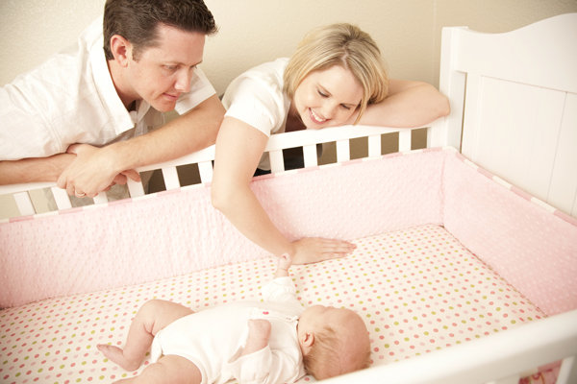
Is this baby safe?
Notes:
“Here is a sleep environment. What do you believe poses a risk to this baby?
Answer: Bumper pads

Slide 16
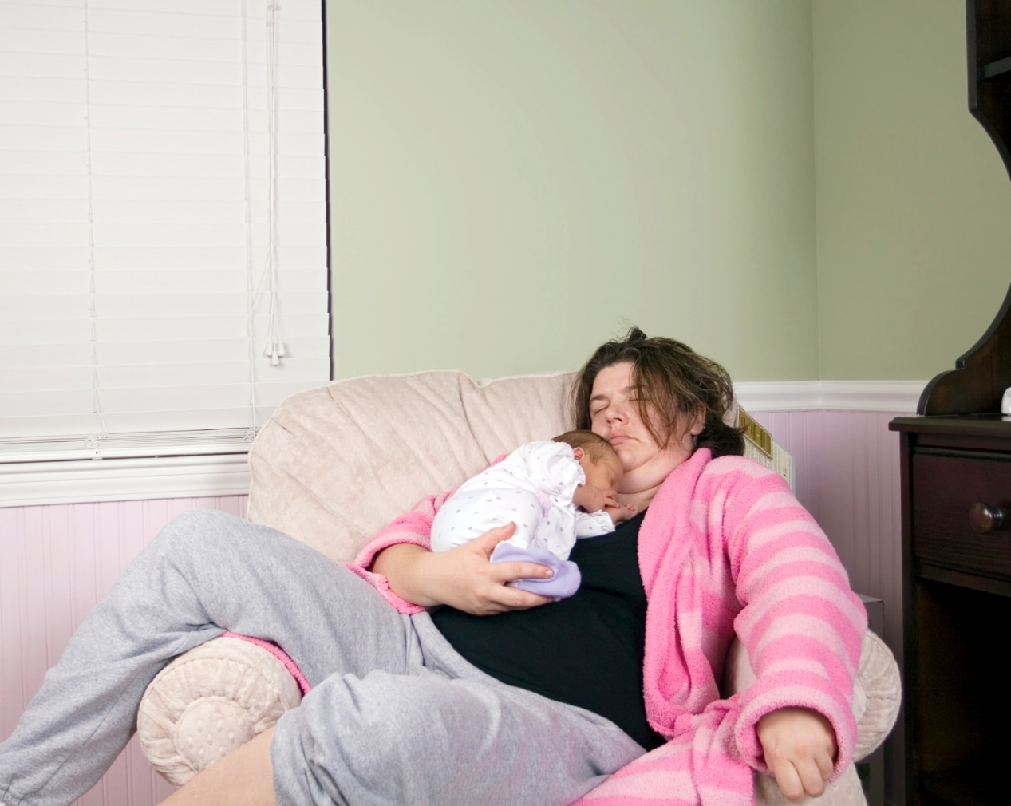
Is this baby safe?
Notes:
“It is important that babies always sleep in a crib or Pack N’ Play every time they are asleep. Couches, chairs – especially bean bag chairs – are dangerous.”
Answer: Chair is unsafe, baby is at risk of falling off of mom, baby is not on back, co-sleeping

Slide 17
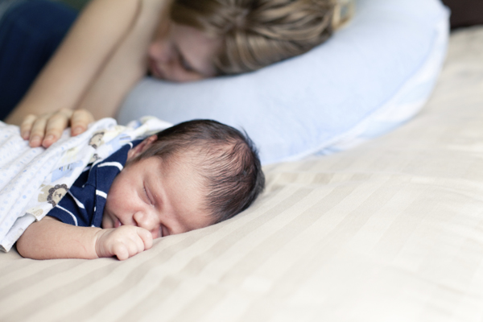
Is this baby safe?
Notes:
“Here is another sleep environment for a baby. What do you think?”
Answer: In bed with adult
On tummy
Sleeping on soft bedding and near big pillow

Slide 18
Who’s advice do you take?
Family tradition
Grandma knows best
Physician
Personal beliefs
Research
Notes:
“Having a baby is an exciting time. Your extended family is happy for you and offering free advice. As mentioned earlier, you also hear different messages from a variety of people. We know you want to do the very best for your baby to make sure he/she grows ups to be healthy and happy. This is why we want to give you support and information as you make decisions that will help your baby do well. It is your decision on how you sleep your baby. We want to make sure you have all the facts about what is the safest way.
Conversations with others can be challenging. Using the story of seat belts is a great way to educate others - While many of us survived never wearing a seat belt, we wear them now, and we would agree if we were in a car crash, our chances of surviving are much greater if we are wearing a seat belt. This is similar to how your mom may have slept you a certain way and you survived, but we have ways to make sure more babies survive.
If you find it may be difficult to talk to family about how you want to sleep your baby, then consider sharing the ‘Table Talk` sheet. You could put it out when Grandma or other caregivers are visiting and this gives you the opportunity to share what you’ve learned.”

Slide 19
What if…
Baby seems to not like their crib
Sleep baby on their back right from the start
Place baby in the crib before they are completely asleep to avoid a startle reflex, then rub the baby’s tummy to soothe them
I want to bond with my baby
Other safe bonding times include feeding, wearing baby carrier, playing during tummy time, rubbing their tummy while they are in the crib
Notes:
“We understand there are many cultures, traditions, environments, socioeconomic status and other factors that can affect a families abilities or choices in how the baby will sleep. We would like to provide suggestion for some common barriers.”
What if baby seems to not like their crib…Again, sleeping is a learned behavior and that is why it is so important for baby to be on their back from the start and get used to the ABC sleep environment . If you lay them in their crib before they are in a deep sleep it avoids the startle reflex and you can rub their tummy to soothe them as they fall asleep
What if I want to bond with my baby… Babies bond best when they are awake and there is interaction… do not think you are missing out on bonding if you are not co sleeping. There are many times to bond with your baby when you are both awake. Bonding is happening as you breast feed, if you are carrying baby around in a baby carrier, playing during tummy time, rubbing their tummy in the crib and not to mention all the bonding that occurs as you are pregnant.”

Slide 20
What if…
It’s easier to take care of baby if he is sleeping with me
There is no space for a crib in my bedroom
Rearrange the room, remove other furniture, or use a smaller alternative option
Place crib just outside the bedroom
Notes:
“What if it is easier to take care of baby if he is sleeping with me or there’s no space for a crib in my bedroom… you can rearrange the room to make space for the crib near your bed, take a piece of furniture out, or put the crib right outside your room. There are many ways to keep baby close but still safe.”
When you are sleeping you are not awake to care for your child and his/her safety, so having baby in a crib or pack n play is best so everyone gets good sleep. MS - I added this
We would love to give you resources for assistance or answer any questions more specifically to you.

Slide 21
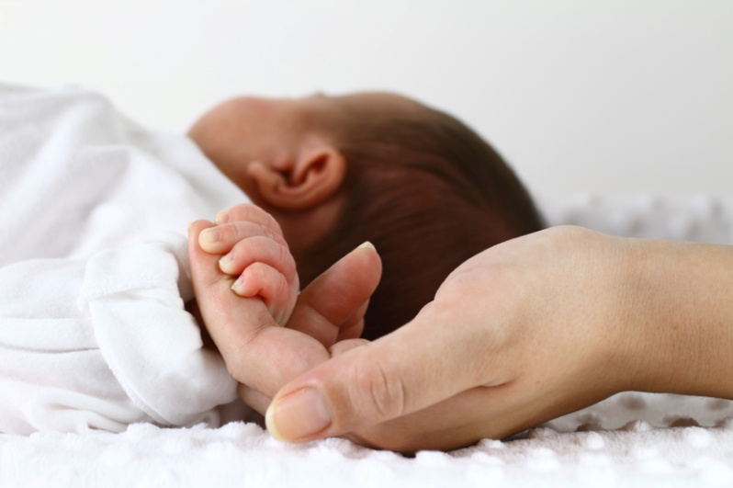
Let’s be safe and not just lucky
“I didn’t think it would happen to me…”
Notes:
“Very commonly when we hear of these tragedies, you hear the parent say “I didn’t think it would happen to me…” This is why it is so important for us to share this message. We would never want a parent to say “I didn’t know” I didn’t know my baby was supposed to sleep on their back, I didn’t know I wasn’t supposed to co-sleep, or that I should avoid blankets. We want everyone to be safe not just lucky that something like this didn’t happen.”

Slide 22
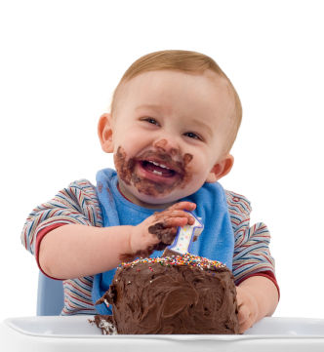
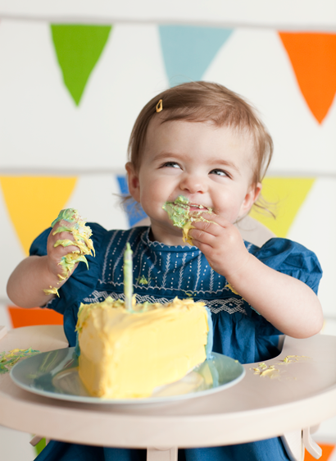
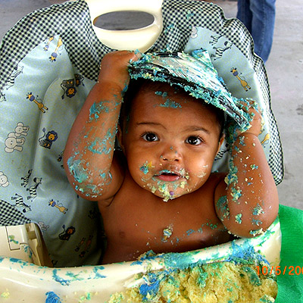
What’s your goal for your baby sleeping safe?
Notes:
“Our goal is to help you and your baby celebrate their first birthday! Please take the time to write down a goal of your own to have your baby sleep safe.
(Ex: telling your family, making space for a crib near your bed so it is convenient and safe, staying clear of bumper pads and any other cute accessories for the crib)
Would anyone like to share? Are there any questions?”
Include action steps worksheet – what is their plan?

Slide 23
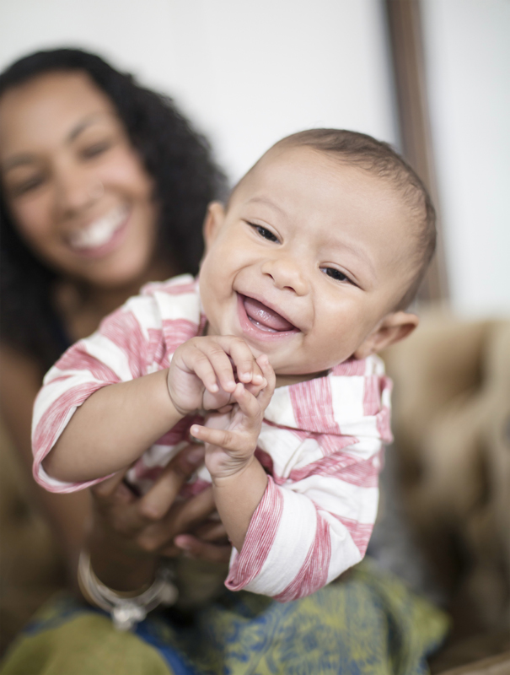
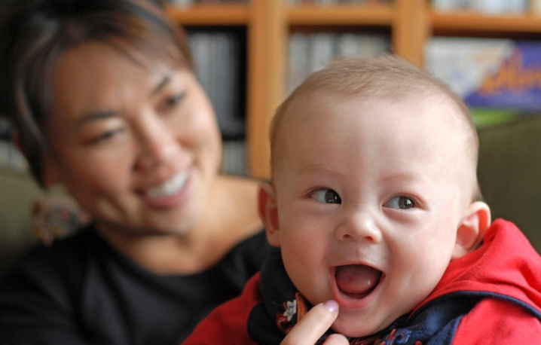
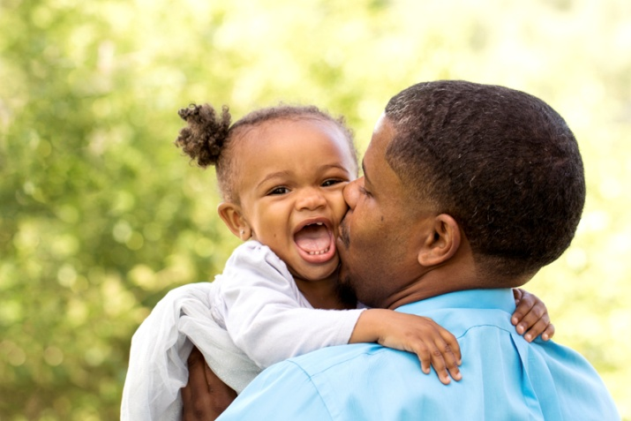
Questions
Notes:
“We are excited for you and wish you the best as you bring your new and precious infant into the world!”

