Slide 1
Sleep Baby Safe
Introducing the Newborn Nest
Notes:
“In response to the infant mortality crisis Wisconsin and the nation is facing, Children’s Hospital of Wisconsin has decided to pilot Newborn Nests in a few of our programs.”

Slide 2
Objectives
Upon completion of training, you will confidently:
Know and share safe sleep recommendations from American Academy of Pediatrics (AAP)
Engage in conversations with caregivers about the Newborn Nest
Start the Newborn Nest program and follow-up process at your site
Notes:
“We are hopeful and confident you will achieve these objectives (Read them) through this training and the materials and tools you will be provided with to use with families.
This is the time any pre-test/survey would be offered.
Please hand out pre-survey at this time. Stress that it’s ok if they do not know some of the answers, participant’s personal information is not included on the survey and their answers are only for us to measure training outcomes.

Slide 3
Your knowledge & confidence
What do you know about alternative sleep environments?
How do you envision the Newborn Nests fitting into your current programs?
What are your personal feelings about how and where an infant should sleep?
Notes:
These questions should be used to engage the group and get a feel for where they are at. After open brief discussion, add following comment:
“Some of us probably put our babies on their tummies to sleep, decorated the crib with cute bumper pads ,matching quilts and stuffed animals, and even shared a bed. Everyone wants to protect a new baby and we used to think this is the way you did it. Now we know “soft” is not always protective. We’ve learned over time, the best way to offer protection of a baby.
Also can use example of our use of seat belts today vs. many years ago or ability to smoke just about anywhere years ago but not any longer.

Slide 4
Background
Alliance supports CDR teams & local health departments working on infant safe sleep as MCH grant objective
Alliance leads surveillance of Sudden Unexpected Infant Deaths (SUIDs) in Wisconsin
Sleep Baby Safe: suite of trainings and resources for professionals working with families
Newborn Nests grew out of need for additional resource for families in Wisconsin

Slide 5
Background
2016 – Alliance worked with CHW Foundation to purchase baby boxes from the Baby Box Co. and worked with UWM and DHS to plan evaluation
2017- Alliance participated in planning stages of baby box distribution through Aurora hospitals in Milwaukee County
2018 – Baby Box Co. announces statewide distribution in Wisconsin
2018 – 2020 – Alliance purchases boxes from Pip & Grow and continues working to improve evaluation

Slide 6
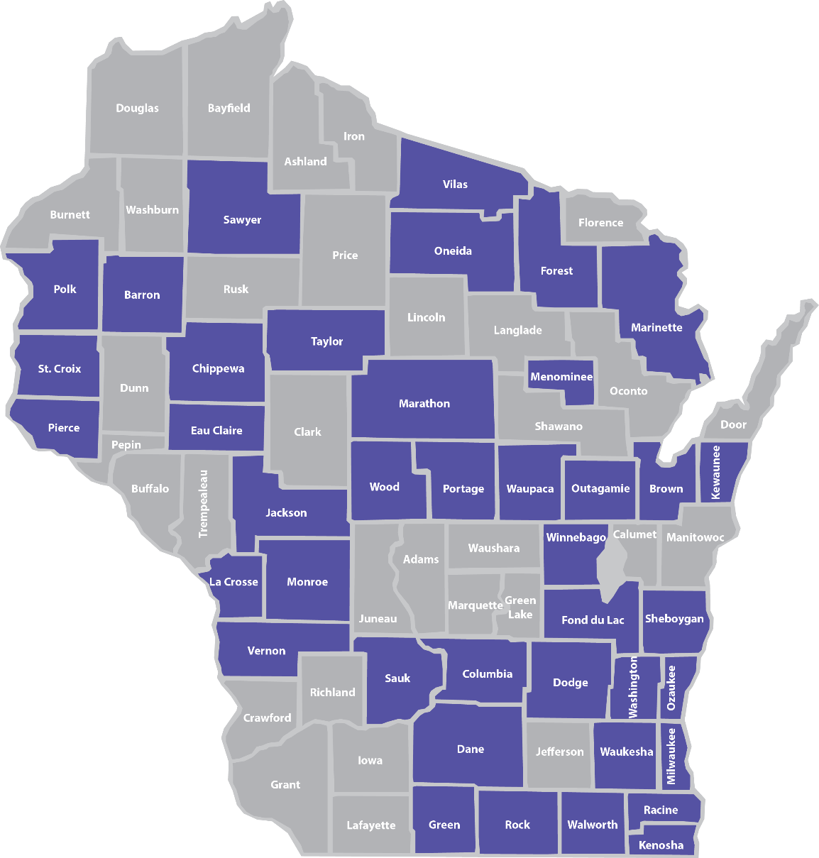
Wisconsin SUIDs by county
Notes:
“Now that you know more about SUID and SIDS, let’s talk about the numbers in Wisconsin. Between 2015-2017, 182 Wisconsin infants died in unsafe sleep environments in 40 different counties.
Each of these deaths occurred while the infant was sleeping or was in the sleep environment. These deaths fall into two categories:
Undetermined (77 percent): This includes deaths certified as SUID, Sudden Infant Death Syndrome (SIDS) and Undetermined.
2. Asphyxia (23 percent): This includes asphyxia due to the infant’s position, other objects in the sleep environment or overlay by another individual.
On average, more than one infant per week dies in an unsafe sleep environment in Wisconsin. This map shows that SUIDs can happen in all corners of our state, in both urban or rural areas.
Additional data from the 2017 SUIDs in Wisconsin:
Among 2017 SUIDs, 25% of infants were placed on their stomachs. An additional 14% were placed on their sides.
In regards to surface, 54% of infants were placed on an adult bed and 9% of infants were on a couch.
The majority (80%) of the incidents leading to a SUID occurred at the infant’s home. Among these cases, 87% of infants had a safe sleep surface available.
The majority (77%) of SUID sleep environments contained soft bedding. The most common bedding items were blankets (49%), pillows (46%) and comforters (42%).
Among 2017 SUIDs, 63% of infants were sharing a surface with one or more adults or children.
Caregiver substance use while sharing a sleep surface with the infant was confirmed in 18% of cases.
More details on the SUID data in Wisconsin is available in the full SUID Report on the Children’s Health Alliance of Wisconsin website: www.chawisconsin.org/sbs.”

Slide 7
AAP safe sleep guidelines
Notes:
"The AAP policy statement on safe sleep was revised in 2016. These are evidence-based recommendations based on research from experts in the field of child safety and safe sleep. These gold standard recommendations have been adapted not only by primary care pediatricians but family physicians, neonatologists, and child care professionals who provide care for infants. (Reference the Academy’s parent portal, www.HealthyChildren.org) These guidelines were never intended to spark debate or controversy. They were meant to better inform families of how they could reduce risk of something very bad happening to their baby, and to establish universal messaging and common language around sleeping babies safely. They are meant to help give every baby the best chance to reach their 1st birthday safely and healthy.”

Slide 8
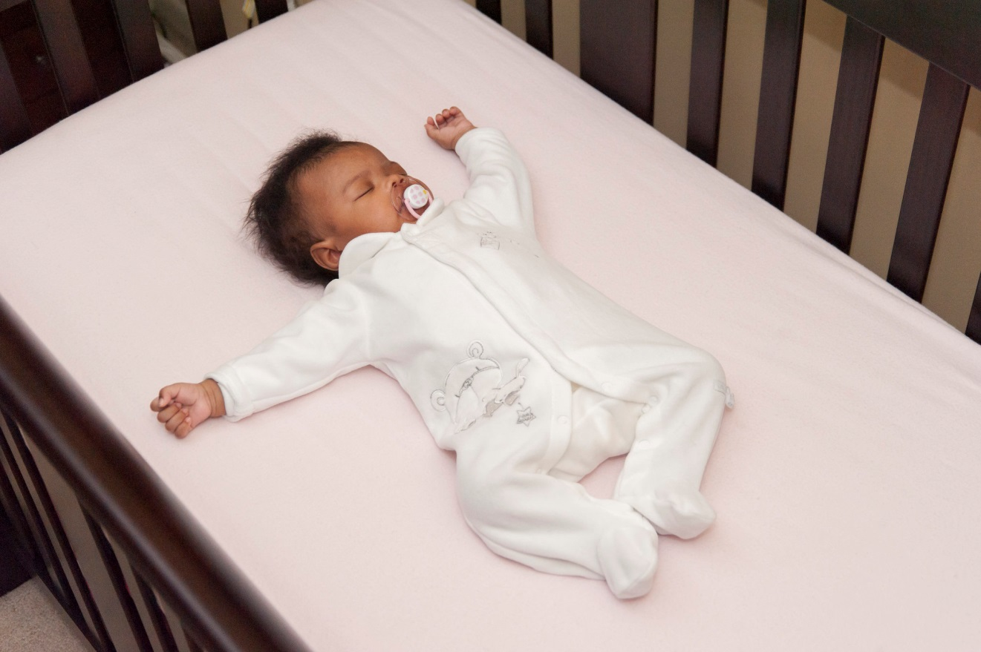
Alone, on Back, in Crib and in Smoke-free air
Notes:
“Babies are not born with habits. How they sleep is a learned behavior. They will learn to be comfortable however they are placed right from the start. In addition to the recommendation encouraging sharing a room, it is highly recommended to follow the ABCs. Alone, on the back and in a crib or Pack N’ Play, and free from any smoke in the air. Babies need to sleep on their back for every sleep time. (Nap, night time, day care, visit to someone’s home etc.) Babies love consistency. If they start out sleeping on their backs, they learn to sleep this way. Habits are hard to break so it is easier for both parents and their baby to sleep safely starting with the very first sleep.“
“As you can see, this baby is using a pacifier. Some research has shown use of a pacifier is a preventive measure. However, if mom is breast feeding, pacifiers should only be used after breast feeding has been established. Generally after one month.”
Let’s talk a moment about the effects of secondhand smoke. Infants who are exposed to secondhand smoke after birth also are at greater risk for SIDS. Chemicals in secondhand smoke appear to affect the brain in ways that interfere with its regulation of infants' breathing. Infants who die from SIDS have higher concentrations of nicotine in their lungs and higher levels of cotinine (a biological marker for secondhand smoke exposure that stays in the baby’s system longer) than infants who die from other causes.”

Slide 9
Back-to-sleep
Babies are less likely to choke
on their backs
Image courtesy of the Safe to Sleep® campaign, for educational purposes only; Eunice Kennedy Shriver National Institute of Child Health and Human Development, http://safetosleep.nichd.nih.gov; Safe to Sleep® is a registered trademark of the U.S. Department of Health and Human Services.
Notes:
“Yes it is true that long ago we put babies on their tummies because we thought it would keep them from choking on their spit-up. But we found out babies were at higher risk for suffocation. Then we put them on their side, but found babies didn’t stay on their side and rolled one way or the other. After research and studies, we found that babies sleeping on their backs is the safest – as you can see the trachea (airway) actually lies on top of the esophagus (tube that goes into the stomach). When a baby spits up, gravity will keep the spit-up in the esophagus, and it will either come out of the baby’s mouth or he will swallow it. Either way his trachea is protected when the baby is on his back. Also, placing the baby on his tummy doesn’t allow him to breathe in fresh air. Since the back to sleep campaign started in 1992, we’ve seen a 50 % reduction in infant deaths. New parents often hear from grandparents and others that their babies slept on their tummy. This is part of the conversation you will have about how over time, we learn new information. Seat belts are a good example to use. While many of us survived never wearing a seat belt, we wear them now, and we would agree if we were in a car crash, our chances of surviving are much greater if we are wearing a seat belt.”
Demonstrate the trachea on top of the esophagus using two fingers. Finger on top is the trachea – baby can breathe.

Slide 10
Share a room, not a bed
Promotes breastfeeding easily
Promotes bonding safely
Avoids risks of bed sharing
Room sharing is now recommended up to age 1year
Notes:
“The AAP guidelines are built around the promotion of breast feeding, bonding and safety. Keeping baby close to mom allows for each of these to occur. Breast fed babies are at a reduced risk for a sudden and unexpected infant death. However, we must recognize not all babies are or can be breast fed and this does not diminish the importance of bonding and safety.”
“Adult beds have lots of risk factors in them. There are a variety of soft, pillow-top mattresses, which do not support infants necks. A baby on a soft surface is at an increased risk of cutting off their airway if their heads roll forward or sideways or are hyperextended. Most adult beds also have pillows and blankets, which could easily suffocate an infant. Babies are not coordinated enough to move a blanket or pillow off of their face.”

Slide 11
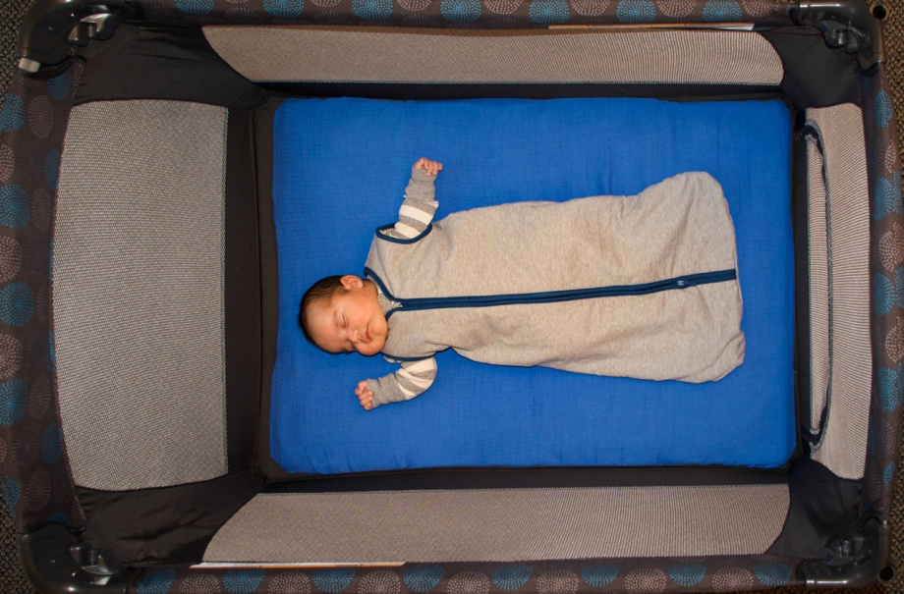
Avoid overheating
Set room temperature to what is comfortable for adults
Dress baby to be comfortable
Use a sleep sack
Notes:
“Parents often think babies need to be kept warmer than themselves. Again, based on the triple risk model, this could be an environmental stressor that increases the risk of an unexplained infant death. We have learned that babies can become overheated and as a result are at risk for death. Sleep sacks are great because the baby is adequately covered and avoids the risk of a blanket. Healthy babies do a good job regulating their own body temperature.”
“Although the research is new, using a fan in the room is considered a protective factor for an unexplained death. This is thought to be due to air circulation and reducing the amount of CO around the baby. However the fan should never blow directly on the infant.”
Many people have questions about the safety of swaddling. The AAP says that swaddling is a good technique for calming baby and promoting sleep if done correctly. Phase out swaddling by age 2 months or before baby can roll. “
Be conscious when putting a blanket over the car seat. Many parents do this to keep baby safe from cold temperatures, but should limit how long the blanket is covering the baby. Use a breathable material to avoid overheating and lack of fresh air.

Slide 12
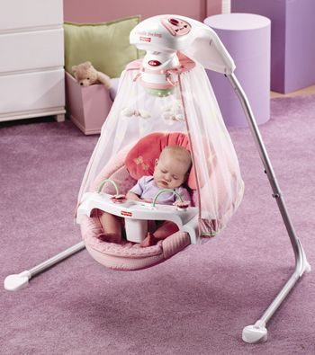
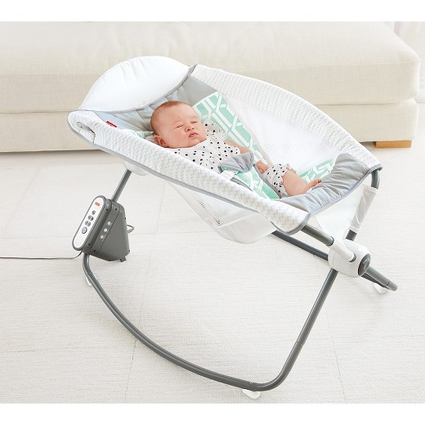
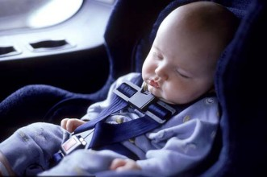
Always sleep on a firm, flat surface
NOT in a swing, car seat, or reclined product
Notes:
“Babies should not be left to sleep in a car seat, baby swing or in other semi-reclined surfaces such as a Rock n’ Play™.
A common reason for using the semi-reclined position of the Rock 'n Play™ and other products is for management of reflux, but research has shown that this position does not actually decrease reflux. The American Academy of Pediatrics' reflux management guidelines for physicians states that, “semisupine positioning, particularly in an infant carrier or car seat, may exacerbate gastroesophageal reflux and should be avoided when possible, especially after feeding" (semisupine means reclined). Additionally, semi-reclined sleep positions can compromise baby's airway and restrict breathing. Many of these infant products also include fluffy pillows and headrests, which increases the risk of SIDS.
A car seat is meant to protect an infant while traveling in a car. When the car seat comes out of the base, it changes the angle of the seat and can compromise baby’s neck position and airway. We know that we cannot keep baby awake all the time and dosing off will happen while traveling, but it is important to avoid baby going into a deep sleep in the car seat– that is when it becomes unsafe. When traveling long distances, encourage families to take frequent breaks and check on baby often if he/she is sleeping.”
References
American Academy of Pediatrics reflux management guidelines for physicians: http://pediatrics.aappublications.org/content/early/2013/04/24/peds.2013-0421
Pediatric Gastroesophageal Reflux Clinical Practice Guidelines: http://www.naspghan.org/files/documents/pdfs/position-papers/FINAL%20-%20JPGN%20GERD%20guideline.pdf

Slide 13
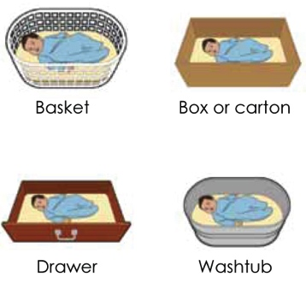
Alternative sleep surfaces
Image courtesy of the Safe to Sleep® campaign, for educational purposes only; Eunice Kennedy Shriver National Institute of Child Health and Human Development, http://safetosleep.nichd.nih.gov; Safe to Sleep® is a registered trademark of the U.S. Department of Health and Human Services.
Notes:
“Alternatives to the traditional crib have been around for a very long time and were introduced to address concerns and desires expressed by families. Such as, how they can sleep near their baby but keep them safe. In 1937 Finland had an extremely high infant mortality rate of 65 deaths for every 1,000 births. The government passed the Maternity Grants Act to help decrease the high rate. Originally for families in poverty, the grant provided every newborn infant with the basics so that he or she would have the same start and chance at life as other infants in higher economic classes. The program now gives every baby a box, no matter what economic class. The kit includes a box for the baby to sleep in along with other necessities such as clothes, diapers, etc. Once Finland’s babies started sleeping in boxes, their infant mortality rates dropped to 3.38 deaths for every 1,000 births.” (Moheny, 2013)
“No matter what container is used, the surface must be flat and firm. A changing pad for example can be used in the bottom of a container as long as it is not fluffy, is tucked into the mattress and is secure and has no gaps between the container and the pad. Often times this alternative can be used for families that are visiting, transient families, or just wanting baby in another room near you.”

Slide 14
Newborn Nest
Complies with ABCs of safe sleep
Promotes room-sharing and breastfeeding
Portable
Space saving
Notes:
“There are many benefits to using a Newborn Nest. Most importantly, the Newborn Nest complies with the ABCs of safe sleep. Although the Newborn Nest is not endorsed by the AAP, what the Nest complies with is the AAP recommendation of a firm and flat, dedicated and separate infant sleep space. Additionally, it promotes room-sharing without bed-sharing. Having baby sleep near mom can support breastfeeding and bonding. The Newborn Nest can be used in multiple locations and is easy to transport.

Slide 15
Newborn Nest contents
Newborn Nest
Mattress
2 sheets
Sleep baby safe and snug book
Liability waiver
Pacifier
Sleep sack

Slide 16
Using the Newborn Nest
Place on the ground/floor
Only use provided mattress
Keep at least two feet away from heaters
Keep pets out of the sleep environment
Do not carry with baby inside
Keep dry
Notes:
Refer to tip sheet for rationale.

Slide 17
Is this safe?
Notes:
We recognize that many families may want to put the Newborn Nest on the bed. However, it is not a firm or stable surface.

Slide 18
Questions to ask parents
Tell me everywhere you took baby yesterday?
Tell me all the places baby has slept in the last 24 hours?
Where does baby sleep during nap time/ at night?
Where does baby sleep while at grandma’s house/day care?
Notes:
Babies, especially newborns, sleep several times throughout the day. It is important that babies sleep safe for every sleep. Asking these questions can help you as the professional identify families that may find a Newborn Nest to be helpful. If the client seems hesitant to talk about safe sleep and the Newborn Nest, ask her to recount whether there was a time when she found her baby in an unsafe environment what happened and what she did.

Slide 19
Introducing the Newborn Nest
Baby boxes can be a divisive topic
Identify if there is a need for a safe sleep environment and a desire to use a baby box as an alternative option
Two short videos are available to discuss safe sleep and Newborn Nest
*Both videos can be found at https://www.chawisconsin.org/sbs/

Slide 20
Demonstrating the Newborn Nest
“Where do you think you will put the Newborn Nest in your home?”
“When do you plan to use it?” (offer suggestions such as naps, nighttime, at grandma’s house, etc.)
“Can we try the Nest with your baby?”
Discuss safety reminders
Use positive reinforcement
Notes:
Research demonstrates that hands on education and practice is an effective tool for promoting behavior change. If the client is open to using a Newborn Nest, you can use this opportunity to demonstrate its utility by placing the Newborn Nest with the client. If the client’s baby is present, then have the client put the baby in the Newborn Nest. If the client says they are planning to use the Newborn Nest on the couch or bed, use a doll to test it out. When testing it out, make sure to highlight things like, the surface being unlevel, the risk of fall, the surface not being flat, etc…It is important to let the client see how the baby would move while in the Newborn Nest.

Slide 21
Frequently asked questions
“I am not putting my baby in a box.”
“We have pets in the home and I am worried about…”
“How am I going to explain to [family member] that my baby sleeps in a box?”
Notes:
“These are examples of common feedback you may hear. Let’s talk about how you would respond to each of these:
I know this is a new concept and may seem weird to you. Let me tell you more about the history of the Newborn Nest and why Children’s Hospital of Wisconsin is encouraging our families to utilize them. After implementing this program, many other countries experienced a drastic decline in infant mortality. The Newborn Nest allows you to keep baby close, but in their own sleep space. What other concerns do you have?”
Pets are a wonderful part of families. It is recommended that you keep pets away from any sleeping infant. This can be accomplished by using a baby gate or closing a door to keep animals away from a sleeping infant. You can put the lid on the Newborn Nest when it is not in use. What other questions do you have?
Mom’s (grandma) and partners may have other suggestions that conflict with the AAP guidelines. This is a great opportunity for the mother of the baby to educate their family and other care providers about the AAP guidelines. Remember, these recommendations are fairly new (2008) as we have only starting collecting consistent data on infant deaths in the last 10 years or so. It’s important that we share this information with everyone. The AAP guidelines are a safer approach

Slide 22
Distribution and follow-up
Identify site champion to assist with distribution, tracking and follow-up
Client must sign liability waiver at distribution.
Keep original in the client’s file. Do not send to the Alliance.
Your organization may use the provided sample waiver or create your own.
Document distribution of the Newborn Nests in client progress notes, EHRs, or track in a spreadsheet.
Determine a process that works well for your organization.
Notes:
“When you distribute the Newborn Nest, families will need to sign a liability waiver. This is required by Children’s Hospital of Wisconsin. The original should be put in the client’s file. The client can have a copy, if they would like one. Document the distribution of the newborn Nest in progress notes, making sure to note any important details from the conversation with the client. Remember to document all safe sleep discussions. Any time a home visitor becomes aware of a sleep-related hazard an incident report must be filled out.
We have implemented this process because we believe it will be effective in documenting our work without adding too many extra layers.

Slide 23
Distribution and follow-up
Follow up with family around one month postpartum
Follow up can be completed by:
Using the online link: https://redcap.wisconsin.gov/surveys/?s=FLLE788FJA
Or scan and email paper form to abagin@chw.org
Notes:
“Today, you took a pre test and will take a post test before leaving. These will be used to measure your knowledge and confidence on infant safe sleep. We want to ensure that you have all of the tools necessary to talk about Newborn Nests with your clients. We will ask that you complete a checklist at 2 weeks and 2 months post distribution of the Newborn Nest. The checklist contains a few places for you to record observations as well as an opportunity to ask your client a few open-ended questions.” Once the evaluations are completed, we will send them to Children’s Health Alliance of Wisconsin, who will enter them. We are using a web-based data system called Redcap to hold our research data. We are hoping to gain an understanding of how families used or did not use the Newborn Nest during this evaluation.

Slide 24
Distribution and follow-up
Follow-up with family by phone or during a check-up/home visit
Ask family if they have secured a sleep space for when baby outgrows box
Connect family with community resources if needed

Slide 25
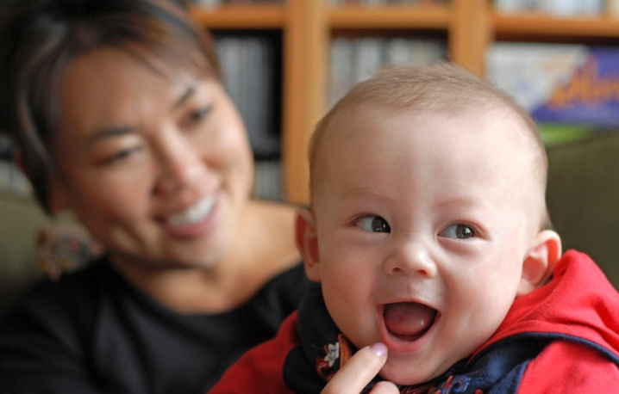
Thank you for all you do!
Notes:
“Let’s role play situations you have encountered and discuss what your response might be given the information learned in this training.”
Some suggestions:
Divide into groups of three (Parent, HV, observer)
Provide each group with the same of different situations on index cards (use examples from slides)
Have groups role play situation. Ask observer to provide feedback to two others in group
Bring entire group back together to share success, comfort in conversation, challenges etc.
Conduct post survey of training session

