Slide 1
Educational Curriculum on
Perinatal and Infant Oral Health Care:
Current Standards of Care for
Dental and Dental Hygiene Students
Module 4- Lifelong Learner

Slide 2


Acknowledgments
Primary Authors
Patty Hooper, RDH, BSDH
Clinical Instructor of Dental Hygiene
Waukesha County Technical College
Debbie Schumacher, RDH-ME
Instructor of Dental Hygiene
Chippewa Valley Technical College
Additional Contributors
Dana Fischer, CHES
HSMB Project Manager
Children’s Health Alliance of Wisconsin
Diane Flanagan, RDH
Senior Project Manager
Children’s Health Alliance of Wisconsin
This project is supported in part by funding from the Maternal and Child Health Bureau, Health Resources and Services Administration, U.S. Department of Health and Human Services grant number H47MC28475

Slide 3
Objectives
After viewing these resources students will be able to appreciate the importance, professional responsibility and skills needed to be a life long learner by:
  Recognizing how the profession of dental hygiene is constantly changing.
  Identifying credible sources of current oral health information.
  Identifying community resources and referral sources to address concerns of patients.
  Understanding motivational interviewing techniques and how they can be utilized to improve patient adoption of healthier oral health behaviors.

Slide 4


Professional Organizations
Find out more: http://www.adha.org/
  Find out more: http://widha.org/

Slide 5
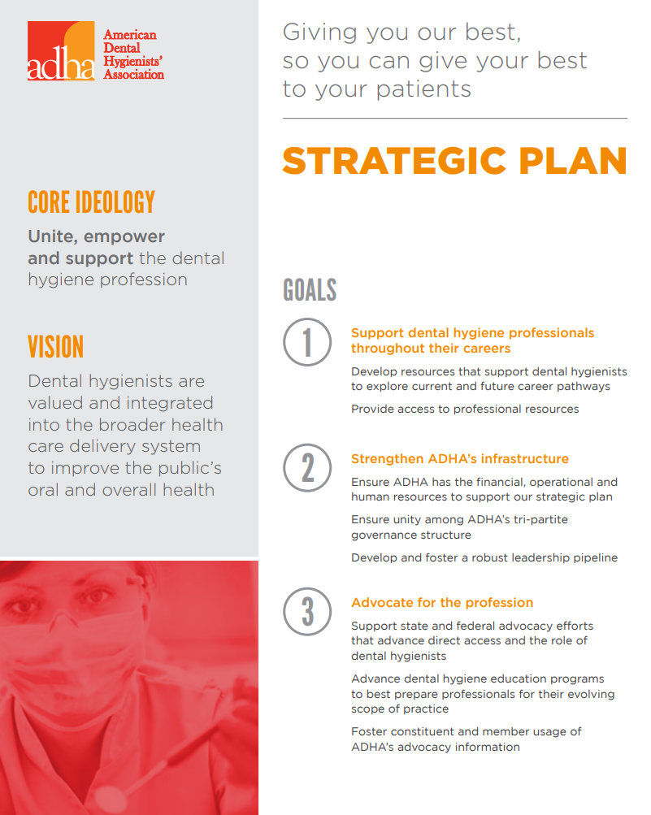
  As a member you have access to:
  Access magazine
  Journal of Dental Hygiene
  Discounts on goods and services
  Networking opportunities
  Leadership support and development
  Career support
  Advocacy on behalf of your interest as a dental hygiene professional.
  Connections to volunteer opportunities.

Slide 6
  WI-DHA supports your goals by helping to ensure access to quality oral health care; promoting dental hygiene education, licensure, practice and research; and representing your legislative interests at the local, state and federal levels. Membership in WI-DHA provides you with the benefits of, and membership in, the ADHA.
  INDIGO Conference is the region’s premier conference planned by dental hygienists with the specific needs of dental hygienists as the top priority. Join more than 500 of your closest colleagues for 60+ hours of CE presented by state and national speakers, social events, networking and more than 35 exhibitors and sponsors.
    http://widha.org/event/indigo-conference/

Slide 7
Activity 1 – Dental Providers
Review the following slides with information on changes to the Dental Hygiene Practice Act from the 1990s to today.
Review the emerging provider types and proposed legislation from 2017/2018.
Complete the assessment activity described on slide 13.

Slide 8
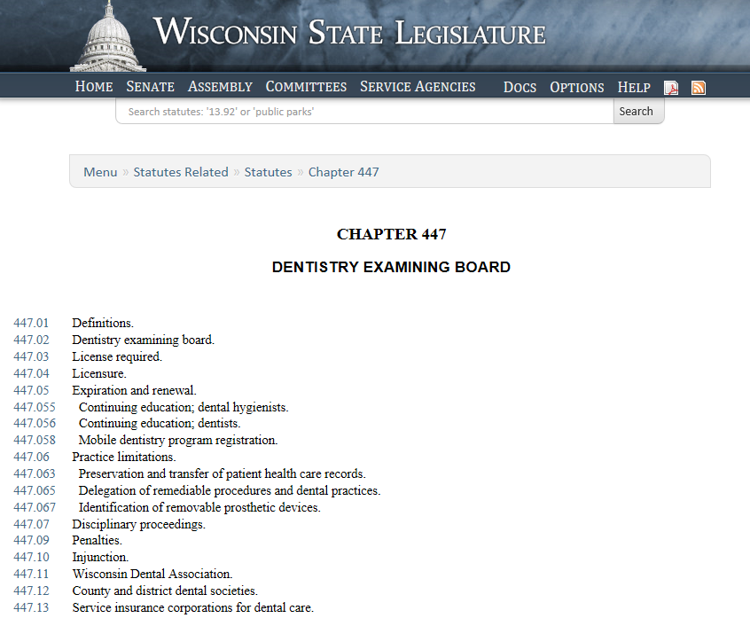
Activity 1 – Dental Hygiene Practice Act
Review the Dental Hygiene Practice Act found in State Statute 447.06 http://docs.legis.wisconsin.gov/statutes/statutes/447/06

Slide 9
Changes in State Practice Act
for Dental Hygienists
1998
Administer local anesthetic.
2004
Can work as an agent of a public health department, in public school and schools of dental hygiene and dentistry without direct supervision.
2007
Became a Medicaid provider.
2013
Administer nitrous oxide inhalation analgesia.
2015
Use lasers for soft tissue therapy.
2017
Expansion of practice settings without direct supervision.

Slide 10
Emerging Providers
During 2018, two new dental provider types were introduced into the Wisconsin State Legislature. While legislation did not pass, it is important to keep up-to-date on proposed changes to the dental practice act.
Read the following legislation drafted to introduce the two new provider types:
  Expanded Function Dental Auxiliary (EFDA)
  Dental Therapists

Slide 11
Emerging Providers – EFDA
To access drafted legislation go to
    https://docs.legis.wisconsin.gov/
    In the search box type ‘Expanded Function Dental Auxiliary’

Slide 12
Emerging Providers – Dental Therapist
To access drafted legislation go to
  https://docs.legis.wisconsin.gov/
  In the search box type ‘Dental Therapist’
View this video on what a Dental Therapist is
  http://www.pewtrusts.org/en/multimedia/video/2018/what-is-a-dental-therapist

Slide 13
Activity 1 – Assessment
Create a Venn Diagram that compares and contrasts the two emerging providers. Consider the following themes:
    Does the provider increase access to dental care?
    Can the provider work independently from a dentist?
    Where does the provider primarily work?
    What education/training is required?

Slide 14
Activity 2-Options for
Bachelor Degree Completion
Articulation agreement programs: the following programs have signed agreements with Wisconsin Technical Colleges to accept all credits toward completion of a Bachelor’s Degree.
    Minnesota State University-Mankato
    Normandale Community College/ Metropolitan State University
    University of Wisconsin- Stout (pending)
National list of degree completion programs

Slide 15
Activity 2 – Assessment
  Identify a hygienist who has completed their Bachelor’s Degree and ask if you can interview them. Ask them about their experience, what challenges they encountered and what opportunities completing their degree has helped them achieve.
  Write a one page summary of your interview to include:
    The name and background of the hygienist you interviewed.
    Brief summary of the challenges and opportunities they’ve had.
    Reflect on how their experience might influence your own decision to pursue your Bachelor’s Degree.

Slide 16
Activity 3 – Oral Health Resources Scavenger Hunt
Complete the resource scavenger hunt by finding the answer to each question listed on the following slides.
Compile your scavenger hunt answers into a word document to provide to your instructor.
If you are asked to find a document, copy and paste the link to the document.

Slide 17
Online Resources Scavenger Hunt
  Wisconsin State Oral Health Program
  What oral health data is available in the Environmental Public Health Tracking oral health module?
  List the four strategic areas of the Roadmap for Improving Oral Health in Wisconsin document.
  National Maternal and Child Oral Health Resource Center
  Find:
    The consumer brochure: Two Healthy Smiles: Tips to Keep You and Your Baby Healthy.
    National Consensus Statement: Oral Health Care During Pregnancy.
  Wisconsin Dental Examining Board
  List the composition of members on the Examining Board.

Slide 18
Online Resources Scavenger Hunt
  Early Childhood Learning and Knowledge Center
  Find one of the “Brush Up on Oral Health” tip sheets.
  American Academy of Pediatric Dentistry
  Find the policy statement “Use of Silver Diamine Fluoride for Pediatric Dental Patients”.
American Dental Hygienists’ Association
  Find the dental hygiene standard of care white paper.
Wisconsin Practice Act
  Find the requirements for license renewal including how often and how many continuing education credits are needed.

Slide 19
Activity 3 – Assessment
In one paragraph describe the top two resources you will use as you begin your professional career. Describe what aspects of the resource you find to be helpful.

Slide 20
Activity 4 – Community Resources
  Community Resources Activity (choose one)
  As a group of 3 or 4 choose one of the organizations listed below to research. Identify a contact person within that organization to do a brief interview with either in-person or via email. Introduce yourselves and ask them to provide a brief background on the oral health programs or initiatives they are working on. Topics to consider asking about include; school sealant programs, fluoride varnish programs, education and dental referrals for pregnant women.
    Local public health department in your county or city. Contact a public health nurse or health officer.
    Local oral health coalition in your county or city.
    The Wisconsin Oral Health Coalition.

Slide 21
Activity 4 – Assessment
Write a one page description of the organization that you interviewed including:
  The name and title of the staff person you communicated with.
  Key oral health initiatives the organization is working on.
  What about their project is most interesting to you.
  Any suggestions you have to improve or expand their programs.

Slide 22
Activity 5 – Motivational Interviewing
Read the Motivational Interviewing article on the following slide.
Watch the Motivational Interviewing video that can be accessed on the next slide.
Choose one activity on slides 25-26 to do with a partner.

Slide 23

“Motivational Interviewing”
Read the following article.
https://dimensionsofdentalhygiene.com/article/motivational-interviewing-dental-hygienists/
Source: Michelle Arnett and Anne Gwozek. (2017). Motivational Interviewing for Dental Hygienists. Dimensions of Dental Hygiene May 2017;15(5):54-57.
Notes:
https://dimensionsofdentalhygiene.com/article/motivational-interviewing-dental-hygienists/

Slide 24
Motivational Interviewing
Watch the Tooth Talk video depicting a home visitor using motivational interviewing techniques to discuss oral health with a young mother.
  http://toothtalk.org/portfolio-view/motivational-interviewing-for-kids-healthy-smiles-2/

Slide 25
Activity 5 – Assessment
Choose one of the five activities on the next two slides to complete with a partner.

Slide 26
Activity 5 – Assessment (continued)

Slide 27
Activity 6 – Oral Health Literacy
Review the American Dental Association webpage on oral health literacy.
Read the Oral Health Literacy article from The Journal of Dental Hygiene.
Choose one of the First Impressions activities on slide 30 to complete.
Complete the assessment activity on slide 31.

Slide 28

Activity 6 – Oral Health Literacy
Review the American Dental Association webpage on oral health literacy.
  https://www.ada.org/en/public-programs/health-literacy-in-dentistry

Slide 29
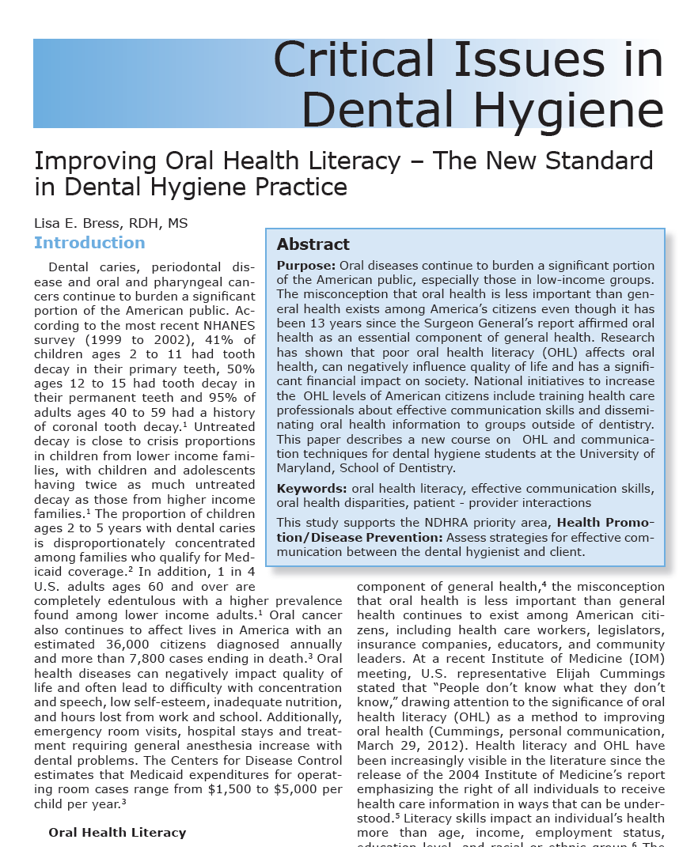
“Improving Oral Health Literacy – The New Standard in Dental Hygiene Practice”
Read the following article.
https://www.ncbi.nlm.nih.gov/pubmed/24357560
Source: Bress, L. (2013). Improving Oral Health Literacy-The New Standard in Dental Hygiene Practice. The Journal of Dental Hygiene, 87(6), 322-329.

Slide 30
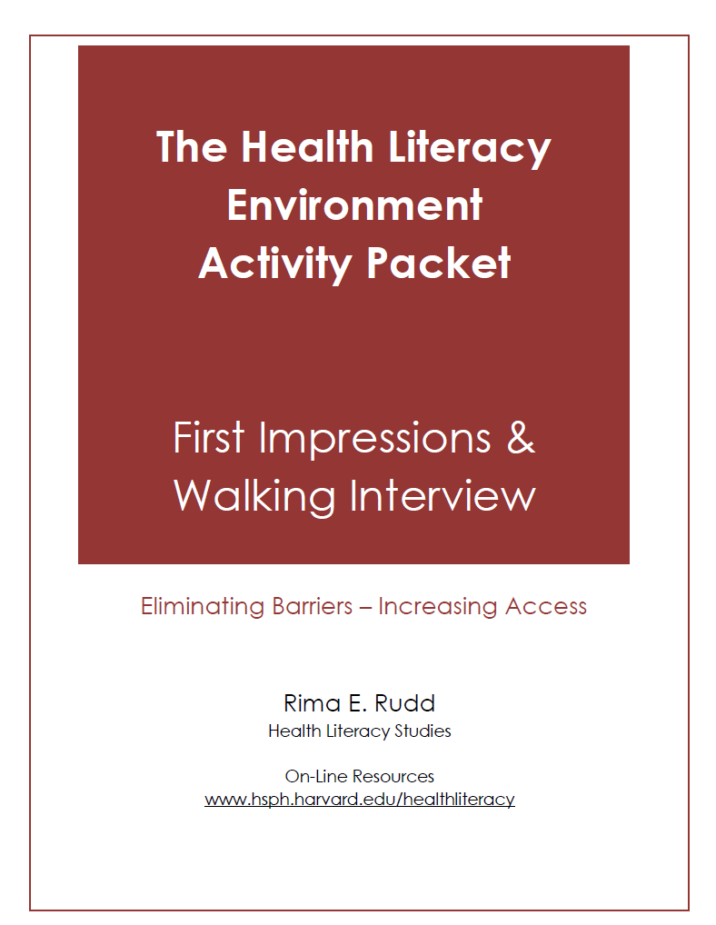
Activity 6 – Oral Health Literacy
Complete one of the First Impressions Activities in The Health Literacy Environmental Activity Packet:
    Telephone
    Web
    Walk to the Entrance
  https://cdn1.sph.harvard.edu/wp-content/uploads/sites/135/2012/09/activitypacket.pdf
Source: Rudd, R.E. The Health Literacy Environment Activity Packet: First Impressions & Walking Interview. On-line tools. Health Literacy Studies. Hsph.harvard.edu/healthliteracy
Notes:
https://cdn1.sph.harvard.edu/wp-content/uploads/sites/135/2012/09/activitypacket.pdf

Slide 31
Activity 6 – Assessment
Complete the worksheet/checklist for the ‘First Impressions’ activity that you did.
In a paragraph provide suggestions on how the clinic could make their telephone answering system, website or entrance more user friendly for all patients.

Slide 32
CODA Standard 2-22
Critical Thinking Competencies
2-22
Graduates must be competent in the evaluation of current scientific literature.
Intent:
Dental hygienists should be able to evaluate scientific literature as a basis for life-long learning, evidenced-based practice and as a foundation for adapting to changes in healthcare.
Examples of evidence to demonstrate compliance may include:
Written course documentation of content in the evaluation of current and classic scientific literature.
Evaluation mechanisms designed to monitor knowledge and performance.
Outcomes assessment mechanisms.

Slide 33
CODA Standard 2-23
Critical Thinking Competencies
2-23
Graduates must be competent in problem solving strategies related to comprehensive patient care and management of patients.
Intent:
Critical thinking and decision making skills are necessary to provide effective and efficient dental hygiene services. Throughout the curriculum, the educational program should use teaching and learning methods that support the development of critical thinking and problem solving skills.
Examples of evidence to demonstrate compliance may include:
Evaluation mechanisms designed to monitor knowledge and performance.
Outcomes assessment mechanisms demonstrating application of critical thinking skills.
Activities or projects that demonstrate student experiences with analysis of problems related to comprehensive patient care.
Demonstration of the use of active learning methods that promote critical appraisal of scientific evidence in combination with clinical application and patient factors.

Slide 34
Please Provide Feedback
Use the link below to provide feedback on the content and how you used these modules.
Thank you!
https://www.surveymonkey.com/r/66Q3ZQ2
For questions contact: dfischer@chw.org

