Slide 1
Educational Curriculum on
Perinatal and Infant Oral Health Care:
Current Standards of Care for
Dental and Dental Hygiene Students
Module 3- Age 1 Dental Visit

Slide 2


Acknowledgments
Primary Authors
Patty Hooper, RDH, BSDH
Clinical Instructor of Dental Hygiene
Waukesha County Technical College
Debbie Schumacher, RDH-ME
Instructor of Dental Hygiene
Chippewa Valley Technical College
Additional Contributors
Dana Fischer, CHES
HSMB Project Manager
Children’s Health Alliance of Wisconsin
Diane Flanagan, RDH
Senior Project Manager
Children’s Health Alliance of Wisconsin
This project is supported in part by funding from the Maternal and Child Health Bureau, Health Resources and Services Administration, U.S. Department of Health and Human Services grant number H47MC28475

Slide 3
Age 1 Dental Visit
After viewing these resources students will be able to describe the components of a dental visit for a young child and recognize the importance of establishing a dental home for a child by age 1 or after the eruption of the first tooth by:
  Understanding primary prevention of disease and the importance of the age 1 dental visit.
  Using a knee to knee position to provide dental services.
  Performing an oral inspection and caries risk assessment.
  Applying preventive treatments (i.e. fluoride).
  Providing anticipatory guidance based on age of child.
  Understanding what constitutes a dental home.
  Recognizing the need of referral for dental treatment.
  Recognizing billable dental codes for provided services.

Slide 4
Activity 1 – Smiles for Life Curriculum
  The Smiles for Life curriculum consists of eight 45-minute modules covering core areas of oral health relevant to health professionals. User competencies are measured through assessments at course completion. Users must score an 80% or higher to receive credit for each course.
Login to the course using the username/login you created in the pregnancy module.
Complete Course 6: Caries Risk Assessment, Fluoride Varnish and Counseling www.smilesforlifeoralhealth.org

Slide 5
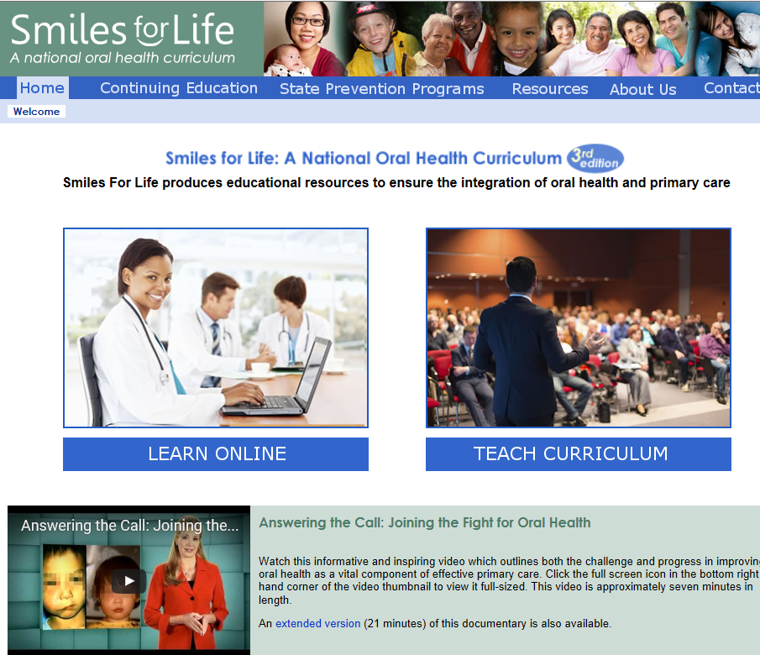
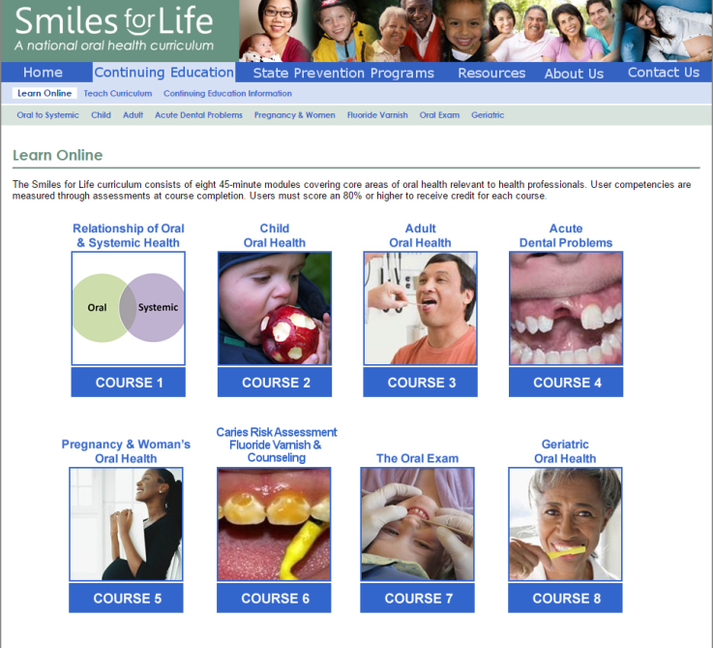

Slide 6
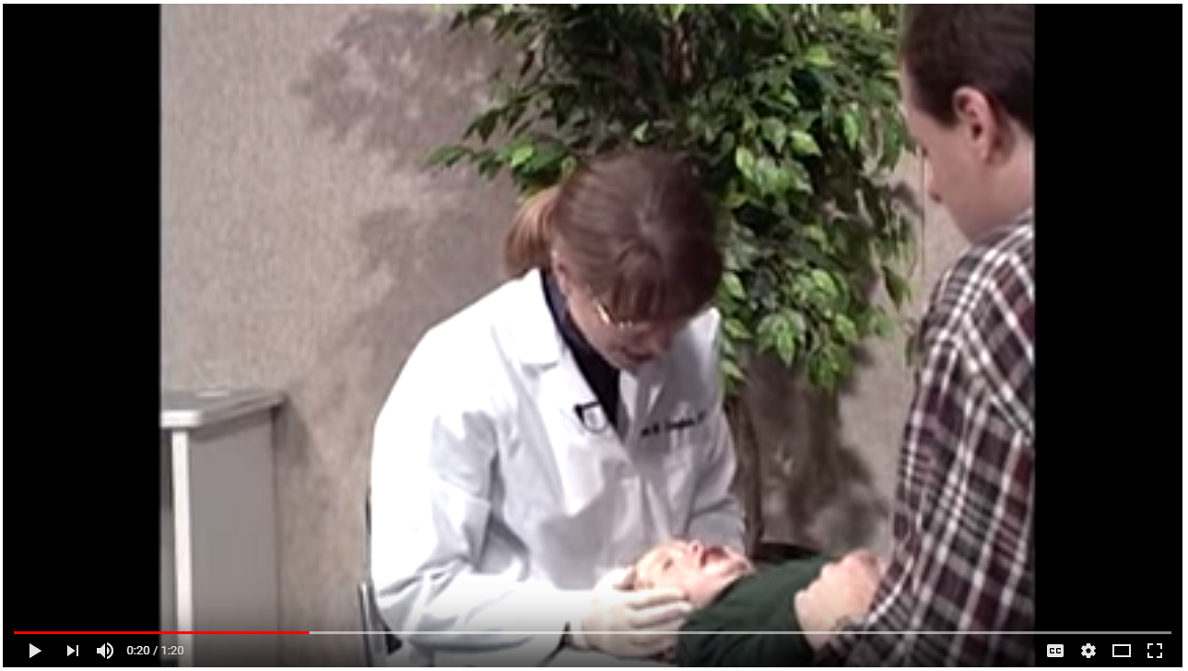
Activity 1 – Smiles for Life Curriculum
  Watch the Knee to Knee exam video below.
    https://youtu.be/Hw99Aoti7ZE

Slide 7
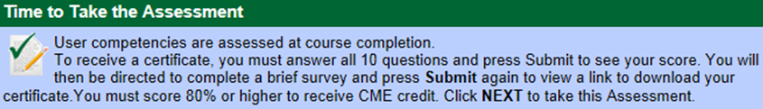
Activity 1 Assessment
In Course 6: Caries Risk Assessment, Fluoride Varnish and Counseling complete the ‘Post Assessment’, print the certificate of completion and provide a copy to your instructor.

Slide 8
Activity 2 – Practice Guidelines
Read the two articles described and accessed on the following slides.
Complete the assessment activity described on slide 11.

Slide 9
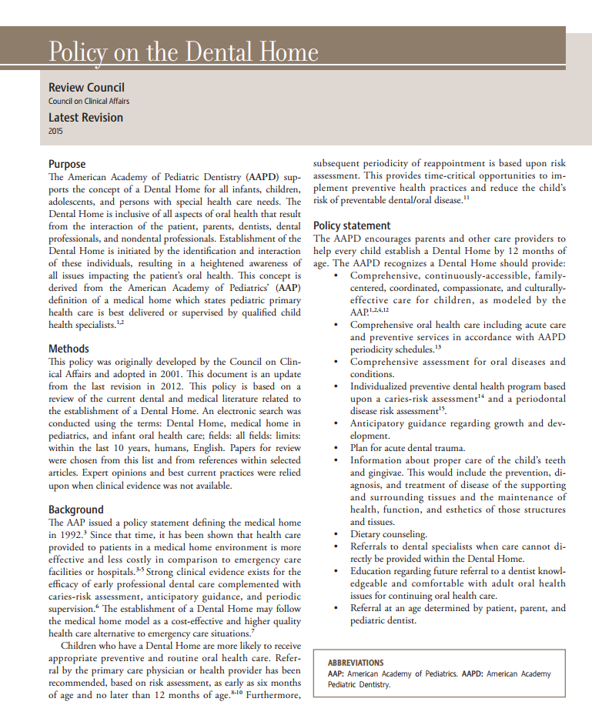
“Policy on the Dental Home”
http://www.aapd.org/media/Policies_Guidelines/P_DentalHome.pdf
  Source: The American Academy of Pediatric Dentistry Council on Clinical Affairs. (2015). Policy on the Dental Home. References Manual Volume 39(6): 17/18:29-30.
Notes:
http://www.aapd.org/policies/

Slide 10
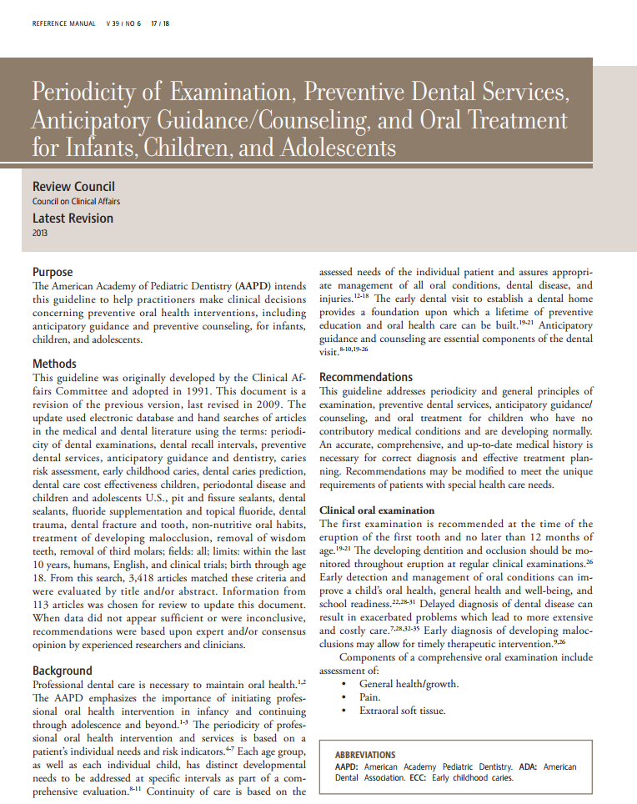
“Guideline on Periodicity of Examination, Preventive Dental Services, Anticipatory Guidance and Oral Treatment for Infants, Children and Adolescents”
http://www.aapd.org/media/Policies_Guidelines/BP_Periodicity.pdf
  Source: The American Academy of Pediatric Dentistry Council on Clinical Affairs. (2013). Guidelines on Examination, Preventive Dental Services, Anticipatory Guidance/Counseling, and Oral Treatment for Infants, Children, and Adolescents. References Manual Volume 39(6): 17/18:188-195.

Slide 11
  Activity 2 – Assessment
You are talking to your friend and she doesn’t understand why you are encouraging an age one dental appointment. She expressed the following common ‘myths’ about this visit;
  Children only have a couple teeth-what are you even looking at?
  How do you clean a child’s teeth when they are so young?
  Why does it matter-they are only baby teeth, they lose them anyway.
Write a paragraph (3-4 sentence) response to each of your friends ‘myths’. Use facts about the importance of an age one dental visit and what to expect during the appointment.

Slide 12
Activity 3 – Oral Evaluation
Review the clinical checklist for an oral evaluation for a patient under the age of 3 embedded in this page. This checklist was developed and is used by students at Chippewa Valley Technical College.
Review the following caries risk assessment tools:
    American Dental Association – Caries Risk Assessment
    American Academy of Pediatric Dentistry – Caries Risk Assessment
    American Academy of Pediatrics – Caries Risk Assessment

Slide 13
Oral Evaluation for a Patient Under Three Years of Age
NAME: ________________________________ AGE: ______ DATE: ____________
O Review child's health history
O Parent/Guardian Concerns
O Caries Risk Assessment
Diet
Bottles/Nursing/Sippy Cups
Snacking
O Current home care practice
O Fluoride exposure
Water
Toothpaste
Fluoride Supplements
O Family dental history
O Perform Examination (knee-to-knee)
Occlusion
Soft tissues
O Show parent/guardian how to clean the child's teeth
Toothbrush
Floss
O Place fluoride varnish
O Home care Recommendations
Brushing
Floss
Use of toothpaste
Use of fluoride
O Diet Recommendations
O Discuss child growth and development including:
Eruption schedule
Teething
Oral habits such as thumb/finger sucking or pacifiers
Trauma prevention
Recommended interval for follow-up care ___________________

Slide 14
Activity 3 – Assessment
Working in a group of 2-4, create a role play of an oral evaluation for a patient under age 3. Follow the checklist and include caries risk assessment, performing the knee to knee exam, and anticipatory guidance for the parent. Record a video of the role play to share with your teacher/ the class.
  OR
Individually, create a patient education material you would use to address a specific part of the age 3 check list (pacifier use, home care, eruption patterns, etc.).

Slide 15
Billable Codes
D0145: “Oral evaluation for a patient under three years of age and counseling with primary caregiver”
Diagnostic services performed for a child under the age of three, preferably within the first six months of the eruption of the first primary tooth, including recording the oral and physical health history, evaluation of caries susceptibility, development of an appropriate preventive oral health regimen and communication with and counseling of the child's parent, legal guardian and/or primary caregiver.
Notes:
CDT code book version

Slide 16
Billable Codes
D1206: “Topical application of fluoride varnish”
D1208: “Topical application of fluoride-excluding varnish”
Prescription strength fluoride product designed solely for use in the dental office, delivered to the dentition under the direct supervision of a dental professional. Fluoride must be applied separately from prophylaxis paste.

Slide 17
CODA Standard 2-12
Patient Care Competencies
2-12
Graduates must be competent in providing dental hygiene care for the child, adolescent, adult and geriatric patient.
Graduates must be competent in assessing the treatment needs of patients with special needs.
Intent:
Age appropriate patient pool should be available to provide a wide scope of patient experiences that include patients whose medical, physical, psychological, or social situations may make it necessary to modify procedures in order to provide dental hygiene treatment for that individual. Student experiences should be evaluated for competency and monitored to ensure equal opportunities for each enrolled student.
Clinical instruction and experiences with special needs patients should include instruction in proper communication techniques and assessing the treatment needs compatible with these patients.

Slide 18
CODA Standard 2-12 (continued)
Examples of evidence to demonstrate compliance may include:
Program clinical and radiographic experiences, direct and non-direct patient contact assignments, and off-site enrichment experiences.
Patient tracking data for enrolled and past students.
Policies regarding selection of patients and assignments of procedures.
Student clinical evaluation mechanism demonstrating student competences in clinical skills, communication and practice management.

Slide 19
CODA Standard 2-23
Critical Thinking Competencies
2-23
Graduates must be competent in problem solving strategies related to comprehensive patient care and management of patients.
Intent:
Critical thinking and decision making skills are necessary to provide effective and efficient dental hygiene services. Throughout the curriculum, the educational program should use teaching and learning methods that support the development of critical thinking and problem solving skills.
Examples of evidence to demonstrate compliance may include:
Evaluation mechanisms designed to monitor knowledge and performance.
Outcomes assessment mechanisms demonstrating application of critical thinking skills.
Activities or projects that demonstrate student experiences with analysis of problems related to comprehensive patient care.
Demonstration of the use of active learning methods that promote critical appraisal of scientific evidence in combination with clinical application and patient factors.

Slide 20
Please Provide Feedback
Use the link below to provide feedback on the content and how you used these modules.
Thank you!
https://www.surveymonkey.com/r/66Q3ZQ2
For questions contact: dfischer@chw.org

