Slide 1
Educational Curriculum on
Perinatal and Infant Oral Health Care:
Current Standards of Care for
Dental and Dental Hygiene Students
Module 2 – Infant Oral Health

Slide 2


Acknowledgments
Primary Authors
Patty Hooper, RDH, BSDH
Clinical Instructor of Dental Hygiene
Waukesha County Technical College
Debbie Schumacher, RDH-ME
Instructor of Dental Hygiene
Chippewa Valley Technical College
Additional Contributors
Dana Fischer, CHES
HSMB Project Manager
Children’s Health Alliance of Wisconsin
Diane Flanagan, RDH
Senior Project Manager
Children’s Health Alliance of Wisconsin
This project is supported in part by funding from the Maternal and Child Health Bureau, Health Resources and Services Administration, U.S. Department of Health and Human Services grant number H47MC28475

Slide 3
Objectives
After viewing these resources students will be able to provide oral health education to parents and caregivers on the risk for, causes and consequences of early childhood caries and promote preventive oral care and treatment services for infants by:
  Understanding the prevalence, etiology and consequences of early childhood caries.
  Conducting a dental caries risk assessment.
  Identifying stages of caries development.
  Implementing prevention strategies (i.e. fluoride).
  Providing appropriate anticipatory guidance.

Slide 4
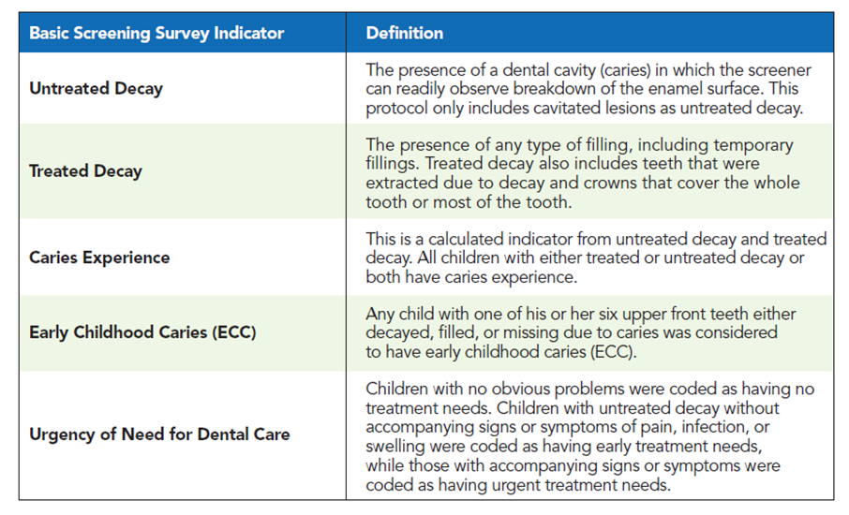
Basic Screening Survey
Data was collected using the Association for State and Territorial Dental Directors (ASTDD) Basic Screening Survey. Dental providers complete the screenings using gloves, headlamps, and disposable mouth mirrors.

Slide 5
State of Oral Health of Young Children in Wisconsin
To begin this module, review the 2014, Wisconsin Healthy Smiles Survey - The Oral Health of Wisconsin’s Head Start Children.
Results:
  Findings indicate that 23% of children had untreated tooth decay.
  The proportion of children with tooth decay increased with age; 15% of three-year-olds, 23% of four-year-olds and 31% of five-year-olds had fillings, crowns or extractions due to decay.
  Surveys conducted in 2002-03 and 2008-09 showed outcomes without change toward improved oral health.
  There is a need to identify high-risk children before age 3 so effective preventive intervention can be provided.
  To view the entire report: https://www.dhs.wisconsin.gov/publications/p01702.pdf

Slide 6
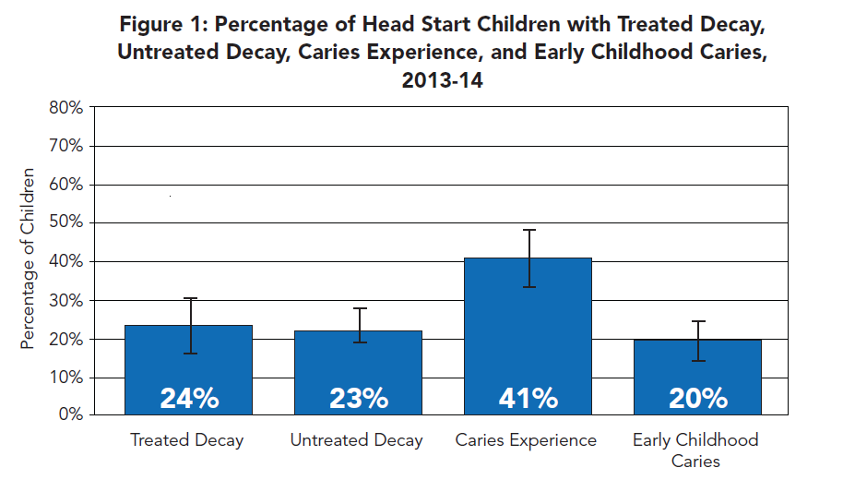
Wisconsin Head Start Survey
Source: Olson MA, Moss ME and Voelker MK. Healthy Smiles Survey: Wisconsin’s Head Start Children, 2014. Wisconsin Oral Health Program, Wisconsin Department of Health Services.

Slide 7
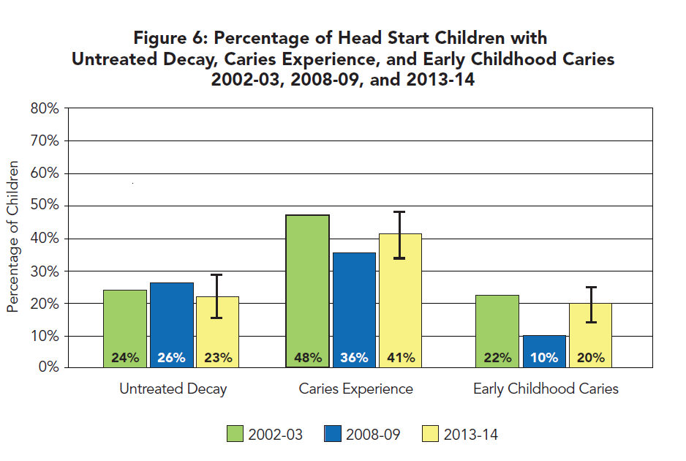
Wisconsin Head Start Survey
Source: Olson MA, Moss ME and Voelker MK. Healthy Smiles Survey: Wisconsin’s Head Start Children, 2014. Wisconsin Oral Health Program, Wisconsin Department of Health Services.

Slide 8
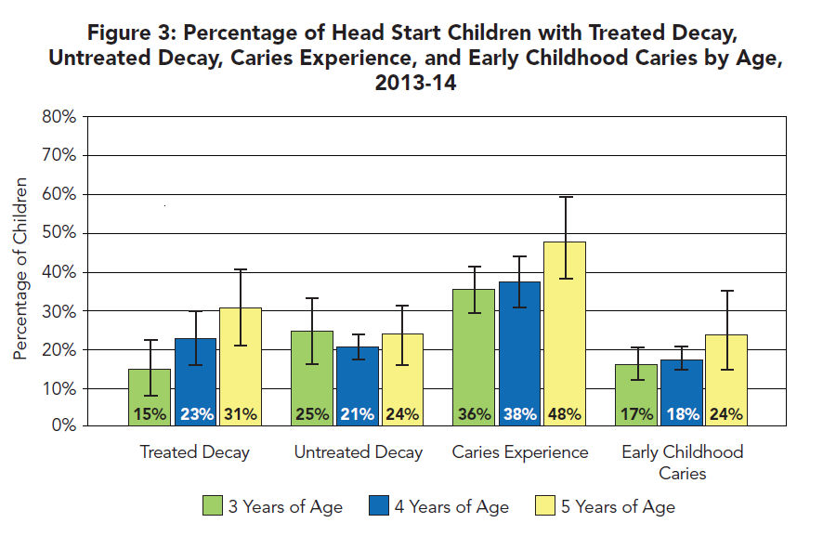
Wisconsin Head Start Survey
Source: Olson MA, Moss ME and Voelker MK. Healthy Smiles Survey: Wisconsin’s Head Start Children, 2014. Wisconsin Oral Health Program, Wisconsin Department of Health Services.

Slide 9
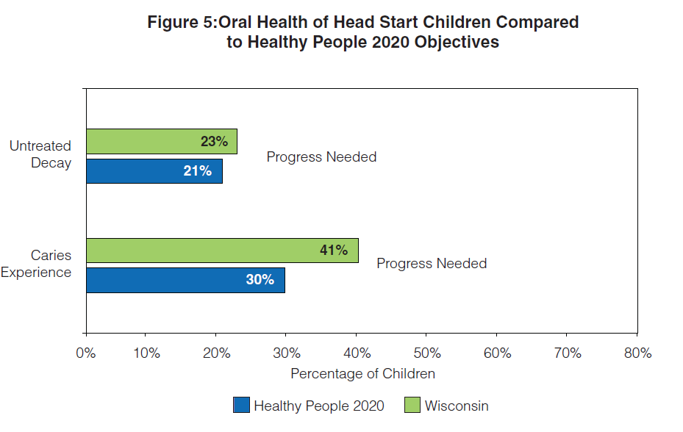
Wisconsin Head Start Survey
Source: Olson MA, Moss ME and Voelker MK. Healthy Smiles Survey: Wisconsin’s Head Start Children, 2014. Wisconsin Oral Health Program, Wisconsin Department of Health Services.

Slide 10
Activity 1 – Online Learning Module
DentaQuest Institute Disease Management Series
  This learning series consists of 30 to 40 minute online learning modules. Each module is designed to promote and increase prevention-focused thinking about oral health care.
  Complete Module 6: Dental Caries Management: Newborn to Age 5. This module covers specialized disease management of dental caries for infants and toddlers, newborn to age five.
  https://www.dentaquestinstitute.org/

Slide 11
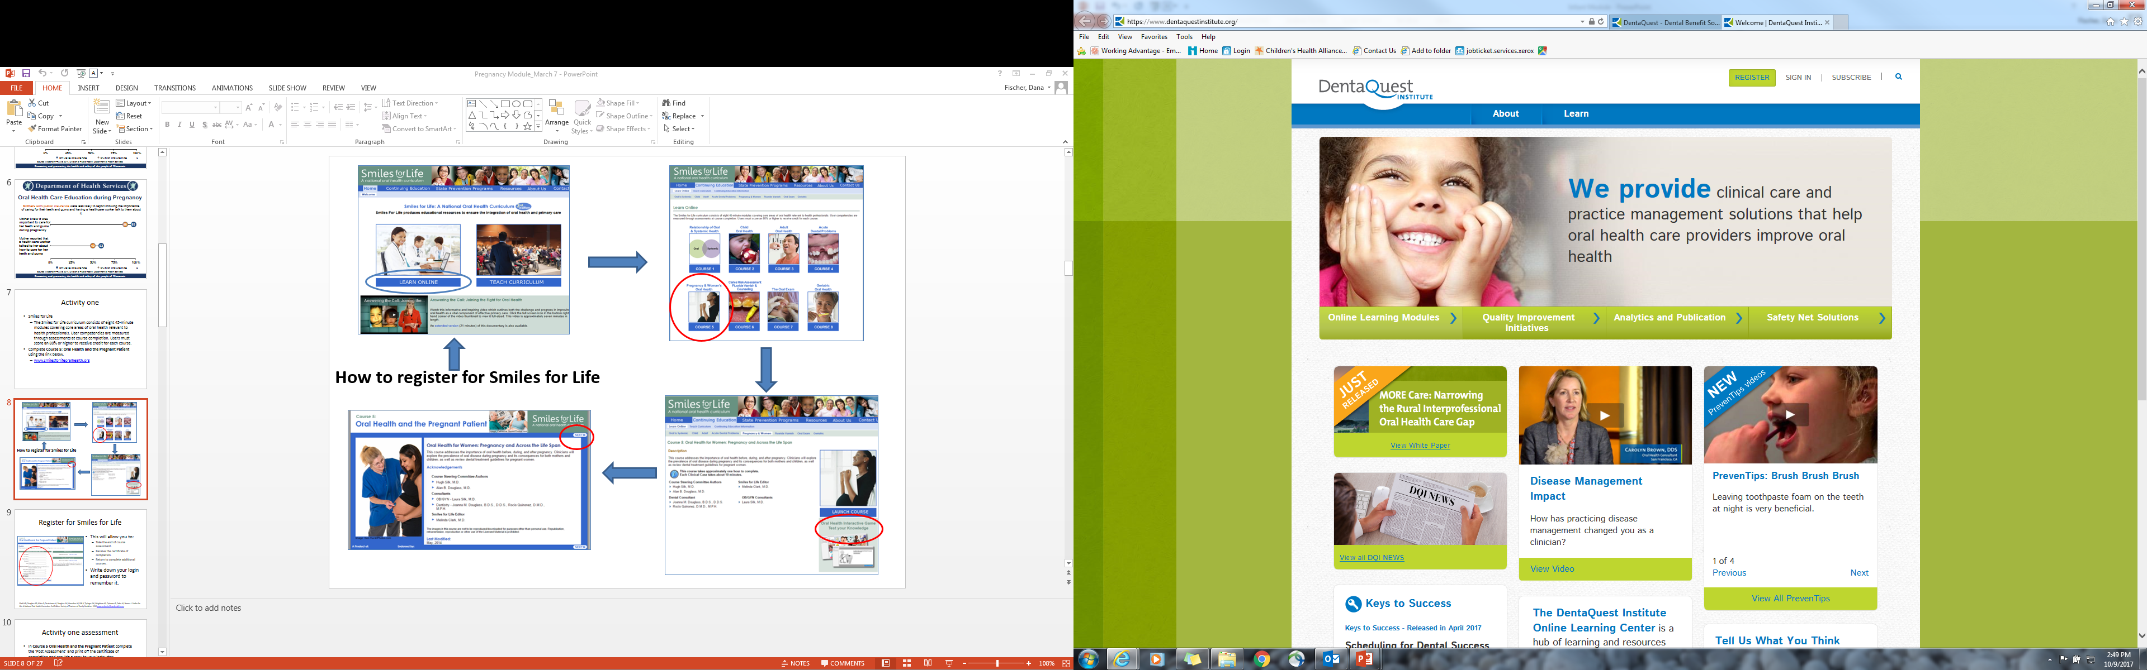
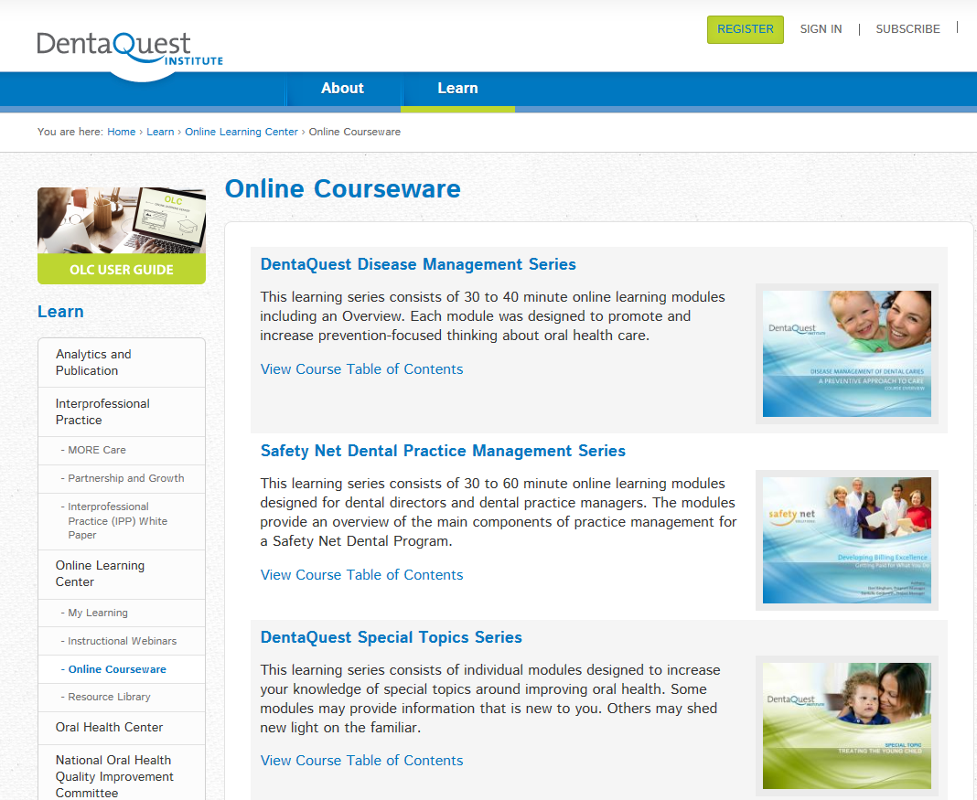
Register for DentaQuest Institute
https://www.dentaquestinstitute.org/

Slide 12
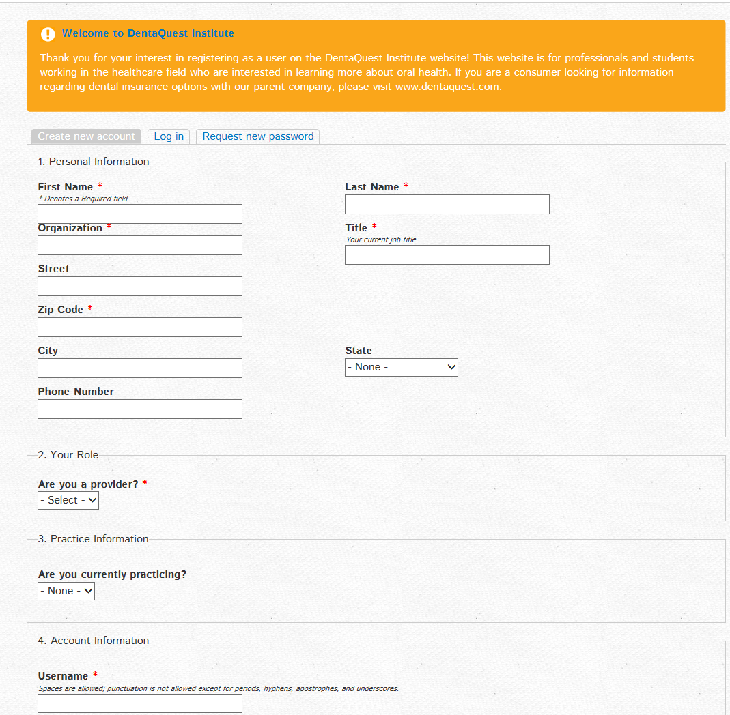
Register for DentaQuest Institute
Registration will allow you to:
    Take the end of course assessment.
    Receive the certificate of completion.
    Return to complete additional courses.
Write down your login and password for future course access.

Slide 13
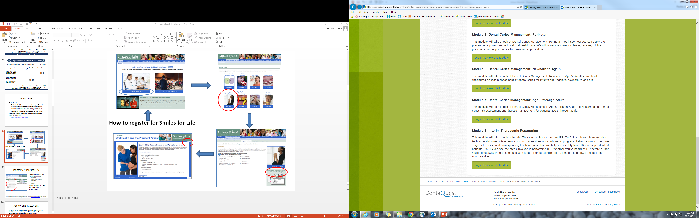
Online Learning Module
Module 6: Dental Caries Management: Newborn to Age 5
  Listen to the Case Study
  Complete the Module Quiz

Slide 14
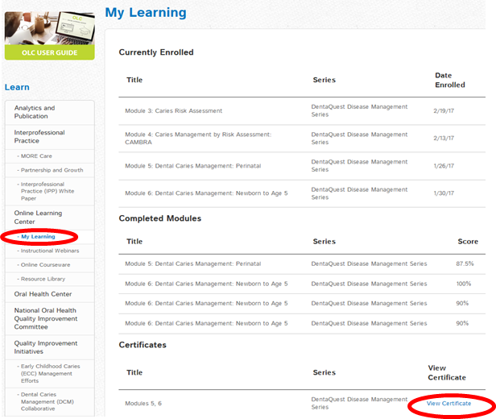
Activity 1 – Assessment
Go to the learn toolbar and in the dropdown select the online learning center then my learning page.
Print the certificate for Module 5 and provide it to your instructor.

Slide 15
Activity 2 – Article Review
Read the two articles described and accessed on the following slides.
Complete the assessment activity described on slide 18 .

Slide 16
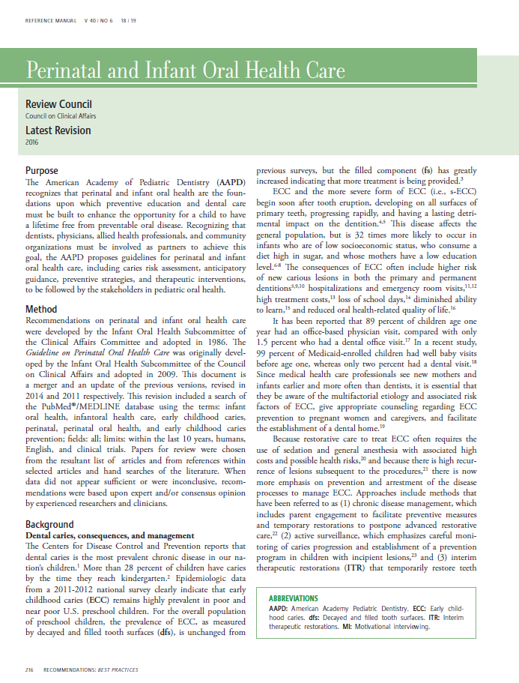
“Guidelines on Perinatal and Infant Oral Health Care”
American Academy of Pediatric Dentistry (AAPD)
https://www.aapd.org/globalassets/media/policies_guidelines/bp_perinataloralhealthcare.pdf
The American Academy of Pediatric Dentistry Council on Clinical Affairs. (2011). Guidelines on Perinatal and Infant Oral Health Care. References Manual Volume 40(6):18/19 pg:2016-220

Slide 17
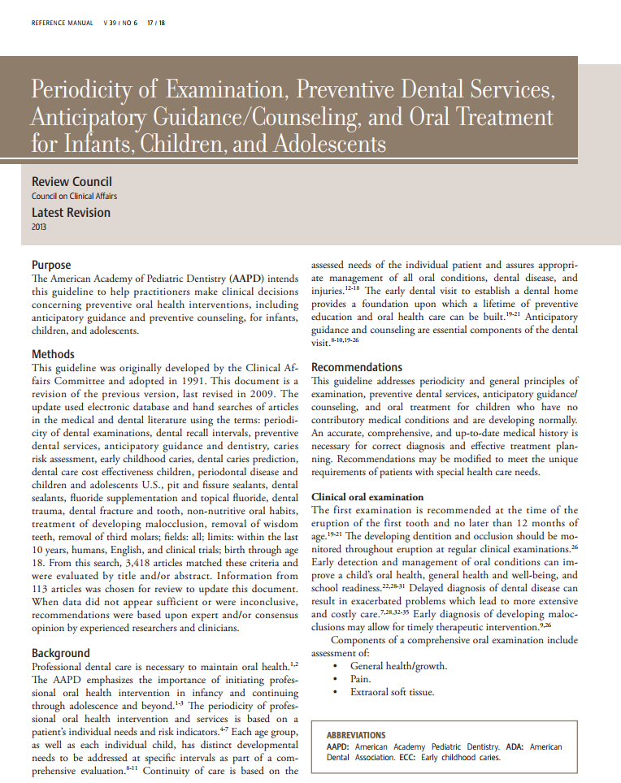
“Guideline on Periodicity of Examination, Preventive Dental Services, Anticipatory Guidance and Oral Treatment for Infants, Children and Adolescents”
http://www.aapd.org/media/Policies_Guidelines/BP_Periodicity.pdf
  Source: The American Academy of Pediatric Dentistry Council on Clinical Affairs. (2013). Guidelines on Examination, Preventive Dental Services, Anticipatory Guidance/Counseling, and Oral Treatment for Infants, Children, and Adolescents. References Manual Volume 39(6): 17/18:188-195.
Notes:
remove

Slide 18
Activity 2 – Assessment
Choose one of the scenarios about a family and child provided on the next slide. Using information from the articles in this section, create anticipatory guidance for the parent that is specific to the child’s age and the scenario presented.
Work in pairs/groups to create a role play depicting a hygienist providing anticipatory guidance to the parent.
Record a video of the role play and share with the class/your teacher.

Slide 19
Scenario 1
Tanesha, a mom of 3 children comes into a dental clinic for appointments for her two older children. The children are 6 and 4 years old and this is their first visit to a dentist. Both older children are diagnosed with several areas of dental decay and need to return for restorative care. The youngest child is a toddler, age 18 months. The mom is concerned and wants to know what she can do to prevent her youngest from getting cavities.
  What anticipatory guidance would you provide to this mom to help her understand the young toddlers oral care needs and how she can reduce his risk of decay?

Slide 20
Scenario 2
During an outreach visit at the local WIC clinic, you are talking to a mom about the oral health of her 16 month old. The Mom says “yes”, I brush my toddler’s teeth, when she lets me, but they are just baby teeth.
As you observe the child you notice thick plaque formation and white line etching along the gum line on her upper front teeth.
What anticipatory guidance would you provide to the mom on the importance of daily oral health care for her child’s baby teeth?

Slide 21
CODA Standard 2-12
Patient Care Competencies
2-12
Graduates must be competent in providing dental hygiene care for the child, adolescent, adult and geriatric patient.
Graduates must be competent in assessing the treatment needs of patients with special needs.
Intent:
Age appropriate patient pool should be available to provide a wide scope of patient experiences that include patients whose medical, physical, psychological, or social situations may make it necessary to modify procedures in order to provide dental hygiene treatment for that individual. Student experiences should be evaluated for competency and monitored to ensure equal opportunities for each enrolled student.
Clinical instruction and experiences with special needs patients should include instruction in proper communication techniques and assessing the treatment needs compatible with these patients.

Slide 22
CODA Standard 2-12 (continued)
Examples of evidence to demonstrate compliance may include:
Program clinical and radiographic experiences, direct and non-direct patient contact assignments, and off-site enrichments experiences.
Patient tracking data for enrolled and past students.
Policies regarding selection of patients and assignments of procedures.
Student clinical evaluation mechanism demonstrating student competences in clinical skills, communication and practice management.

Slide 23
CODA Standard 2-23
Critical Thinking Competencies
2-23
Graduates must be competent in problem solving strategies related to comprehensive patient care and management of patients.
Intent:
Critical thinking and decision making skills are necessary to provide effective and efficient dental hygiene services. Throughout the curriculum, the educational program should use teaching and learning methods that support the development of critical thinking and problem solving skills.
Examples of evidence to demonstrate compliance may include:
Evaluation mechanisms designed to monitor knowledge and performance.
Outcomes assessment mechanisms demonstrating application of critical thinking skills.
Activities or projects that demonstrate student experiences with analysis of problems related to comprehensive patient care.
Demonstration of the use of active learning methods that promote critical appraisal of scientific evidence in combination with clinical application and patient factors.

Slide 24
Please Provide Feedback
Use the link below to provide feedback on the content and how you used these modules.
Thank you!
https://www.surveymonkey.com/r/66Q3ZQ2
For questions contact: dfischer@chw.org

