Slide 1
Educational Curriculum on
Perinatal and Infant Oral Health Care:
Current Standards of Care for
Dental and Dental Hygiene Students
Module 1 – Oral Health during Pregnancy

Slide 2


Acknowledgments
Primary Authors
Patty Hooper, RDH, BSDH
Clinical Instructor of Dental Hygiene
Waukesha County Technical College
Debbie Schumacher, RDH-ME
Instructor of Dental Hygiene
Chippewa Valley Technical College
Additional Contributors
Dana Fischer, CHES
HSMB Project Manager
Children’s Health Alliance of Wisconsin
Diane Flanagan, RDH
Senior Project Manager
Children’s Health Alliance of Wisconsin
This project is supported in part by funding from the Maternal and Child Health Bureau, Health Resources and Services Administration, U.S. Department of Health and Human Services grant number H47MC28475

Slide 3
Objectives
After viewing these resources students will be able to provide oral health education to women on the potential impact of dental infections on pregnancy, and the importance of preventive oral care and treatment services throughout pregnancy by:
  Recognizing the need to establish optimal oral health prior to pregnancy.
  Understanding the association between inflammatory response and adverse birth outcomes (i.e. low birth weight and pre-term delivery).
  Identifying bacteria implicated in the inflammatory response system.
  Understanding the association between maternal oral bacteria and dental caries risk to her child.
  Providing dental care that is safe and ethical throughout all stages of pregnancy.

Slide 4
State of Oral Health of
Pregnant Women in Wisconsin
To set the stage for this module, please review the current Pregnancy Risk Assessment Monitoring System or PRAMS data collected in 2014.
This is self reported data collected from postpartum women about experiences during their most recent pregnancy.
Results:
  Mothers of minority race/ethnicity were significantly less likely than non-Hispanic white mothers to have their teeth cleaned before and during pregnancy.
  Mothers with public insurance were significantly less likely to have their teeth cleaned before and during pregnancy.

Slide 5
Teeth Cleaning Before and During Pregnancy
Mothers of minority race/ethnicity were significantly less likely than non-Hispanic white mothers to have their teeth cleaned before and during pregnancy.
Source: Wisconsin PRAMS 2014, Division of Public Health, Department of Health Services

Slide 6
Teeth Cleaning Before and During Pregnancy
Mothers with public insurance were significantly less likely to have their teeth cleaned before and during pregnancy.
Source: Wisconsin PRAMS 2014, Division of Public Health, Department of Health Services

Slide 7
Oral Health Care Education during Pregnancy
Mothers with public insurance were less likely to report knowing the importance of caring for their teeth and gums and having a healthcare worker talk to them about it.
Source: Wisconsin PRAMS 2014, Division of Public Health, Department of Health Services

Slide 8
Activity 1 – Smiles for Life Curriculum
  The Smiles for Life curriculum consists of eight 45-minute modules covering core areas of oral health relevant to health professionals. User competencies are measured through assessments at course completion. Users must score an 80% or higher to receive credit for each course.
  Complete Course 5: Oral Health and the Pregnant Patient www.smilesforlifeoralhealth.org

Slide 9

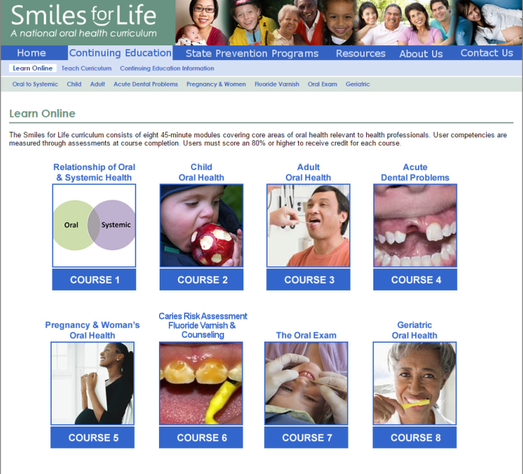
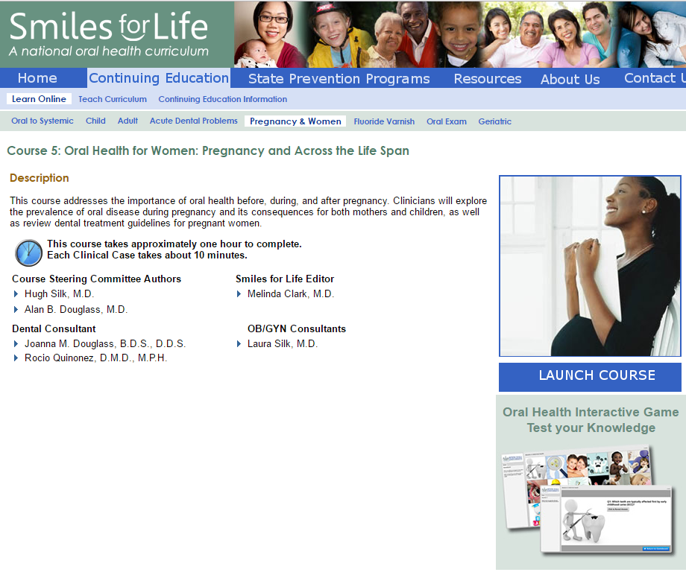
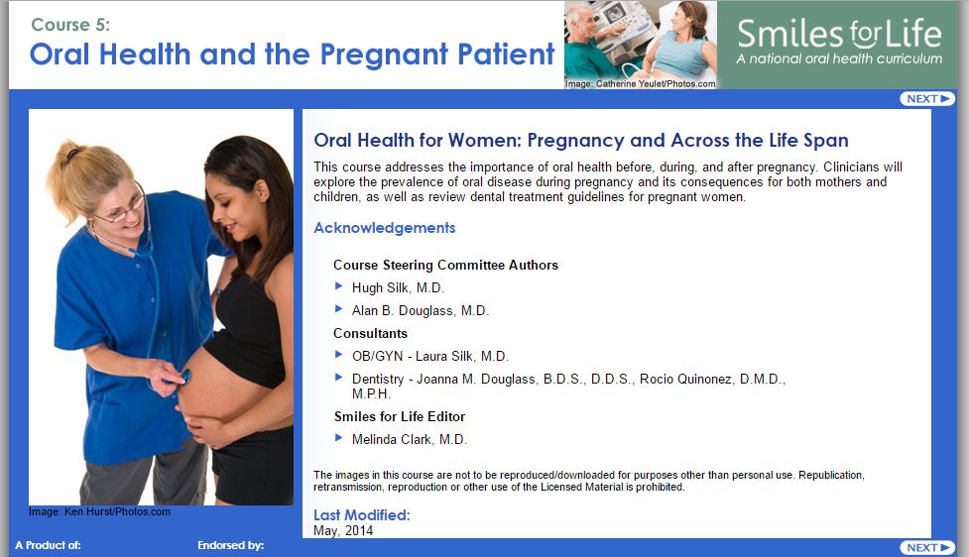
How to register for Smiles for Life

Slide 10
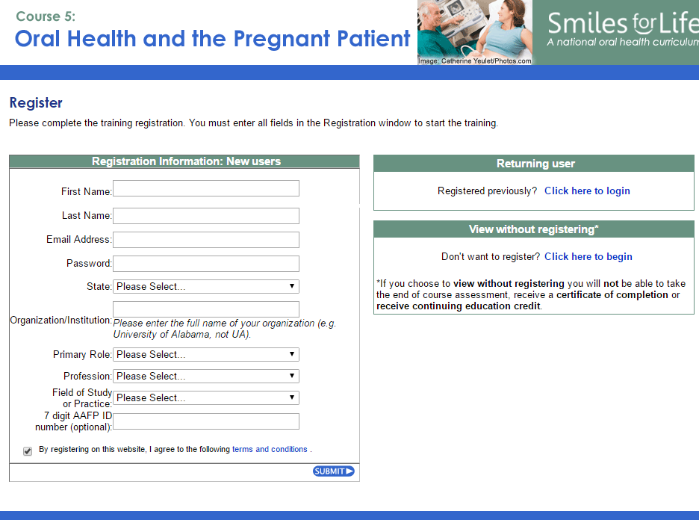
Register for Smiles for Life
Registration will allow you to:
    Take the end of course assessment.
    Receive the certificate of completion.
    Return to complete additional courses.
Write down your login and password for future course access.
Source: Clark MB, Douglass AB, Maier R, Deutchman M, Douglass JM, Gonsalves W, Silk H, Tysinger JW, Wrightson AS, Quinonez R, Dolce M, Bowser J. Smiles for Life: A National Oral Health Curriculum. 3rd Edition. Society of Teachers of Family Medicine. 2010 www.smilesforlifeoralhealth.com.

Slide 11
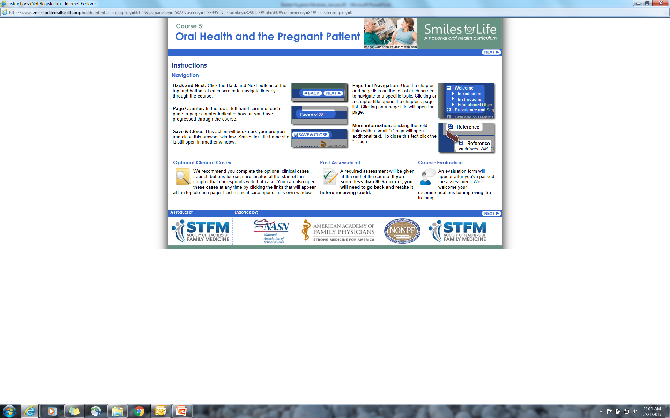
Activity 1 – Assessment
In Course 5: Oral Health and the Pregnant Patient complete the ‘Post Assessment’, print the certificate of completion and provide a copy to your instructor.
Complete questions # 1-11 in the case study guide.

Slide 12
Activity 2 – Article Review
Read the four articles described and accessed on the following slides.
Complete two assessment activities described on slide 17.

Slide 13
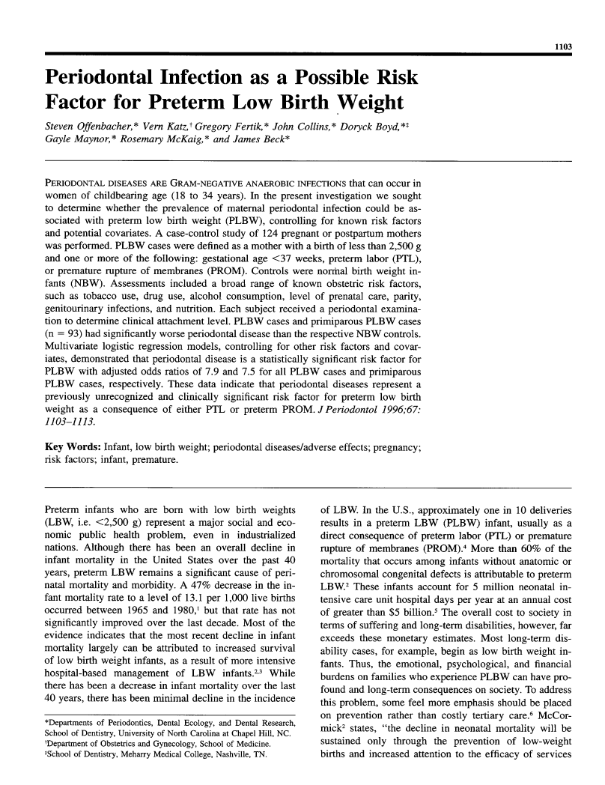
“Periodontal Infection as a Possible Risk Factor for Preterm Low Birth Weight”
https://onlinelibrary.wiley.com/doi/abs/10.1902/jop.1996.67.10s.1103
  Source: Offenbacher et.al. Periodontal Infection as a Possible Risk Factor for Preterm Low Birth Weight. J Periodontol 1996;67:1103-1113.
Notes:
Offenbacher article included on flash drive folder for Module 1.

Slide 14
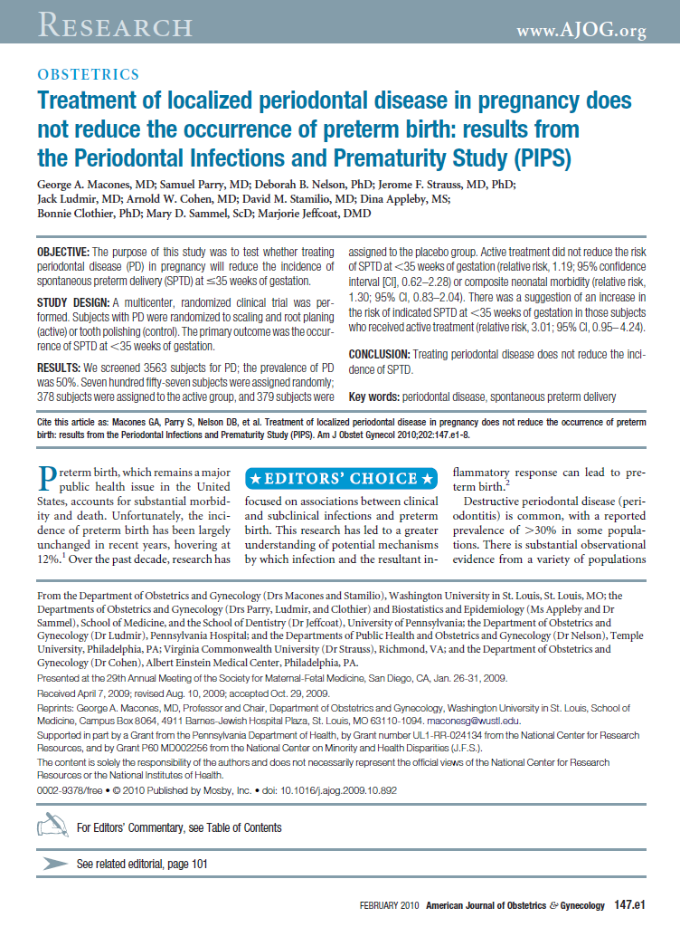
“Treatment of localized periodontal disease in pregnancy does not reduce the occurrence of preterm birth: results from the Periodontal Infections and Prematurity Study (PIPS)”
https://www.sciencedirect.com/science/article/pii/S0002937809021188
Source: Macones GA, Parry S, Nelson DB, et al. Treatment of localized periodontal disease in pregnancy does not reduce the occurrence of pretermbirth: results from the Periodontal Infections and Prematurity Study (PIPS). Am J Obstet Gynecol 2010;202:147.e1-8.

Slide 15
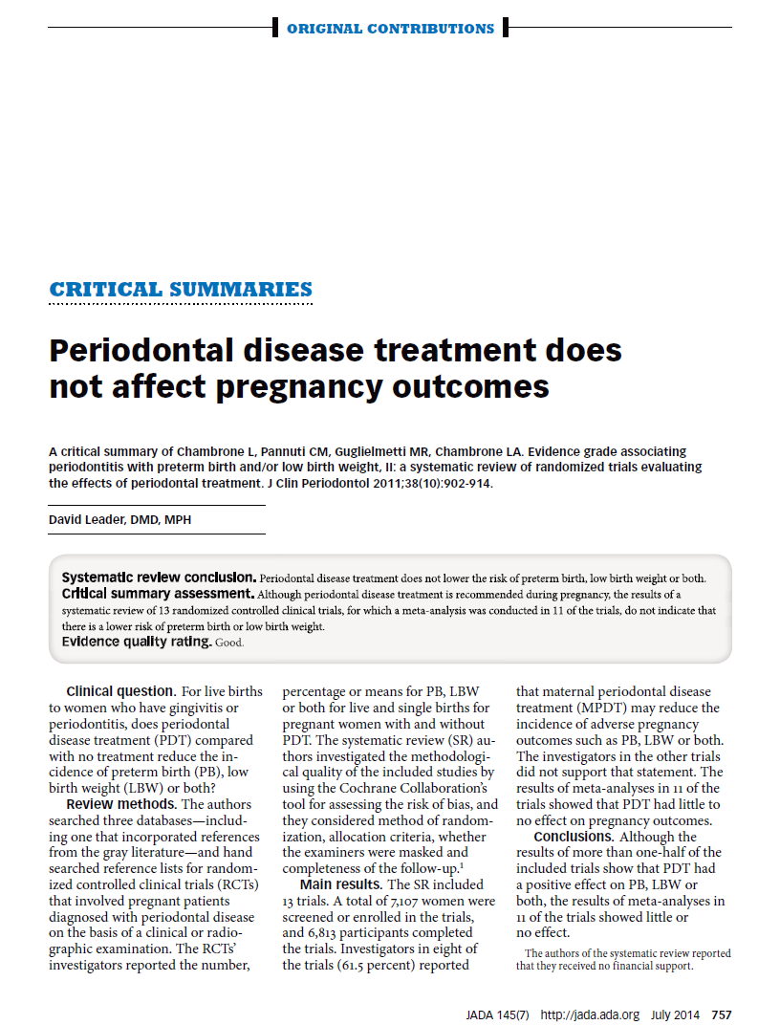
“Periodontal disease treatment does not affect pregnancy outcomes”
https://jada.ada.org/article/S0002-8177(14)60094-5/fulltext
Source: Leader, David. Periodontal disease treatment does not affect pregnancy outcomes. Journal of the American Dental Association 2014;145(7):757-759.

Slide 16
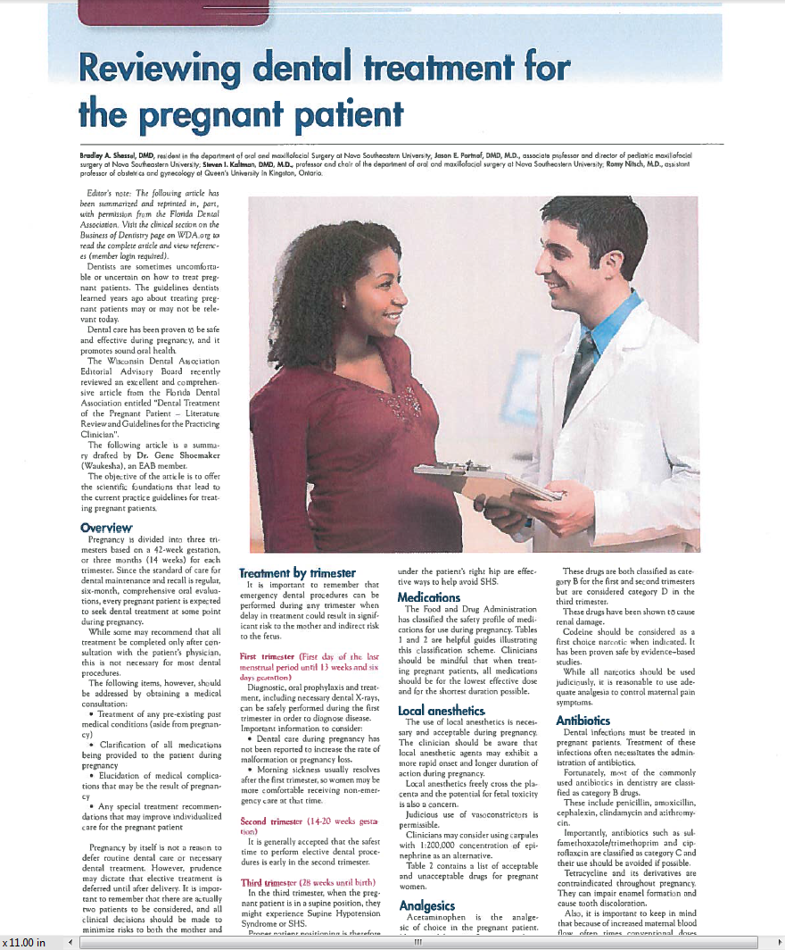
“Reviewing dental treatment for the pregnant patient”
Source: Shessel, B., Partnaf, J., Kaltman, S., Nitsch, R. (2014). Reviewing dental treatment for the pregnant patient. Wisconsin Dental Association Journal 2014: September Issue: 8-9.
Notes:
This article is only available via PDF found on flash drive.

Slide 17
Activity 2 – Assessment
Reflect on key concepts presented in the articles by completing two of the following activities:
  Create a Venn Diagram comparing and contrasting the main outcomes of 2 of the articles. Include how the key points and outcomes are similar, different and areas that overlap.
  Find another article on the topic and provide a 1 page summary. Include key points and describe how they support, rebuke or provide new evidence to support current practice guidelines.
  Interview a current provider on their clinical experience providing care to pregnant women and reflect on how this aligns with the articles.
  Complete a 1 page summary of the key concepts presented in the 4 articles. Include what was new information to you, what was most interesting and any questions you have about the information.

Slide 18
Activity 3 – Perinatal Guidelines
Read the perinatal guidelines, produced by three professional organizations, described and accessed on the following slides.
Choose one assessment activity described on slide 22 to complete.

Slide 19
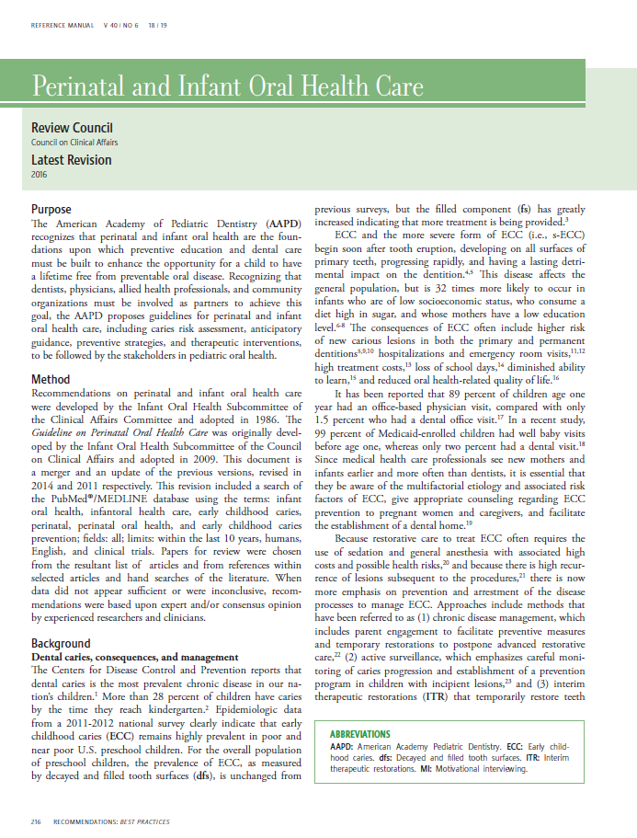
“Guidelines on Perinatal and Infant
Oral Health Care”
American Academy of Pediatric Dentistry (AAPD)
https://www.aapd.org/globalassets/media/policies_guidelines/bp_perinataloralhealthcare.pdf
The American Academy of Pediatric Dentistry Council on Clinical Affairs. (2011). Guidelines on Perinatal and Infant Oral Health Care. References Manual Volume 40(6):18/19 pg:2016-220

Slide 20
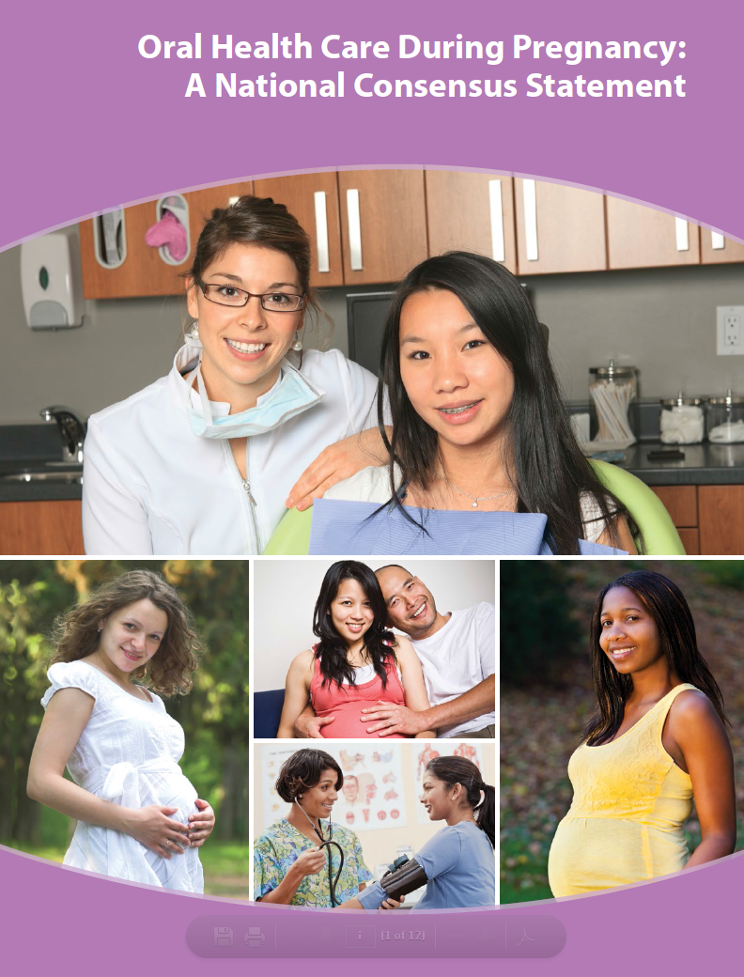
“Oral Health Care During Pregnancy:
A National Consensus Statement”
Oral Health Care During Pregnancy Expert Workgroup
https://www.mchoralhealth.org/PDFs/OralHealthPregnancyConsensus.pdf
Source: Oral Health Care During Pregnancy Expert Workgroup. (2012). Oral Health Care During Pregnancy: A National Consensus Statement. Washington, DC: National Maternal and Child Oral Health Resource Center.

Slide 21
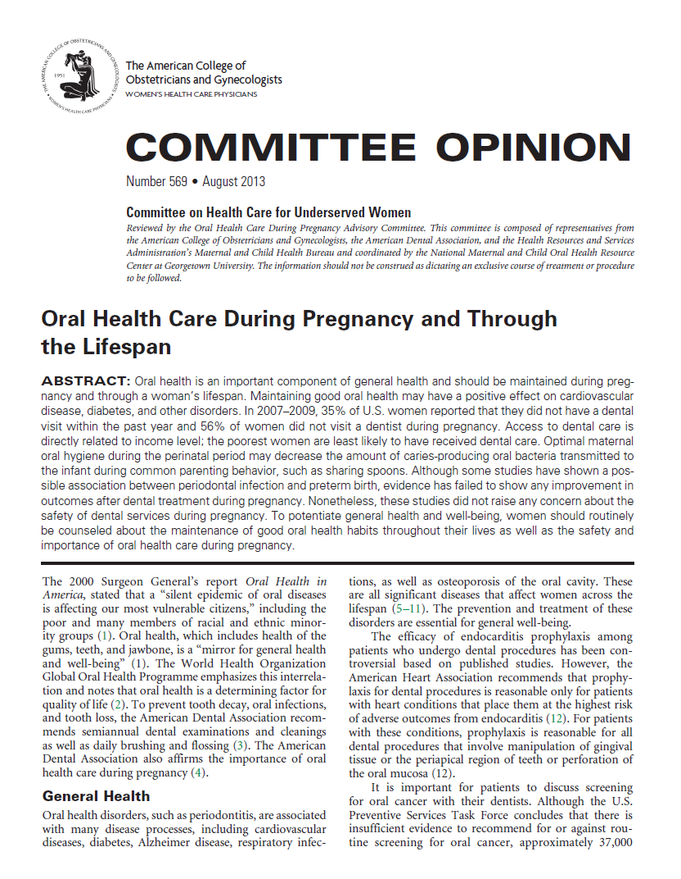
“Oral Health Care During Pregnancy and
Through the Lifespan”
The American College of Obstetricians and Gynecologists
https://www.acog.org/Clinical-Guidance-and-Publications/Committee-Opinions/Committee-on-Health-Care-for-Underserved-Women/Oral-Health-Care-During-Pregnancy-and-Through-the-Lifespan
Source: American College of Obstetricians and Gynecologists. (2013). Oral health care during pregnancy and through the lifespan. Committee Opinion No. 569. Obstet Gynecol 112:417-22.

Slide 22
Activity 3 – Assessment
  Reflect on key concepts presented in the guidelines by completing one of the following activities:
    Pretend you are a newly hired dental hygienist in a private practice. Upon starting at the clinic, you realize that an exam and cleaning is provided to pregnant women but any restorative needs are not completed until after the patient delivers. With the new information you’ve learned, create a ‘lunch and learn’ session to share with your colleagues on the clinical background, importance, and safety of providing preventive and restorative care during all trimesters.
    Your best friend is a registered nurse at the local hospital and responsible for leading educational sessions (birthing classes) for pregnant women. She invited you to come and provide a brief presentation on the importance of oral health care for pregnant woman. Create a brief (5-8 slide) presentation to include key messages and action steps to promote optimal oral health prior to delivery.
    Create a poster on the importance of oral health care for the pregnant patients that could hang in a private practice. Include key patient messages using language that is easily understood. In addition, find two already developed resources (tip sheets, brochures) for take home patient education.
    Contact via phone, 5 local dental clinics to see if they are accepting pregnant patients, what services they provide and when (what trimester). Write a reflection on your experience comparing and contrasting the results you found with the information you’ve learned by reading the professional guidelines.

Slide 23
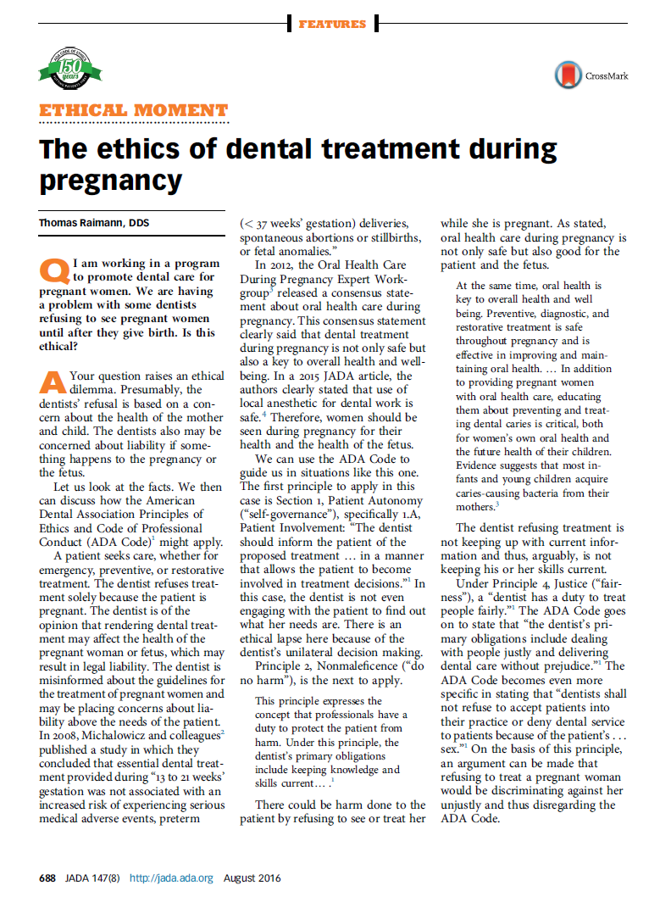
Activity 4 – Ethics Article
Read the following article.
Choose one assessment activity described on slide 24 to complete.
https://jada.ada.org/article/S0002-8177(16)30337-3/fulltext
Source: Raimann, Thomas. The ethics of dental treatment during pregnancy. Journal of the American Dental Association 2016;147(8):688-689.

Slide 24
Activity 4 – Assessment
Complete a 1 page reflection paper on the ethical considerations presented in the article and what consequences there are for refusing to treat a pregnant patient.
OR
Based on what you now know about the ethical perspective of dental treatment of pregnant women, create a public service announcement that could be broadcasted in your community to increase awareness on the importance of oral health care for pregnant women.

Slide 25
CODA Standard 2-12
Patient Care Competencies
2-12
Graduates must be competent in providing dental hygiene care for the child, adolescent, adult and geriatric patient.
Graduates must be competent in assessing the treatment needs of patients with special needs.
Intent:
Age appropriate patient pool should be available to provide a wide scope of patient experiences that include patients whose medical, physical, psychological, or social situations may make it necessary to modify procedures in order to provide dental hygiene treatment for that individual. Student experiences should be evaluated for competency and monitored to ensure equal opportunities for each enrolled student.
Clinical instruction and experiences with special needs patients should include instruction in proper communication techniques and assessing the treatment needs compatible with these patients.

Slide 26
CODA Standard 2-12 (continued)
Examples of evidence to demonstrate compliance may include:
Program clinical and radiographic experiences, direct and non-direct patient contact assignments, and off-site enrichments experiences.
Patient tracking data for enrolled and past students.
Policies regarding selection of patients and assignments of procedures.
Student clinical evaluation mechanism demonstrating student competences in clinical skills, communication and practice management.

Slide 27
CODA Standard 2-22
Critical Thinking Competencies
2-22
Graduates must be competent in the evaluation of current scientific literature.
Intent:
Dental hygienists should be able to evaluate scientific literature as a basis for life-long learning, evidenced-based practice and as a foundation for adapting to changes in healthcare.
Examples of evidence to demonstrate compliance may include:
Written course documentation of content in the evaluation of current and classic scientific literature.
Evaluation mechanisms designed to monitor knowledge and performance.
Outcomes assessment mechanisms.

Slide 28
CODA Standard 2-23
Critical Thinking Competencies
2-23
Graduates must be competent in problem solving strategies related to comprehensive patient care and management of patients.
Intent:
Critical thinking and decision making skills are necessary to provide effective and efficient dental hygiene services. Throughout the curriculum, the educational program should use teaching and learning methods that support the development of critical thinking and problem solving skills.
Examples of evidence to demonstrate compliance may include:
Evaluation mechanisms designed to monitor knowledge and performance.
Outcomes assessment mechanisms demonstrating application of critical thinking skills.
Activities or projects that demonstrate student experiences with analysis of problems related to comprehensive patient care.
Demonstration of the use of active learning methods that promote critical appraisal of scientific evidence in combination with clinical application and patient factors.

Slide 29
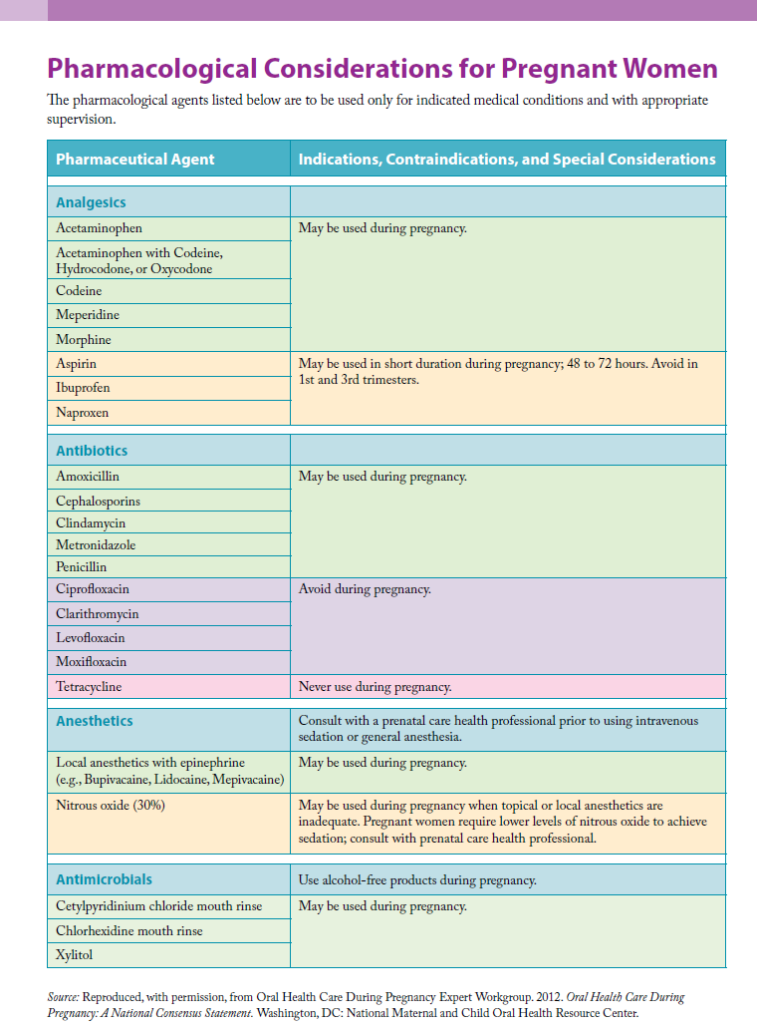
Resources
https://www.mchoralhealth.org/PDFs/OralHealthPregnancyPharmacological.pdf
Source: Oral Health Care During Pregnancy Expert Workgroup. (2012). Oral Health Care During Pregnancy: A National Consensus Statement. Washington, DC: National Maternal and Child Oral Health Resource Center.

Slide 30
Please Provide Feedback
Use the link below to provide feedback on the content and how you used these modules.
Thank you!
https://www.surveymonkey.com/r/66Q3ZQ2
For questions contact: dfischer@chw.org

