Slide 1

Minor Head Trauma:
Let’s Move On
Jeff Schunk, MD
June 2021

Slide 2

Disclosure
No relevant financial disclosures
No relevant business relationships

Slide 3

Objectives
The participant will:
  Recite the relative risk of intracranial injury in children with normal mental status
  List the features for which risk of clinically important brain injury warrants obtaining a head CT and features for which the risk is very low
  List common hurdles and challenges to implementing practice changes

Slide 4
Would You Scan:
A 4 month old fell out of bouncy, off counter, no symptoms, and normal exam except a 4x4 cm boggy parietal hematoma?
A 16 month old who fell 3 feet, was stunned for a second or two and vomited twice in 2 hours, but with normal exam and no other symptoms?
A 14 year old playing football and had LOC for 2 minutes, but now, 30 minutes later, is a little confused (keeps asking the same question) but otherwise normal exam?

Slide 5

Evaluation of Pediatric Head Trauma –
Updates from PECARN and Beyond
Who “Needs” a CT?

Slide 6
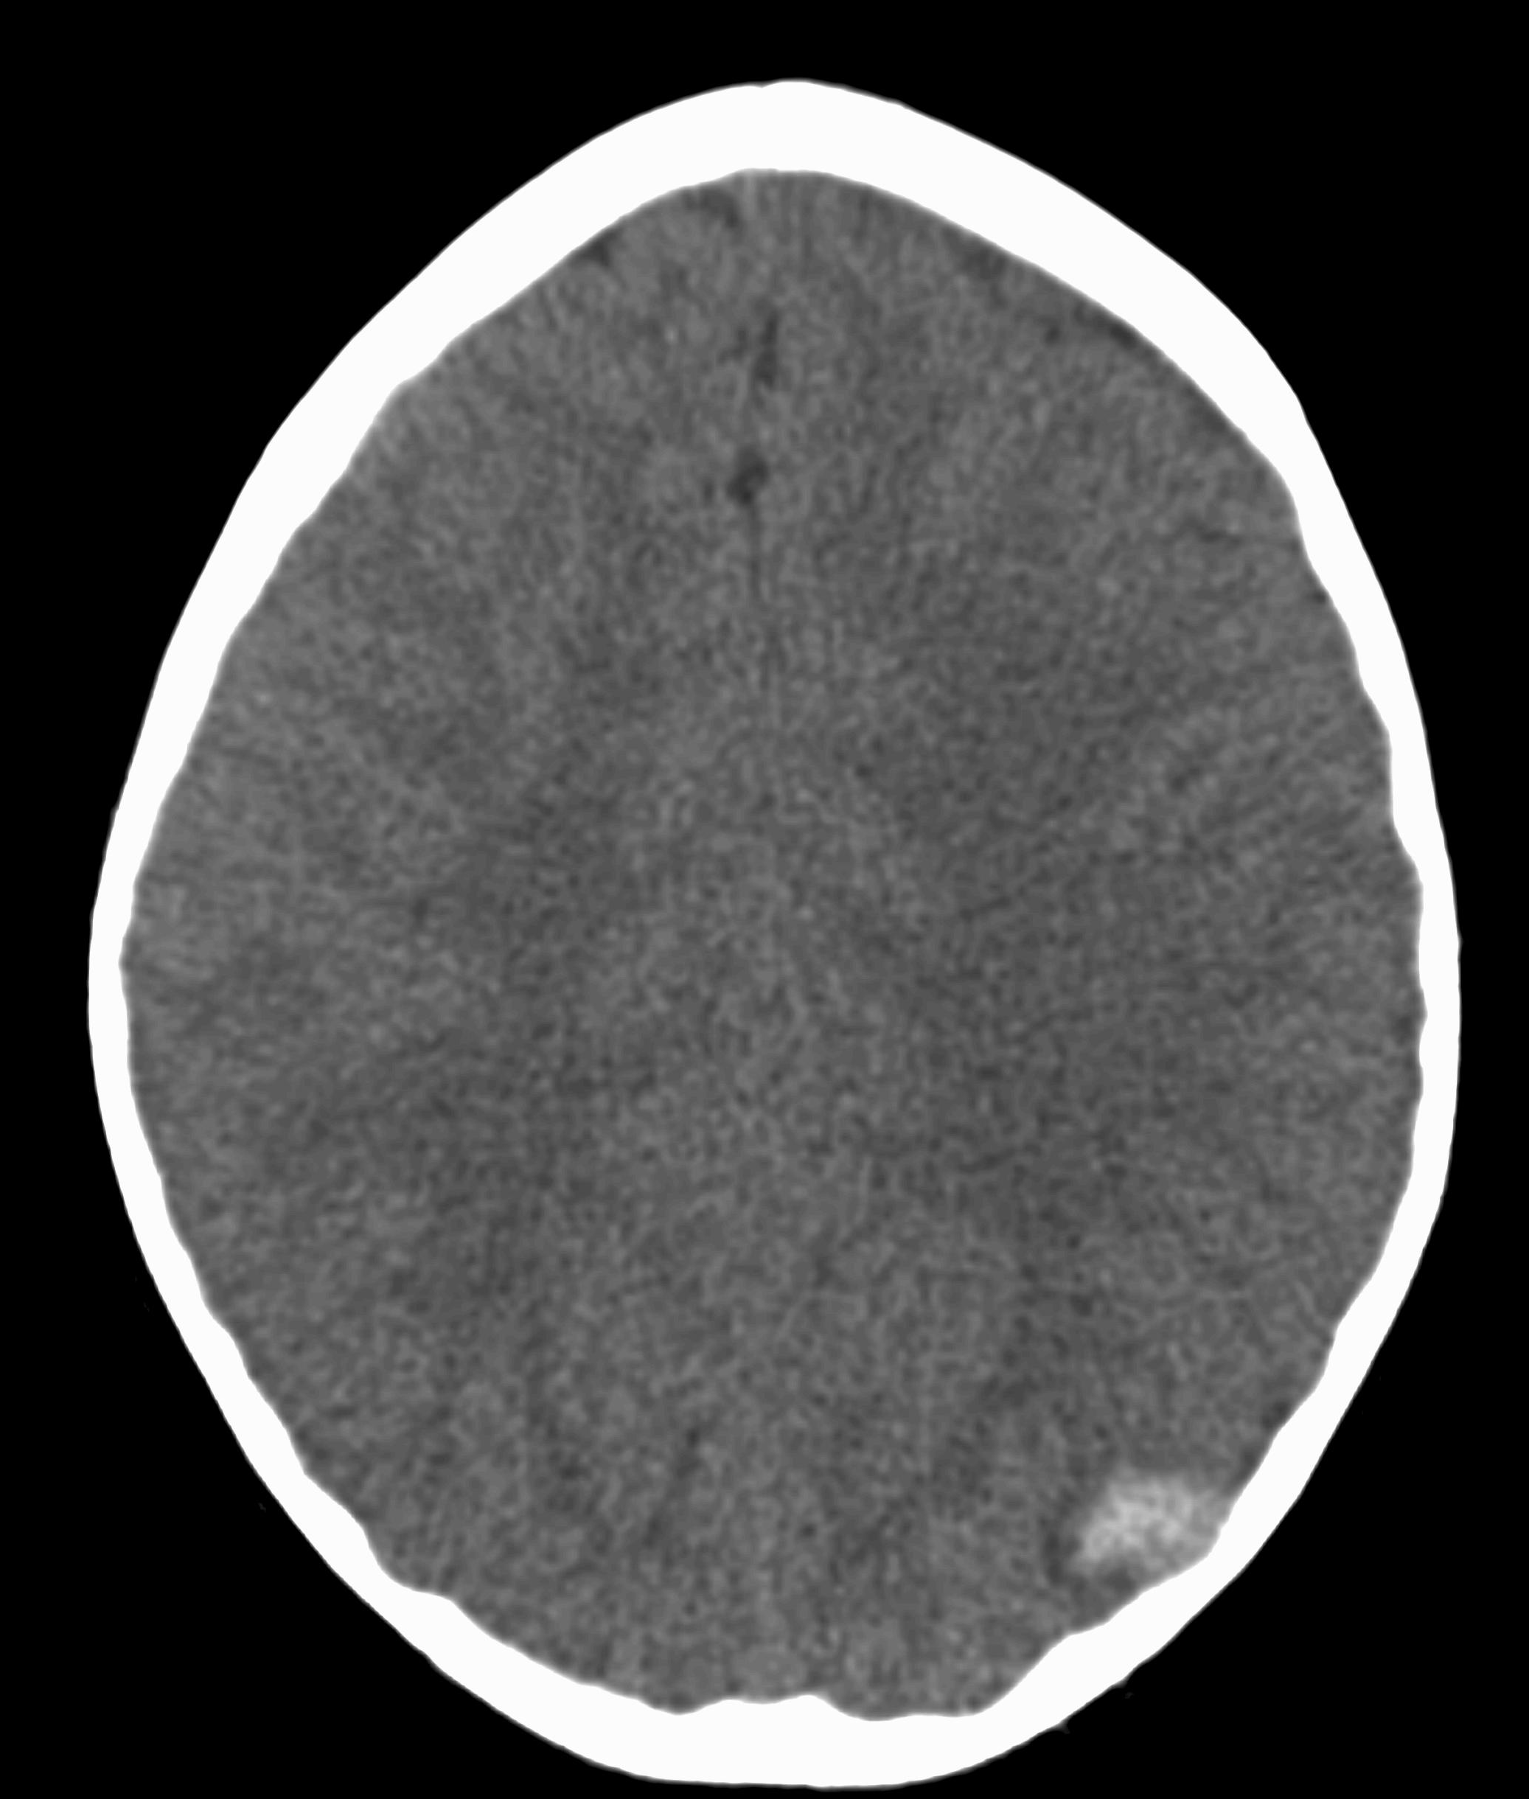
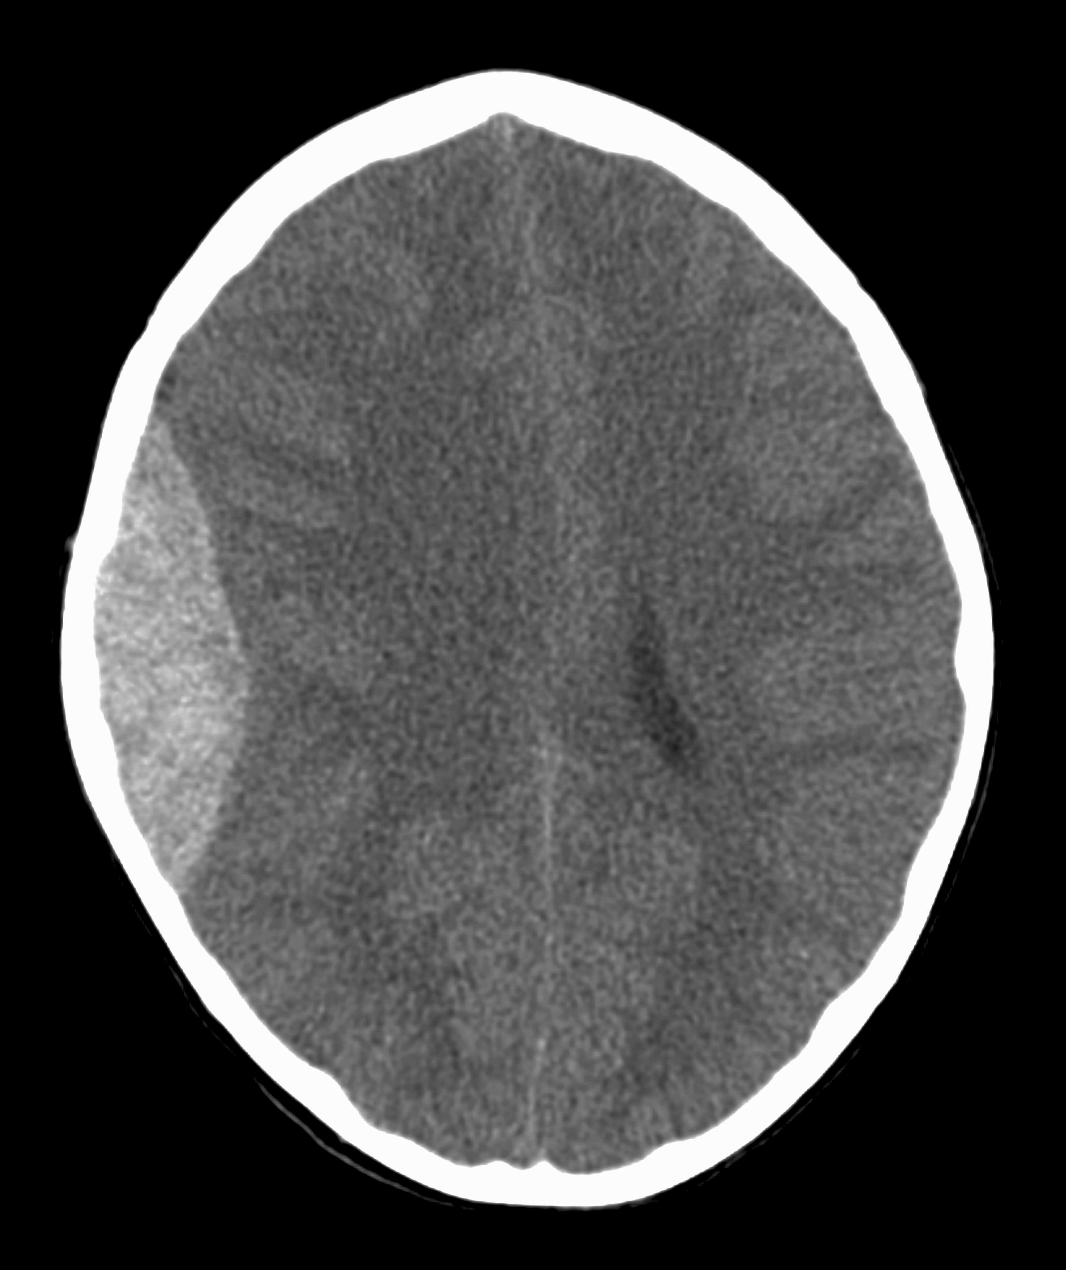
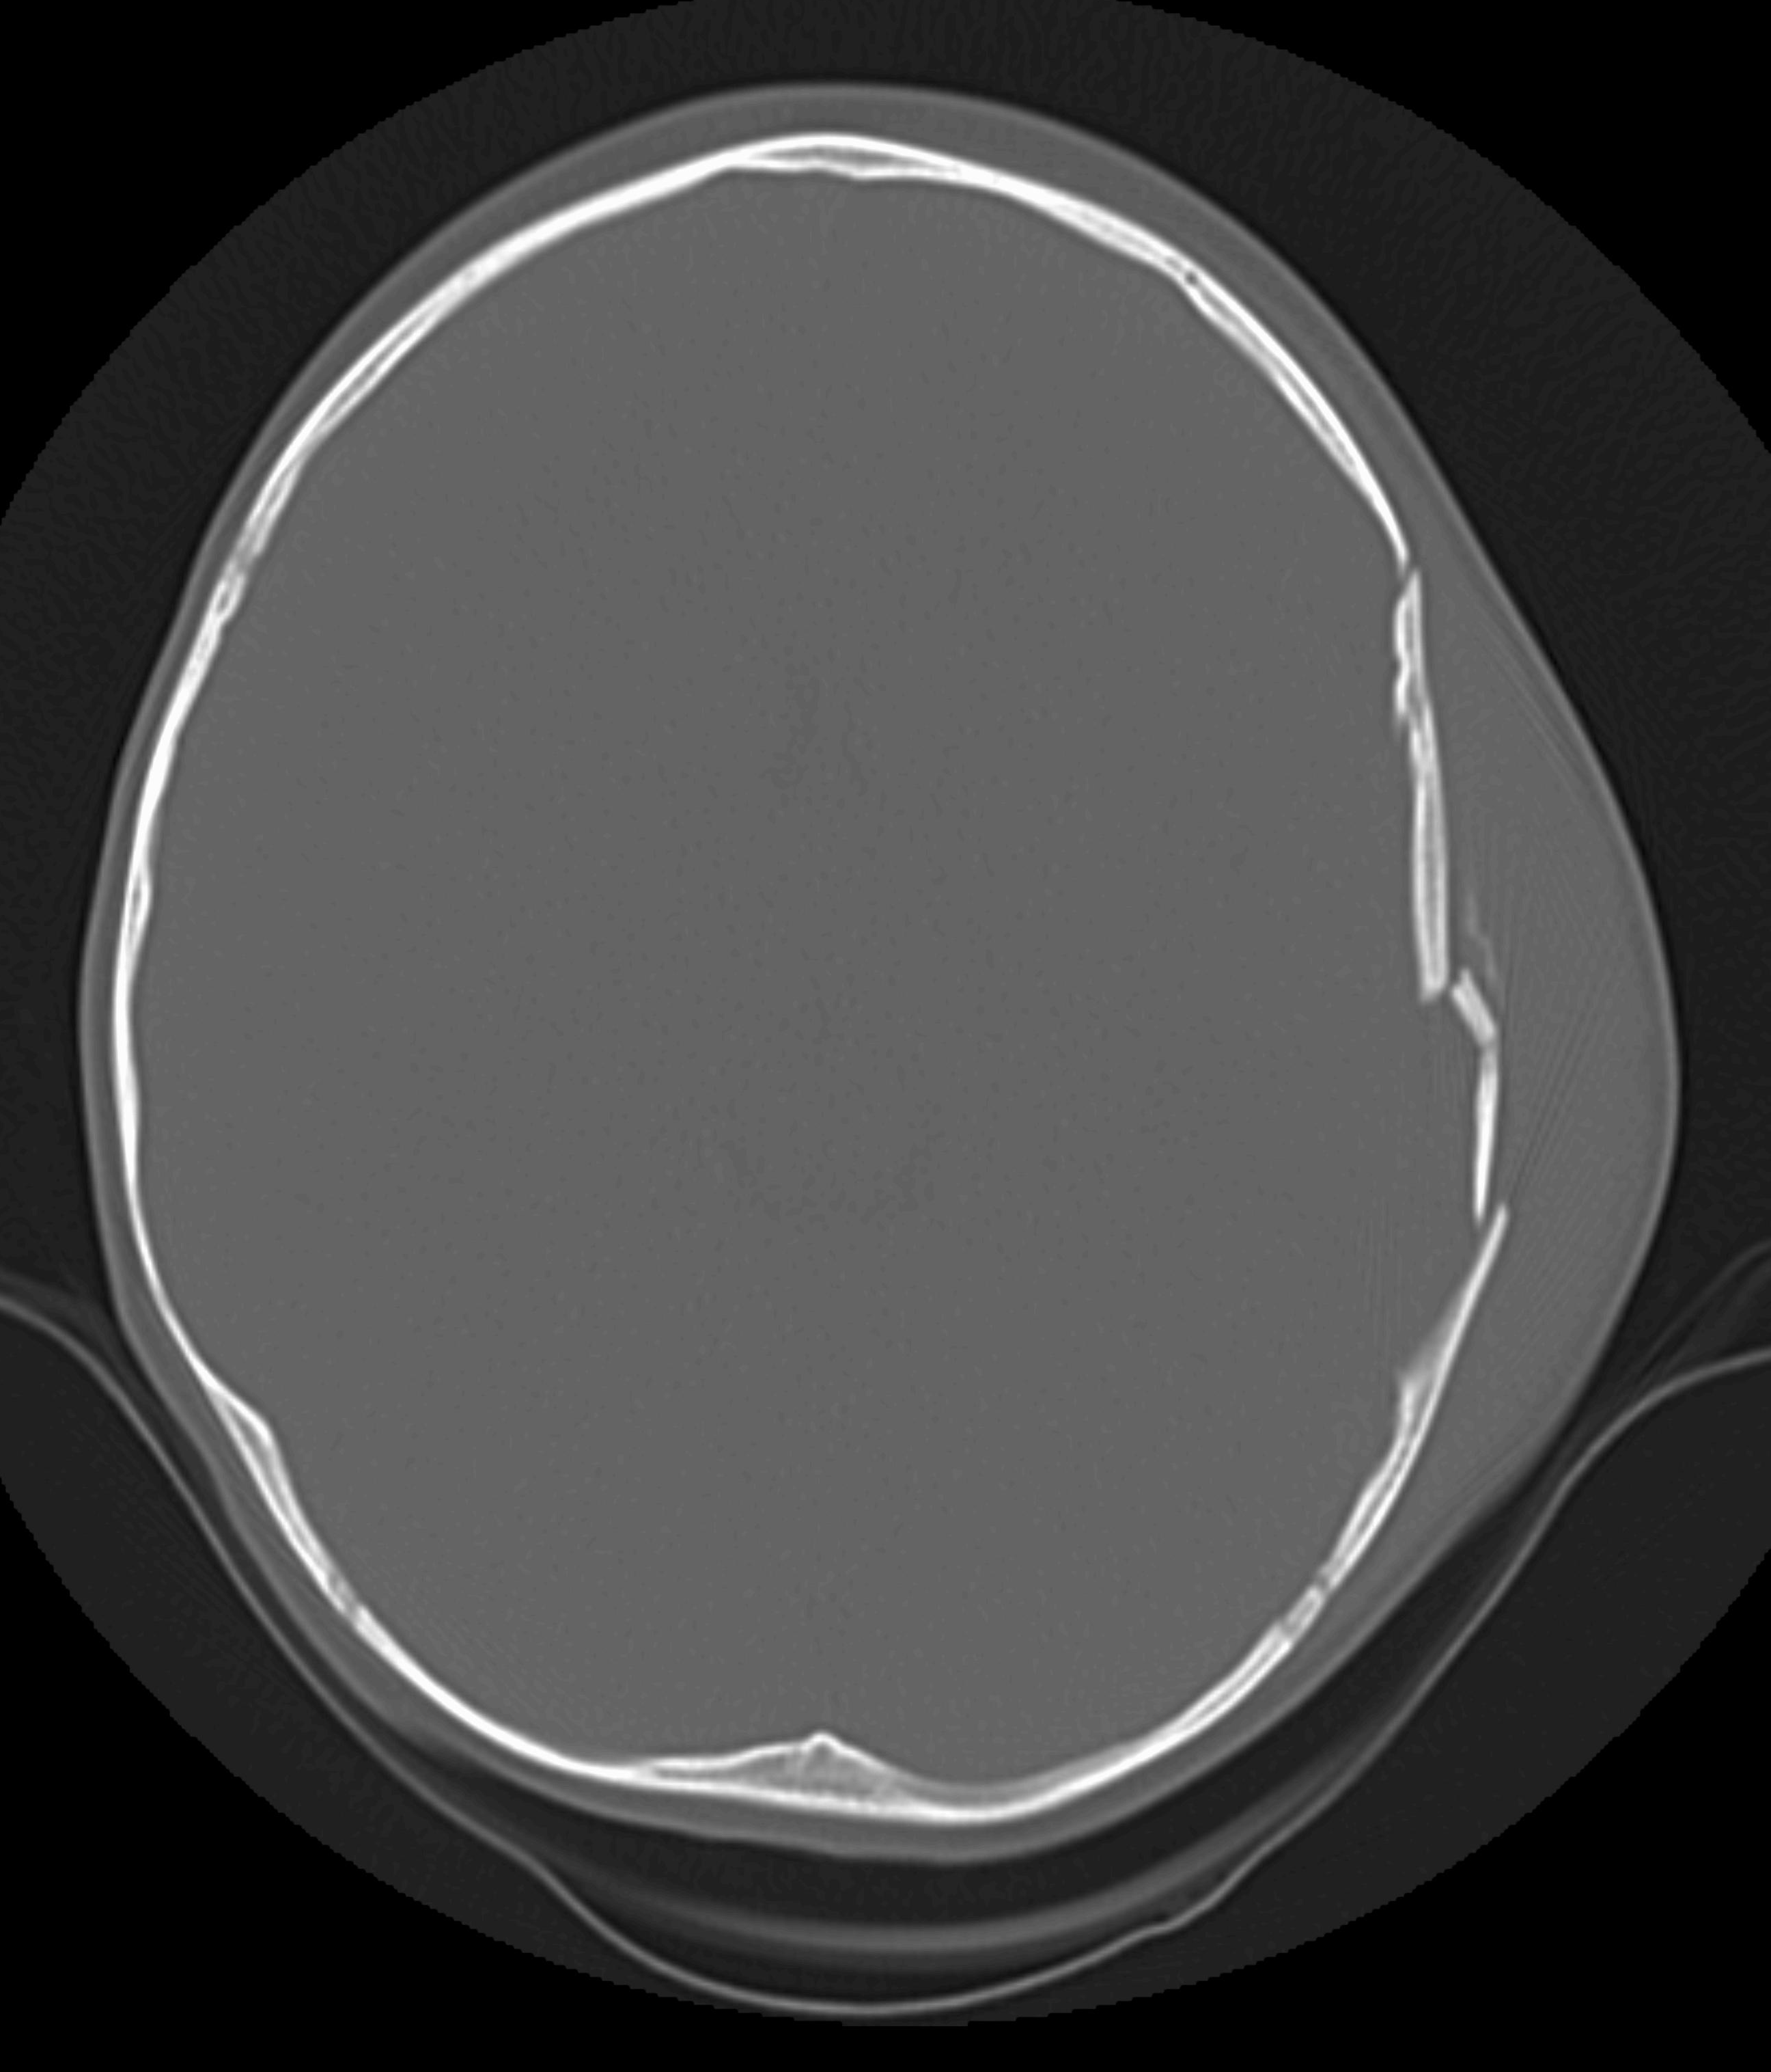
What We Worry About

Slide 7

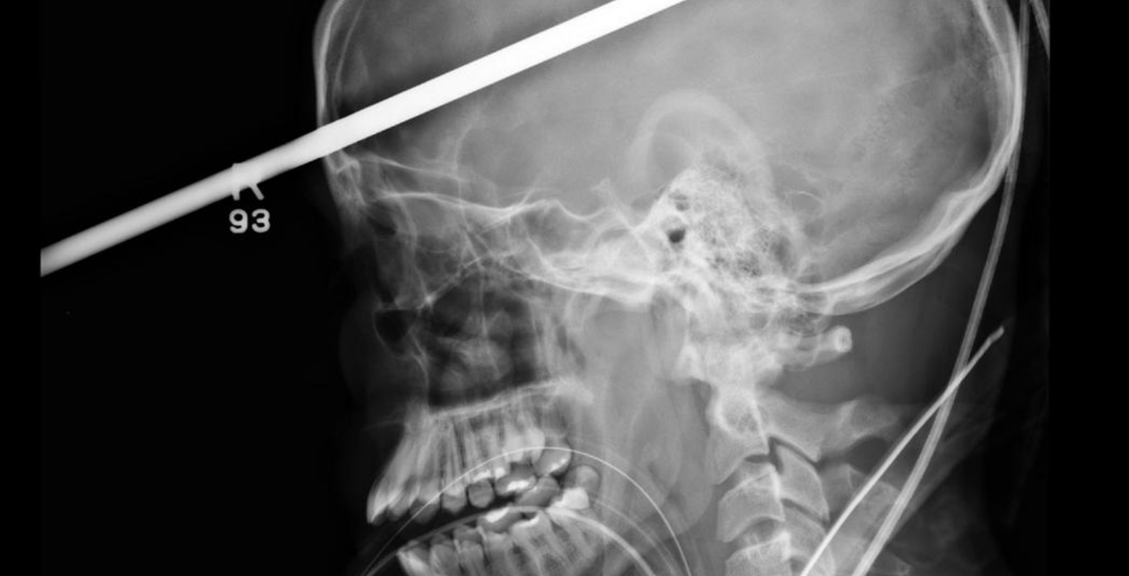
CT Scan When:
Penetrating head injury
Significantly altered LOC or decreasing LOC
Focal neurologic deficits

Slide 8
In Blunt Trauma, CT Scan When…
GCS < 14
Focal neurologic deficits
Signs of depressed skull fracture
Basilar skull fracture signs
What about the well appearing and GCS = 14-15 group?
Notes:
Isolated basilar skull fracture patients tend to do well but would still can with any physicial exam findings

Slide 9
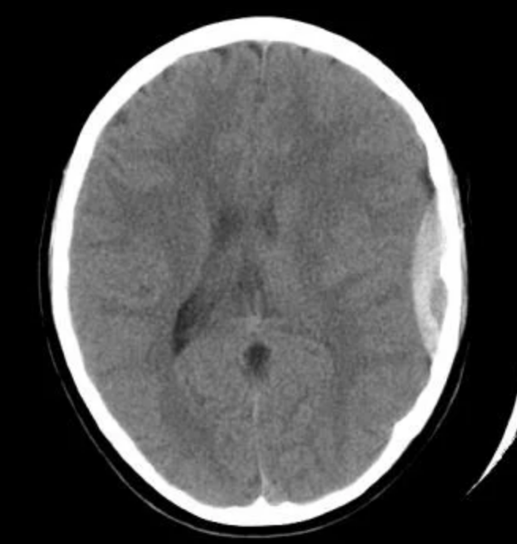
Worrisome symptoms based on descriptions of patients with
Epidural
Subdural
Subarachnoid etc.
For decades we have worried about a variety of symptoms because of their presence in serious intracranial injuries (e.g. vomiting, headache or loss of consciousness)

Slide 10
Prelude to PECARN Head Injury Study
Multiple studies in the previous decades focused on well appearing children with normal neurologic exams/GCS 15
All had low likelihood of intracranial injury (ICI) if above criteria met
In general things associated with ICI: skull fx/basilar skull fx, LOC > 5 minutes, altered mental status, focal neuro exam, age< 6 months
In general things NOT associated with ICI: scalp findings, vomiting, headache, seizure, amnesia, drowsiness, LOC < 5 minutes
Quayle et al. Pediatrics 1997
Schunk et al. Pediatr Emerg Care 1996
Greenes and Schutzman. Ann Emerg Med 1998

Slide 11
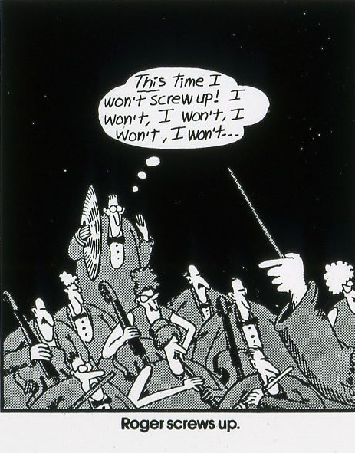

Slide 12

PECARN Head Trauma Study
Identification of children at very low risk of clinically-important brain injuries after head trauma: a prospective cohort study.
Kuppermann et al. Lancet Oct 2009

Slide 13
Purpose
Derive and validate prediction rules for clinically important TBI (ciTBI) and therefore identify children at low risk for ciTBI

Slide 14
Methods
25 Emergency Departments, <18 years, non-trivial head injury within 24 hours and no prior imaging
June 04 - March 06 derivation group
March 06 - September 06 validation group
TBI on CT: edema, hemorrhages, pneumocephalus, depressed skull fracture etc.
ciTIB: death, need for neurosurgery, intubation > 24 hours, admission for head injury ≥ 2 nights

Slide 15
Exclusions
Trivial Injury Mechanism
Ground level falls
Walking or running into stationary objects
And no signs of head trauma other than scalp abrasion, or laceration
Other Exclusions
Penetrating trauma, known brain tumor, pre-existing neurologic conditions limiting assessment, neuroimaging at outside facility

Slide 16

Severity of Mechanism
Severe
MVC and ejection, death in MVC, rollover, auto-pedestrian, auto-bike (no helmet), falls > 5 feet or more than 3 feet if < 2 years, high impact object if < 2 years
Mild
Ground level or run into stationary objects
Moderate
All others

Slide 17
Enrollees
57,030 eligible and 43,904 enrolled
Average age 7.1 years, 25% < 2 years
CT in 14,969 (35%)
Mechanism of injury
  Fall from height 27%
  fall ground level or ran into object 17%
  MVC 9%, object struck head 7%
  assault 7%, sports 7%, stair fall 7%
  bicycle 4%
  auto-pedestrian 3%
  other wheeled 2%
  auto-bike 1%
  other 8%
Derivation and validation group did not differ

Slide 18
PECARN HEAD TRAUMA STUDY
The main findings…using decision tree analysis
The best discriminator goes first and others follow

Slide 19
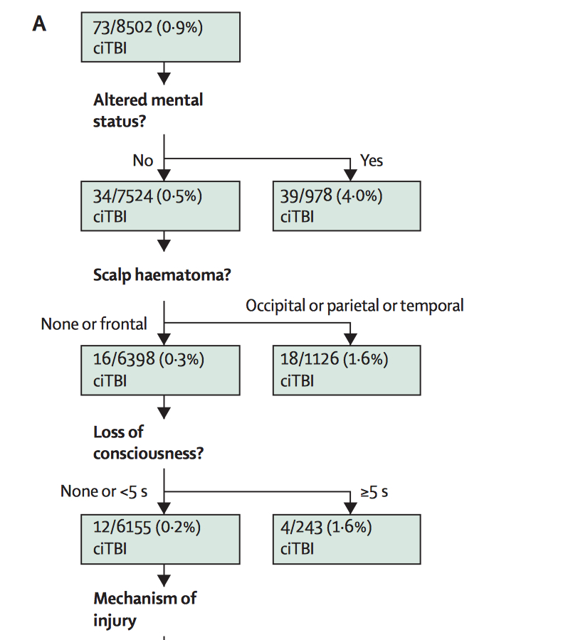
HI Decision Tree < 2 Years (top)

Slide 20
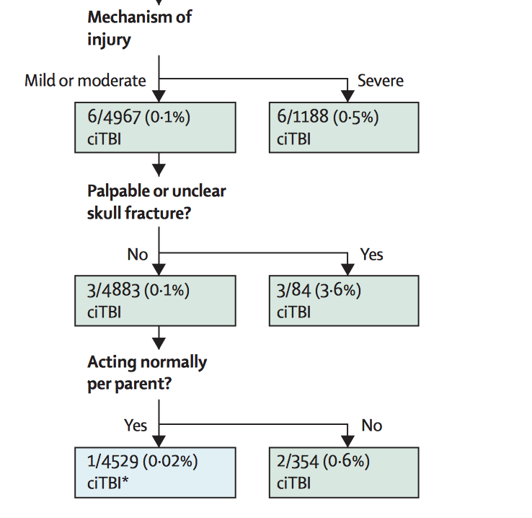
HI Decision Tree < 2 yrs (bottom)

Slide 21
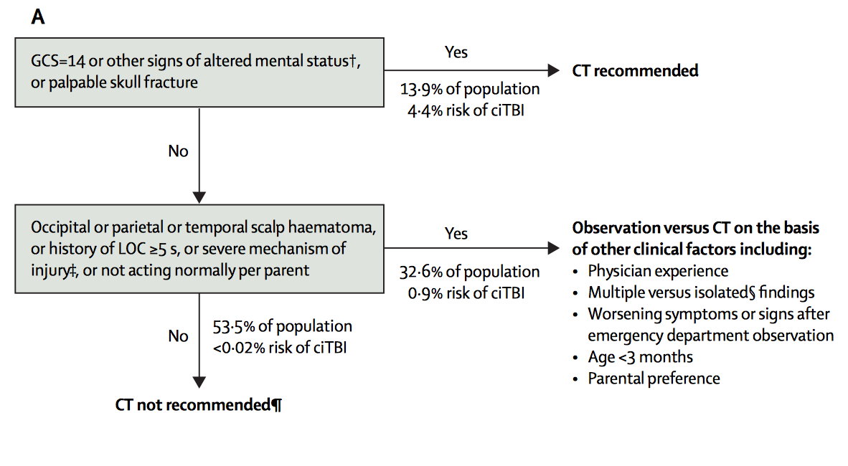
Scan Options < 2 Years

Slide 22
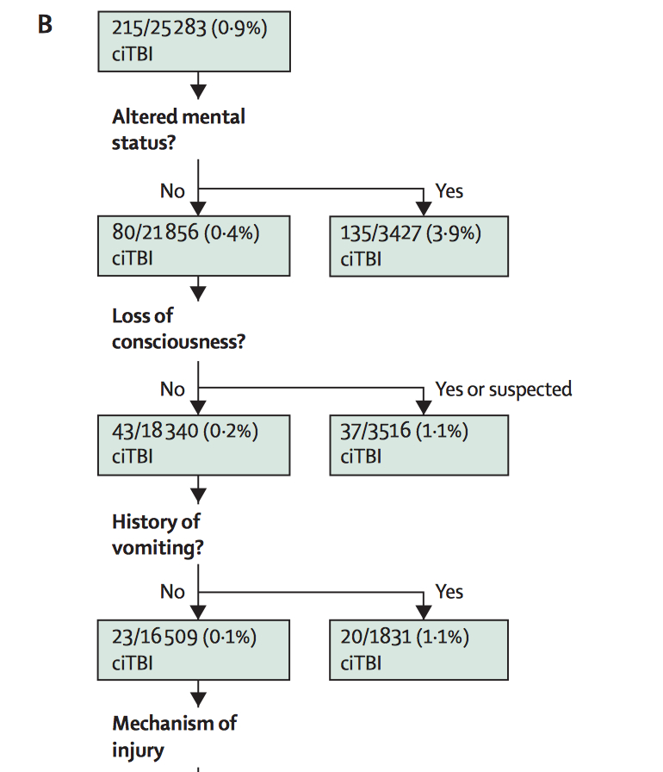
HI Decision Tree > 2 years (top)

Slide 23
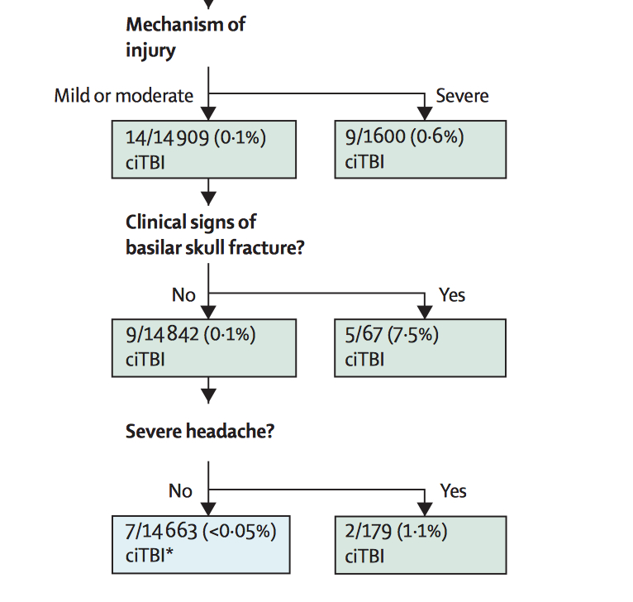
HI Decision Tree > 2 years (bottom)

Slide 24
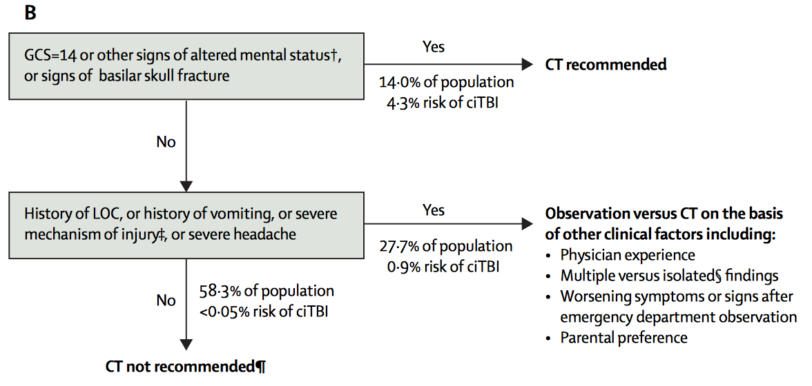
Scan Options > 2 Years

Slide 25

Other Studies PECARN Head Injury

Slide 26
Isolated Severe Mechanism
Overall 6263 had severe mechanism; of those 3630 had isolated severe mechanism
Of 2303 children > 2 years with isolated severe mechanism, 12 (0.5%) had ciTBI (95% CI 0.3%, 0.9%)
Of 1327 children < 2 with isolated severe mechanism, only 4 (0.3%) had ciTBI (95% CI 0.1%, 0.8%)
Nigrovic et al. Arch Pediatr Adolesc Med 2011
Notes:
Severe mechanism:
MVC and ejection, death in MVC, rollover,auto-pedestrian, auto-bike (no helmet),
falls > 5 feet or more than 3 feet if < 2 years, high impact object if < 2 years

Slide 27

Isolated Vomiting
• Of 42,112 children, 5557 had vomiting
Children > 2 years
  Isolated vomiting: 3.2% had some TBI on CT
  ciTBI occurred in 10 /1501 (0.7%) with isolated vomiting
Children < 2 years
  Vomiting is a very poor discriminator
  Isolated vomiting: 1% had some TBI on CT
  ciTBI occurred in 0 / 567 with isolated vomiting
Dayan et al. Ann Emerg Med 2014.

Slide 28

Isolated Headache
12,567 with headaches
Isolated headache: 0/2462 had ciTBI (0%, 0.1%)
  Isolated headache: any TBI on CT: 3/456 (0.7%)
  Non isolated headache TBI on CT: 271/6089 (4.5%)
Dayan et al. Pediatrics 2015

Slide 29
Isolated LOC
LOC occurred in 6286
Any LOC, ciTBI occurred 2.5% of the time
No LOC, ciTBI occurred 0.5% of the time
Isolated LOC: 13/2780, 0.5% (0.2%, 0.8%)
“Children with minor blunt head trauma presenting to the emergency department with isolated LOC are at very low risk for ciTBI and do not routinely require computed tomographic evaluation”
Lee et al. JAMA Pediatrics 2014

Slide 30
Seizures
Seizure was not included in the original PECARN study because many of these patients presented with other risk factors (e.g. altered mental status)
A subsequent follow-up study found
  Impact seizure with 8.6% (95% CI 5.1%, 13.5%) risk of any TBI
  Seizures occurring more than 30 minutes after had 20% (95% CI 10.4%, 33%) risk of TBI
  Of TBIs identified on CT, 28% underwent neurosurgery
Badawy et al. Acad Emerg Med 2017

Slide 31

Infant Scalps

Slide 32
Infant Scalps
Prospective study of 422 head-injured asymptomatic children < 2 years without obvious skull fx on exam
41 had head CT only, 96 had skull x-rays only and 35 had both
Greenes and Schutzman. Ann Emerg Med 1997
Greenes and Schutzman. Pediatr Emerg Care 2001
Notes:
Of 422 study patients, 45 (11 %) were diagnosed with SF and 13 (3%) with ICI. In the 172 subjects who had head imaging, there was a stepwise relationship between hematoma size and likelihood of SF. Parietal and temporal hematomas were highly associated with SF; frontal hematomas were not. There was a trend toward higher rates of SF in younger patients. Both large scalp hematoma and parietal hematoma were associated with ICI. Using these data, we developed a clinical decision rule to determine which asymptomatic infants need head imaging. In our study population, this rule has a sensitivity of 0.98 and specificity of 0.49 for SF, and it detects all 13 cases of ICI. The clinical rule calls for imaging in 146/422 (35%) study subjects.

Slide 33
Scalp Hematoma Score
Risk Score | Age | Size | Location
0 | Over 12 months | none | Frontal
1 | 6-11 months | Small (barely) | Occipital
2 | 3-6 months | Medium (easy) | Temp / Parietal
3 | < 3 months | Large (boggy)
Score < 3 ICI 0%
Score 3-4 ICI 6%-9%
Score 5 ICI 17%
Score > 5 ICI 30-50%
Based on study of 422 asymptomatic
Infants (0-24 months),
172 who had imaging

Slide 34
PECARN Infant Scalps in Head Injury
Characteristic | Number | % with TBI on CT
AGE
12-24 months | 156 | 1.9
6 – 12 months | 213 | 7.0
3 – 6 months | 107 | 13.1
< 3 months | 127 | 18.1
LOCATION
Frontal | 289 | 2.4
Occipital | 79 | 10.1
Temporal / parietal | 227 | 17.6
SIZE
Small | 105 | 3.8
Medium | 314 | 6.7
Large | 151 | 17.9
Dayan et al. Ann Emerg Med 2014

Slide 35

Putting It All Together

Slide 36
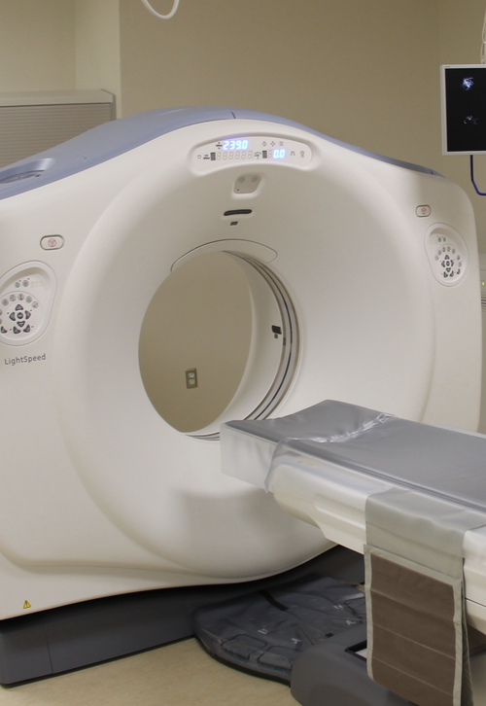
High Risk (4.5% ciTBI risk)
GCS ≤ 14 or altered mental status
Palpable skull fracture
Signs of basilar skull fracture
Focal neurologic exam
Seizure ** (impact vs late)
CT scan is recommended

Slide 37
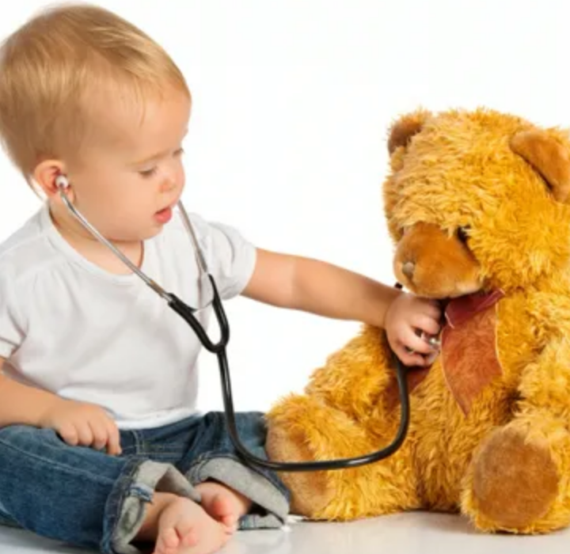
Medium Risk (0.9% ciTBI risk)
Severe mechanism of injury
LOC
  History of LOC (age > 2 years)
  LOC > 5 seconds (age < 2 years)
Severe headache (age > 2 only)
Vomiting (age > 2 years only)
High risk hematoma
  Non-frontal, large, boggy, < 6-12 months
Observation is generally preferred in this group
Many factors left to the clinician, number of symptoms, severity, access to definitive care

Slide 38

Low Risk ( < 0.02% risk ciTBI)
Absence of High risk factors
Absence of Medium risk factors

Slide 39
Practice Variation and Management Guidelines: Can Providers Be Influenced to Change Behavior?
quality improvement
continuous improvement
system improvement

Slide 40
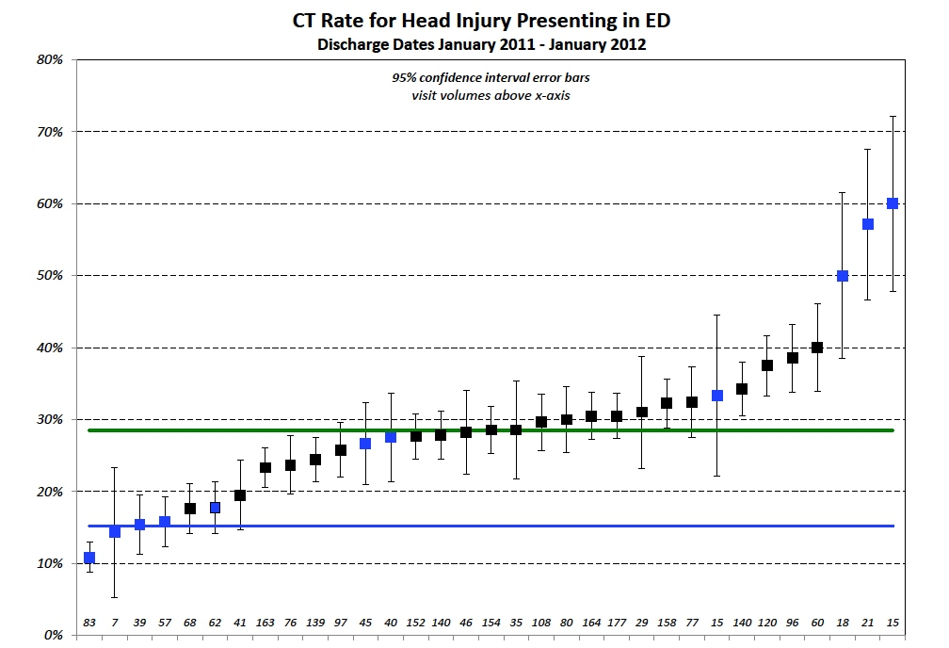

Slide 41
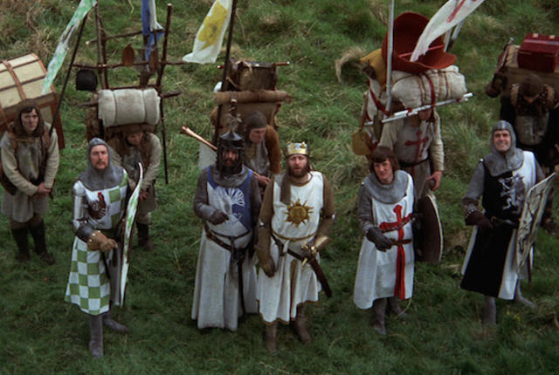
Dissemination / Implementation Science
“the study of methods to promote the systematic uptake of clinical research findings into routine practice”
Alternatively: “Knowledge __________ “
  Translation
  Transfer
  Mobilization
  Exchange
  Dissemination
All share the goal: close the persistent knowledge-to-practice gaps in health care and decision making in a effort to improve outcomes
Wittmeier, Klassen, Sibley. JAMA Pediatrics 2015

Slide 42
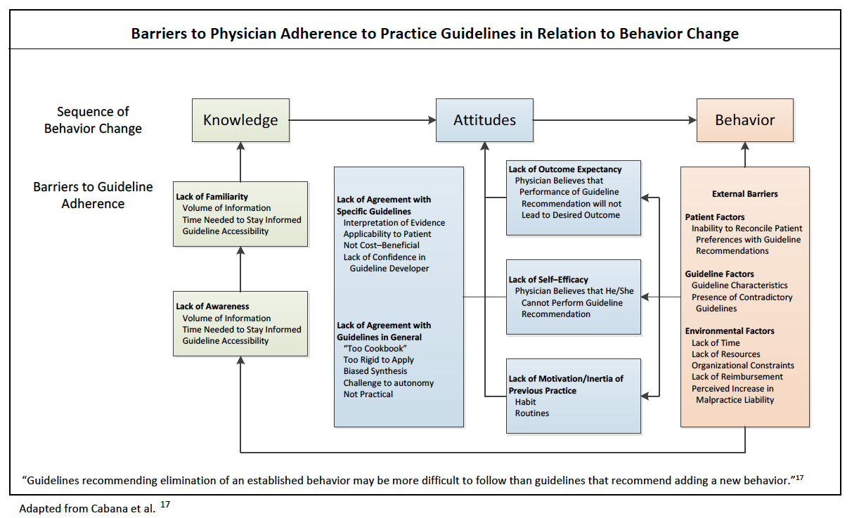

Slide 43
Greiner and Schein: Power Bases
Power Base | Strategy
Knowledge -expertise -information -tradition | Playing It Straight -use data to convince -focus on target group -be persistent
Support of Others -political access -staff support | Use Social Networks -alliance and coalitions -deal with decision makers -contacts for information
Personality -charisma -reputation -professional credibilty | Go Around Formal Systems -work around roadblocks -do not use organizational rules

Slide 44
Management Wisdom and Influencing
Systematic and thoughtful implementation plan
Leadership buy in (resources)
Understand culture of target group (obstacles)
Identify and focus on vital behaviors
Incorporate a variety of methods
Develop metrics and provide feedback
Establish an on-going system to review (and ideally maintain) changes—avoid regression
Influencer

Slide 45
Preliminary Field Assessment Work
Physicians often believe they know the risk factors for traumatic brain injury (TBI) but sometimes misremember elements.
Information retrieval when delivering ED care can be cumbersome
Many physicians also perceive ordering CT scans is the safest course of action despite a lack of significant symptoms.
Patients and families are sometimes primed to expect a head CT scan
Increase cognitive support at the scan decision point
Notes:
De-implementation problem
We theorized that targeting evidence-based education at the individual scan decision point, coupled with timely performance feedback, would increase cognitive support for assessing risk of clinically-important TBI (ciTBI), reducing potentially unnecessary scans.

Slide 46
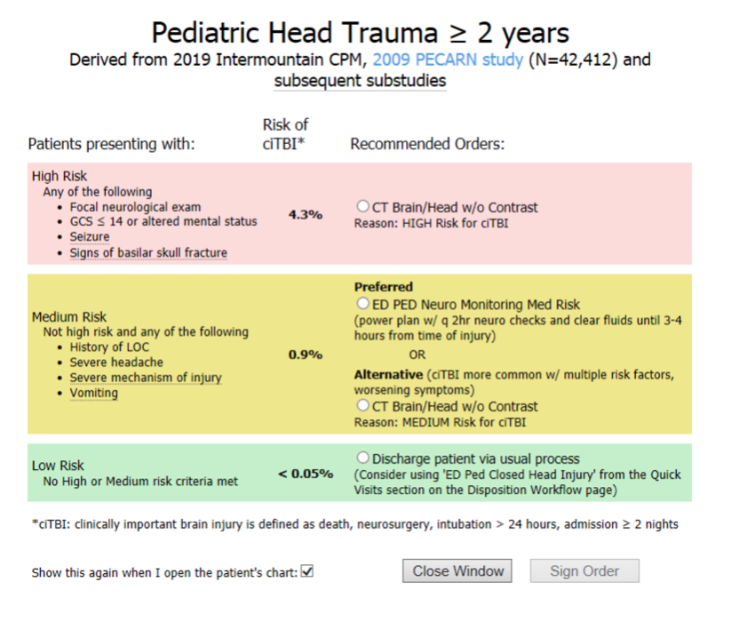

Slide 47
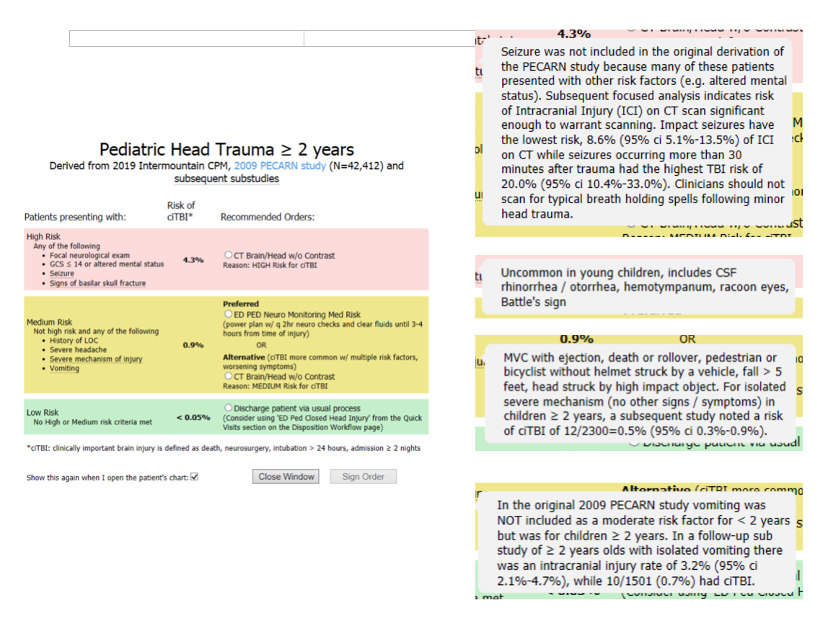

Slide 48
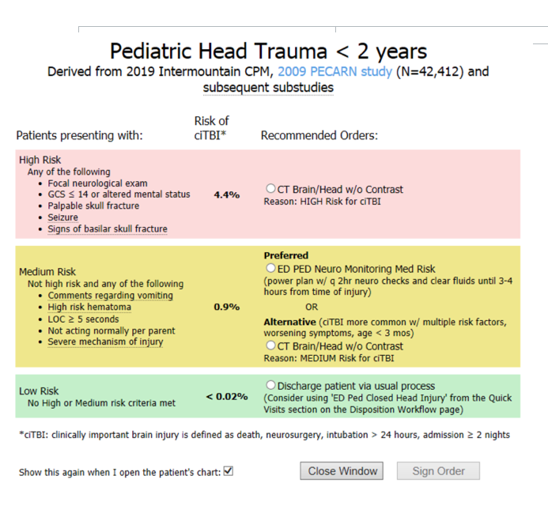

Slide 49
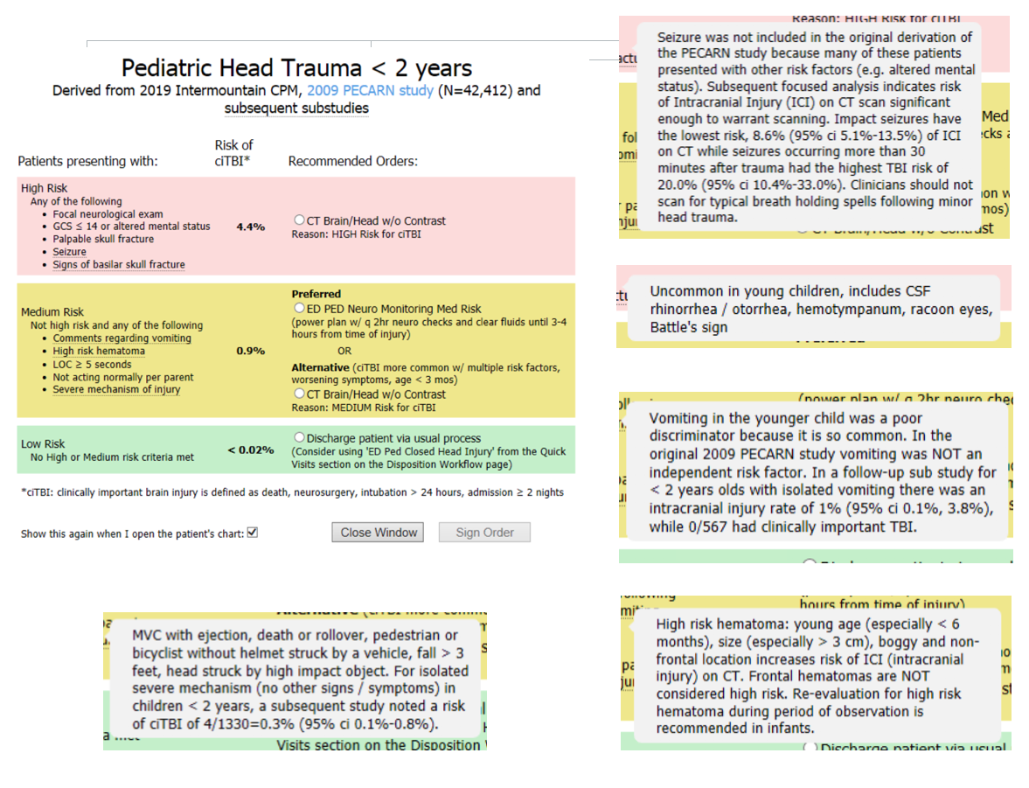

Slide 50
How Did it All Work Out

Slide 51
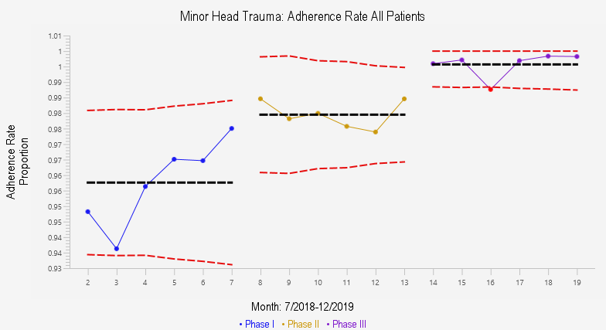

Slide 52
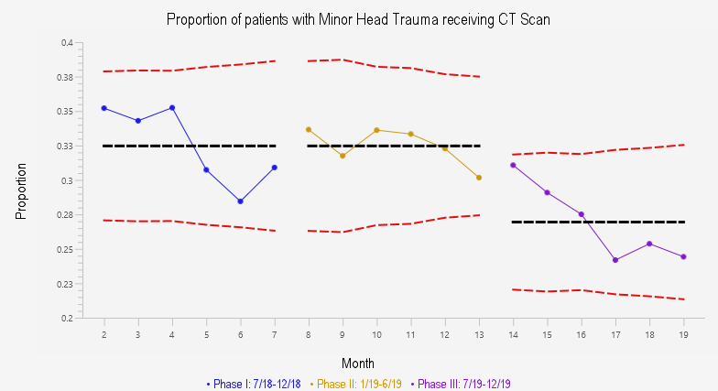

Slide 53
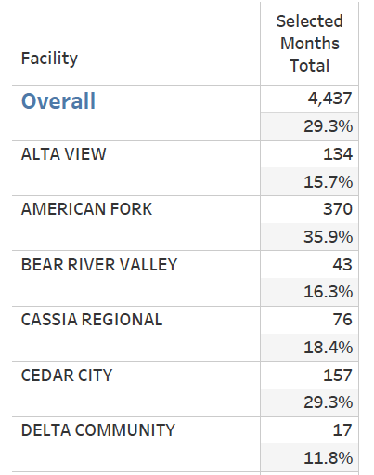
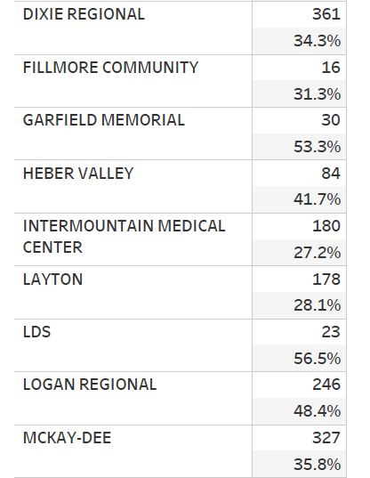
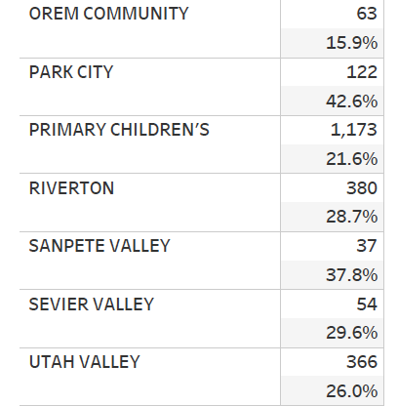
MHT CT Scan Rate
12 months to August 2020

Slide 55
Implications for Policy/Practice
Simple, information-rich text alerts for triage and risk classification
De-implementation of clinical practices
Emphasis on alert specificity to reduce alert fatigue
Long term migration to “call up” strategy

Slide 57
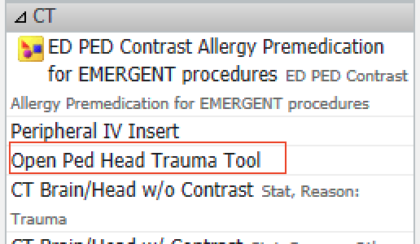
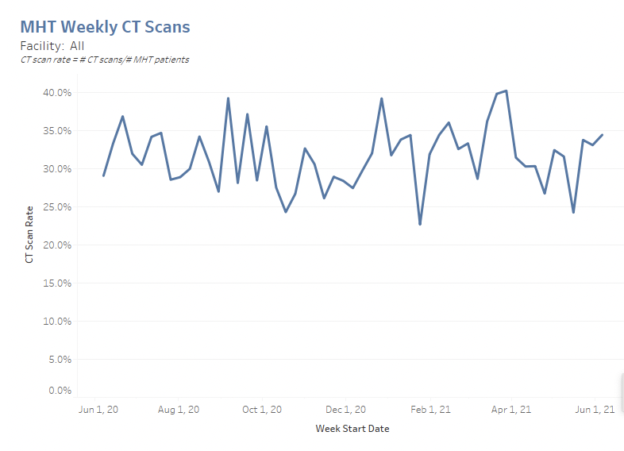
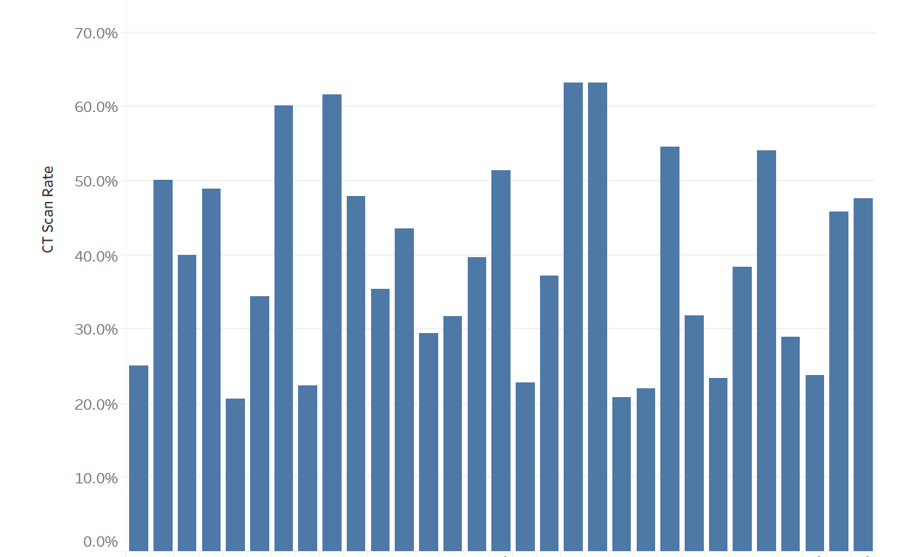

Slide 58
Would You Scan A:
4 month old fell out of bouncy, off counter, no symptoms, and normal exam except a 4x4 cm boggy parietal hematoma?
16 month old who fell 3 feet, was stunned for a second or two and vomited twice in 2 hours, but with normal exam and no other symptoms?
14 year old playing football and had LOC for 2 minutes, but now, 30 minutes later, is a little confused (keeps asking the same question) but otherwise normal exam?

Slide 59
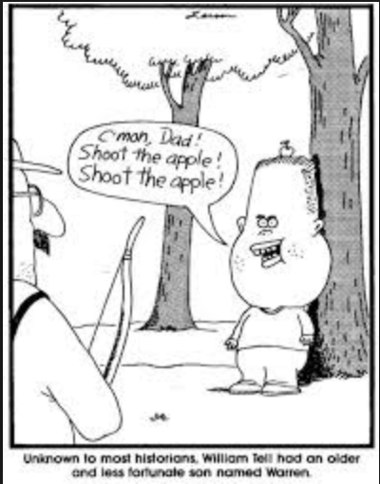
END
Questions?

Slide 60



Slide 61
CT Use…
Rates of CT for those at higher risk for ciTBI did not vary by race / ethnicity
Black non-Hispanic and Hispanic had lower rate of CT for those intermediate risk
Physician often cited parental concerns / anxiety as reason for obtaining CT
Children with VP shunts had higher rates of CT use but similar rates of ciTBI
Children with coagulopathies had higher CT rates, but not higher ciTBI, all with ciTBI had symptoms
Natale et al. Arch Pediatr Adolesc Med 2012
Nigrovic et al. Ann Emerg Med 2012
Lee et al. J Peds 2010

Slide 62
More Peds HI News
Mild and moderate pediatric traumatic brain injury: replace routine repeat head computed tomography with neurologic examination (J Trauma Acute Care Surg 2013)
Pharmacological sedation for cranial computed tomography in children after minor blunt head trauma (Pediatr Emerg Care 2014)
Pediatric Emergency Care Applied Research Network head injury clinical prediction rules are reliable in practice (Arch Dis Child 2014)
Cost-effectiveness of the PECARN rules in children with minor head trauma (Ann Emerg Med 2015)
Are CT scans obtained at referring institutions justified prior to transfer to a pediatric trauma center? (J Ped Surg 2014)

