Slide 1

Improving Prehospital Pediatric Weight Estimate Accuracy
WI PECC Quarterly Meeting
Michael K Kim, MD
Co-Chair WI EMSC

Slide 2

Objectives
Impact of inaccurate weight estimate
Current practice
Approach to weight estimate
Ultimate goal

Slide 3
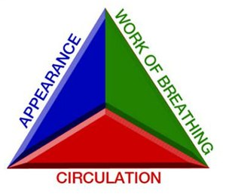

Case: Seizing child
3 YO old has been actively seizing for 10 minutes
Pediatric Assessment Triangle: unconscious, erratic resp effort and cyanotic
P: 183, R???, T 39.3, Pox 75%
Oxygen
POC Glu
Intervention

Slide 4

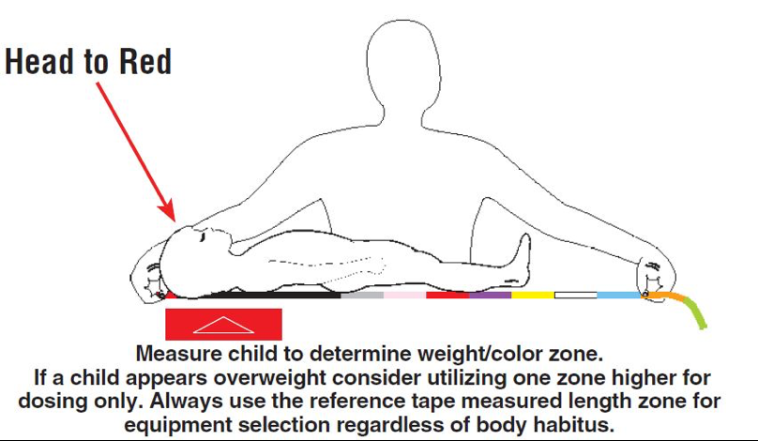
Scenario 1
Broselow tape
Red zone (8-9 Kg)
  Midazolam (0.2 mg/Kg) 1.6 mg administered (IN)
Continues to Seize
ED weight 16 Kg
  Administered 3.2 mg IN

Slide 5



Scenario 2
POC Glu 34
No Broselow…
Mom says “he is 35”
D10: 105 ml(3 ml/Kg) administered
ED weight 16 Kg

Slide 6


Scenario 3
No Broselow
No parent
EMS provider has 3 YO son who is 42#
Convert to 19 Kg
Midazolam 3.8 mg given
ED weight 16 Kg

Slide 7
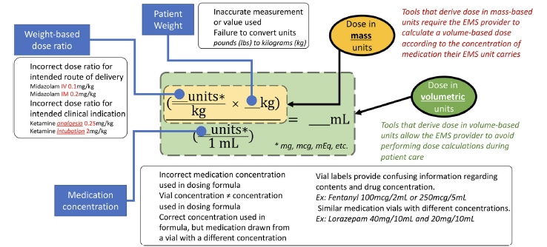
Weight based medication error

Slide 8
Estimate methods
Patient
Parent
Guess
Tape
Age

Slide 9

NAEMSP Position statement
Pediatric patient weight should be confirmed at the time care is delivered.
Weight should not be visually estimated.
Weight may be estimated by asking a parent the child’s weight, using a validated weight-estimation tool based on a child’s length, preferentially, or by age (the least accurate method).

Slide 10
Other reasons
Prep the ED
5-7%
Routine psychomotor skill

Slide 11

Is weight vital?

Slide 12
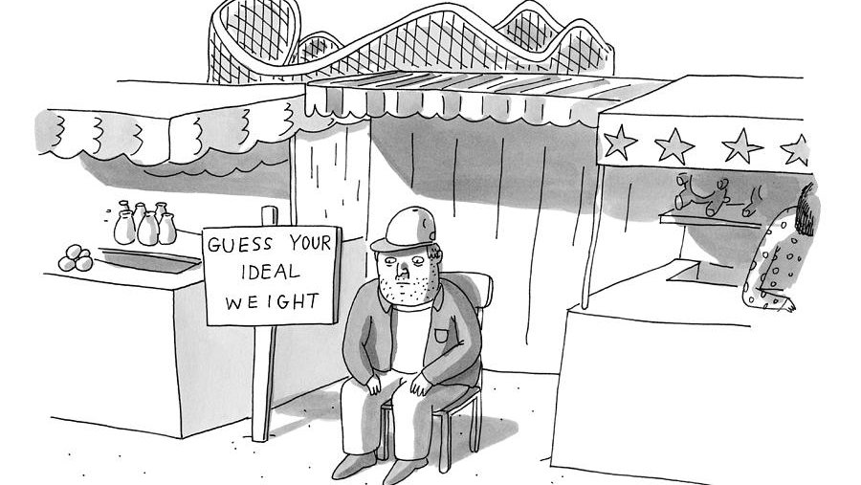
Current Practice…

Slide 13

UW ALS consortium QI project: questions..
How often weight is estimated?
What method of estimation?
Weight documentation (when?)
Is real time weight estimate capture possible?
How accurate is it?

Slide 14

Data needed
Prehospital weight estimate
Estimate method
ED measured weight

Slide 15
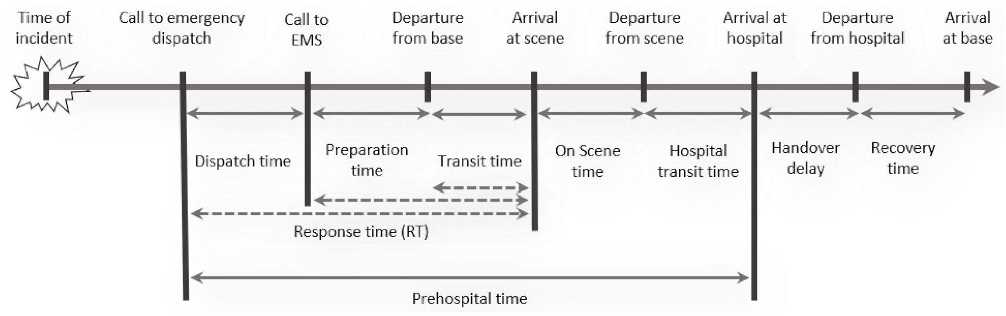
Sequence of a call

Slide 16

Validity of weight documented
How to capture weight estimate in real time

Slide 17


Real time data acquisition

Slide 18
Timeline
22 Apr.
Algorithm introduced
22 May
Monthly CME
22 June
Weight Doc request with the EMS radio call
22 Nov.
Fall education days
23 Feb.
Reference card & Broselow tape
23 Jan.
PDSA cycles begins
July 2022
Baseline data
April 2023
Data capture completed

Slide 19

Results
Data was collected from July 21, 2021 to April 22, 2021.
A total of 236 transports were recorded for analysis.
The mean age was 7.5 years
175 patients with weight estimate and method
PW 10 > 70%
PW 20 > 95%

Slide 20
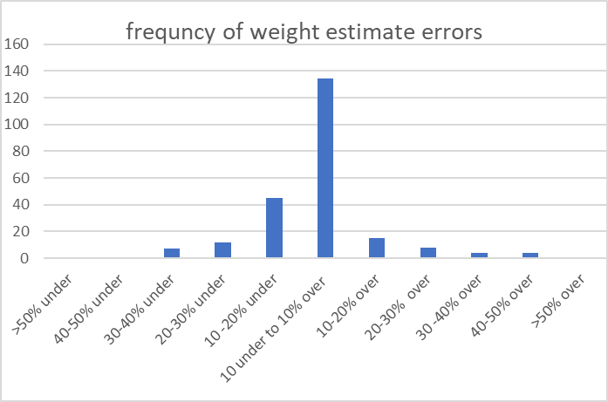

Slide 21
Weight estimate accuracy by methods n=175
 | n | Mean age (yrs) | Accuracy | % Error
ED/Clinic | 11 | 5.7 | 97% | 3.0 +/- 2.1
Patient | 22 | 13.9 | 94% | 6.0 +/- 6.4
Parent | 83 | 4.7 | 89.2% | 10.2 +/- 8.9%
Broselow | 12 | 6.7 | 88.5% | 11.5 +/- 11.4%
Guess | 48 | 8.4 | 86.2% | 13.8 +/- 11/4%
Age based | 175 | 5.7 | 34.3%
 | n | Mean age (yrs) | % Error
ED/Clinic | 11 | 5.7 | 3.0 +/- 2.1
Patient | 22 | 13.9 | 6.0 +/- 6.4
Parent | 83 | 4.7 | 10.2 +/- 8.9%
Broselow | 12 | 6.7 | 11.5 +/- 11.4%
Guess | 48 | 8.4 | 13.8 +/- 11/4%
Total | 175 | 7.5

Slide 22
PW10 and PW20
 | PW10 (>70%) | PW20 (>95%)
ED/Clinic | 100% | 100%
Patient | 81.8% | 95.5%
Parent | 58.5% | 86.6%
Broselow | 50.0% | 83.3%
Guess | 47.9% | 80.9%
Total | 60.2% | 85.6%
Age based | 22.7% | 41.8%

Slide 23
Different age groups
Age | n | PW10 (>70%) | PW20 (>95%)
<1 | 24 | 58.3% | 79.2%
1-3 | 75 | 56.0% | 84.0%
4-10 | 50 | 62.0% | 86.3%
11-14 | 44 | 65.9% | 86.4%
>15 | 40 | 62.5% | 90.0%

Slide 24
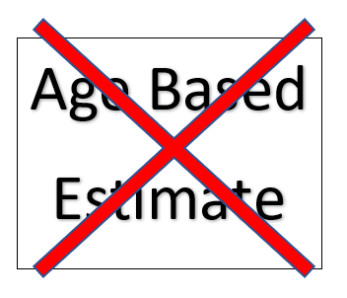

Pediatric Weight Estimate Algorithm
Ask Patient
Ask Parent
*Broselow
PLEASE, Include weight estimate and method when making radio report to base ED!!!

Slide 25
Must
Readily available tools/references/protocols
Minimize calculation
lbs to Kg conversion
Dose calculation
Volume based dosing
Double check with partner

Slide 26
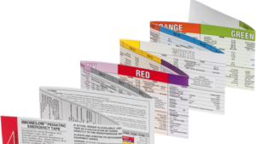
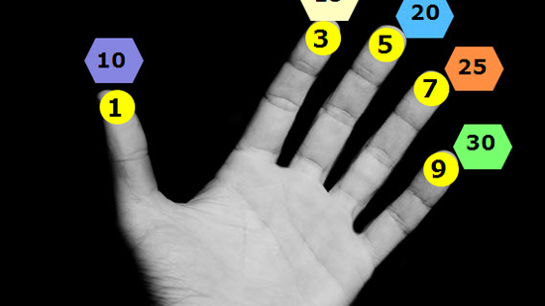
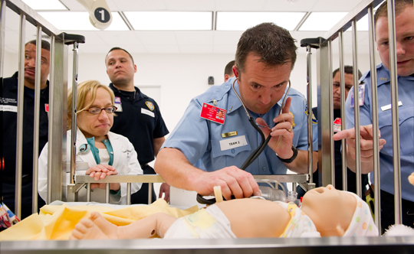
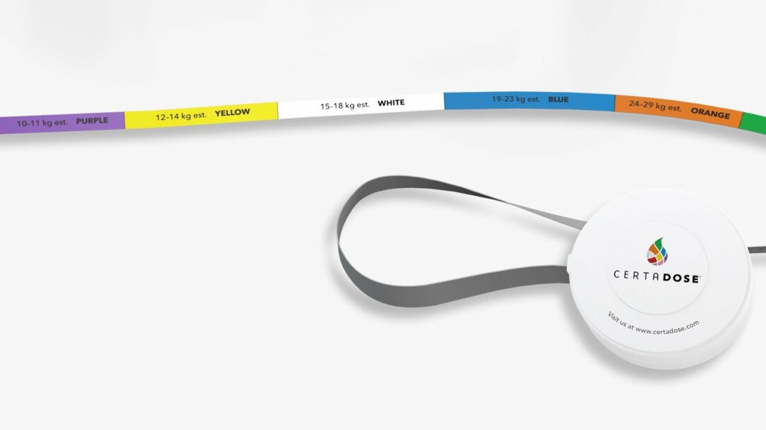
Tools

Slide 27
to come…
Statewide CQI effort to monitor weight documentation
Statewide education efforts
Grant application for retractable Broselow tapes for all agencies
Improving medication dosing accuracy quality improvement initiative

Slide 28
The ask…
Weight estimate early and document on every pediatric patient
Use accurate available tools
Call in weight estimate
Be the change champion

Slide 29


